Slide 1

Telecommunication Services Management System
Aishwarya sawant
Eshanee thakur
Gnana tej cherukuru
Omkar kalange
Ritesh pendurkar

Slide 2
Summary
To provide a consolidated view of billing of all the utilities the customer has subscribed
Enabling the user to analyze the previous months spends for these subscribed services
Enabling the service providers to analyze the subscriptions for the current plans
To help determine the service provider the interests and current demands to enhance the current plans and propose more convenient plans for the customers

Slide 3
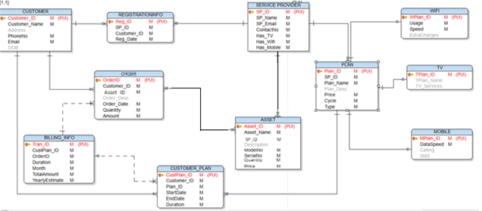
FINAL ERD

Slide 4
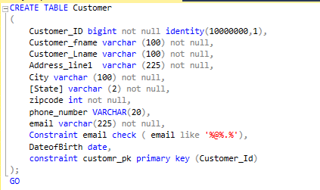
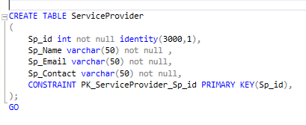
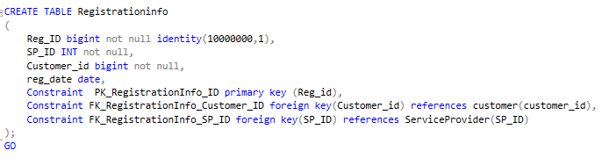
Sql dDl statements

Slide 5
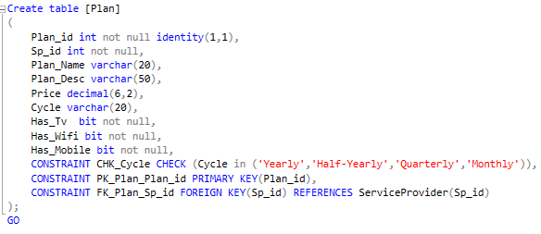
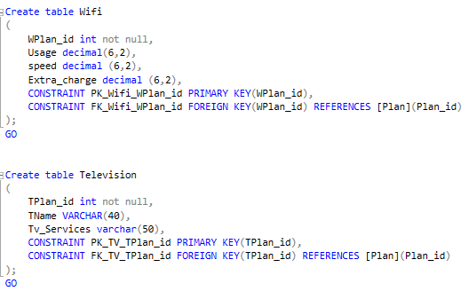
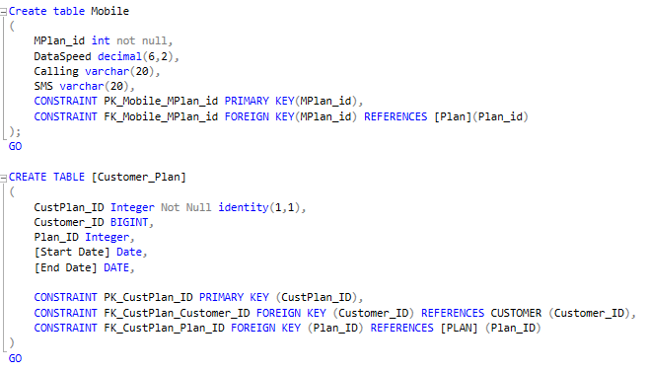

Slide 6
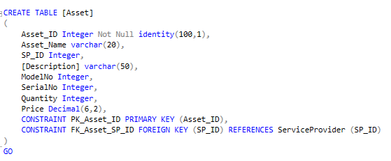
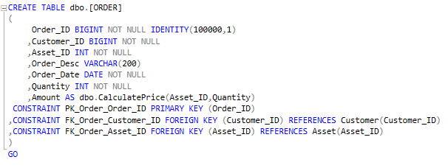
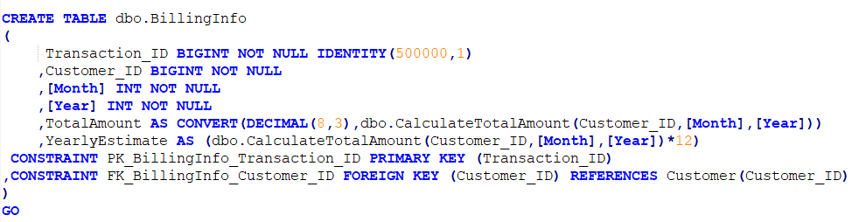

Slide 7
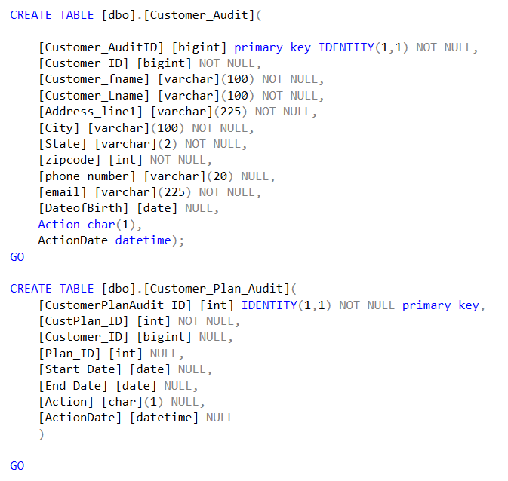
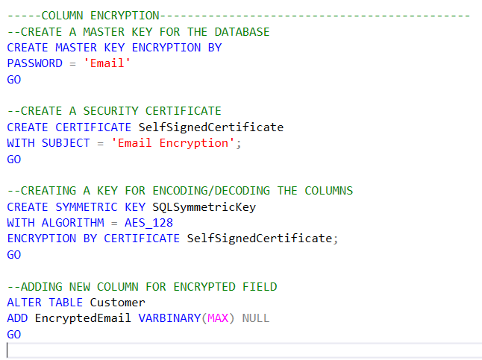

Slide 8
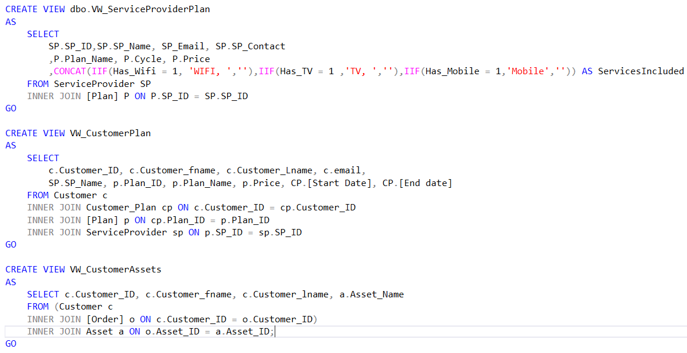
Database objects - views

Slide 9
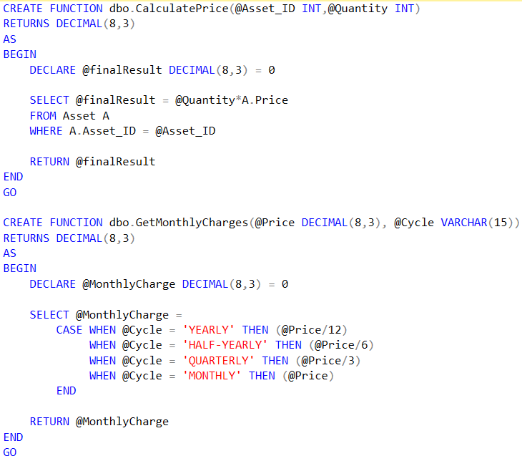
Database objects - functions

Slide 10
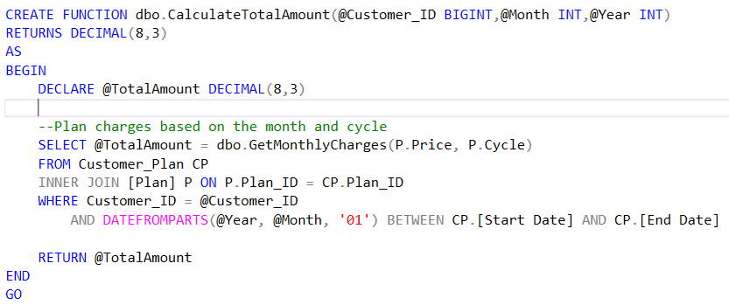
Database objects - functions

Slide 11
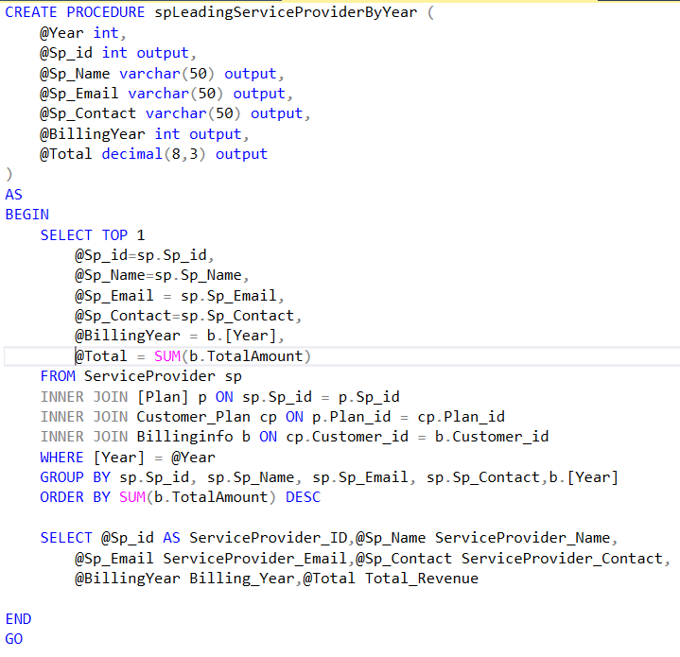
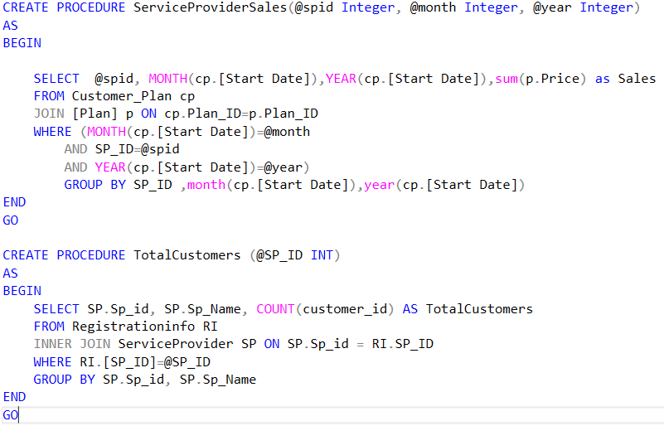
Database objects – stored procedures

Slide 12
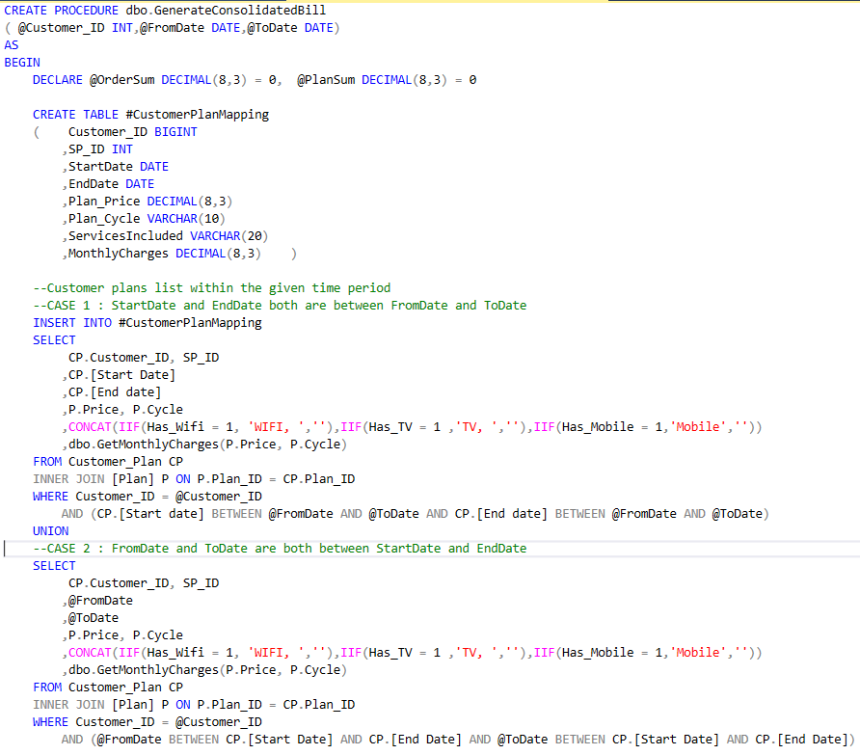
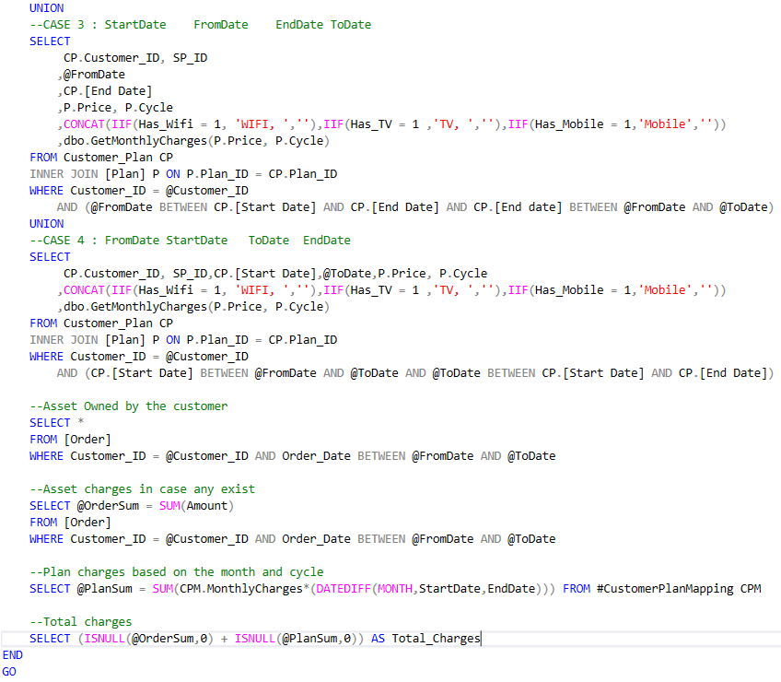
Database objects – stored procedures

Slide 13



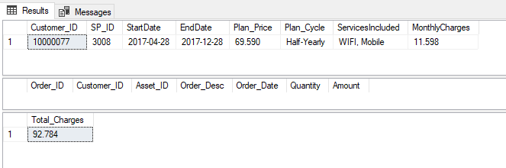
Database objects – stored procedures
LeadingServiceProviderByYear
ServiceProviderSales
TotalCustomers Per Service Provider
GenerateConsolidatedBill

Slide 14
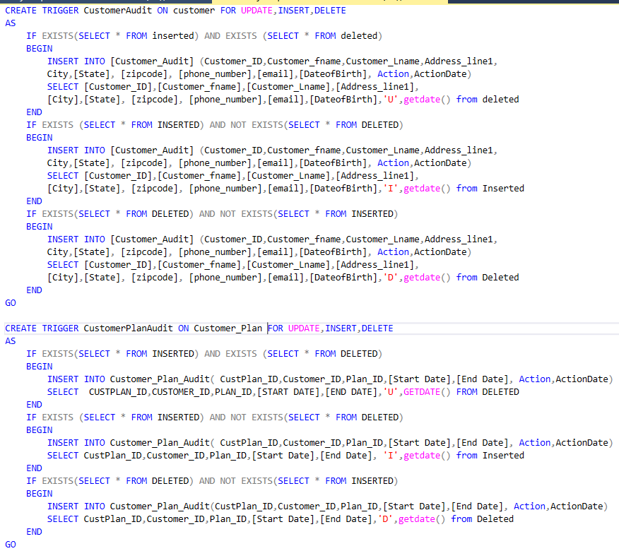
Database objects - triggers

Slide 15
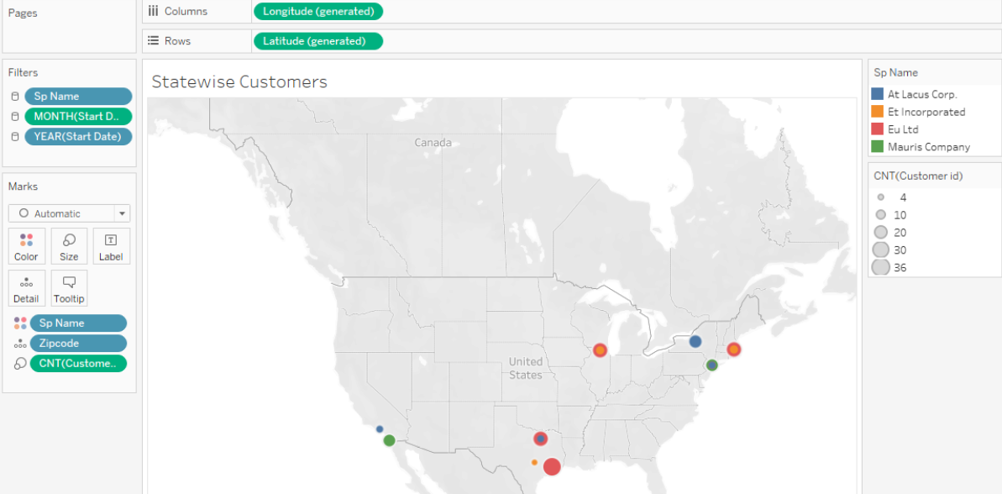
Location wise customers

Slide 16
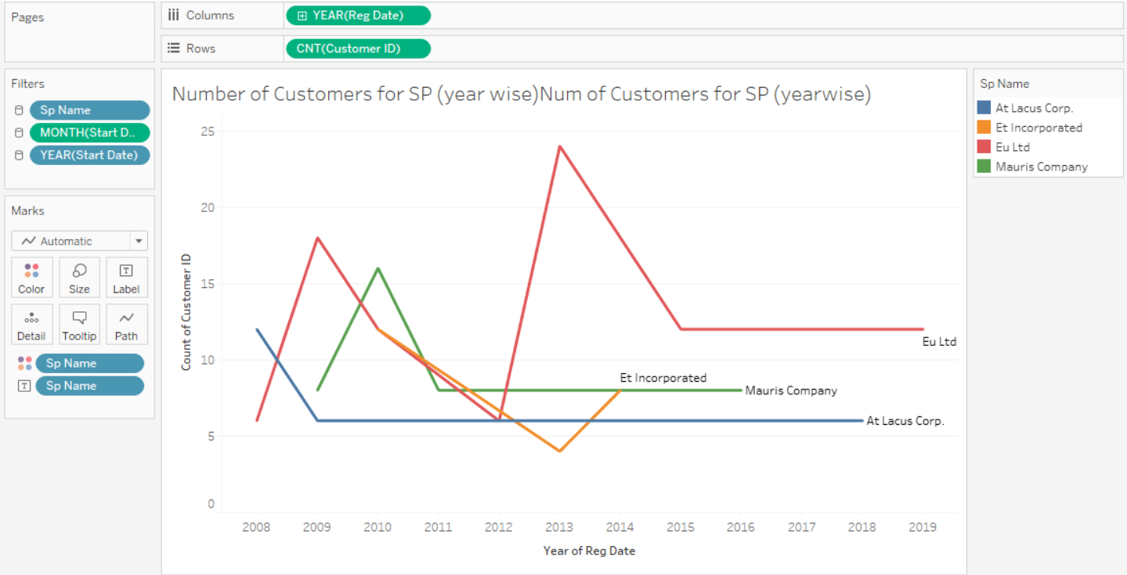
Year wise customers for service providers

Slide 17
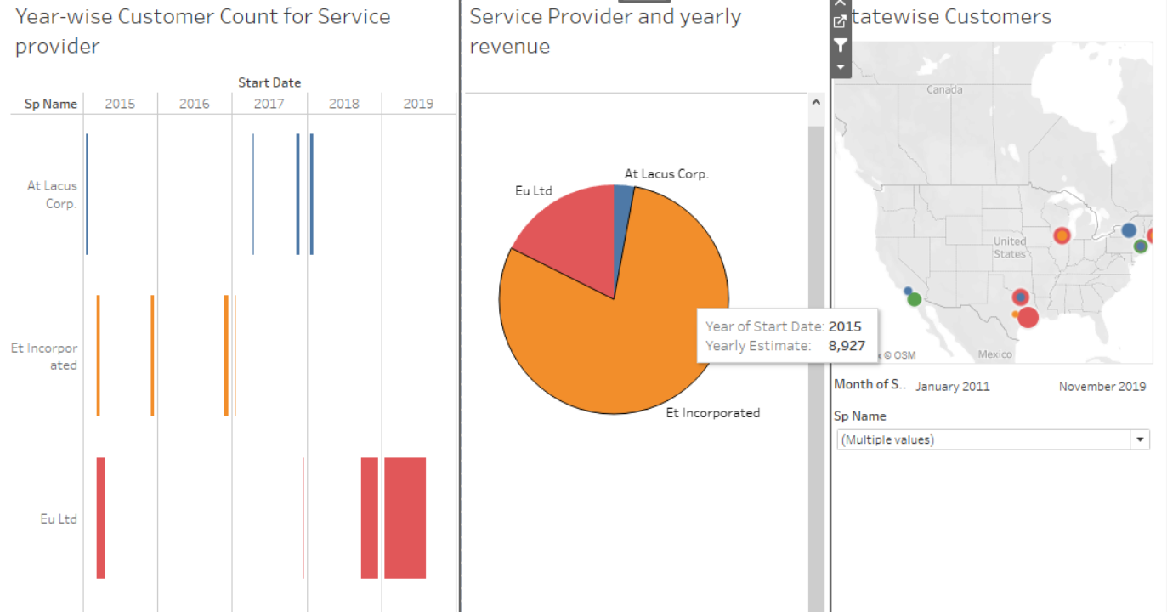
dashboard

Slide 18
Thank you!

