Slide 1
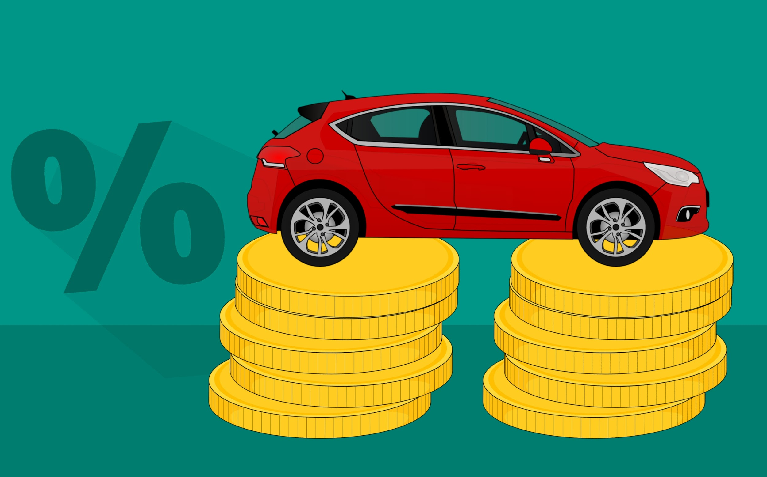
INFO6105 - Data Science Engineering Methods and Tools
Used Car Price Prediction
Team members:
Aishwarya Sawant (NUID: 001059228)

Slide 2
Table of Contents
1. Problem statement
2. Data Source
3. Existing solutions
4. Idea
5. Explain
6. Results
7. Future Scope
8. References

Slide 3
1. Problem statement
The car's value depends on many factor including year of registration, manufacturer, model, mileage, horsepower, origin and several other specific informations such as type of fuel and braking system, condition of bodywork and interiors, interior materials (plastics of leather), safety index, type of change (manual, assisted, automatic, semi-automatic), number of doors.
For used car the other important features are number of previous owners, if it was previously owned by a private individual or by a company and the prestige of the manufacturer.
Therefore, all the above features should be considered to determine the price of the used car accurately.

Slide 4
2. Data Source
https://www.kaggle.com/austinreese/craigslist-carstrucks-data
Size of the data is 1.34GB
It contains 458213 rows and 26 columns
The column ‘condition’ describes the condition of the car
There is an ‘odometer’ column describing the distance travelled by the car
There is manufacture column and other feature values for each car on the basis of which the ‘price’ column is calculated using different ML models

Slide 5
3. Existing solutions
Some of the examples of existing solutions on kaggle dealing with the same dataset for used car price prediction are as below :
https://www.kaggle.com/ashmani999/preowned-car-price-prediction
https://www.kaggle.com/mathiasleys/data-cleaning-ml-price-prediction
https://www.kaggle.com/pranavpaldewar/used-car-price-predictions

Slide 6
4. Idea
The goal of the project is to find the best price for used cars depending on the numerous features
Data preprocessing is one of the most important step as the accuracy of ML models depends mainly on cleaning of data
We are using 7 different ML models and in the end we compare the R-square, MSE & RMSE to obtain the best model
To achieve the goal, below are the steps that we are performing :
Data Preprocessing
Removing irrelevant features, missing value imputation using iterative imputer method, detecting and removing outliers using Z and IQR score, data normalization using Standard Scalar and MinMax Scalar functions
Data Visualization
Data visualization is important to understand the correlation of various features with the price of the car
Model Implementation
Training 7 different ML Regression Models
Hyper-parameter tuning is done to compute the best parameters for each model
Final Comparison Result
The MSE, RMSE, and R2 Scores of all the 7 ML models is compared to obtain the best model

Slide 7
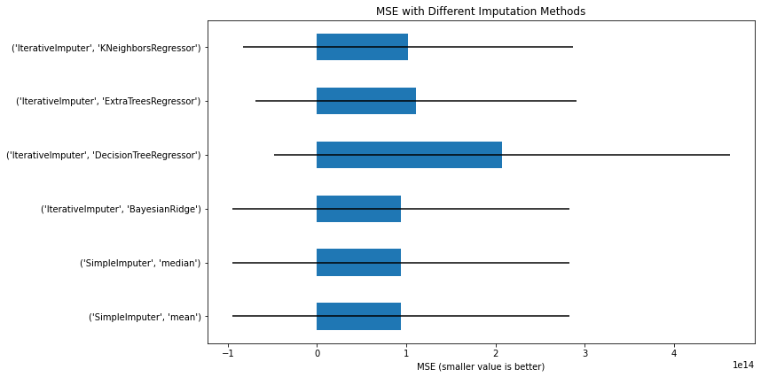
5. Explain
Data preprocessing : Data preprocessing is a data mining technique which is used to transform the raw data into a useful and efficient format.
Using iterative imputer to obtain best imputer method
Performing missing value imputation using best imputer method
Detecting outliers using Box-Plot, Histogram and co-relation matrix and removing it using IQR
Transforming categorical columns to integer values
Scaling/Standardizing the data so that the data with random ranges for each feature is standardized to a particular range easier to compare using Standard & MinMax Scaler

Slide 8
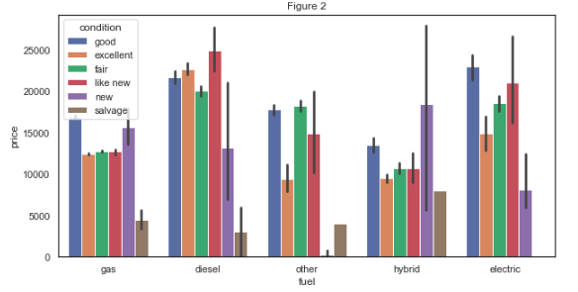
Data Visualization : Data visualization is the process of creating interactive visuals to understand trends, variations, and derive meaningful insights from the data.
We plot different graphs for features vs the price to identify the most important features to decide the selling price of a used car
Models : Regressor models are used for training the dataset.
Linear Regression, KNN, Random Forest Regressor, Bagging Regressor, Adaboost Regressor, and XGBoost, DNN - Using ML models to determine the model which would give the highest accuracy for the prediction of price of a used car using the given dataset.
Hyper-parameter tuning is also performed to improve the accuracy of each of the model scores
Final Comparison Result : The MSE, RMSE and R2 Scores of all the 7 models are compared find the best model with the highest scores for the most accurate price prediction of a used car.

Slide 9
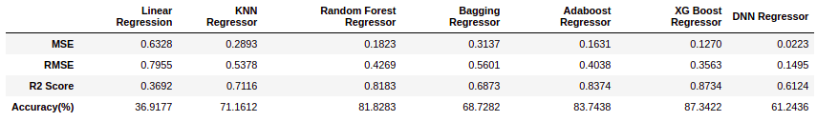
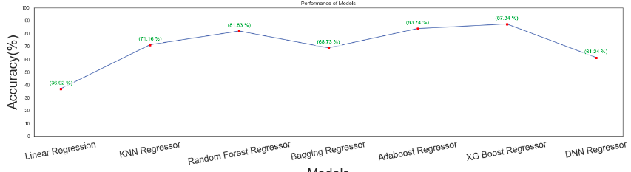
6. Results

Slide 10
7. Future Scope
To correct for overfitting in Random Forest, different selections of features and number of trees will be tested to check for change in performance
There could be more features that can be good predictors. For example, here are some variables that might improve the model: number of doors, gas/mile (per gallon), color, mechanical and cosmetic reconditioning time, used-to-new ratio, appraisal-to-trade ratio
While pre-processing data, instead of using label encoder, one hot encoder method can be used. Thus, all non-numeric features can be converted to nominal data instead of ordinal data if that suits the dataset used.

Slide 11
8. References
Few of the references for this project are as below :
https://scikit-learn.org/stable/
https://keras.io/
https://towardsdatascience.com/xgboost-theory-and-practice-fb8912930ad6
https://towardsdatascience.com/understanding-adaboost-2f94f22d5bfe

Slide 12
Thank you !!!

