Slide 1

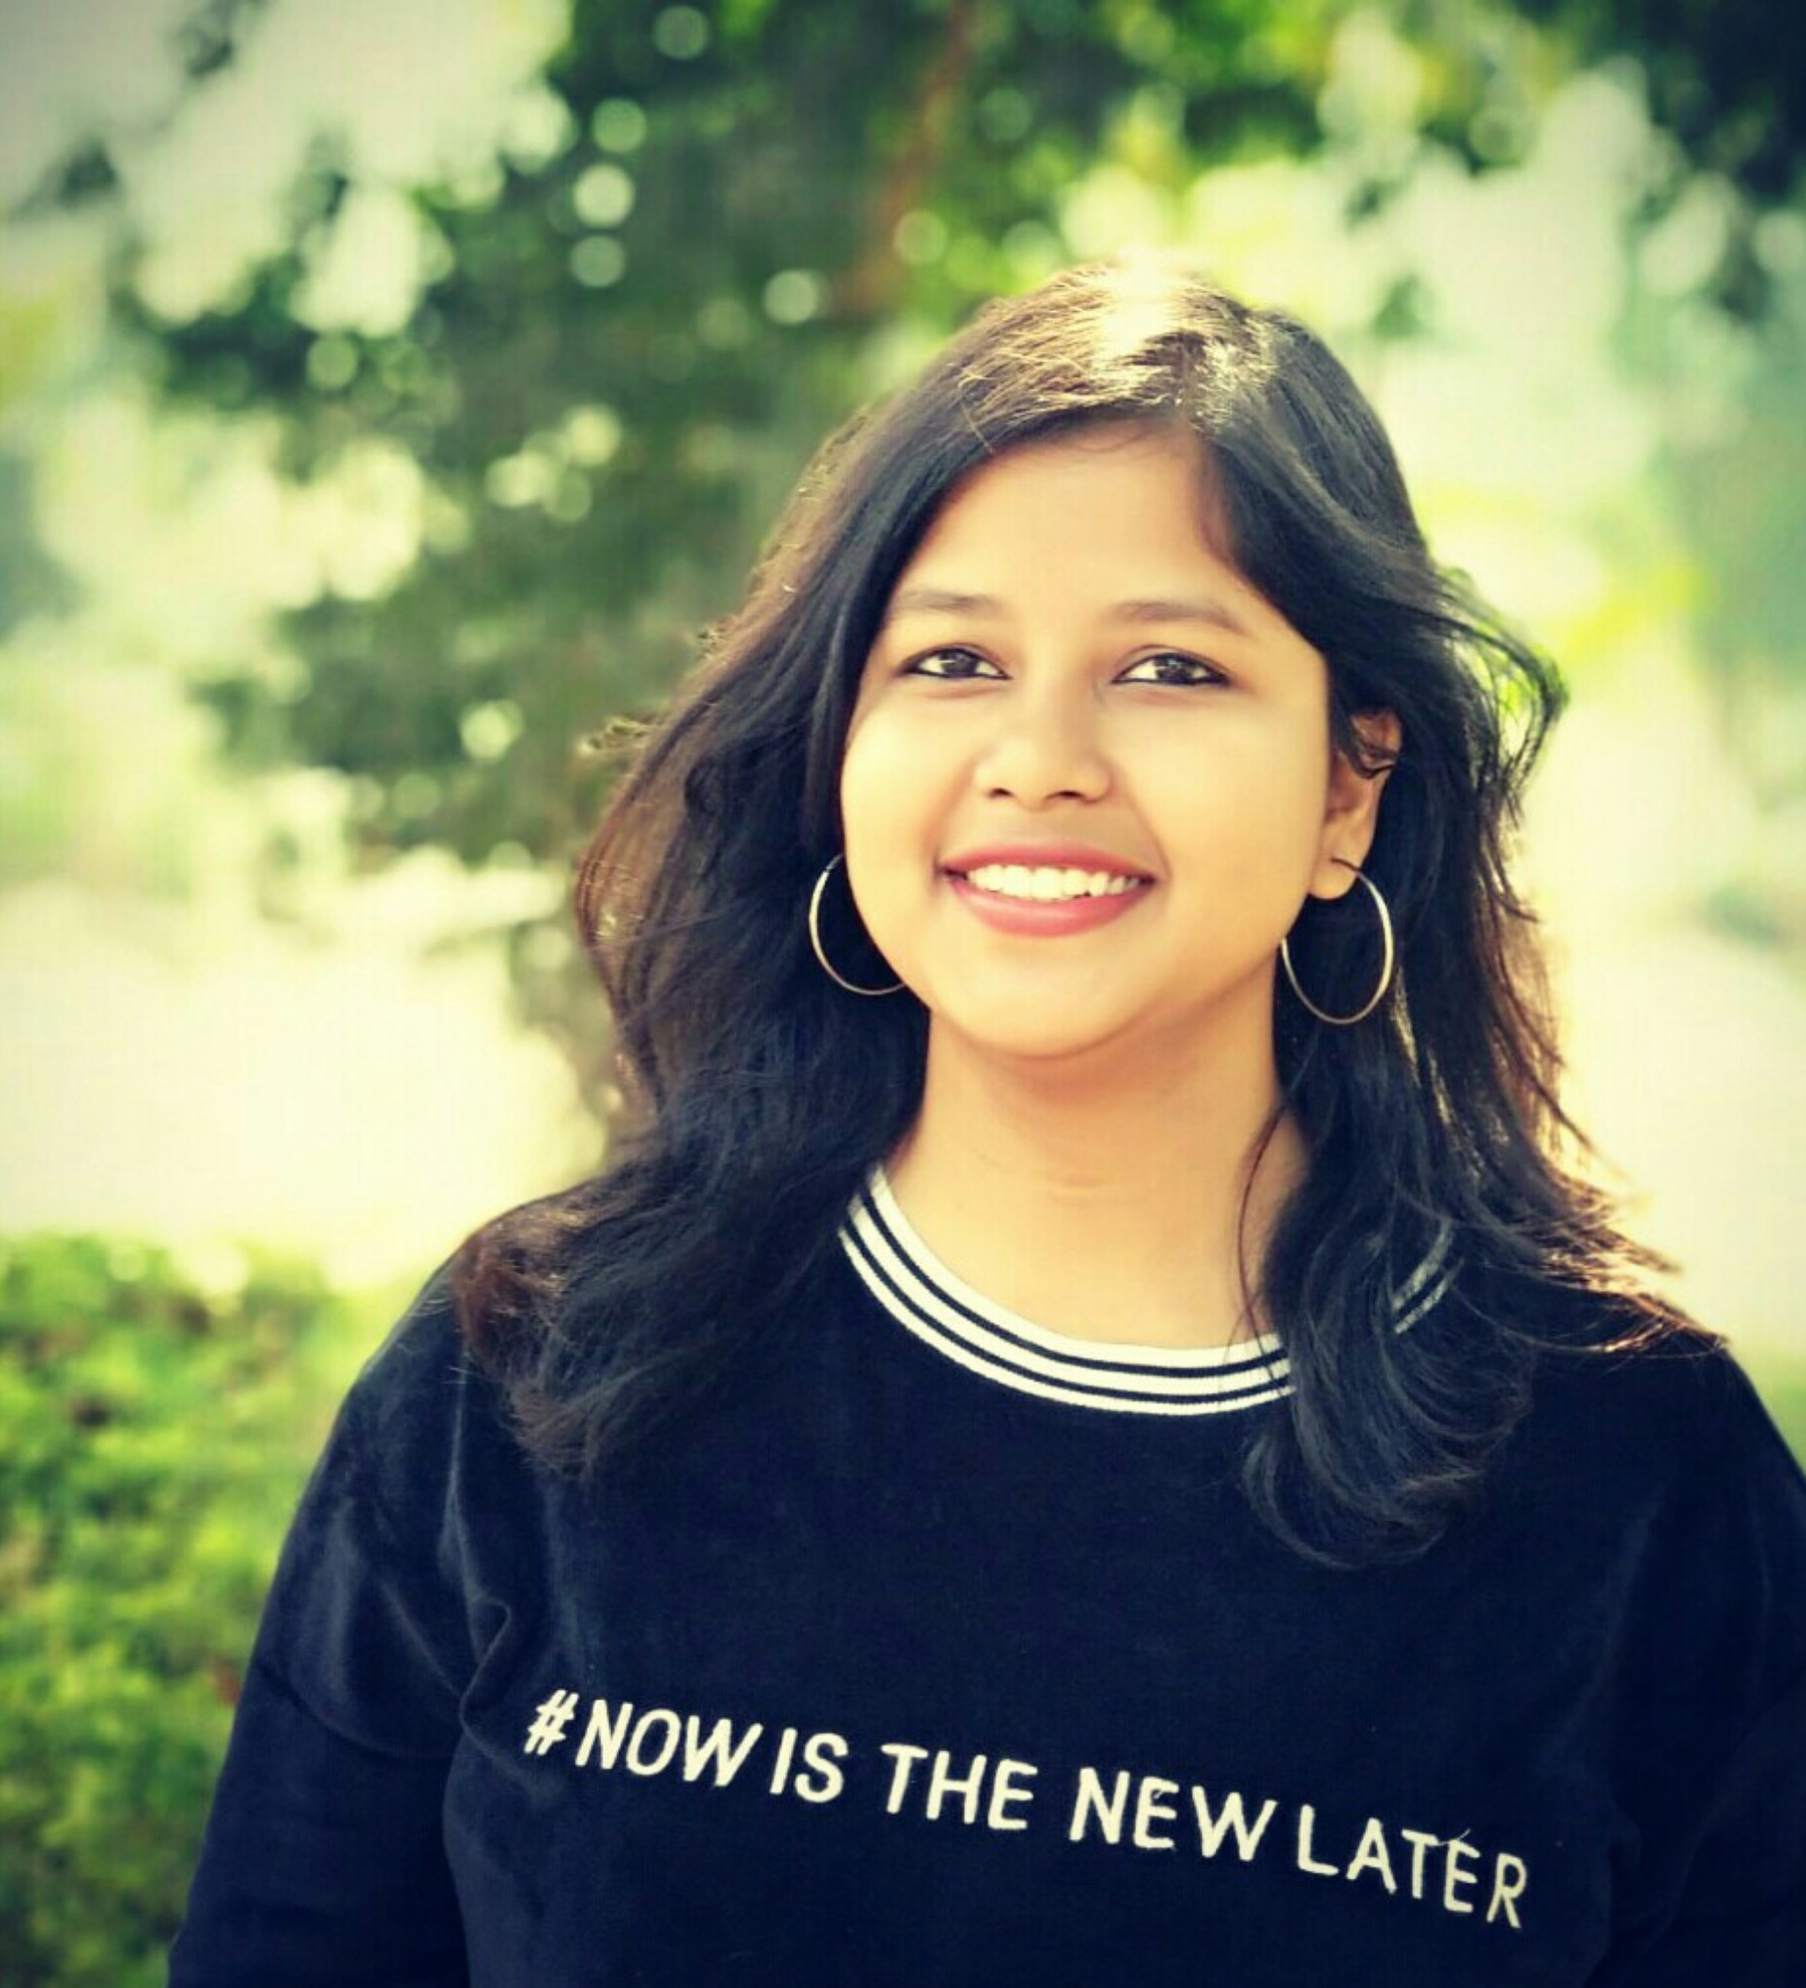
AISHWARYA SHUBHALAXMI
-M1046926

Slide 2
People call me : Aishwarya
I landed on earth on : 8th March, 1996
I was born and brought up in Bokaro Steel City, Jharkhand.
Currently, I am working as an Engineer in Mindtree.
ABOUT ME :-

Slide 3
My family is my lifeline and my greatest strength.
My father works in Damodar Valley Corporation, Chandrapura.
My mother is a homemaker.
I have a younger brother who is currently in his 3rd year of B.Tech.
FAMILY:-

Slide 4
Matriculation:
BRL DAV Public School, Bhandaridah, Bokaro
Intermediate:
Chinmaya Vidyalaya, Bokaro
Engineering:
College of Engineering & Technology, Bhubaneswar
EDUCATION:-

Slide 5
I am very fond of painting and sketching.
I am interested in crafting as well.
I love reading novels and watching crime and thriller drama.
HOBBIES AND
INTERESTS:-

Slide 6
PROGRAMMING LANGUAGES:-
C
JAVA
TOOLS:-
ECLIPSE
SELENIUM WEBDRIVER
JMETER
TECHNICAL SKILLS:-

Slide 7
My first step into corporate world: Mindtree, Kalinga.
I am a part of Orchard Learning Program at Kalinga.
It has been a great learning experience till now.
LIFE AT KALINGA:-

Slide 8
Mail me at:-
Aishwarya.Shubhalaxmi2@mindtree.com
aishwaryashubhalaxmi8@gmail.com
Call me at:-
8455902044
CONTACT DETAILS:-

Slide 9
THANK YOU !!!

