Slide 1
JavaScript
Gunjan Keswani, CSE, RCOEM

Slide 2
Static vs. Dynamic Pages
Static | Dynamic
Content and design does not change unless edited and redeployed. | Content changes according to users preferences/some other factors
Contains non interactive text, images, etc. May contain hyperlinks that point to other static pages | Contains interactive elements.
Updates can be error prone and tedious | Updating the design/ data is independent of one another
Cannot access resources like DBs, files, etc | Can access all resources
E.g. Blogs, About Us page of many websites | E.g. Social Media sites, Juno Campus
Gunjan Keswani, CSE, RCOEM

Slide 3
JAVASCRIPT
JavaScript is used in millions of Web pages to improve the design, validate forms, detect browsers, create cookies, and much more.
JavaScript is the most popular scripting language on the internet, and works in all major browsers, such as Internet Explorer, Mozilla, Firefox, Netscape, Opera.
Gunjan Keswani, CSE, RCOEM

Slide 4
WHAT IS JAVASCRIPT?
JavaScript was designed to add interactivity to HTML pages
JavaScript is a scripting language (a scripting language is a lightweight programming language)
A JavaScript consists of lines of executable computer code
A JavaScript is usually embedded directly into HTML pages
JavaScript is an interpreted language (means that scripts execute without preliminary compilation)
  JavaScript is free and open-source
Gunjan Keswani, CSE, RCOEM

Slide 5
What can a JavaScript do?
  JavaScript gives HTML designers a programming tool (very simple syntax)
  JavaScript can put dynamic text into an HTML page
  JavaScript can react to events
  JavaScript can read and write HTML elements
  JavaScript can be used to validate data (validate form data)
  JavaScript can be used to detect the visitor's browser
  JavaScript can be used to create cookies
Gunjan Keswani, CSE, RCOEM

Slide 6
JavaScript
JavaScript is used to program the behavior of web pages
It is a client side programming language
Runs in the browser
So, No download or installation required
JavaScript is capable of dynamically:
Changing the HTML Content
Changing the HTML attribute values
Changing the HTML styles
Gunjan Keswani, CSE, RCOEM

Slide 7
Are Java and JavaScript the Same?
NO!
Java and JavaScript are two completely different languages in both concept and design!
Java (developed by Sun Microsystems) is a powerful and much more complex programming language - in the same category as C and C++.
Gunjan Keswani, CSE, RCOEM

Slide 8
JavaScript Code
Code can be written in the html file in <script> tag
OR
Code can be written in an external file with extension .js and can be included as:
<script src=“dir/filename.js”></script>
*src can also point to a JS file URL
External js files are useful when same functionality is required by different web pages
These scripts can be placed in the body/head of the document.
Multiple scripts in the same file will apply sequentially
Gunjan Keswani, CSE, RCOEM

Slide 9
Viewing output in console
Write log using console.log()
View in browser console
Other ways to view output/debug code:
  document.write()
  Alerts
  Modifying html using innerHTML
Gunjan Keswani, CSE, RCOEM

Slide 10
Statements
statements are executed sequentially Separated by semicolon
Variables
  var a = 2;
  var a1 = 2, b = 3.5, c = “Hi”;
  var a_squared = a * a;
Variables can also be declared using let or const keyword
Gunjan Keswani, CSE, RCOEM

Slide 11
Ending Statements With a Semicolon?
With traditional programming languages, like C++ and Java, each code statement has to end with a semicolon (;).
Many programmers continue this habit when writing JavaScript, but in general, semicolons are optional! However, semicolons are required if you want to put more than one statement on a single line.
Gunjan Keswani, CSE, RCOEM

Slide 12
JavaScript Variables
Variables are used to store data.
A variable is a "container" for information you want to store. A variable's value can change during the script. You can refer to a variable by name to see its value or to change its value.
Rules for variable names:
  Variable names are case sensitive
  They must begin with a letter or the underscore character
    strname – STRNAME (not same)
Gunjan Keswani, CSE, RCOEM

Slide 13
Declaring (Creating) Variables
Variables are placeholders. You can create (or 'declare') them in JavaScript by using the "var" keyword.
var x;
var carname;
You can also assign values to the variables when you declare them:
var x=5;
var carname="Volvo"; // Text requires quotes
If you assign values to variables that have not yet been declared, the variables will automatically be declared.
x=5;
carname="Volvo";
Gunjan Keswani, CSE, RCOEM

Slide 14
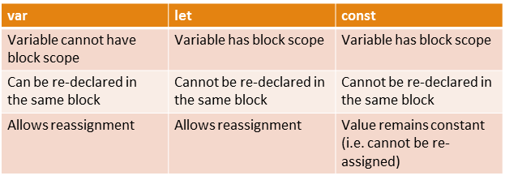
var vs. let vs. const
Gunjan Keswani, CSE, RCOEM

Slide 15
Math && Logic
JavaScript supports the following operators
Mathematical:
+, -, *, /, %, ++, --
Logical:
&&, ||, !, <, >, etc...
var x=10;
var y=2;
var z=x/y;
Strings can be concatenated with the '+' sign.
var txt1="What a very";
var txt2="nice day";
var txt3=txt1+" "+txt2;
Note: If you add a number and a string, the result will be a string!
Gunjan Keswani, CSE, RCOEM

Slide 16
JavaScript Operators
Arithmetic Operators
Operator | Description | Example | Result
+ | Addition | x=2 | 4
 |  | y=2
 |  | x+y
- | Subtraction | x=5 | 3
 |  | y=2
 |  | x-y
* | Multiplication | x=5 | 20
 |  | y=4
 |  | x*y
/ | Division | 15/5 | 3
 |  | 5/2 | 2,5
% | Modulus (division remainder) | 5%2 | 1
 |  | 10%8 | 2
 |  | 10%2 | 0
++ | Increment | x=5 | x=6
 |  | x++
-- | Decrement | x=5 | x=4
 |  | x--
Gunjan Keswani, CSE, RCOEM

Slide 17
JavaScript Operators – 2
Assignment Operators
Operator | Example | Is The Same As
= | x=y | x=y
+= | x+=y | x=x+y
-= | x-=y | x=x-y
*= | x*=y | x=x*y
/= | x/=y | x=x/y
%= | x%=y | x=x%y
Gunjan Keswani, CSE, RCOEM

Slide 18
JavaScript Operators - 3
Comparison Operators
Operator | Description | Example
== | is equal to | 5==8 returns false
=== | is equal to (checks for both value and type) | x=5
 |  | y="5"
 |  | x==y returns true
 |  | x===y returns false
!= | is not equal | 5!=8 returns true
> | is greater than | 5>8 returns false
< | is less than | 5<8 returns true
>= | is greater than or equal to | 5>=8 returns false
<= | is less than or equal to | 5<=8 returns true
Gunjan Keswani, CSE, RCOEM

Slide 19
JavaScript Operators - 4
Logical Operators
Operator | Description | Example
&& | and | x=6
 |  | y=3
 |  | (x < 10 && y > 1) returns true
|| | or | x=6
 |  | y=3
 |  | (x==5 || y==5) returns false
! | not | x=6
 |  | y=3
 |  | !(x==y) returns true
Gunjan Keswani, CSE, RCOEM

Slide 20
Datatypes
Numbers
  let x = 5;
  x = 4.5;
Strings
  let x = “Hello”;
Arrays
  var students = [“Ram”, “Shyam”, “XYZ”];
Boolean
  true / false
Objects
  var student = { roll : 1, name : ”abcd”};
Gunjan Keswani, CSE, RCOEM

Slide 21
Boolean values in JavaScript
True
  Keyword true
  Any non empty string
  Any number except zero
False
  Keyword false
  Null variables
  Undefined variables
  Empty string
  NaN
Gunjan Keswani, CSE, RCOEM

Slide 22
Undefined and null values
Undefined
  When memory space is been allocated but value is not set
NaN
  Not a Number
Null
  represent a missing/empty object, use strict equality check to compare null values
Gunjan Keswani, CSE, RCOEM

Slide 23
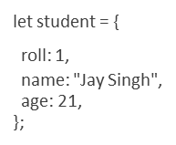

Objects
When a variable constitutes multiple key value pairs it can be declared as an object
Gunjan Keswani, CSE, RCOEM

Slide 24
Functions
Block of code designed for a specific task. Treated as objects.
function add(n1,n2){
return n1+n2;
}
To call a function
var sum = add(1, 3);
Gunjan Keswani, CSE, RCOEM

Slide 25
Functions as part of Object
Functions are stored as a property of the object
let student = {
roll : 1,
name : "Jay Singh",
age : 21,
display: function(){
return this.roll+ “ “ + this.name + “ “ + this.age;
}
};
To invoke the display function: student.display()
Gunjan Keswani, CSE, RCOEM

Slide 26
Strings
Property
length
Methods
substring(start, end)
replace(old_seq, new_seq) //first match
indexOf(char_seq)
toUpperCase()/LowerCase()
starts/endsWith(char_seq)
concat()
Gunjan Keswani, CSE, RCOEM

Slide 27
Arrays
var nums = [20, 21];
OR
var nums = [];
nums[0] = 20;
nums[1] = 21;
OR
var nums = new Array(20, 21);
Can be accessed using name and index in []
Can contain heterogenous types
Gunjan Keswani, CSE, RCOEM

Slide 28
Methods of Array
toString() – converts to comma separated string
join(“ . ”) – converts to custom separated string
pop() – removes and returns the last element
push() – adds new element at the end
concat(array1, arr2, …) – concatenates two or more arrays sort() – sort lexicographically
reverse()
includes() – returns true if element is found in array
Gunjan Keswani, CSE, RCOEM

Slide 29
For loop
let s = 0;
for (let i = 0; i < nums.length; i++) {
s += nums[i];
}
The initialization, condition and counter update statements are optional
Gunjan Keswani, CSE, RCOEM

Slide 30
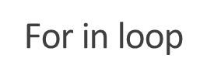
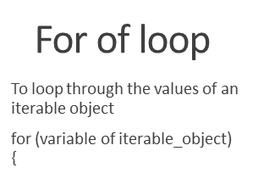
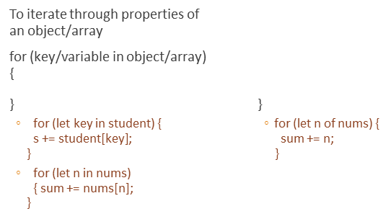
Conti…
Gunjan Keswani, CSE, RCOEM

Slide 31
Conditional Statements
Very often when you write code, you want to perform different actions for different decisions. You can use conditional statements in your code to do this.
In JavaScript we have the following conditional statements:
if statement - use this statement if you want to execute some code only if a specified condition is true
if...else statement - use this statement if you want to execute some code if the condition is true and another code if the condition is false
if...else if....else statement - use this statement if you want to select one of many blocks of code to be executed
switch statement - use this statement if you want to select one of many blocks of code to be executed
Gunjan Keswani, CSE, RCOEM

Slide 32
Conditional statements
if (condition) {
} else if (condition2) {
}else {
}
switch(expression) {
case x:
break;
case y:
break;
default:
}
Gunjan Keswani, CSE, RCOEM

Slide 33
Selection (the 'if' statement)
<script type="text/javascript">
// Comments are VERY VERY important
// If the time < 10, "Good morning" greeting.
// Otherwise you will get a "Good day" greeting.
var d = new Date();
var time = d.getHours();
if (time < 10){
console.log("Good morning!");
} else {
console.log("Good day!");
}
</script>
Gunjan Keswani, CSE, RCOEM

Slide 34
Repetition (loops)
<script type="text/javascript">
// This script shows the two common types of loops.
// The for loop
for (var counter = 1; counter <= 5; ++counter)
console.log(counter);
}
// The while loop
var i = true
while (i == true) {
i = window.confirm("Redisplay this dialog box?");
}
</script>
Gunjan Keswani, CSE, RCOEM

Slide 35
Popup boxes
As you have seen some of JavaScripts interactive abilities come from the use of pop-up boxes.
window.alert(message)
  Message and OK button to proceed
window.confirm(message)
  Message and OK button to proceed, Cancel button to cancel. Returns boolean
window.prompt(Message, defaultInput)
  Message with textbox, OK & Cancel button. Returns value entered in the box, else null.
Gunjan Keswani, CSE, RCOEM

Slide 36
JavaScript Popup Boxes
Alert Box
  An alert box is often used if you want to make sure information comes through to the user.
  When an alert box pops up, the user will have to click "OK" to proceed.
<script>
alert("Hello World!")
</script>
Gunjan Keswani, CSE, RCOEM

Slide 37
JavaScript Popup Boxes - 2
Confirm Box
  A confirm box is often used if you want the user to verify or accept something.
  When a confirm box pops up, the user will have to click either "OK" or "Cancel" to proceed.
  If the user clicks "OK", the box returns true. If the user clicks "Cancel", the box returns false.
Gunjan Keswani, CSE, RCOEM

Slide 38
JavaScript Popup Boxes - 3
Prompt Box
  A prompt box is often used if you want the user to input a value before entering a page.
  When a prompt box pops up, the user will have to click either "OK" or "Cancel" to proceed after entering an input value.
  If the user clicks "OK“, the box returns the input value. If the user clicks "Cancel“, the box returns null.
Gunjan Keswani, CSE, RCOEM

Slide 39
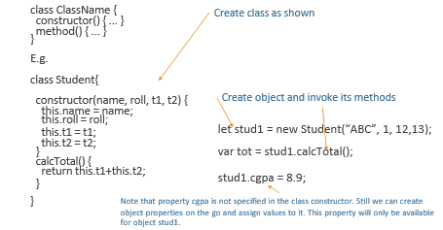
JavaScript Class
Gunjan Keswani, CSE, RCOEM

Slide 40
window object
It is supported by all browsers.
All global objects and methods belong to window
Can be accessed by this keyword in the global context or use window
Contains properties like height, width, document, screen, history, etc and methods like print(), open(), close, resize(), setTimeout(), etc.
Gunjan Keswani, CSE, RCOEM

Slide 41
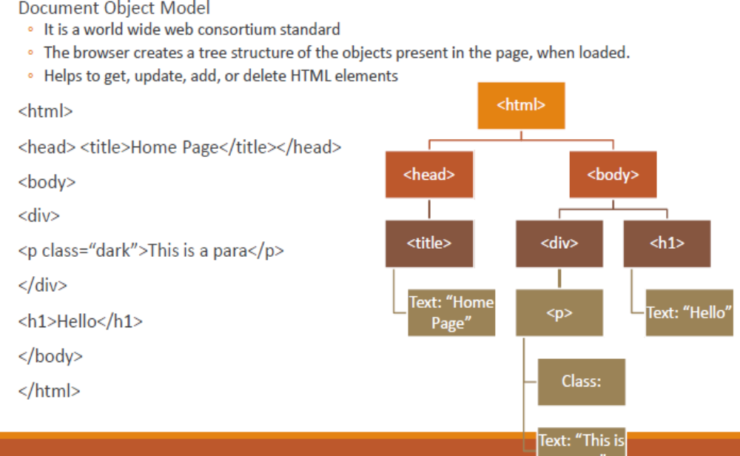
HTML DOM
Gunjan Keswani, CSE, RCOEM

Slide 42
JavaScript DOM Manipulation
JavaScript allows:
Modifying/adding/removing HTML elements
Modifying HTML attributes
Modifying CSS
React to/create events
Gunjan Keswani, CSE, RCOEM

Slide 43
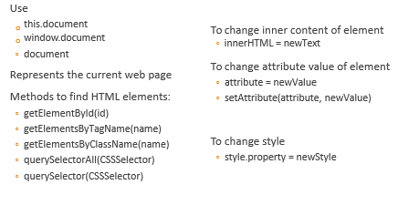
Document object
Gunjan Keswani, CSE, RCOEM

Slide 44
Events
Clicks / change in text fields / mouse hover / form submission / key press are examples of events
The onclick event generally occurs when the user clicks on an element.
It allows the programmer to execute a JavaScript's function when an element gets clicked.
This event can be used for validating a form, warning messages and many more.
In HTML
  <element onclick = "fun()">
In JavaScript
  object.onclick = function() { myScript };
In JavaScript by using the addEventListener() method
  object.addEventListener("click", myScript);
Gunjan Keswani, CSE, RCOEM

Slide 45
Events…
USING HTML ATTRIBUTES TO ADD EVENT HANDLERS
Add click event handler
  getElementById(id).onclick = function fname(){code}
OR
  Directly define action in onclick attribute of element
Add change event handler
  getElementById(id).onchange = function fname(){code}
OR
  Directly define action in onchange attribute of element
Gunjan Keswani, CSE, RCOEM

Slide 46
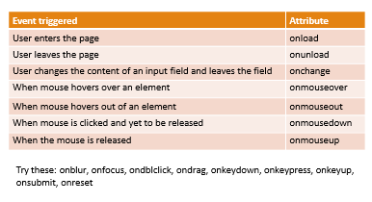
Events…
Gunjan Keswani, CSE, RCOEM

Slide 47
Event Handling using JavaScript
The addEventListener() method is used to attach an event handler to a particular element.
It does not override the existing event handlers.
A web page responds according to the event that occurred.
Events can be user-generated or generated by API's.
An event listener is a JavaScript's procedure that waits for the occurrence of an event.
Gunjan Keswani, CSE, RCOEM

Slide 48
Conti…
element.addEventListener(event, function, useCapture);
event: It is a required parameter. It can be defined as a string that specifies the event's name.
function: It is also a required parameter. It is a JavaScript function which responds to the event occur.
useCapture: It is an optional parameter. When it is set to true, the event handler executes in the capturing phase. When it is set to false, the handler executes in the bubbling phase. Its default value is false.
Gunjan Keswani, CSE, RCOEM

Slide 49
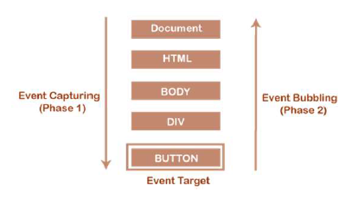
Event bubbling vs. capturing
Bubbling – If an event occurs on a target element, which is nested within other elements then the event is propagated to the containing handlers
Capturing – The event is propagated from outermost element to the target element.
Gunjan Keswani, CSE, RCOEM

