Slide 1

CLINIC MANAGEMENT SYSTEM
Aishwarya Virigineni
BL.EN.U4AIE19068
II sem C Section (CSE-AI)
19AIE111- DATA STRUCTURES AND ALGORITHMS 1

Slide 2
ABSTRACT
Gives doctor’s appointment to the patients.
Basic details of the patient like name, age, gender, phone number will be noted.
Patients will also be asked about the doctor (specialist) they want to meet.
He’ll be given a token number. And after that he’ll be added into the waiting list.
There is also special appointment available here, where the patient is placed in the first position of the waiting list exceeding the others.
Finally, the patient on the top of the list will be called out by displaying his token no., name and the specialist on the screen available for patients.

Slide 3
DATA STRUCTURES AND GUI USED
Data Structure used: SINGLY LINKED LIST
Singly Linked List:
A singly linked list is a collection of ordered set of elements. It is represented by a pointer to the first node of the linked list. The first node is called the head.
One way chain or singly linked list can be traversed only in one direction.
Used for storing the data of the patients.. And removing them wherever required.
GUI used: SWING & AWT
import javax.swing.*;
import javax.swing.table.DefaultTableModel;
import java.awt.*;
import java.awt.event.*;

Slide 4
CLASSES/FUNCTIONS/METHODS
Classes
class patient()
public patient(parametrized)
class node()
node()
node(parametrized)
class SLL()
void insert_first()
void insert_last()
void delete_first()
public int checkEmpty()
public int count()
public String[][] getData()

Slide 5
public class Final_DS()
public Final_DS ()
public void action performed(ActionEvent e)
public Boolean isCapital(parameter)
public Boolean is10digit(parameter)
public Boolean checkAge(parameter)
public Boolean isNumber(parameter)
public Boolean isString(parameter)
public static void main(String args[])
{
new Final_DS();
}

Slide 6
class SLL
{
node head= null;
int size=0;
void insert_first(patient st)
{
if (head==null)
head=new node(st);
else
{
node t=new node(st);
t.next=head;
head=t;
}
size++;
}
void insert_last(patient st)
{
node n=new node(st);
node t=head;
if(t==null)
{head=n;head.next=null;size++;}
else
{
while(t.next!=null)
{
t=t.next;
}
t.next=n;
n.next=null;
size++;
}
}
void delete_first()
{
if(head==null)
System.out.println("Empty list");
else
{head=head.next;
size--;}
}
public int checkEmpty()
{
if(head==null)
{
return 0;
}
else
return 1;
}
public int count()
{
return size;
}
}
SINGLY LINKED LIST

Slide 7
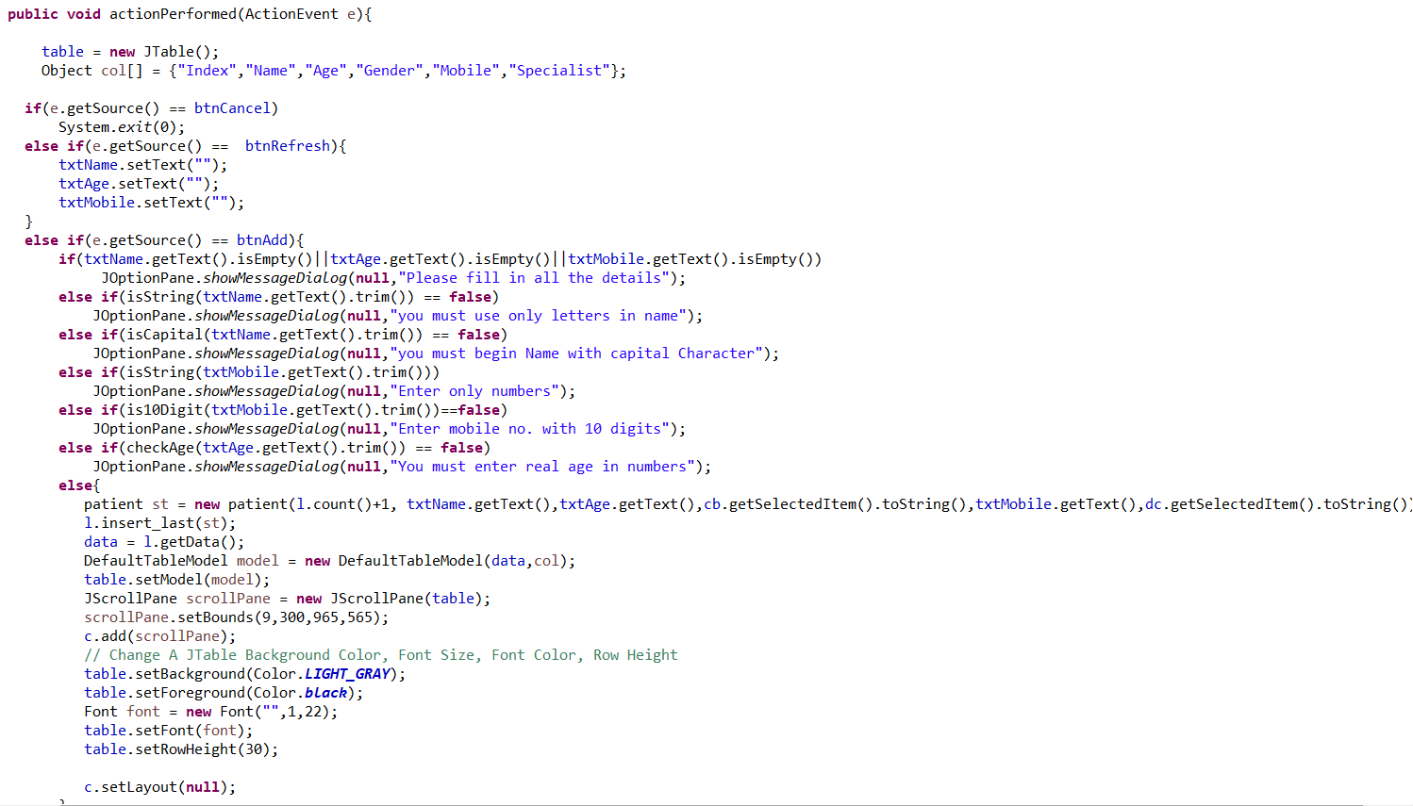
SAMPLE CODE

Slide 8
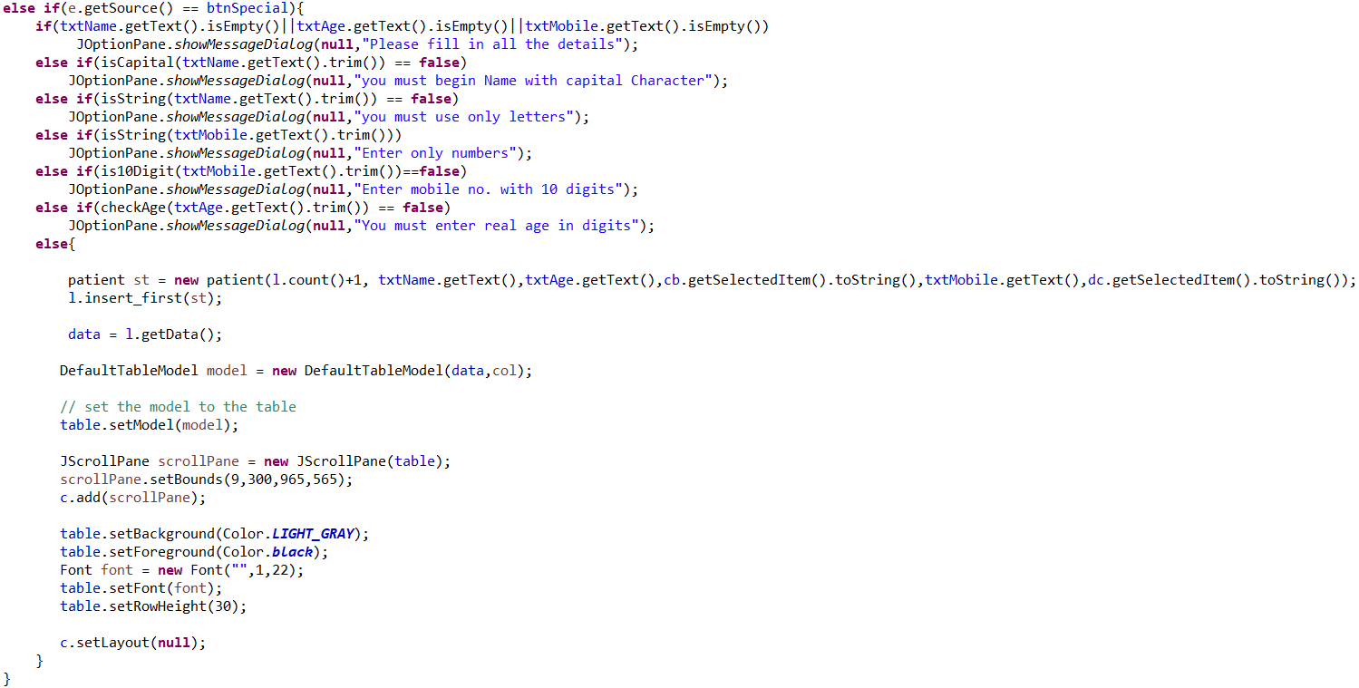

Slide 9
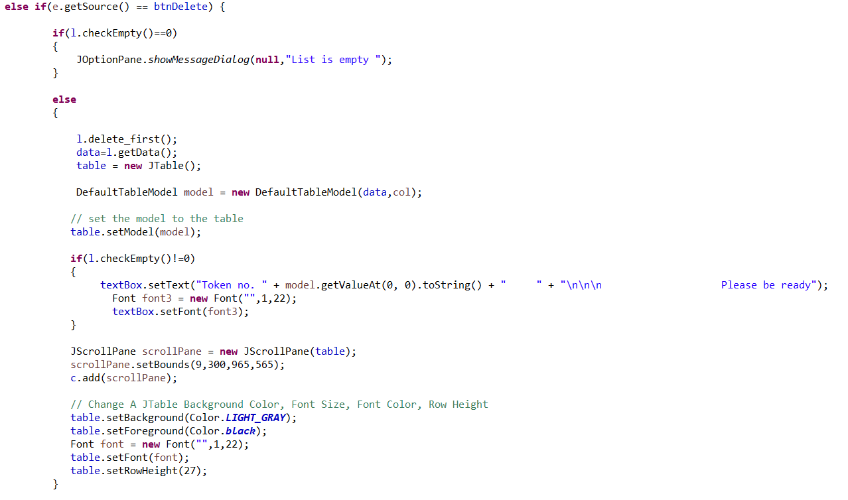

Slide 10
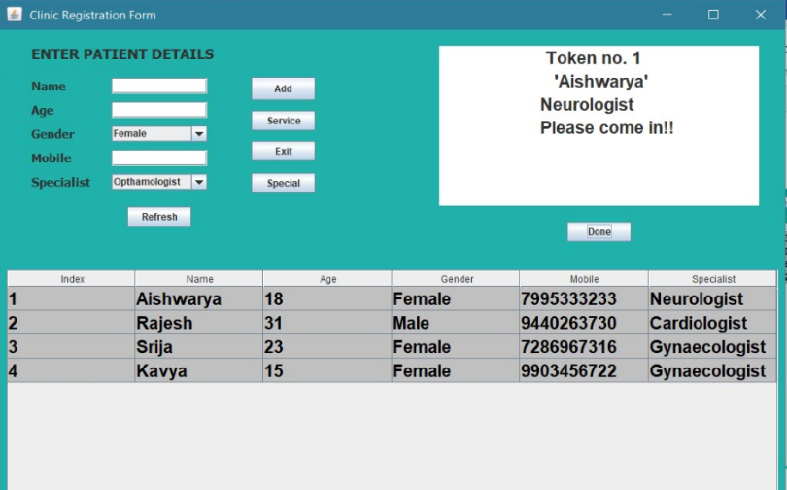
Patients added in the list by clicking on add button are in the following order :
Aishwarya
Rajesh
Srija
Kavya
Aishwarya is called out as she’s in the first of the list

Slide 11
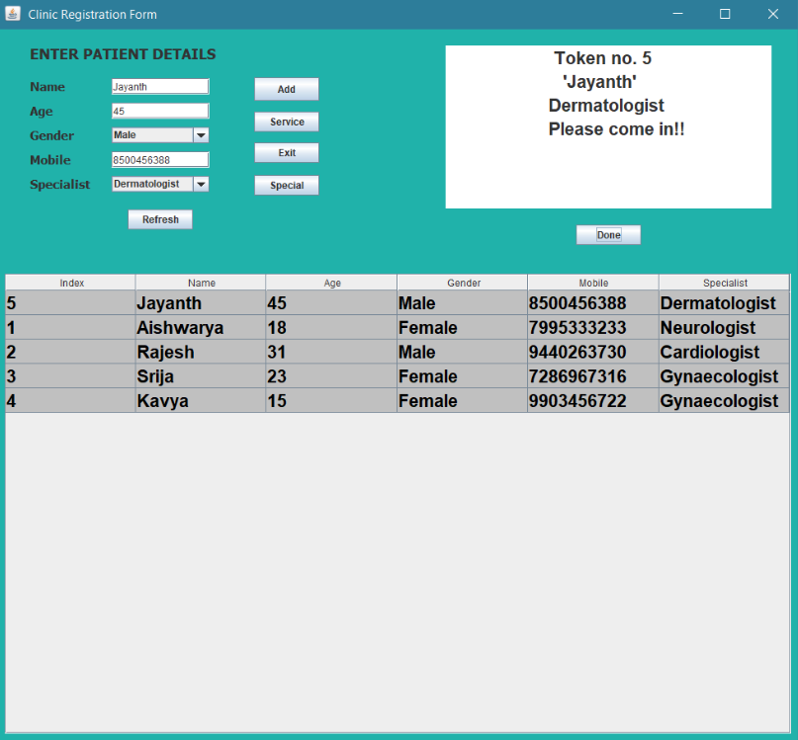
Now, Jayanth is added using special appointment using special button, so moves to the first position.

Slide 12

After clicking on service button , the first patient is deleted and the next patient will be called out.

Slide 13
THANK YOU

