Slide 1
UE23CS320A – Capstone Project Approval
Project Title : AI-Based Dog Health Monitoring System Using Dual-Input (Images + Symptoms) for Small, Medium, and Large Breeds
Project ID 193
Project Guide : Prof.Umme haani
Project Team : Aishwarya ravi – PES2UG23AM008
Deepika N – PES2UG23AM028
Rahul rathod – PES2UG23CS462 Renuka Gangadhar - PES2UG23CS474

Slide 2
Outline
Problem Statement
Scope and Feasibility study
Applications/Use cases
Expected Deliverables
Capstone (Phase-I Phase-II, Phase-III) Project Timeline
Any other information

Slide 3
Problem Statement
Problem statement
Pet owners often struggle to identify whether their pets are suffering from common or serious illnesses. Visiting a veterinarian for every minor concern can be costly and inconvenient. Many diseases show early signs in the form of symptoms (loss of appetite, vomiting, fatigue) and visible indicators (abnormal stool, urine color, skin conditions, or vomit appearance). There is currently no widely available system that integrates both symptom descriptions and visual evidence to support early health assessments. We aim to develop a hybrid, multi-modal AI system that analyzes both symptom descriptions and pet images to predict possible diseases, highlight key evidence, and guide owners on whether they should seek veterinary care.

Slide 4
Scope and Feasibility study
This project aims to develop an AI-based dog health monitoring system using dual-inputs: images and symptoms. The system will support small, medium, and large dog breeds, identifying visible and behavioral health issues. Image analysis will detect physical signs like skin problems or injuries, while symptom input will capture behavioral changes. A fusion model will process both inputs to suggest possible health conditions. The system will be accessible via a mobile or web interface. Technically feasible using existing AI models and datasets. Economically viable for a research or MVP phase. Operationally practical with clear user guidelines and disclaimers. Offers valuable assistance to pet owners and can reduce unnecessary vet visits.

Slide 5
Applications/Use cases
•Early Disease Detection – Identifies common illnesses (e.g., skin infections, eye issues) in dogs through image and symptom analysis.
•Breed-Specific Health Monitoring – Offers tailored insights based on breed size (small, medium, large) and common health risks.
•Educational Tool for Pet Owners – Informs owners about symptoms and breed-specific health concerns.
•Telehealth Integration – Can be extended to support remote consultations with veterinarians.
•Pet Wellness Apps – Integrates into pet care apps to track ongoing health and alerts.
•AI Research in Veterinary Medicine – Contributes to the development of intelligent systems for animal healthcare.

Slide 6
Expected Deliverables
Capstone-I deliverables
Defined and refined problem statement
Literature survey on CNNs, symptom analysis, multimodal AI Initial dataset collection (dog images, symptoms, breed data) Dataset annotation and preprocessing plan
Interim report and presentation
Capstone-II deliverables
System architecture and workflow diagram Preprocessing pipelines for image and symptom data
Baseline AI models (CNN for images, NLP/rule-based for symptoms) Prototype interface (image/symptom input + result display)
Progress report and demo presentation

Slide 7
Capstone-III deliverables
Model optimization and evaluation results Functional recommendation/alert system Draft research paper (methodology + results) Usability testing report with user feedback
Integrated dual-input AI model with breed-specific tuning

Slide 8
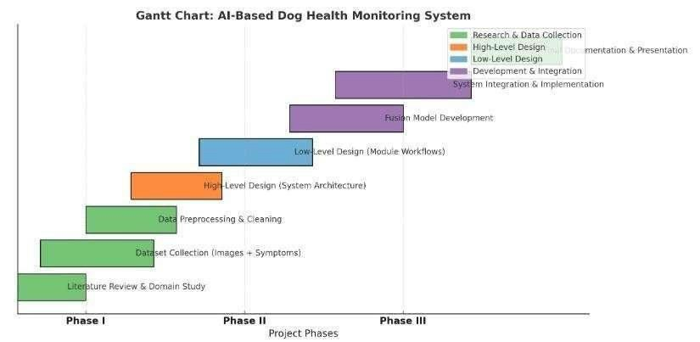
Capstone (Phase-I & Phase-II) Project Timeline

Slide 9
Any other information
Objectives:
-Develop an AI model capable of analyzing pet symptoms and images (vomit, stool, urine, skin, etc.)
Fuse multi-modal inputs (symptoms + images) for improved prediction accuracy
Provide explainable AI outputs (highlight image regions or symptom factors influencing predictions)
Design the system to be user-friendly for non-expert pet owners
Offer preventive health advice and alerts for serious issues
Deliverables:
A dataset combining symptom descriptions and annotated pet images
A trained hybrid AI model (CNN for images + ML classifier for symptoms)
A prototype web/mobile application for pet owners
Explainability module (Grad-CAM for images, SHAP for symptoms)
Final report and presentation

Slide 10
Risks and Challenges :
-Limited availability of publicly accessible datasets combining symptoms and images
Variability in image quality due to different lighting and camera devices
Need for careful design to ensure predictions are advisory, not diagnostic
Balancing explainability with accuracy
Integration of multi-modal data sources

Slide 11
Thank You

