Slide 1

“A Statistical Study of Analysis of India’s Gross Domestic Product”
Presented by
Miss. Desai Aishwarya Ganapat
M.Sc. II
Department of Statistics
S.G.M. College, Karad

Slide 2
Contents:
Introduction
Objectives of study
Data source
Methodology : 1) Graphical representation
2)Data analysis
3) ARIMA model
Results and Discussion
Conclusion
Reference

Slide 3
Introduction
In today’s vision of 2023 it is seen that many of the businesses, companies, manufacturing industries and agricultural welfares, etc. are the main factors which leads to the growth of economy. The Gross Domestic Product (GDP) is the monitory value of all finished goods and services made within a country during a specific period and it tells us how’s the performance of a country’s current aggregate production of goods and services and based on that, GDP is often considered the best measure of how well the economy is performing.
This paper is work of model implementation of the time series data which is GDP of India at constant price and in time series models it gives snapshot of an Indian economy with its sub sequential development.

Slide 4
Objectives of study
The purpose and objectives of this research is:
To analyse GDP at current prices.
To study the trend of GDP data and examine the trend line.
To study stationarity of GDP
To fit ARIMA model and forecast future values.

Slide 5
Data source
Government of India publishes every year the data on economic variables in Economic Survey. Here I have taken the time series data on GDP at constant price and it consists of 72 records and each record has 9 attribute values (features)as follows:
a) Year
b) PFCE: Private Final Consumption Expenditure
c) GFCE: Government Final Consumption Expenditure
d) GFCF: Gross Fixed Capital Formation
e) CIS: Change in Stocks
f) Valuables
g) Export of goods and cervices
h) Import of goods and services, these are independent variables, and
i) GDP is dependent variable.
This data is secondary and is collected from the period 1950-51 to 2021-2022.

Slide 6
Graphical Representation
1.1. Trend line:
Table 1. Year wise Gross Domestic product at constant prices (in crore)
Conclusion: From the above , we conclude that
1) GDP of India is showing an increasing trend with time.
2) As there are some little fluctuations in the line, which indicates absence of cyclical and seasonal variation in the data.

Slide 7
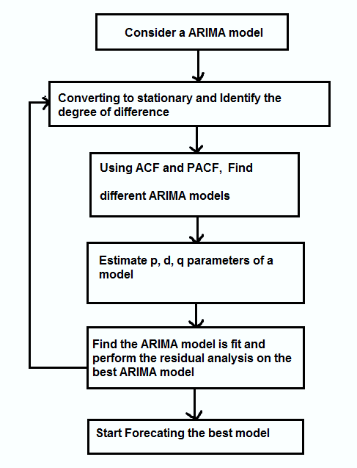
Methodology Time series analysis can be done by using following steps:

Slide 8
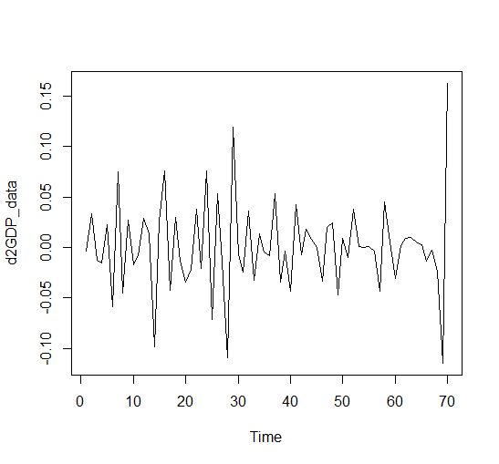
Stationarity:
Stationarity is the most important concept in every time series analysis. Stationarity refers to the concept that the statistical properties like mean, variance and covariance of series data are constant i.e. do not change over time. And it is very useful because our results rely on the series which is without trend or seasonal components.
Conclusion:
From above fig. we can say, after performing ADF test on second differenced data our series became stationary. Its mean and variance seems to be constant. But further we need to study for the covariance effects.

Slide 9
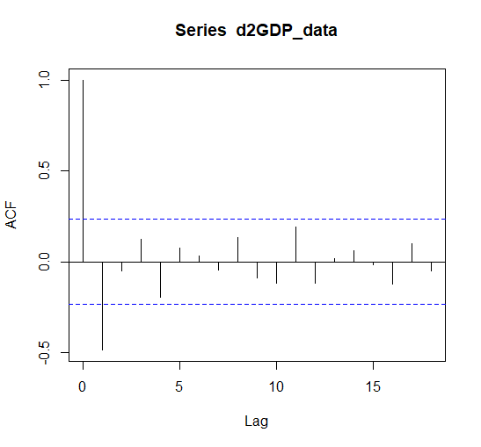
Conclusion: This ACF plot explains how the present value of given time series is correlated with the past values. Here y-axis expresses the correlation coefficient and x-axis explains the number of lags. Here for GDP data ACF has only single significant positive peak and it smoothly cuts after 1 particular lag.
2) Identifying AR and MA terms using Autocorrelation function(ACF) and Partial autocorrelation function(PACF) Plots:
1. ACF plot:

Slide 10
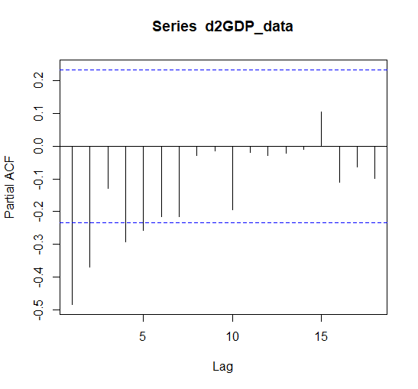
2. PACF plot:
Conclusion:
Here PACF shows slow decay(decrease). And again observing PACF it increases and later gradually drops after two significant lags. Hence for GDP series we can say it having alternative exponential decline with a positive peak PACF(1)
It indicates that an MA (1) would be a good model for the process. Therefore, we should consider and work with both ARMA (1,1) and MA (1) for the process and later select the optimal model based on a performance metric like AIC (Akaike Information Criteria).

Slide 11
Results and Discussion Table 1. Different ARIMA(p,d,q) models for Forecasting comparisons for GDP parameters with minimum AIC measures
Model | AIC
ARIMA(0,1,0) | -158.92
ARIMA(1,1,0) | -193.08
ARIMA(2,1,1) | -253.38
ARIMA(1,0,0) | -253.49
ARIMA(0,0,1) | -281.46
ARIMA(1,2,1) | -181.95
ARIMA(1,1,2) | -267.31
ARIMA(1,0,2) | -279.23
ARIMA(2,2,2) | -236.84
ARIMA(2,2,1) | -208

Slide 12
Result of best fit model:
Series | Best Model | MAPE | RMSE
GDP data | ARIMA(0,0,1) | 5490.81 | 0.0255666
From table 1. we conclude following things:
The model with lowest AIC values are considered to be the best model. Hence, it can be concluded that ARIMA (0, 0, 1) is the best model for GDP data.
here AIC, MAPE and RMSE values are -281.46, 5490.81 and 0.0255666 respectively.
3) For an ARIMA (0,0,1) model, Yt is statistically independent of Yt-k.
Also, because of white noise et and et-k are statistically independent.
The model is: Yt = et + θet-1
Hence,
The equation for ARIMA(0,0,1) is given as:
GDP=0.0001-0.9289et-1

Slide 13
Interpretation of ARIMA(0,0,1) model: 1) Here the PACF value is 0 i.e. p=0 Basically it means that the lags value in the PACF graph are not to be significant and it can be interpreted as trend components does not play a significant role for the given time series data. 2) d=0 It indicates that the given time series data is stationary and it does not need check nonseasnal differences. 3) q=1 It indicates that ACF value is 1. Which is nothing but the lag after which the ACF value will becomes a zero in the graph is 1. It suggest that our time series has a randomness component and the ACF after the lag 2 becomes 0. It is because of the reason that the first small pick in ACF plot is because of the correlation of the variable with itself.

Slide 14
Conclusion
GDP series has increasing trend with time and shows no seasonal or cyclical effects.
ARIMA (0, 0, 1) is the best model for GDP data.
AIC, MAPE and RMSE values of ARIMA model are -281.46, 5490.81 and 0.0255666 respectively.
ARIMA models equation for GDP data is : GDP=0.0001-0.9289et-1

Slide 15
Limitations:
For the study purpose the data which have been used, that consist only 72 records.
which are not enough for further study and analysis.
Hence I limit my research till building ARIMA model only.
Future scope:
1. From above results and conclusion we have got the ARIMA(0,0,1) model and later after we can perform ArchTest to see the presence of ARCH effect. If we could get an ARCH effect is to be present in the series ,
2. Then study can continued to fit ARCH and GARCH models on the GDP series for forecasting the series of next 10 years.

Slide 16
References :
GDP modelling and forecasting using ARIMA: an empirical study from India By Varun Agrawal; Budapest, Hungary (2018)
Comparative Performance of ARIMA and GARCH Models in Modelling and forecasting volatility of Malaysia Market Properties and Shares Nor Hamizah MiswanNor Azazi Ngatiman, Khairum Hamzah and Zaminor Zamzamir Zamzamin(2014)
Modeling the Volatility of Real GDP Growth: The Case of Japan Revisited WenShwo Fang University of Connecticut (2008)
An Emperical Study of GDP in Indian Economy on Inflation and Population Article, Palvi Jearth ,Shikhil Munjal, Patiala 7 Gurcharan Singh,Punjabi University (2019)
Analysis and comparison of overall GDP depending only on three major sectors in Indian economy Dr. Konda Hari Prasad Reddy Associate Professor, Jain University Lalbagh Road, Bengaluru.

Slide 17
Thank You

