Slide 1
World Education Ranking Data
- A simple Tableau project
By : Aishwarya H Y

Slide 2
Introduction- The World Ranking Data
The data explains the education through out the
world .
This data deals with around 2000+ rows and 13
columns.
It consists of data such as world ranks , university
names, country ,citation, broadcast, national ranks, quality of faculty , quality of education, alumni employment ,publications , influences , patents ,scores and years.
The year ranges from 2012-2015 .

Slide 3
Platform Used:Tableau
Tableau is a powerful and fastest growing data visualization tool used in the Business Intelligence Industry.
It is the most powerful, secure, and flexible end-to-end analytics platform for your data.
Data analysis is very fast with Tableau and the visualizations created are in the form of dashboards and worksheets.

Slide 4
Problem Statements

Slide 5
Retrieve the highest Average world ranks among the years.
Retrieve the highest Average national ranks among the years.
Sum of scores of top 10 countries with respect to years.
Sum of the alumni employment through out the years.
Retrieve the average count of patent score with respect to years

Slide 6
Retrieve the sum of patent and sum of scores of the top most countries in world rank.
Top most citations and broad impacts of top 20 countries.
The average of alumni placements.
Variance of quality of education through out the years.
Show the dependency of publications with respect to the quality of faculty.

Slide 7
Story Explanation

Slide 8

Outcomes of the project

Slide 9
- The average rankings based on the world ranks have
been found.
- The average rankings based on national ranks have
been obtained.
- Sum of the scores with respect to years have been
found.
- Sum of the alumni employment through out the years have been analysed.
-Count of patents with respect to years have been found.

Slide 10
-Sum of patents and sum of socres of the first ten countries with respect to world rank have been analysed. -Top most citations and broad impact have been analysed. -Average alumni placements have been analysed. -Variance of quality of education through out the years have been found. -Dependency chart with respect to publications and faculty quality has been analysed.

Slide 11

Basic Analysis

Slide 12
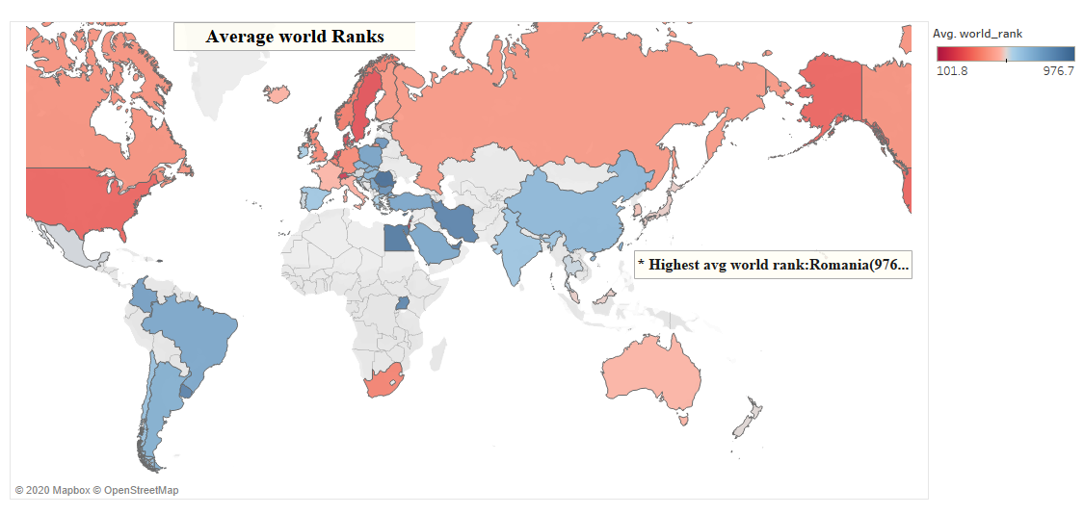
Highest Average of a country’s scores based on World ranks

Slide 13
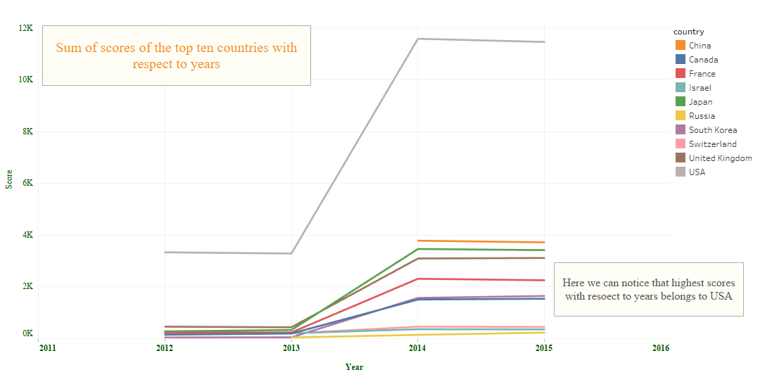

Slide 14
Conclusion
From the charts created :
The highest average scores with respect to national ranks is: USA (56,034).
USA stands in top1 position with respect to sum of scores having the value of 11,475
Romania stands first for the average alumni employment with the score of 537.3.
USA has highest number of patents of 549.
The number of publications depends on the quality of faculty..

Slide 15
With respect to sum of citations and broad impact USA stands in the first position.
The ranks show their dependency on the variance of quality of education.
USA has the highest alumni employment with 1,47,556.

Slide 16
Thank you

Slide 17
Links
Video: https://drive.google.com/file/d/1dyoIkx3wJ-M36t7wPYHuU3OeUmHK7IVp/view
Source : https://www.kaggle.com/datasets
Project : https://public.tableau.com/profile/aishwarya.anand#!/vizhome/Tableau_Project1_15933654547050/Story1

