Slide 1
Real-Time Fleet Monitoring System
Aishwarya Vijay Ananth
29-12-2024

Slide 2
Real-Time Fleet Monitoring System
Fleet management involves the administration and coordination of a company's vehicle fleet. This process ensures that vehicles are used efficiently, maintained properly, and operated safely.
Vehicle Maintenance: Regular servicing and repairs.
Fuel Management: Monitoring and reducing fuel consumption.
Telematics: Using GPS to track vehicles and gather data.
Compliance: Ensuring vehicles and drivers meet regulations.
Cost Control: Managing expenses like fuel, maintenance, and insurance.
Driver Management: Overseeing driver performance and safety.
Effective fleet management reduces costs, improves efficiency, and enhances safety.

Slide 3
Class Diagram (Relationship between subsystems)
-machineryData
-mtx
+addMachinery()
+monitorMachinery()
+getMachineryData()
FleetMonitor
FleetService
+checkAndServiceMachinery()
Customer
Name
Machinery machinery
+ Customer()
+getName()
+getMachinery()
-machineryID
-status
+Machinery()
+update()
+getStatus()
+getID()
Machinery

Slide 4
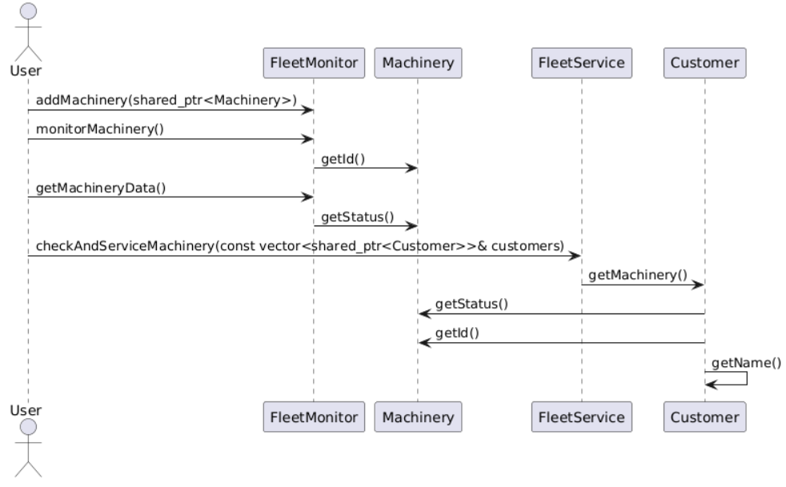
Sequential Diagram

