Slide 1
Openstack Neutron: Openvswitch Agent
Sridhar K. N. Rao

Slide 2
Class Hierarchy
dvr_rpc.DVRServerRpcApiMixin
agent_rpc.PluginApi
sg_rpc.SecurityGroupServerRpcApiMixin
class PluginReportStateAPI
class OVSPluginApi
sg_rpc.SecurityGroupAgentRpcCallbackMixin
class OVSNeutronAgent
l2population_rpc.L2populationRpcCallBackTunnelMixin
dvr_rpc.DVRAgentRpcCallbackMixin
Implements Procedures that are called from Plugin
P2A Interaction
Implements Calls to Plugin
A2P interaction

Slide 3
RPC Calls
Class | Members
OVSNeutronAgent | network_delete port_update tunnel_update
SecurityGroupAgentRpcCallbackMixin | security_groups_rule_updated security_groups_member_updated security_groups_provider_updated
DVRAgentRpcCallbackMixin | dvr_mac_address_update
Calls from Plugin:
Class | Members
DVRServerRpcApiMixin | get_dvr_mac_address_by_host get_dvr_mac_address_list get_ports_on_host_by_subnet get_subnet_for_dvr
PluginApi | get_device_details get_devices_details_list update_device_down update_device_up tunnel_sync
SecurityGroupServerRpcApiMixin | security_group_rules_for_devices security_group_info_for_devices
PluginReportStateAPI | report_state
Calls to Plugin

Slide 4
class OVSNeutronAgent
self.int_br = ovs_lib.OVSBridge(integ_br, self.root_helper)
self.setup_integration_br()
self.setup_rpc()
self.setup_physical_bridges(self.bridge_mappings)
self.tun_br = None
if self.enable_tunneling:
self.reset_tunnel_br(tun_br)
self.setup_tunnel_br()
__init__
self.dvr_agent = ovs_dvr_neutron_agent.OVSDVRNeutronAgent(
self.dvr_agent.setup_dvr_flows_on_integ_tun_br()
# Collect additional bridges to monitor
self.ancillary_brs = self.setup_ancillary_bridges(integ_br, tun_br)
self.sg_agent = OVSSecurityGroupAgent(self.context, self.plugin_rpc,
root_helper)
self.connection.consume_in_threads()
Notes:
Implements OVS-based tunneling, VLANs and flat networks.
Two local bridges are created: an integration bridge (defaults to
'br-int') and a tunneling bridge (defaults to 'br-tun'). An
additional bridge is created for each physical network interface
used for VLANs and/or flat networks.
All VM VIFs are plugged into the integration bridge. VM VIFs on a
given virtual network share a common "local" VLAN (i.e. not
propagated externally). The VLAN id of this local VLAN is mapped
to the physical networking details realizing that virtual network.
For virtual networks realized as GRE tunnels, a Logical Switch
(LS) identifier is used to differentiate tenant traffic on
inter-HV tunnels. A mesh of tunnels is created to other
Hypervisors in the cloud. These tunnels originate and terminate on
the tunneling bridge of each hypervisor. Port patching is done to
connect local VLANs on the integration bridge to inter-hypervisor
tunnels on the tunnel bridge.
For each virtual network realized as a VLAN or flat network, a
veth or a pair of patch ports is used to connect the local VLAN on
the integration bridge with the physical network bridge, with flow
rules adding, modifying, or stripping VLAN tags as necessary.
'''

Slide 5
def setup_rpc(self):
q-agent-notifier
Agent Acting as RPC Server
self.topic = topics.AGENT
self.plugin_rpc = OVSPluginApi(topics.PLUGIN)
self.state_rpc = agent_rpc.PluginReportStateAPI(topics.PLUGIN)
self.endpoints = [self]
# Define the listening consumers for the agent
consumers = [[topics.PORT, topics.UPDATE],
[topics.NETWORK, topics.DELETE],
[constants.TUNNEL, topics.UPDATE],
[topics.SECURITY_GROUP, topics.UPDATE],
[topics.DVR, topics.UPDATE]]
if self.l2_pop:
consumers.append([topics.L2POPULATION,
topics.UPDATE, cfg.CONF.host])
self.connection = agent_rpc.create_consumers(self.endpoints,
self.topic,
consumers,
start_listening=False)
For Agent acting as
RPC Client.
Agent Acting as RPC
Server
ex: q-agent-notifier-port-update

Slide 6
Exchanges and Queues – P2A
ML2-Plugin
q-agent-notifier-port-update_fanout
q-agent-notifier-network-delete_fanout
q-agent-notifier-tunnel-update_fanout
q-agent-notifier-security_group-update_fanout
q-agent-notifier-dvr-update_fanout
q-agent-notifier-l2population-update
q-agent-notifier-port-update_fanout _<uuid>
q-agent-notifier-network-delete_fanout _<uuid>
q-agent-notifier-tunnel-update_fanout _<uuid>
q-agent-notifier-security_group-update_fanout_<uuid>
q-agent-notifier-dvr-update_fanout _<uuid>
q-agent-notifier-l2population-update
OVSNeutronAgent
Notes:
impl_rabbit.py
unique = uuid.uuid4().hex
exchange_name = '%s_fanout' % topic
queue_name = '%s_fanout_%s' % (topic, unique)

Slide 7
Exchanges and Queues : A2P
q-plugin
q-plugin

Slide 8
updated_ports.add()
create_port
daemon_loop
_create_port_db
rpc_loop
_process_port_binding
tunnel_sync()
_notify_port_updated
tunnel_update
notifier.port_update
_setup_tunnel_port
tunnel_sync()
br.add_tunnel_port
tunnel_update
br.add_flow
br.mod_flow

Slide 9
ML2-Plugin RPC

Slide 10
Implements calls from Agents
Implement calls from agents
type_tunnel.TunnelRpcCallbackMixin
rpc.RpcCallbacks(self.notifier, self.type_manager),
securitygroups_rpc.SecurityGroupServerRpcCallback(),
dvr_rpc.DVRServerRpcCallback(),
dhcp_rpc.DhcpRpcCallback(),
agents_db.AgentExtRpcCallback(),
metadata_rpc.MetadataRpcCallback()
dvr_rpc.DVRAgentRpcApiMixin
type_tunnel.TunnelAgentRpcApiMixin
sg_rpc.SecurityGroupAgentRpcApiMixin
class AgentNotifierApi
class Ml2Plugin
db_base_plugin_v2.NeutronDbPluginV2,
dvr_mac_db.DVRDbMixin,
external_net_db.External_net_db_mixin,
sg_db_rpc.SecurityGroupServerRpcMixin,
agentschedulers_db.DhcpAgentSchedulerDbMixin,
addr_pair_db.AllowedAddressPairsMixin,
extradhcpopt_db.ExtraDhcpOptMixin

Slide 11
Calls to Agents
Class | Members
AgentNotifierApi | network_delete port_update
DVRAgentRpcApiMixin | dvr_mac_address_update
SecurityGroupAgentRpcApiMixin | security_groups_rule_updated security_groups_member_updated security_groups_provider_updated
TunnelAgentRpcApiMixin | tunnel_update

Slide 12
Calls from AGENT
Class | Members
RpcCallbacks | get_device_details get_devices_details_list update_device_down update_device_up
TunnelRpcCallbackMixin | tunnel_sync
SecurityGroupServerRpcCallback | security_group_rules_for_devices security_group_info_for_devices
DVRServerRpcCallback | get_dvr_mac_address_by_host get_dvr_mac_address_list get_ports_on_host_by_subnet get_subnet_for_dvr
AgentExtRpcCallback | report_state
MetadataRpcCallback | ???
DhcpRpcCallbac | get_active_networks_info get_active_networks get_network_info get_dhcp_port release_dhcp_port release_port_fixed_ip create_dhcp_port update_lease_expiration update_dhcp_port

Slide 13
Security Groups.
How the Bridges are Set-Up.?
How the VIFs are attached to Integration Bridges?
How the Flows are added in the two bridges?
How the Filters are setup on VIFs.?

Slide 14
Setup integration bridge.
self.int_br.create()
self.int_br.delete_port(patch-tun)
remove_all_flows()
switch all traffic using L2 learning
self.int_br.add_flow(priority=1, actions="normal")
Add a canary flow to track OVS restarts
add_flow(table=constants.CANARY_TABLE, priority=0, actions="drop")

Slide 15
Reset Tunnel Bridge
1
self.tun_br = ovs_lib.OVSBridge
2
patch_tun_ofport = self.int_br.add_patch_port()
3
patch_int_ofport = self.tun_br.add_patch_port
4
tun_br.remove_all_flows()

Slide 16
setup_physical_bridges
Create Bridges from the mappings.
Create patch ports and join with Integration bridge.
Add Flows.
Do any other necessary configurations
MTU
Db-attribute.

Slide 17
Setup tunnel bridge
resubmit
Incoming
patch_int_port
Outgoing
LEARN_FROM_TUN
Table-0
0
outputs
LEARN_FROM_TUN
PATCH_LV_TO_TUN
10
2
Dynamic
adds
20
21
UCAST_TO_TUN
FLOOD_TO_TUN
ARP_RESPONDER
22
GRE/VXLAN_TUN_TO_LV
3/4
More invhttps://openflow.stanford.edu/display/ONL/POX+Wiki#POXWiki-TheLearnAction

Slide 18
 | Process that adds entry.
0 | setup_tunnel_br provision_local_vlan port_dead setup_integration_br setup_physical_bridges _setup_tunnel_port
LV_TO_TUN | setup_tunnel_br
UNICAST | setup_tunnel_br LEARN*******
FLOOD | setup_tunnel_br provision_local_vlan _setup_tunnel_port
ARP | setup_tunnel_br setup_entry_for_arp_reply
LEARN | setup_tunnel_br
TUN_TO_LV | setup_tunnel_br provision_local_vlan

Slide 19
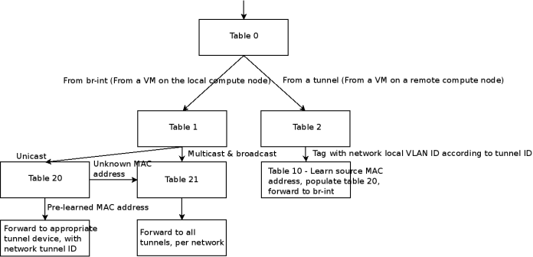
Source: http://dischord.org/2015/03/09/troubleshooting-openstack-neutron-networking-part-one/

Slide 20
Limitation
limitation in OVS: The virtual switch cannot directly attach a TAP device where iptables rules are applied.
As a workaround nova sets up a Linux bridgeqbr that links the TAP interface with a veth pair.

Slide 21
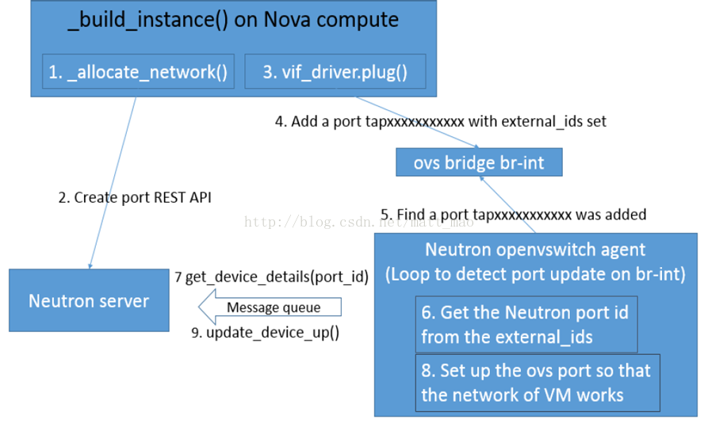
Notes:
http://blog.oddbit.com/2014/01/19/show-ovs-externalids/
http://www.aboutyun.com/thread-9538-1-1.html

Slide 22
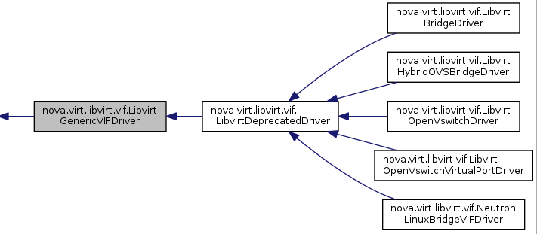




Slide 23
Attach_interfaces.py
def create(self, req, server_id, body):
nova/virt/libvirt/driver.py
def attach_interface(self, instance, image_meta, network_info)
Appropriate vif-driver is set here.
def plug(self, instance, vif):
VIF_TYPE_OVS
def plug_ovs(self, instance, vif):
firewall_required
class LibvirtGenericVIFDriver (vif.py)
def plug_ovs_hybrid(self, instance, vif):
Create a per-VIF linux bridge, then link that bridge to the OVS integration bridge via a veth device, setting up the other end of the veth device just like a normal OVS port. Then boot the VIF on the linux bridge using standard libvirt mechanisms.

Slide 24
rpc_loop
setup_port_filters***
(securitygroups_rpc.py)
process_network_ports
1
get_devices_details_list
treat_devices_added_or_updated
4
update_device_up
3
2
treat_vif_port
self.int_br.get_vif_port_by_id **
ovs-vsctl --format=json, '--', '--columns=external_ids, name,ofport', 'find', 'Interface', external_ids:iface-id="%s"' % port_id
port_bound
provision_local_vlan
bind_port_to_dvr
LocalVLANMapping
in_port=self.phys_ofports[physical_network],dl_vlan = lvid, actions="strip_vlan,normal"
in_port=self.phys_ofports[physical_network], dl_vlan=lvid, actions="mod_vlan_vid:%s,normal
dl_vlan=lvid, actions="strip_vlan," "set_tunnel:
in_port=self.int_ofports[physical_network], dl_vlan = 0xffff, actions= "mod_vlan_vid: %s,normal
in_port=self. int_ofports [physical_network], dl_vlan= segmentation_id, actions= "mod_vlan_vid:%s,normal
tun_id=segmentation_id, actions="mod_vlan_vid:,"
"resubmit(,%s)"

Slide 25
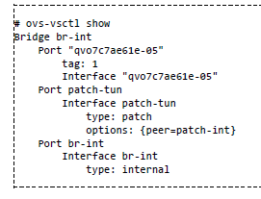
The interface qvo7c7ae61e‐05 is the other end of qvb7c7ae61e‐05, and carries traffic to and from the firewall bridge. The tag: 1 you see in the above output integrates that
this is an access port attached to VLAN 1. Untagged outbound traffic from this instance will be assigned VLAN ID 1, and inbound traffic with VLAN ID 1 will stripped of
it's VLAN tag and sent out this port.
Each network you create (with neutron net‐create) will be assigned a different VLAN ID.
The interface named patch‐tun connects the integration bridge to the tunnel bridge, br‐tun.

Slide 26

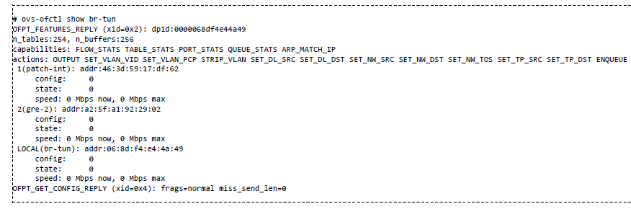
Before creating any instances, the flow rules on the bridge look like this:
these rules are responsible for mapping traffic between VLAN ID 1, used by the integration bridge, and tunnel id 2, used by the GRE tunnel
matches traffic coming in on tunnel 2 (tun_id=0x2) with an ethernet destination of fa:16:3e:dd:c1:62 (dl_dst=fa:16:3e:dd:c1:62) and tags the ethernet frame with VLAN
ID 1 (actions=mod_vlan_vid:1) before sending it out patch‐int.
matches traffic coming in on port 1 (in_port=1) with VLAN ID 1 (dl_vlan=1) and set the tunnel id to 2 (actions=set_tunnel:0x2) before sending it out the GRE tunnel.
matches all multicast traffic on tunnel id 2 (tun_id=0x2), tags the ethernet frame with VLAN ID 1 (actions=mod_vlan_vid:1), and sends it out port 1.

Slide 27
Agent\securitygroups.py
setup_port_filters
2
If-new
prepare_devices_filter(new_devices)
prepare_port_filter(device)
refresh_firewall(updated_devices)
2
update_port_filter(device)
1
3
_update_security_group_info
If(enhanced_rpc)
security_group_info_for_devices
update_security_group_members
else
security_group_rules_for_devices
.update_security_group_rules(
RPC
Firewall driver
Notes:
Configure port filters for devices.
This routine applies filters for new devices and refreshes firewall
rules when devices have been updated, or when there are changes in
security group membership or rules.
:param new_devices: set containing identifiers for new devices
:param updated_devices: set containing identifiers for
updated devices

Slide 28
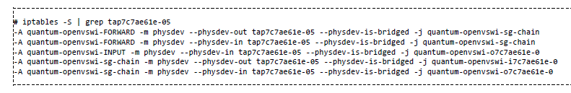
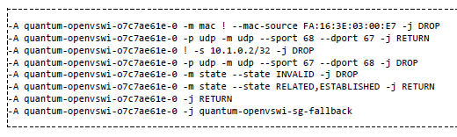
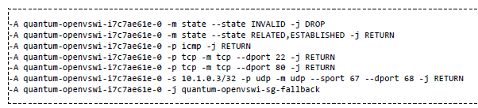
firewall rules on your compute host
quantum‐openvswi‐sg‐chain is where neutronmanaged security groups are realized.
The quantum‐openvswi‐o7c7ae61e‐0 chain controls outbound traffic FROM the instance, and by default looks like this:
The quantum‐openvswi‐i7c7ae61e‐0 chain controls inbound traffic TO the instance.
The rules look like this:

Slide 29
details['device']
details['port_id']
details['network_id'],
details['network_type'],
details['physical_network'],
details['segmentation_id'],
details['admin_state_up'],
details['fixed_ips'],
details['device_owner'],
binding.vif_type
binding.vif_details
binding.driver
binding.segment
binding.host
binding.profile

Slide 30
Port-Bindings
Port binding in ML2 is the process by which a mechanism driver is selected for the port, determining how connectivity is provided for that port.
Since ML2 is designed to support heterogeneous deployments, its possible for different ports to be bound using different mechanism drivers.
The end results of port binding visible outside ML2 are the values of the binding:vif_type and binding:vif_details port attributes that control the Nova VIF driver behavior.
The inputs to the port binding process are the port and the network to which the port belongs, including the network's set of segments, as well as the values of the binding:host_id, binding:vnic_type, and binding:profile port attributes.
Nova (or any L3, DHCP, or service agent owning the port) sets binding:host_id to indicate the host on which the port is being bound. The setting of this attribute triggers the port binding process.

Slide 31
Port-Bindings
During port binding, the bind_port() method is called by ML2 on each registered mechanism driver until one driver indicates it has succeeded by calling PortContext.set_binding().
The driver calls PortContext.set_binding() with the identity of the network segment it bound, and the values for the binding:vif_type and binding:vif_details attributes.
Typical mechanism drivers for L2 agents decide whether they can bind the port by looking through the list of network segment for one with a network_type value that the agent on the host identified by binding:host_id can handle, and if relevant, a physical_network value for which that agent has connectivity.
The current L2 agent mechanism drivers use agents_db info sent from the agents to the service via RPC, including the agent's health and the bridge_mappings or interface_mappings value that describes its connectivity to physical_networks.

Slide 32
binding:vif_type and
binding:vif_details
Port Binding
port and the network to which the port belongs, including the network's set of segments, as well as the values of the binding:host_id, binding:vnic_type, and binding:profile port attributes

Slide 33
When nova-compute creates an instance, it must 'plug' each of the instance's vNICs into a OpenStack Network controlled virtual switch, and inform the virtual switch about the OpenStack Network port-id associated with each vNIC. This is done by specifying a field in the nova.conf of the nova-compute instance indicating what type of vif-plugging should be used. The exact field(s) you need to set depend on your plug-in. For plug-ins not listed below, see the plug-in specific documentation.
libvirt_vif_driver=nova.virt.libvirt.vif.LibvirtHybirdOVSBridgeDriver.
libvirt_vif_driver=nova.virt.libvirt.vif.LibvirtOpenVswitchDriver.
libvirt_vif_driver=nova.virt.libvirt.vif.QuantumLinuxBridgeVIFDriver.

Slide 34
Helper

Slide 35
agent/rpc.py
create_consumers(endpoints, prefix, topic_details, start_listening=True):
Create agent RPC consumers
class PluginReportStateAPI(object):
__init__
report_state
class PluginApi(object):
__init__
get_device_details
get_devices_details_list
update_device_down
update_device_up
tunnel_sync

Slide 36
cfg.CONF.register_opts(ip_lib.OPTS)
common_config.init(sys.argv[1:])
common_config.setup_logging()
q_utils.log_opt_values(LOG)
create_agent_config_map(cfg.CONF)
Create a map of agent config parameters
integ_br=config.OVS.integration_bridge,
tun_br=config.OVS.tunnel_bridge,
local_ip=config.OVS.local_ip,
bridge_mappings=bridge_mappings,
root_helper=config.AGENT.root_helper,
polling_interval=config.AGENT.polling_interval,
minimize_polling=config.AGENT.minimize_polling,
tunnel_types=config.AGENT.tunnel_types,
veth_mtu=config.AGENT.veth_mtu,
enable_distributed_routing=config.AGENT.enable_distributed_routing,
l2_population=config.AGENT.l2_population,
arp_responder=config.AGENT.arp_responder,
use_veth_interconnection=config.OVS.use_veth_interconnection,
agent = OVSNeutronAgent(**agent_config)

Slide 37
Additional.
Can be discarded.

Slide 38
Adding flow entries (flow-mods) in Tunnel-Bridge for outbound broadcast/multicast flows, which strips the vlans and adds tunnel-ID is performed by both provision_vlan and setup_tunnel_port.
Though both are initiated from rpc_loop, the first one is when NOVA adds an interface to the bridge (br-int), whereas, the second one is neutron-plugin handling create-port rest API - where pulgin notifies the agent about port update and may result in tunnel-sync.
Understanding is – First one is for everytime a new instance is added. Whereas, the second one is only when tunnel-sync is required – (Beginning, OVS Restarted, when any tunnel-sync process fails). We may have to confirm this from the ‘mailing-list’ --- Anybody has fake ID?
br.mod_flow(table=constants.FLOOD_TO_TUN,
dl_vlan=vlan_mapping.vlan,
actions="strip_vlan,set_tunnel:%s,output:%s" %
(vlan_mapping.segmentation_id, ofports))
self.tun_br.mod_flow(table=constants.FLOOD_TO_TUN,
dl_vlan=lvid,
actions="strip_vlan,"
"set_tunnel:%s,output:%s" %
(segmentation_id, ofports))

Slide 39
MechanismDriver
pass
AgentMechanismDriverBase
_init_()
bind_port()
SimpleAgentMechanismDriverBase
__init__()
try_to_bind_segment_for_agent()
check_segment_for_agent()
OpenvswitchMechanismDriver():
__init__()
get_allowed_network_types()
get_mappings()

Slide 40
Some ML2-Plugin contents….
create_port Rest API:
Nova
DHCP agent.
…

Slide 41
create_port
_bind_port_if_needed
_bind_port
mechanism_manager.bind_port
driver.obj.bind_port(context)

Slide 42
MechanismDriverContext
self._plugin
self._plugin_context
PortContext
A PortContext instance wraps a port resource. It provides helper methods for accessing other relevant information. Results from expensive operations are cached so that other MechanismDrivers can freely access the same information.
self._port
self._original_port
self._network_context
self._binding
self._original_bound_segment_id
self._original_bound_driver
self._new_port_status
NetworkContext
SubnetContext
A NetworkContext instance wraps a network resource. It provides helper methods for accessing other relevant information. Results from expensive operations are cached so that other MechanismDrivers can freely access the same information.
A SubnetContext instance wraps a subnet resource. It provides helper methods for accessing other relevant information. Results from expensive operations are cached so that other MechanismDrivers can freely access the same information
status():
original_status():
network():
bound_segment():
original_bound_segment():
host():
original_host():
bound_driver():
original_bound_driver():
host_agents():
set_binding(),
allocate_dynamic_segment():
release_dynamic_segment():
self._network
self._original_network
self._segments
self._subnet
self._original_subnet
Current()
Original()
network_segments()
Current()
Original()

Slide 43
VIF_TYPE_UNBOUND = 'unbound'
VIF_TYPE_BINDING_FAILED = 'binding_failed'
VIF_TYPE_DISTRIBUTED = 'distributed'
VIF_TYPE_IOVISOR = 'iovisor'
VIF_TYPE_OVS = 'ovs'
VIF_TYPE_IVS = 'ivs'
VIF_TYPE_DVS = 'dvs'
VIF_TYPE_BRIDGE = 'bridge'
VIF_TYPE_802_QBG = '802.1qbg'
VIF_TYPE_802_QBH = '802.1qbh'
VIF_TYPE_HYPERV = 'hyperv'
VIF_TYPE_MIDONET = 'midonet'
VIF_TYPE_MLNX_DIRECT = 'mlnx_direct'
VIF_TYPE_MLNX_HOSTDEV = 'hostdev'
VIF_TYPE_HW_VEB = 'hw_veb'
VIF_TYPE_VROUTER = 'vrouter'
VIF_TYPE_OTHER = 'other'
VIF_TYPES = [VIF_TYPE_UNBOUND, VIF_TYPE_BINDING_FAILED, VIF_TYPE_OVS,
VIF_TYPE_IVS, VIF_TYPE_BRIDGE, VIF_TYPE_802_QBG,
VIF_TYPE_802_QBH, VIF_TYPE_HYPERV, VIF_TYPE_MIDONET,
VIF_TYPE_MLNX_DIRECT, VIF_TYPE_MLNX_HOSTDEV, VIF_TYPE_HW_VEB,
VIF_TYPE_DVS, VIF_TYPE_OTHER, VIF_TYPE_DISTRIBUTED,
VIF_TYPE_VROUTER]
VNIC_NORMAL = 'normal'
VNIC_DIRECT = 'direct'
VNIC_MACVTAP = 'macvtap'
VNIC_TYPES = [VNIC_NORMAL, VNIC_DIRECT, VNIC_MACVTAP]
The context is the neutron api request context, you can make use of this context to perform DB operation (by SQLAlchemy) using context.session.

Slide 44
Things to Address
Setting up the tunnel port.

