Slide 1
Understanding Neutron Advanced Services
Basics, Services and Random Topics
Shreyansh Jain

Slide 2
Agenda
Collection of Neutron Services
To touch upon various services provided by Neutron
Lbaas as an example of Services
For each of the above
Architecture
Code References
References

Slide 3
LBaaS

Slide 4
Load Balancer as a Service
Evenly distribute incoming requests to configured instances
Configured instances are made part of a ‘Pool’ which is services by some global IP addresses called ‘VIP’
Distribution of incoming requests is round robin
Existing connection always go to same instance - state of connections is stored by LBaaS to enable this
An instance with least number of connections is selected

Slide 5
Load Balancer as a Service - Features
Function | Description
Monitors | LBaaS provides availability monitoring with the ping, TCP, HTTP and HTTPS GET methods. Monitors are implemented to determine whether pool members are available to handle requests.
Management | LBaaS is managed using a variety of tool sets. The REST API is available for programmatic administration and scripting. Users perform administrative management of load balancers through either the CLI (neutron) or the OpenStack dashboard.
Connection limits | Ingress traffic can be shaped with connection limits. This feature allows workload control, and can also assist with mitigating DoS (Denial of Service) attacks.
Session persistence | LBaaS supports session persistence by ensuring incoming requests are routed to the same instance within a pool of multiple instances. LBaaS supports routing decisions based on cookies and source IP address.
From: http://docs.openstack.org/admin-guide-cloud/content/section_lbaas-overview.html

Slide 6
Code Layout for Services in neutron/neutron
├── server
│ ├── __init__.py
├── service.py
├── services
│ ├── advanced_service.py
│ ├── firewall
│ │ ├── agents
│ │ │ ├── firewall_agent_api.py
│ │ │ ├── __init__.py
│ │ │ └── l3reference
│ │ │ ├── firewall_l3_agent.py
│ │ │ └── __init__.py
│ │ └── __init__.py
│ ├── __init__.py
│ ├── l3_router
│ │ ├── brocade
│ │ │ ├── __init__.py
│ │ │ └── l3_router_plugin.py
│ │ ├── __init__.py
│ │ ├── l3_apic.py
│ │ ├── l3_arista.py
│ │ ├── l3_router_plugin.py
│ │ └── README
│ ├── loadbalancer
│ │ └── __init__.py
│ ├── metering
│ │ ├── agents
│ │ │ ├── __init__.py
│ │ │ ├── metering_agent.py
│ │ ├── drivers
│ │ │ ├── abstract_driver.py
│ │ │ ├── __init__.py
│ │ │ ├── iptables
│ │ │ │ ├── __init__.py
│ │ │ │ └── iptables_driver.py
│ │ │ └── noop
│ │ │ ├── __init__.py
│ │ │ ├── noop_driver.py
│ │ ├── __init__.py
│ │ ├── metering_plugin.py
│ ├── provider_configuration.py
│ ├── service_base.py
│ └── vpn
│ └── __init__.py
├── tests
├── version.py
├── wsgi.py

Slide 7
Loadbalancer
Understanding the Code

Slide 8
Places where loadbalancer is mentioned (conf)
neutron/etc/neutron.conf
configuration for number of loadbalancer allowed
configuration for loadbalancer scheduler to use
neutron/neutron/db/migration/models/frozen.py - ??
Multiple references for various classes of Loadbalancer functions (probably DB migration)
neutron-lbaas/neutron_lbaas/services/*
Most of the loadbalancer code seems to be here. In the previous releases (prior to Juno), the code was placed in neutron/services, but it has been moved out from Kilo onwards: Refer 25986774972ea6ab56359c6b9370acd6cfd7fb97 commit in the git for tracking this change
neutron/neutron.egg-info/entry_points.txt - lists various code entry points for all neutron services
neutron.services.loadbalancer.plugin.LoadBalancerPlugin = neutron_lbaas.services.loadbalancer.plugin:LoadBalancerPlugin
neutron.services.vpn.plugin.VPNDriverPlugin = neutron_vpnaas.services.vpn.plugin:VPNDriverPlugin
neutron.services.firewall.fwaas_plugin.FirewallPlugin = neutron_fwaas.services.firewall.fwaas_plugin:FirewallPlugin

Slide 9
openstack/neutron_lbaas
Folder layout
common/ | Contains certification and TLS code
db/ | Contains the load balancer database model files (migration ??)
extensions/ | (**) Abstract classes for the loadbalancer
services/ | Base code for the loadbalancer
tests/ | Tempest test files

Slide 10
LoadBalancer of a HA-Proxy
HA-Proxy or High Availability Proxy is category of LoadBalancer which can divide load (or requests) across multiple backends (or server, server-pool) by exposing a set of IP Addresses (called Virtual IP or vip).
A HAProxy supports one or many Pools of Backend servers, serviced by Frontends
Pools are the real request handling machines and Frontends are essentially VIPs
HAProxy has a HealthCheck function which uses mechanisms like ping to check the health of individual backend servers belonging to a pool
if a backend server is not available, it is removed from the pool
Scheduler is a part of HAProxy which is used for scheduling the requests received by frontend to the backends belonging to a particular pool
For example, a SaaS provider has three services Blogging, Mails and Chats
Each service is served by 100 servers; thus, we have 3 pools of 100 servers each
Each service has 10 IP addresses publically available; thus, we have 10 VIP for each pool of 100 servers
For each pool, there exists a Health Monitor for dynamically managing servers, using only servers which are healthy
Healthy servers at the receiving end of the Scheduled requests
Scheduler for each Pool (? one instance or many?) is responsible for selecting an algorithm for dividing requests to the pools; For example,
For Blogging, algo is roundrobin
For Mail, algo is least recently used

Slide 11
LoadBalancer Model
Listener
1
1
HealthMonitor
A Listener is defined for each LoadBalancer instance. A Listener has many pools. Each pool has one or more members. Each Pool has one or more VIPs. Each Pool has a Health Monitor. Each HealthMonitor monitors all members in the Pool
1
1..*
1
LoadBalancer Pool
1
Monitors
1..*
1..*
1..*
Members
VIP
More information here: https://wiki.openstack.org/wiki/Neutron/LBaaS/API
https://wiki.openstack.org/wiki/Neutron/LBaaS/Glossary

Slide 12
LBaaS: How does LoadBalancer Work
Workflow of deploying a LBaaS
Details:
The request to create pool is is received by LBaaS Plugin
LBaaS Plugin calls DB plugin to create model and store it to DB, pool_id is returned
LBaaS Plugin calls Scheduler and passes it service_type, pool_id, pool and other optional parameters.
Scheduler finds device that satisfies service_type and parameters, including those specified in pool.
If no device could be found, scheduler creates new DB object representing tenant's private virtual HAProxy
Scheduler stores mapping between device_id and pool_id in its DB. This mapping will be used in latter requests
Scheduler returns device_info to LBaaS plugin
LBaaS Plugin responds to API with "HTTP 202 Accepted". The rest of process is done asynchronously
LBaaS plugin sends rpc message to Agent, specifying command, service_type, logical object (pool) and physical object (device parameters)
Agent reads message and forwards it to driver.
Driver is responsible for booting up new device in case it is on-demand HAProxy
Driver is responsible to wire device to tenant network according to service insertion mode and deploy logical object to the device
Agent returns result to LBaaS plugin which updates state of corresponding DB object: pool, resource association and device
From: https://wiki.openstack.org/wiki/Neutron/LBaaS/Architecture/Scheduler

Slide 13
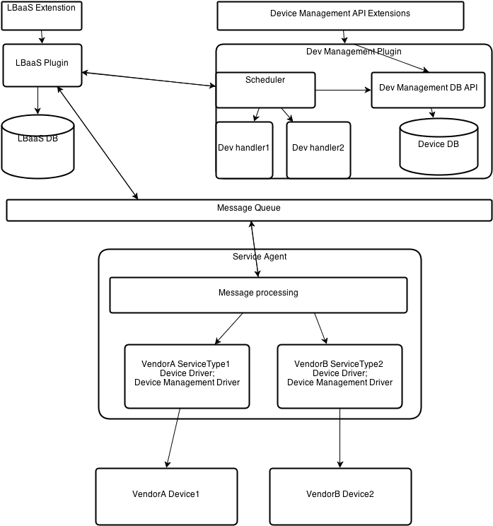
LBaaS Architecture
From file: neutron-lbaas/etc/neutron-lbaas.conf
46 [service_providers]
47 # Must be in form:
48 # service_provider=<service_type>:<name>:<driver>[:default]
…
53 service_provider= LOADBALANCER:Haproxy:neutron_lbaas.services.loadbalancer.drivers.haproxy.plugin_driver.HaproxyOnHostPluginDriver:default
From: https://wiki.openstack.org/wiki/Neutron/LBaaS/Architecture/Scheduler

Slide 14
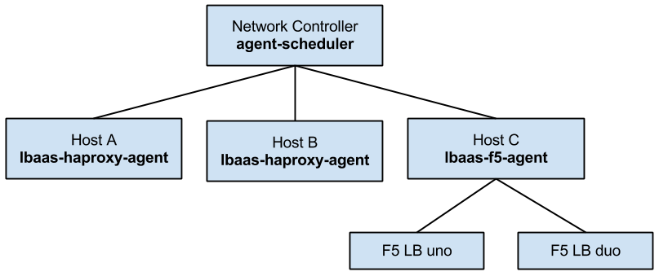
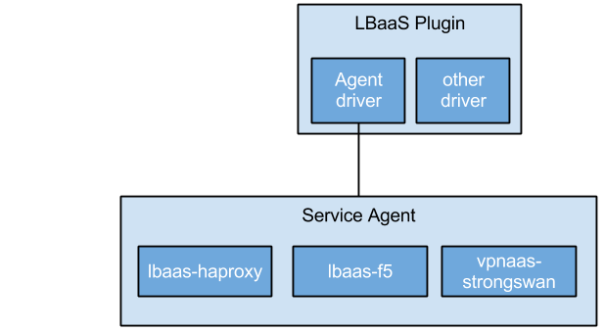
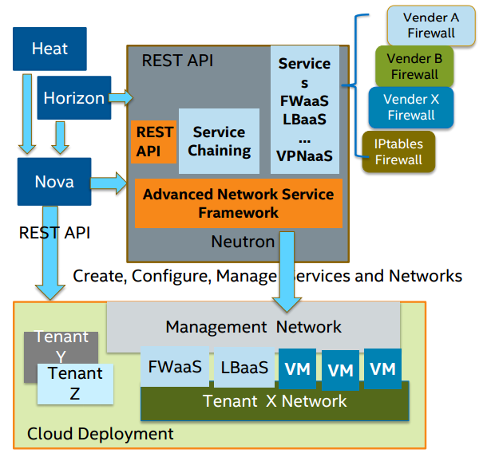
LBaaS Architecture - How it is called from Controller
This is the Plugin-Agent Architecture for advanced service:
From: https://wiki.openstack.org/wiki/Neutron/ServiceAgent
From: http://events.linuxfoundation.jp/sites/events/files/slides/advanced-network-sercie-framework-cloudopen-japan-published_0.pdf

Slide 15
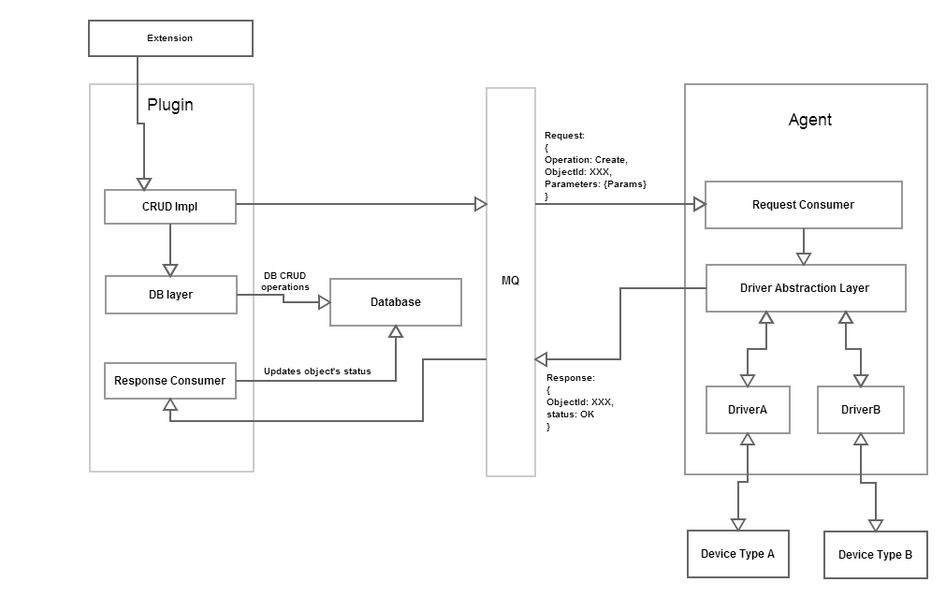
LBaaS Architecture
From: https://wiki.openstack.org/wiki/Neutron/LBaaS/Agent

Slide 16
Extension Initialization: LBaaS Example
extensions.py
WSGI Router
RequestExtension
router.py
ExtensionManager
APIRouter
Inherits wsgi.Router
ResourceExtension
PluginAwareExtensionManager
__init__()
cls._instance = cls(get_extensions_path(),
manager.NeutronManager.get_service_plugins())
ActionExtension
ext_mgr = extensions.PluginAwareExtensionManager.get_instance()
neutron/setup.cfg
neutron.service_plugins = neutron.services.loadbalancer.plugin.LoadBalancerPlugin = neutron_lbaas.services.loadbalancer.plugin:LoadBalancerPlugin
ExtensionManager.__load_all_extensions_from_path()
.add_extension()
neutron/neutron.conf
api_extensions_path=extension
RESOURCE_ATTRIBUTE_MAP = {
‘loadbalancers’: {
‘vip_address’: {},
...},
‘listeners’: {
...},
‘pool’: {
...},
‘healthmonitors’: {
...},
}
neutron-lbaas/neutron-lbaas/extensions/loadbalancerv2.py
LoadBalancerV2
LoadBalancerv2.get_resources()
base.create_resource(...)
resource.ResourceExtension(...)
{create,update,delete}_vip
{create,update,delete}_pool
{create,update,delete}_member
{create,update,delete}_pool_health_monitor
Resources are added for handling Neutron API calls
Neutron-lbaas/driver/ haproxy/plugin_driver.py
Neutron-lbaas/driver/common
AgentDriverBase
HaproxyOnHostPluginDriver

Slide 17
Extension/Advanced Services: Lbaas Agent API Handling
neutron-lbaas/setup.cfg
console_scripts = neutron-lbaas-agent = neutron_lbaas.services.loadbalancer.agent.agent:main neutron-lbaasv2-agent = neutron_lbaas.agent.agent:main
neutron-lbaas/agent/agent.py
neutron-lbaas/agent/agent_manager.py
neutron/agent/agent_rpc.py
def main():
...
mgr = manager.LbaasAgentManager(cfg.CONF)
svc = LbaasAgentService(
host=cfg.CONF.host,
topic=constants.LOADBALANCER_AGENTV2,
manager=mgr
PluginReportStateAPI
LbaasAgentManager
__init__()
Neutron-lbaas/agent/agent_api.py
LbaasAgentApi
neutron-lbaas/agent/agent.py
def __init__(self,conf):
...
self.plugin_rpc = agent_api.LbaasAgentApi(
lb_const.LOADBALANCER_PLUGINV2,
self.context,
self.conf.host
...
self._load_drivers()
self._setup_state_rpc()
LbaasAgentService(n_rpc.Service)
LbaasAgentService spawns a RPC instance of LbaasAgentManager, listening to WSGI Requests from Neutron Plugin
neutron-lbaas/agent/agent_manager.py
Agent -> Plugin API
- get_loadbalancer()
- loadbalancer_deployed()
- update_status()
- loadbalancer_destroyed()
- plug_vip_port()
- unplug_vip_port()
- update_loadbalancer_stats
.{create,update,delete}_loadbalancer -> driver.loadbalancer.{create,update,delete}()
.{create,update,delete}_listener -> driver.listener.{create,update,delete}()
.{create,update,delete}_pool -> driver.pool.{create,update,delete)
.{create,update,delete}_member -> driver.member.{create,update,delete}
.{create,update,delete}_healthmonitor -> driver.healthmonitor.{create,update,delete}
Notifications to Neutron Server
neutron-lbaas/setup.cfg
neutron-lbaas/driver/haproxy/namespace_driver.py
device_driver=
neutron.services.loadbalancer.drivers.haproxy.namespace_driver.HaproxyNSDriver =neutron_lbaas.services.loadbalancer.drivers.haproxy.namespace_driver:HaproxyNSDriver
HaproxyNSDriver(agent_device_driver.AgentDeviceDriver)

Slide 18
Extension/Advanced Services: HA Proxy Driver
LoadBalancerManager() {create/update/delete)
neutron-lbaas/driver/haproxy/namespace_driver.py
HaproxyNSDriver(agent_device_driver.AgentDeviceDriver)
ListenerManager() {create/update/delete)
deploy_instance() ← LbaasAgentManager.sync_state()
undeploy_instance()← LbaasAgentManager.sync_state()
get_stats() ← LbaasAgentManager.collect_stats()
<Other create/update/delete API have already been explained previously>
PoolManager() {create/update/delete)
MemberManager() {create/update/delete)
HealthMonitorManager() {create/update/delete)
neutron-lbaas/driver/haproxy/namespace_driver.py

Slide 19
Neutron: LBaaS
.
├── agent
│ ├── agent_api.py
│ ├── agent_device_driver.py
│ ├── agent_manager.py
│ ├── agent.py
│ └── __init__.py
├── agent_scheduler.py
├── common
│ ├── cert_manager
│ └── tls_utils
├── db
├── drivers
│ ├── common
│ │ ├── agent_callbacks.py
│ │ ├── agent_driver_base.py
│ │ └── __init__.py
│ ├── driver_base.py
│ ├── driver_mixins.py
│ ├── haproxy
│ │ ├── __init__.py
│ │ ├── namespace_driver.py
│ │ ├── plugin_driver.py
│ │ └── synchronous_namespace_driver.py
│ ├── __init__.py
│ └── logging_noop
│ ├── driver.py
│ └── __init__.py
├── extensions
│ ├── __init__.py
│ ├── lbaas_agentscheduler.py
│ ├── lbaas_agentschedulerv2.py
│ ├── loadbalancer.py
│ ├── loadbalancerv2.py
├── __init__.py
├── services
│ ├── __init__.py
│ └── loadbalancer
│ ├── agent
│ │ ├── agent_api.py
│ │ ├── agent_device_driver.py
│ │ ├── agent_manager.py
│ │ ├── agent.py
│ │ ├── __init__.py
│ ├── agent_scheduler.py
│ ├── constants.py
│ ├── data_models.py
│ ├── drivers
│ │ ├── a10networks
│ │ ├── abstract_driver.py
│ │ ├── common
│ │ │ ├── agent_driver_base.py
│ │ │ ├── __init__.py
│ │ ├── embrane
│ │ ├── haproxy
│ │ ├── __init__.py
│ │ ├── logging_noop
│ │ │ └── __init__.py
│ │ ├── netscaler
│ │ │ ├── __init__.py
│ │ │ ├── ncc_client.py
│ │ │ └── netscaler_driver.py
│ │ └── radware
│ ├── __init__.py
│ ├── plugin.py
└── version.py

Slide 20
Neutron: Common
./neutron/neutron/db/model_base.py
./neutron/neutron/common/rpc.py
def init()
def cleanup()
def add_extra_exmods()
def get_allowed_exmods()
def get_client()
def get_server()
def get_notifier()
class RequestContextSerializer()
def serialize_entity()
def deserialize_entity()
def serialize_context()
def deserialize_context()
class Service()
def start()
def stop()
class Connection():
def create_consumer()
def consume_in_threads()
def close()
NeutronBase(models.ModelBase)
*Base class for Neutron Models*
NeutronBaseV2(NeutronBase)
*Derived Version2 Base for Neutron*
Inherited by LoadBalancerAgentBinding

Slide 21
Neutron: LBaaS
./neutron/neutron/db/model_base.py
./agent_scheduler.py
from neutron.db import agents_db
from neutron.db import agentschedulers_db
from neutron.db import model_base
LoadbalancerAgentBinding(model.base.BASEV2)
*Represents binding between Neutron Loadbalancer and the Agents*
LbaasAgentSchedulerDbMixin(agentschedulers_db.AgentSchedulerDbMixin,lbaas_agentschedulerv2.LbaasAgentSchedulerPluginBase)
ChanceScheduler(object)
*Allocating a loadbalancer agent randomly for a single VIP*
./agent/agent.py
from neutron_lbaas.agent import agent_manager as manager
from neutron_lbaas.services.loadbalancer import constants
class LbaasAgentService(n_rpc.Service)
*RPC service Agent for listening to API requests*
Service Launched from here
mgr = manager.LbaasAgentManager(cfg.CONF)
svc = LbaasAgentService(
host=cfg.CONF.host,
topic=constants.LOADBALANCER_AGENTV2,
manager=mgr
)
service.launch(svc).wait()
main()
*Entry point for LBaaS Agent*
./neutron_lbaas/agent/agent_manager.py
from neutron_lbaas.agent import agent_api
class LbaasAgentManager(periodic_task.PeriodicTasks):
__init__()
Initialized
./agent/agent_api.py
from neutron.common import rpc as n_rpc
get_ready_devices
get_loadbalancer
loadbalancer_deployed
update_status
loadbalancer_destroyed
plug_vip_port
unplug_vip_port
update_loadbalancer_stats

Slide 22
LBaaS
From setup.cfg in openstack base:
lbaas = neutron_lbaas.services.loadbalancer.plugin:LoadBalancerPlugin
vpnaas = neutron_vpnaas.services.vpn.plugin:VPNDriverPlugin
metering = neutron.services.metering.metering_plugin:MeteringPlugin
neutron.services.firewall.fwaas_plugin.FirewallPlugin = neutron_fwaas.services.firewall.fwaas_plugin:FirewallPlugin
neutron.services.loadbalancer.plugin.LoadBalancerPlugin = neutron_lbaas.services.loadbalancer.plugin:LoadBalancerPlugin
neutron.services.vpn.plugin.VPNDriverPlugin = neutron_vpnaas.services.vpn.plugin:VPNDriverPlugin
services/loadbalancer/plugin.py
from neutron_lbaas import agent_scheduler as agent_scheduler_v2
from neutron_lbaas.db.loadbalancer import loadbalancer_db as ldb
from neutron_lbaas.db.loadbalancer import models
from neutron_lbaas.extensions import lbaas_agentschedulerv2
from neutron_lbaas.extensions import loadbalancer as lb_ext
from neutron_lbaas.extensions import loadbalancerv2
from neutron_lbaas.services.loadbalancer import agent_scheduler
…
class LoadBalancerPlugin(ldb.LoadBalancerPluginDb,
agent_scheduler.LbaasAgentSchedulerDbMixin):
./neutron_lbaas/db/loadbalancer/loadbalancer_db.py
- class SessionPersistence(model_base.BASEV2):
- class SessionPersistence(model_base.BASEV2):
- class Vip(...)
- class Member(...)
- class Pool(...)
- class HealthMonitor(...)
- class PoolMonitorAssociation(...)
- class LoadBalancerPluginDb (loadbalancer.LoadBalancerPluginBase,base_db.CommonDbMixin)
- def update_status
- CRUD VIP
- CRUD Pool
- CRUD Pool Health Monitor
- CRUD Member
- CRUD Member Health Monitor
This is where Neutron knows about the advanced services available.
on Next Slide
From neutron.conf
using python-neutronclient Neutron API Library
# (ListOpt) List of service plugin entrypoints to be loaded from the
# neutron.service_plugins namespace. See setup.cfg for the
# entrypoint names of the plugins included in the neutron source
# distribution. For compatibility with previous versions, the class
# name of a plugin can be specified instead of its entrypoint name.
#
# service_plugins =
# Example: service_plugins = router,firewall,lbaas,vpnaas,metering
service_plugins = neutron.services.l3_router.l3_router_plugin.L3RouterPlugin,neutron_lbaas.services.loadbalancer.plugin.LoadBalancerPlugin,neutron_vpnaas.services.vpn.plugin.VPNDriverPlugin,neutron_fwaas.services.firewall.fwaas_plugin.FirewallPlugin
From: horizon/openstack_dashboard/api/lbaas.py
After parsing a HTTP request:
def vip_create():
...
vip = neutronclient(request).create_vip(body).get('vip')
return Vip(vip)
create_pool() → create_member() → create_vip()

Slide 23
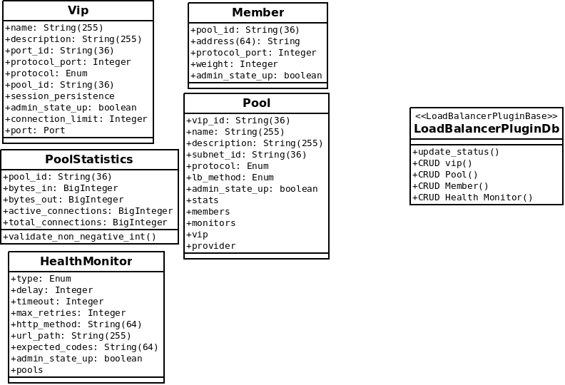
LBaaS: LoadBalancerPluginDb

Slide 24
Entering into LBaaS
In the file horizon/openstack_dashboard/api/lbaas.py following are defined:
class Vip
class Member
class Pool
class PoolStats
class PoolMonitor
Various functions to create the LBaaS resources like
def vip
def member
def pool
...
These functions are called when Dashboard events are initiated with user action. These functions in turn use the python-neutronclient API library (installed along with other Python Libraries) to access the resources within Neutron.
So, Call from Dashboard would hit the above functions, from where it would be routed to neutronclient library, from where, after handling the HTTP, calls would be routed to Neutron plugin for lbaas based on neutron.conf configuration.
<Pending - routing from Neutron to Neutron-lbaas for each unit function. At present, it can be seen how neutron-lbaas is defined as plugin, but wrappers for neutron to neutron-lbaas are missing>

Slide 25
LBaaS: Code dependency
In Folder neutron-lbaas
├── agent/
├── agent_scheduler.py
├── common/
├── db/
├── drivers/
├── extensions/
├── __init__.py
├── __init__.pyc
├── services/
├── tests/
└── version.py
agent/
├── agent_api.py
├── agent_device_driver.py
├── agent_manager.py
├── agent.py
└── __init__.py
Just an abstract class
services/loadbalancer/agent
├── agent_api.py
├── agent_device_driver.py
├── agent_manager.py
├── agent.py
├── __init__.py
db/
├── __init__.py
├── loadbalancer/
│ ├── __init__.py
│ ├── loadbalancer_db.py
│ ├── loadbalancer_dbv2.py
│ ├── models.py
services/loadbalancer/drivers/common/
├── agent_driver_base.py
├── __init__.py
drivers/
├── a10networks/
│ ├── driver_v2.py
├── common/
│ ├── agent_callbacks.py
│ ├── agent_driver_base.py
├── driver_base.py
├── driver_mixins.py
├── haproxy/
│ ├── namespace_driver.py
│ ├── plugin_driver.py
│ └── synchronous_namespace_driver.py
services/
├── __init__.py
└── loadbalancer/
├── agent/
├── agent_scheduler.py
├── constants.py
├── data_models.py
├── drivers/
├── __init__.py
├── plugin.py
extensions/
├── __init__.py
├── lbaas_agentscheduler.py
├── lbaas_agentschedulerv2.py
├── loadbalancer.py
├── loadbalancerv2.py

Slide 26
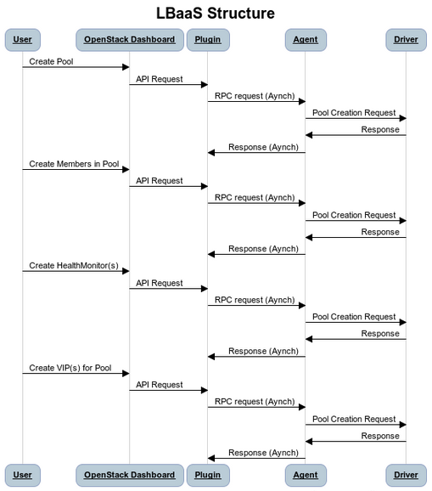
How LBaaS is Deployed
From: https://wiki.openstack.org/wiki/Neutron/LBaaS/Architecture/Scheduler

Slide 27
References

Slide 28
References
Neutron Hacking: https://github.com/openstack/neutron/blob/master/HACKING.rst
Starting point for Neutron code study: https://wiki.openstack.org/wiki/NeutronDevelopment
Neutron API Documentation: http://docs.openstack.org/api/openstack-network/2.0/content/index.html
Neutron Architecture details: https://onedrive.live.com/view.aspx?resid=8F95A76243630FB1!127&app=PowerPoint&authkey=!AK0Y3KWzD6o3WVI
Slide 19 of 32 from http://goo.gl/Vzni6E contains details about LBaaS
LBaaS: From API Documentation: http://docs.openstack.org/admin-guide-cloud/content/section_lbaas-overview.html
Neutron Service Types: https://wiki.openstack.org/wiki/Neutron/ServiceTypeFramework
Neutron Deep Dive: https://www.openstack.org/assets/presentation-media/ML2-Past-Present-and-Future.pptx
Neutron Developer Guide: http://docs.openstack.org/developer/neutron/devref/index.html
Deep Dive into Neutron (Excellent Code reference): http://www.slideshare.net/gongys2004/inside-neutron-2
LBaaS related
OpenStack Wiki Page for LBaaS: https://wiki.openstack.org/wiki/Neutron/LBaaS
LBaaS Architecture: https://wiki.openstack.org/wiki/Neutron/LBaaS/Architecture/Scheduler
Requirements, which also helps understand the architectural components: https://wiki.openstack.org/wiki/Neutron/LBaaS/requirements
Service Agent Architecture: https://wiki.openstack.org/wiki/Neutron/ServiceAgent
LBaaS Agent Architecture: https://wiki.openstack.org/wiki/Neutron/LBaaS/Agent
Lbaas Agent: https://wiki.openstack.org/wiki/Neutron/LBaaS/Architecture
Service Insertion Framework
Service Insertion Framework for L4-L7 Services in Neutron: https://wiki.openstack.org/wiki/Neutron/ServiceInsertion

