Slide 1
Earthquake Damage Mapping and overall assessment of ground surveys and VHR Image
change detection after L’Aquila 2009 Earthquake
AISHWARYA KOTHARU

Slide 2
INDEX
Abstract
Objective
Scope
Existing System
Proposed System
Algorithm used
Modules
Designing
Results
Testing
Conclusion
Future Enhancements
References

Slide 3
ABSTRACT
Earth Observation (EO) data are used to map mostly affected urban areas after an earthquake generally exploiting change detection techniques applied at pixel scale.
However, Civil Protection Services require damage assessment of each building according to a well-established scale to manage rescue operations and to estimate the economic losses.
The proposed approach relies on a pre-existing urban map to identify image objects corresponding to building footprints.

Slide 4
The image analysis is carried out according to many different parameters with the objective of assessing their effectiveness in singling out changes associated to the building collapse.
Features describing edge and colour changes, as well statistical similarity were included in our analysis.
Supervised classification approaches namely SVM and Random forest were compared.

Slide 5
OBJECTIVE:
Preparedness
Humanitarian Action
Response
Recovery

Slide 6
SCOPE:
Can’t reduce the occurrence of disasters but proper care and safety measures an be taken accordingly depending on the situation.
Always earthquake reading cant be considered as a measure ,the analysis must be done from ground level.
The government White paper and Act on Disaster Management define the roles of Local Authorities after evaluating the cost of damages and analysis made on severity of damage and assign the roles accordingly .
These are trained individuals, and are given extensive training to perform in the event of a disaster or a natural calamity depending on the percentage of damaged.

Slide 7
EXISTING SYSTEM:
Support Vector Machine has only 2 classes.
Edge enhancement
Edge based image segmentation
damage assessment
DISADVANTAGES:
Accuracy is less
Supports at maximum 2 classes

Slide 8
PROPOSED SYSTEM:
Edge enhancement
Edge based image segmentation
GLCM Feature extraction
Random forest based feature classification .
damage assessment (No Damage, Medium, Extensive damage)

Slide 9
Advantages:
Support more than 2 classes.
Better accuracy results.
Leads to make better prediction.
Better assessment.
Obtain different scales of damages.

Slide 10
RANDOM FOREST:
supervised learning algorithm
Random forest builds multiple decision trees and merges them together to get a more accurate and stable prediction.
advantage of random forest is, that it can be used for both classification and regression problems
Random Forest is a collection of Decision Trees
the Random Forest algorithm randomly selects observations and features to build several decision trees and then averages the results.

Slide 11
HARDWARE REQUIREMENTS:
-> RAM : 4GB and Higher
-> Processor : Intel i3
-> Hard Disk : 500GB
SOFTWARE REQUIREMENTS:
->Operating system : Windows 7,10
->Coding language : MATLAB
->Tool : MATLAB R2018a

Slide 12
MODULES
Input Images (Pre and Post)
Edge enhancement
Edge based image segmentation
GLCM Feature extraction
Random forest based feature classification
damage assessment (No Damage, Medium, Extensive damage)

Slide 13
1. Data set:
Collecting different type of data set of area images before and after earthquake.
2. Edge enhancement:
Sharpening the image using the required filters.
3. Edge based image segmentation:
Segmentation technique, this divides the image into smaller regions.
4. GLCM feature extraction:
Extracting the features of the images with different types of parameters.
5. Random forest based feature classification:
This algorithm is a group of decision trees, takes a average and can deal with more than 2 classes.
6. damage assessment :
Better accuracy can be obtained by the RF algorithm ,highly affected ,moderately affected and unaffected areas

Slide 14
DESIGN
INPUT HIGH RESOLUTION SATELLITE IMAGE
NOISE ELIMINATION
EDGE DETECTION
(HIGH AND LOW LEVEL)
MATCHING THE FEATURE VECTORS
FEATURE VECTOR EXTRACTION
BLOCK DIVISION
DISASTER ASSESMENT

Slide 15
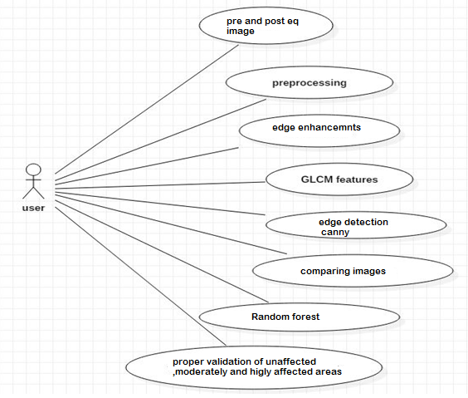
Use case Diagram:

Slide 16
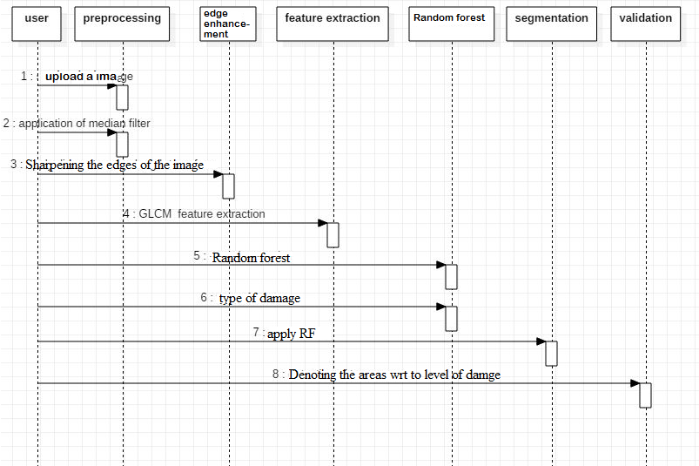
Sequence Diagram:

Slide 17
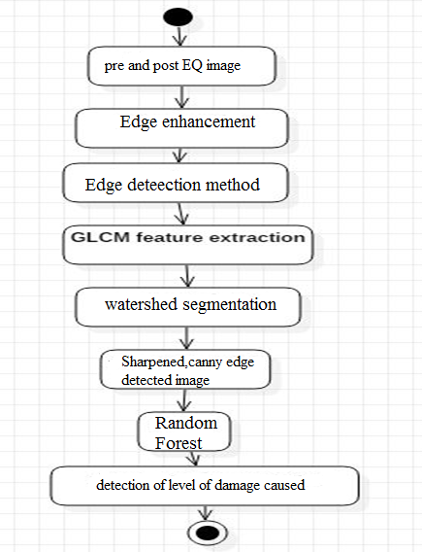
Activity Diagram:

Slide 18
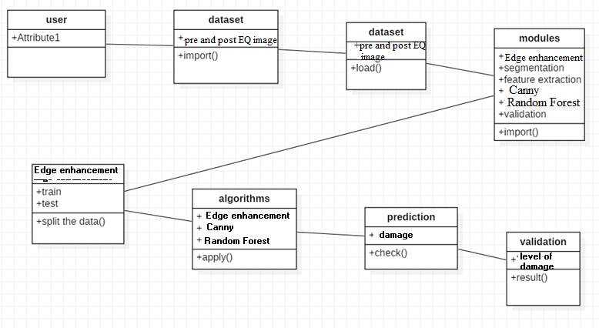
Class Diagram:

Slide 19
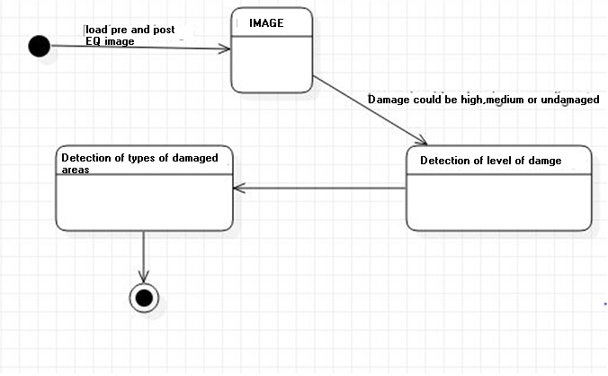
State-Chart Diagram:

Slide 20
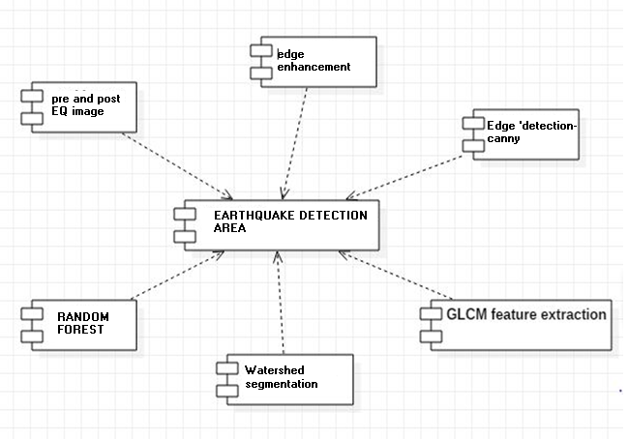
Component Diagram:

Slide 21
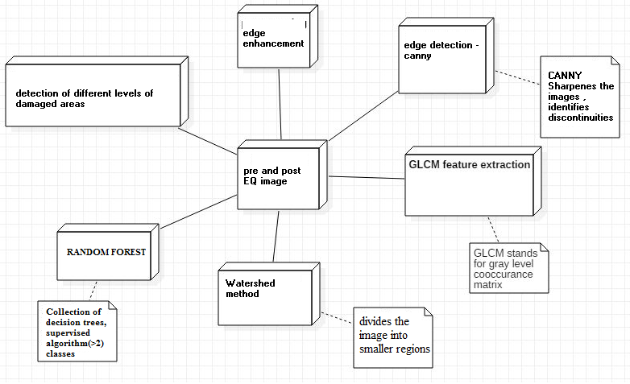
Deployment Diagram:

Slide 22
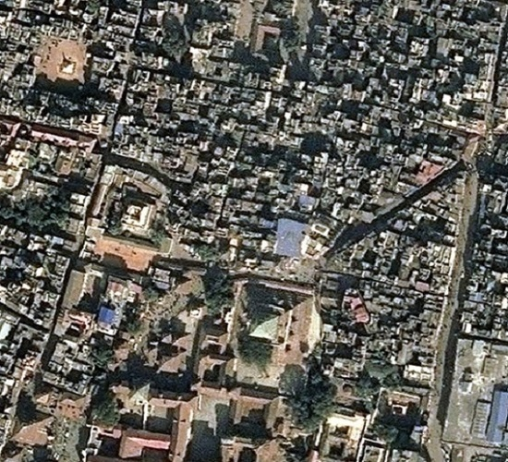
RESULTS:
Fig: Pre disaster image

Slide 23
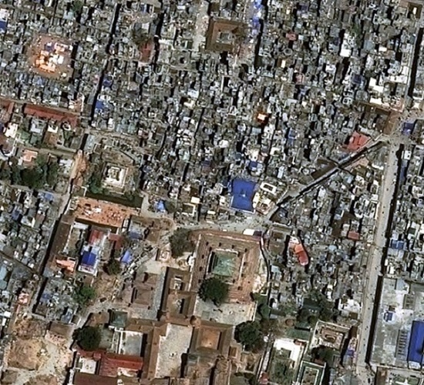
Fig: Post disaster image

Slide 24
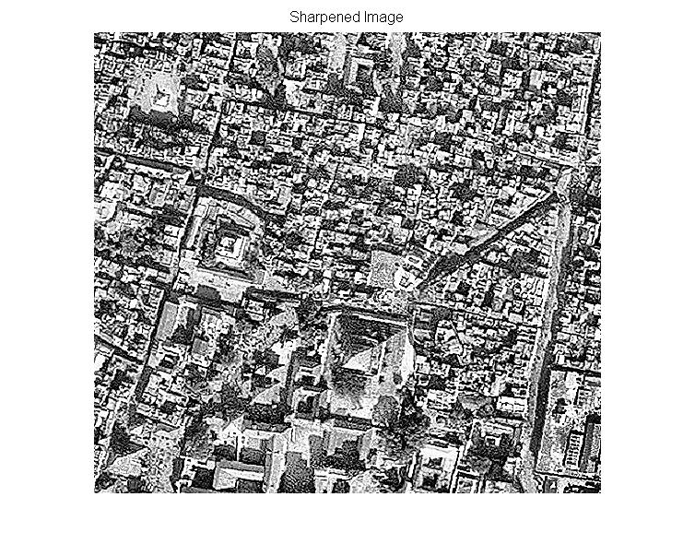
Fig: Sharpened image pre disaster

Slide 25
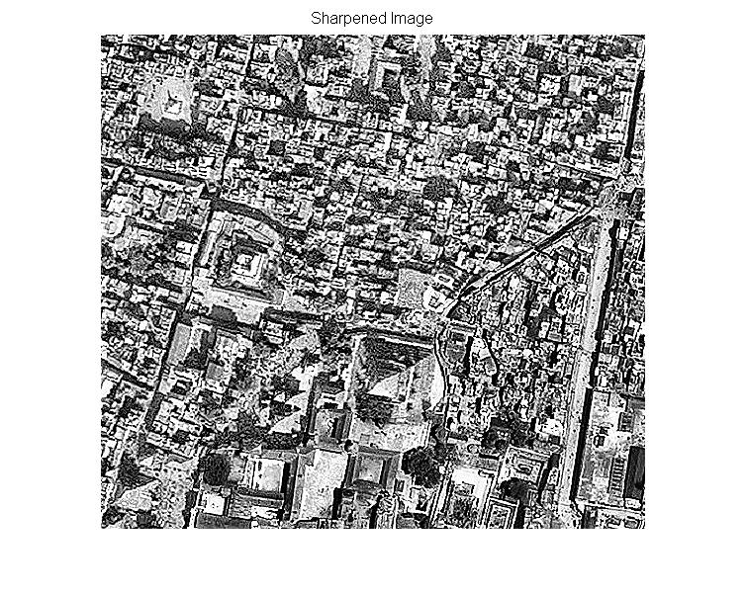
Fig: Sharpened image post disaster

Slide 26
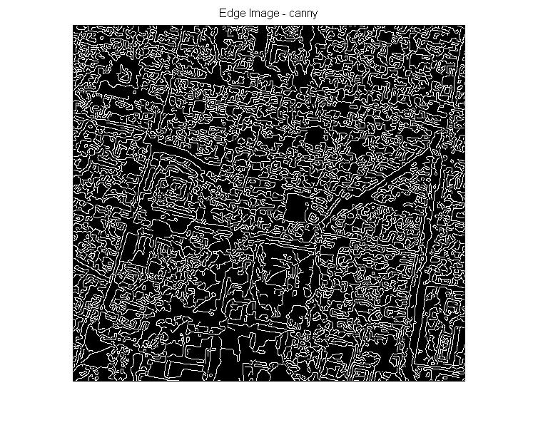
Fig: Canny edge detection output pre disaster

Slide 27
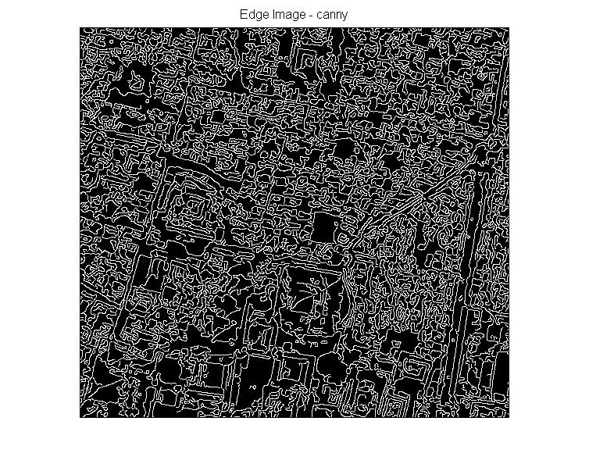
Fig: Canny edge detection post disaster

Slide 28
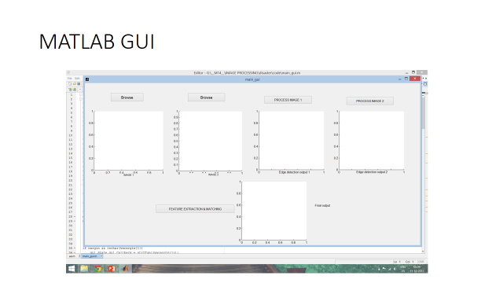

Slide 29
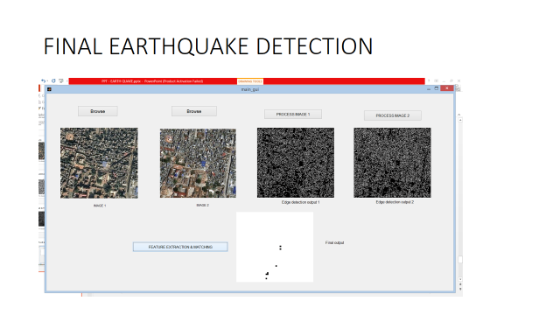

Slide 30
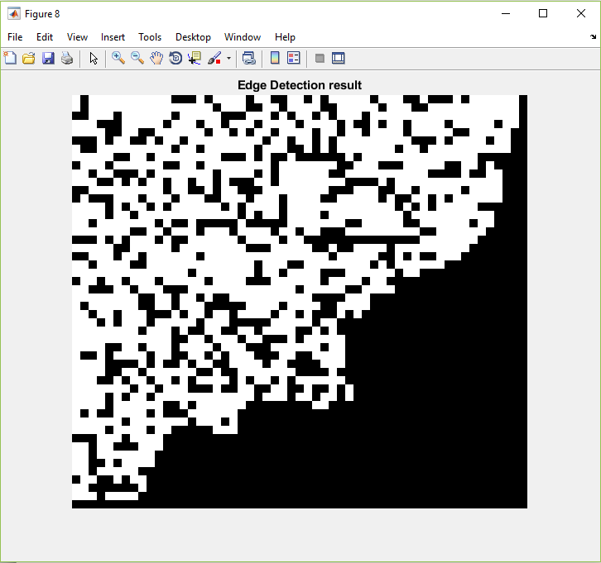
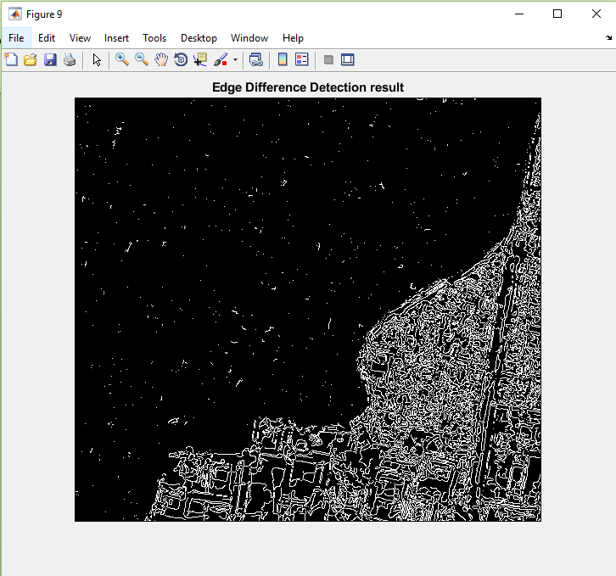
Edge Detection results
Edge Difference Detection results

Slide 31
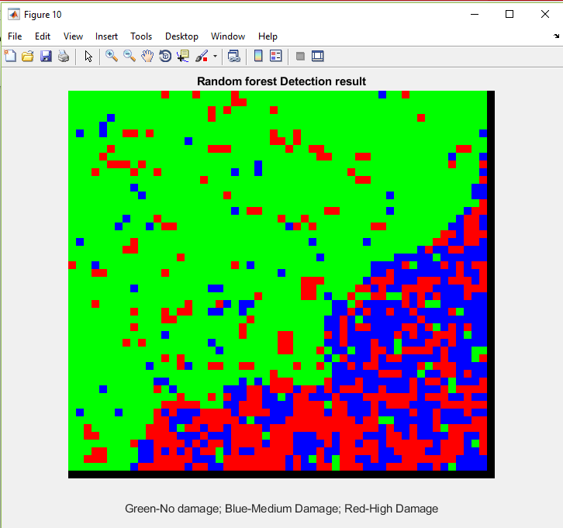
High damage
Medium damage
No damage
Random forest Detection Result

Slide 32
Testing
PUROSE :discover errors
TEST OBJECTIVES :
All field entries must work properly.
Affected and unaffected areas must be accurately identified from the given satellite images.
FEATURES TO BE TESTED:
Verify that the images are of the correct format.
Giving different images should be allowed.
All given images should take evaluated accordingly producing accurate results.

Slide 33
TEST CASES:
S No TEST CASE DESCRIPTION ACTUAL VALUE EXPECTED VALUE RESULT
Uploading PNG file File open Data set True
displayed
Giving same image with shadows properly classify Classifies exactly True
areas accordingly as per given
S No TEST CASE DESCRIPTION ACTUAL VALUE EXPECTED VALUE RESULT
1 different areas images error message shows entire area as False
damaged/affected

Slide 34
TEST CASE ID | INPUT | TEST CASE DESCRIPTION | EXPECTED RESULT | ACTUAL RESULT | REMARK
1 | png, jpeg image | Loading of a satellite image | The image must be loaded | The image is loaded successfully | success
2 | Edge enhancement | Edges of the image need to be sharpened | Sharpened image must be displayed | Sharpened image is displayed | success
3 | Edge detection | Edge detection identifying and locating sharp discontinuities in an image | Must display a canny edge detected image | Must display a canny edge detected image | success

Slide 35
5 | segmentation | The image is segmented into into smaller regions | Must identify discontinuities and sharpen and divide | Must identify discontunities and sharpen and divide | success
6 | Display appropriate damaged image | Enable us to find out the undamaged area | The area which is unaffected can be identified from displayed image | The area which is unaffected can be identified from displayed Image. | success
7 | Result analysis | A image representing undamaged, Moderately & highly damaged by different colors | A image displaying all the levels of damages. | A image displaying all the levels of damages. | success

Slide 36
CONCLUSION:
In this paper, we have presented a novel damage assessment method for single (isolated) rectangular buildings using prevent and post-event images.
The method is tuned to work at the individual building level and determines whether a building is completely destroyed (collapsed) after a catastrophic event or whether it is still standing.
This information is combined with the acquisition parameters of the actual post-event data to simulate the signature of the undamaged building.

Slide 37
vThe predicted signature is compared quantitatively to the actual scene.
The low level canny edge detection and feature extraction has produced better results than the existing algorithms.

Slide 38
FUTURE ENHANCEMENTS
As the natural disasters like earthquake can’t be prevented all we can do is to take the appropriate remedies ,in order to reduce the damage caused.
If we adopt this pattern proper remedies can be taken accordingly and be prepared .
Percentage of damaged cost can be reduced .
More further classification can be done accordingly ,for better accuracy results to be obtained .
Extremely important to get 100% accurate results else severe consequences need to be faced by humans.

Slide 39
References
Earthquake damage mapping -R. Anniballe, F. Noto, T. Scalia, C. Bignami, S. Stramondo, M. Chini, and N. Pierdicca Remote Sensing of Environment, vol. 210, pp. 166-178, 2018.
B. McGuire, I. Mason, and C. Killburn, Natural Hazards and Environmental Change (Key Issues in Environmental Change). London, U.K.:Arnold, 2002.
D. Brunner, G. Lemoine, F.-X. Thoorens, and L. Bruzzone, “Distributed geospatial data processing functionality to support collaborative and rapid emergency response,” IEEE J. Sel. Topics Appl. Earth Obs. Remote Sens.,vol. 2, no. 1, pp. 33–46, Mar. 2009.

