Slide 1
Stakeholder Report
Five Business Insights | January 2024 – December 2025
Purpose: turn sales data into clear business findings and actions.
Dataset: 288 synthetic monthly records across 4 regions and 3 product categories.
Audience: business stakeholders and decision-makers.

Slide 2
Executive KPI Snapshot
Illustrative values calculated from the sample dataset
Total sales: 15,151,845
Total profit: 3,123,171
Total orders: 27,271
Average order value: 555.60

Slide 3
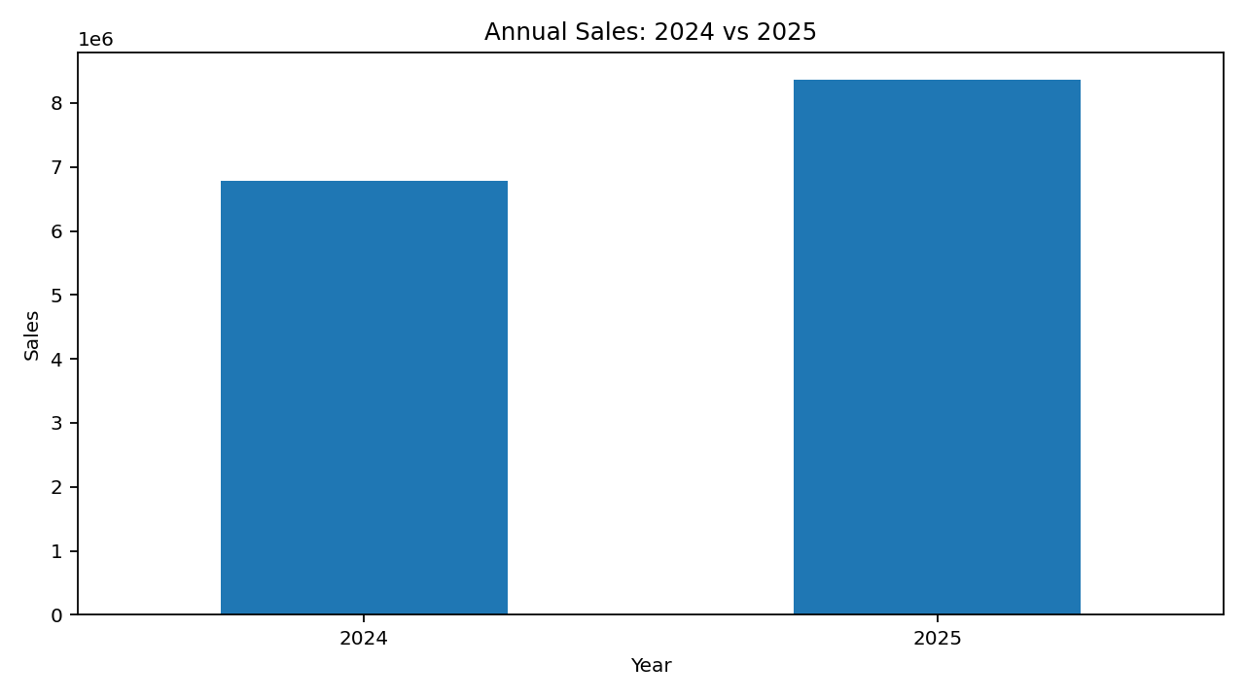
Insight 1 — Sales Growth
2025 sales increased 23.4% compared with 2024.
Business meaning: the sample shows positive year-over-year growth of 23.4%. Action: validate the trend with actual data and align inventory and capacity plans.

Slide 4
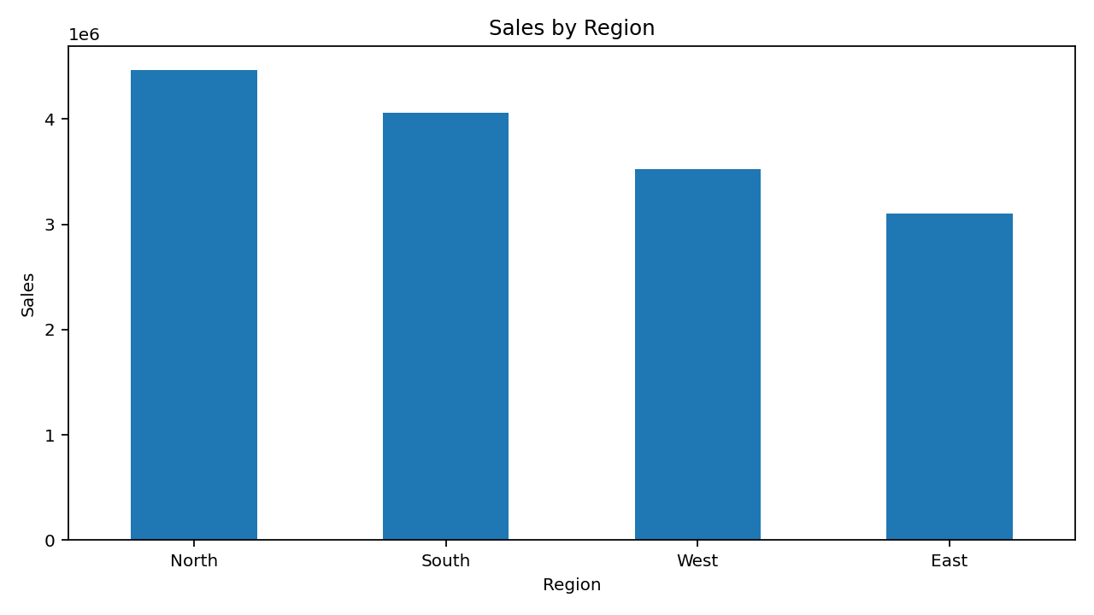
Insight 2 — Regional Leader
North contributes the largest regional sales share.
North contributes 29.5% of total sales. Action: protect service levels in this region and identify practices that can be replicated elsewhere.

Slide 5
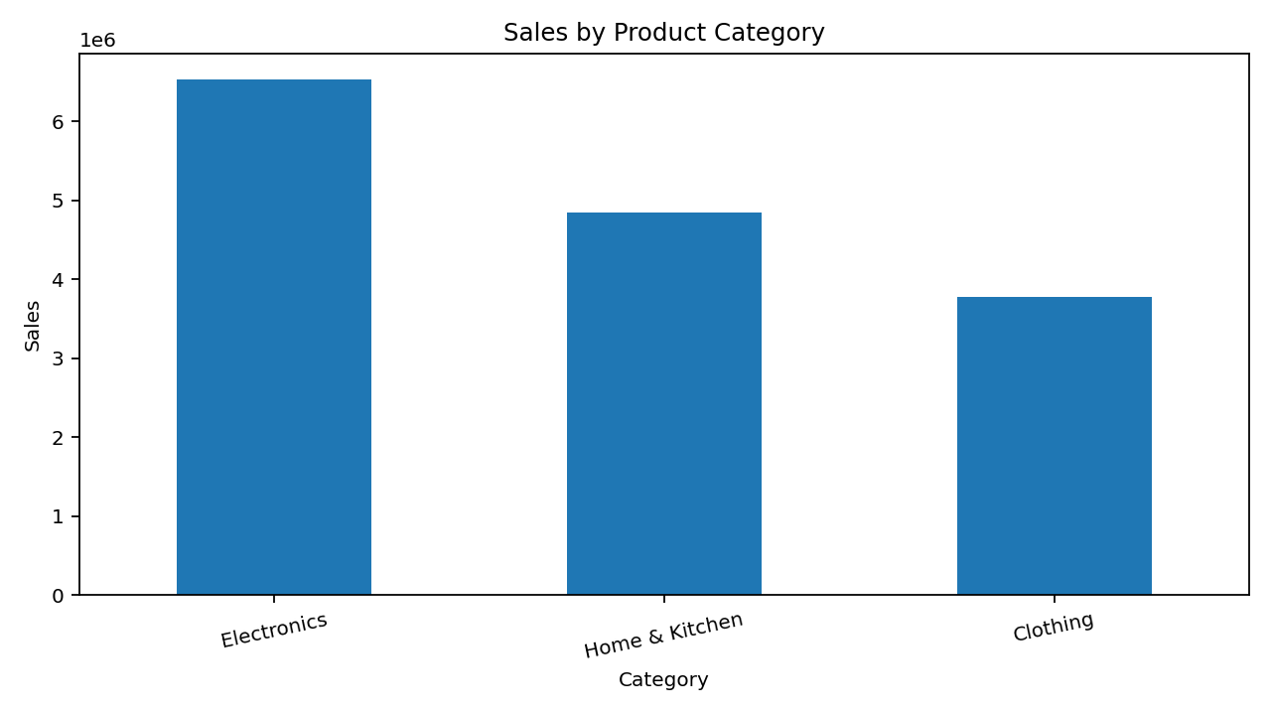
Insight 3 — Category Mix
Electronics is the largest product category.
Electronics contributes 43.1% of sales. Action: maintain availability and evaluate profit margin before expanding promotions.

Slide 6
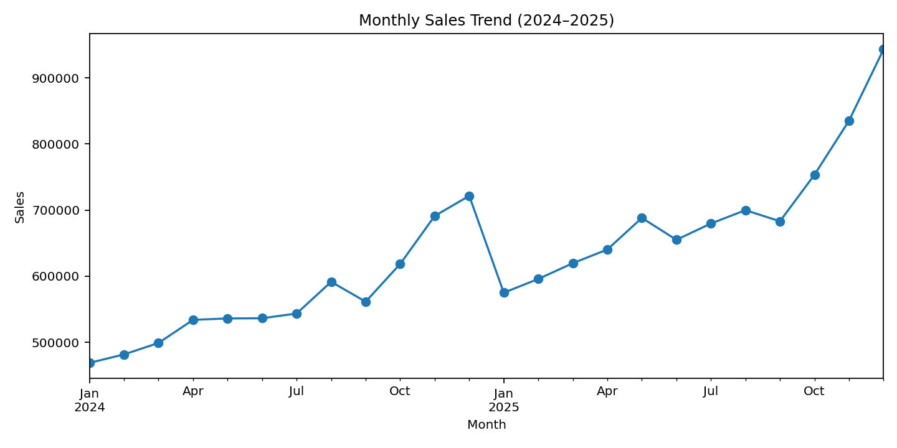
Insight 4 — Seasonality
Fourth-quarter sales are an important part of the annual cycle.
October–December represent 30.1% of total sales in this sample. Action: prepare stock, staffing, and campaigns ahead of Q4.

Slide 7
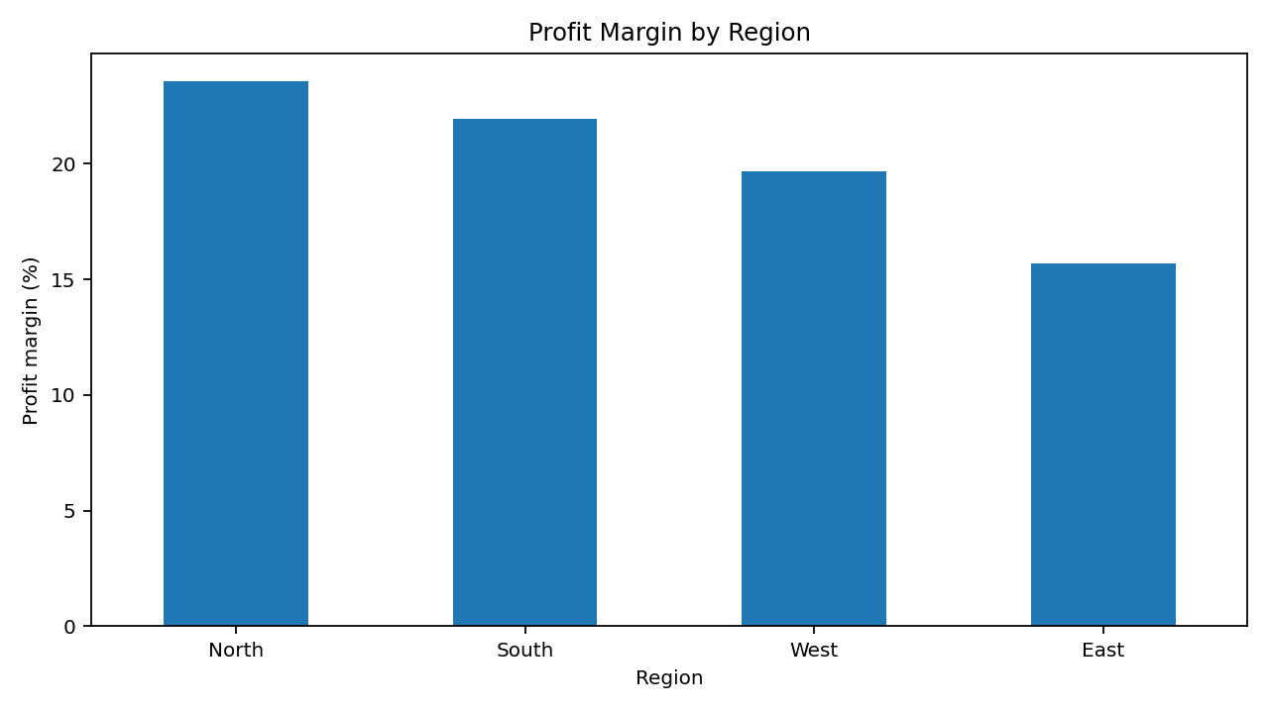
Insight 5 — Profitability Gap
East has the lowest regional profit margin.
East margin is 15.7%, the lowest region. Action: investigate discounts, product mix, delivery costs, and acquisition cost.

Slide 8
Recommendations & Next Steps
Validate all five insights with actual company data before decisions.
Investigate East-region margin drivers at product and channel level.
Plan inventory and staffing ahead of the fourth-quarter peak.
Assign owners and review KPI movement in the next reporting cycle.
Data note: all figures in this presentation are synthetic and illustrative.

