Slide 1
PROJECT FORESIGHT
Demand & Inventory Intelligence
Executive Readout
SKU-level demand forecasting
Lead-time risk scoring and four-quadrant decisioning
Streamlit operations dashboard and scoring service

Slide 2
Business problem & objective
Turn sales + inventory extracts into decisions the operations team can act on.
NorthBay needs weekly SKU demand forecasts and early-warning signals for stockouts and excess inventory.
The system converts predictions into REORDER, MARKDOWN/CLEAR, WATCH or HEALTHY decisions.
Rupee exposure is attached to the decision so teams can prioritize work.
SKUs
50
Forecast horizon
13 weeks
Weekly records
650
Project FORESIGHT • 2

Slide 3
Data foundation
Reproducible raw-to-weekly pipeline with explicit quality checks.
Raw extracts
Sales • SKU master • Calendar • Inventory
Validation
Missing values • duplicates • formula checks • date coverage
Weekly grain
SKU-week aggregation + promotion days
Inventory mapping
Latest known snapshot on/before week start
Output
analysis_ready_weekly.csv
Project FORESIGHT • 3

Slide 4
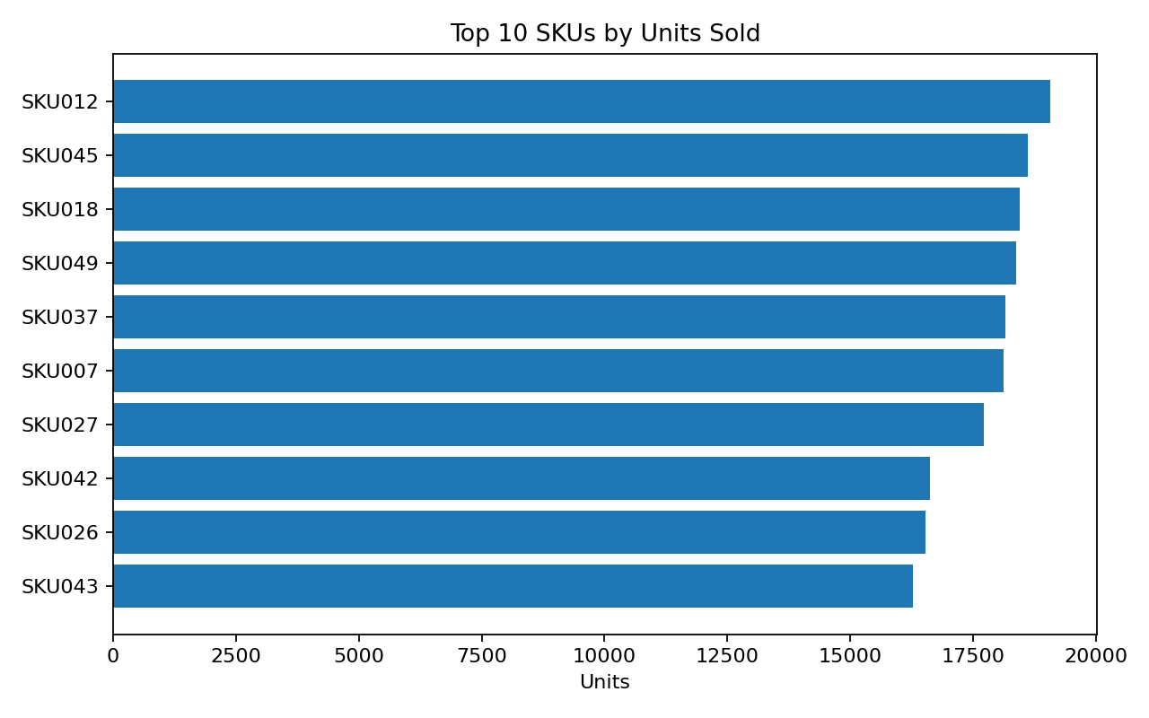
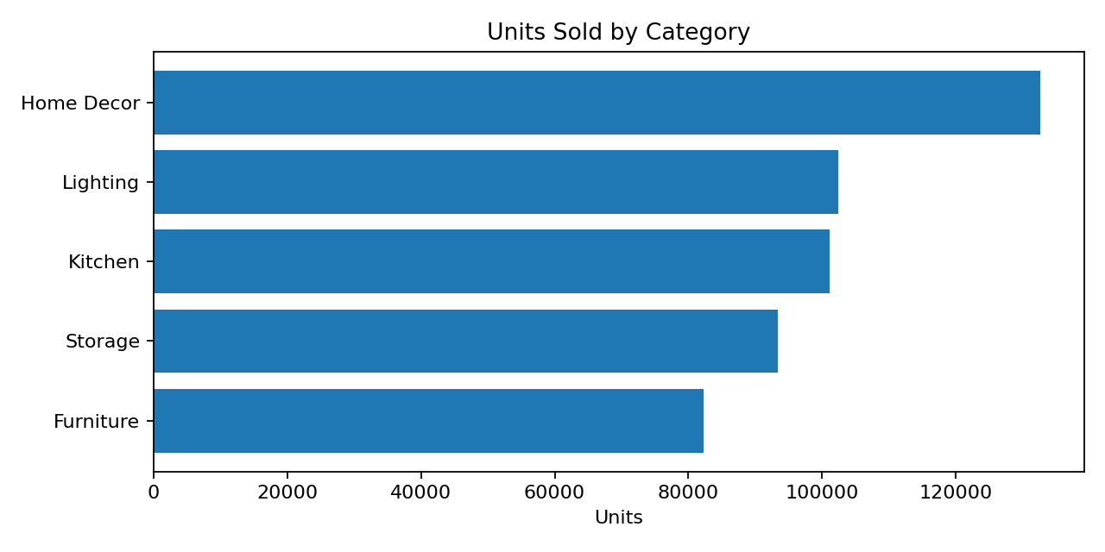
EDA highlights
Patterns surfaced before modelling.
SKU012 is the top unit seller; SKU026 is the top revenue SKU. Home Decor leads category demand.
Project FORESIGHT • 4

Slide 5
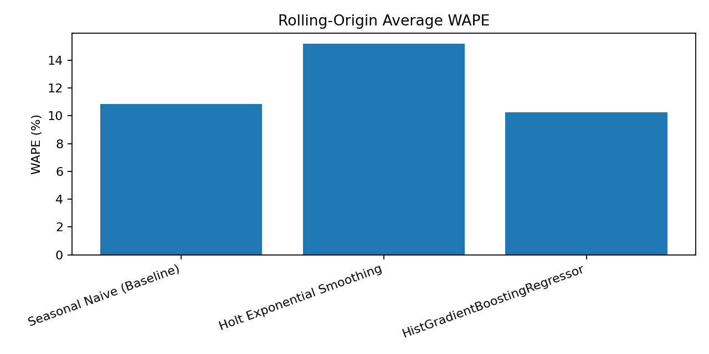
Forecasting: baseline → model → backtest
Four rolling-origin 13-week folds; WAPE is the primary accuracy metric.
Method
Single holdout WAPE
Rolling avg WAPE
Seasonal Naive (Baseline)
11.62%
10.84%
Holt Exponential Smoothing
10.56%
15.19%
HistGradientBoostingRegressor
8.96%
10.24%
Final selected model: HistGradientBoostingRegressor.
Rolling-origin WAPE improves from 10.84% (Seasonal Naive) to 10.24% — about 5.6% relative improvement.
Holt performed better on the single holdout but worse on the four-fold rolling backtest.
Project FORESIGHT • 5

Slide 6
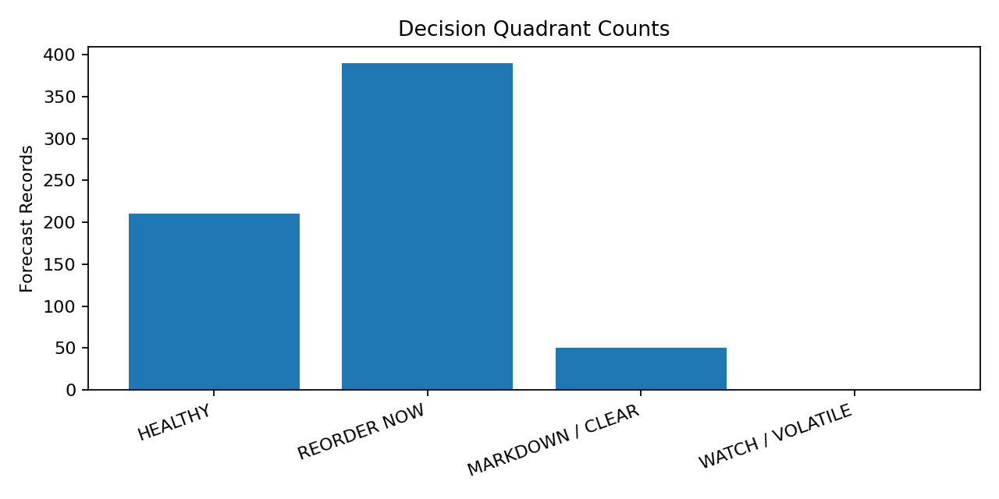
Risk scoring & decisioning
Lead-time demand + progressive inventory position → transparent actions.
High stockout risk
390
High overstock risk
50
REORDER
390
MARKDOWN
50
Decisioning uses the brief’s four quadrants: REORDER NOW, MARKDOWN/CLEAR, WATCH/VOLATILE, HEALTHY.
Project FORESIGHT • 6

Slide 7
Financial exposure
Model-based exposure estimates to help prioritize inventory actions.
Potential lost-sales value
₹312.9M
Potential overstock inventory value
₹38.1M
Estimated reorder value
₹981.5M
These are estimated planning exposures, not realized losses.
Use the dashboard to focus planners on the highest-value reorder and clearance candidates.
Project FORESIGHT • 7

Slide 8
Productization & next steps
From notebook output to a reusable decision-support product.
Streamlit dashboard: filters, forecast view, decision grid, prioritized actions and CSV export.
Optional FastAPI scoring endpoint: /health and /score/{sku}.
README, notebooks, scripts, reports and requirements are packaged for reproducibility.
Deployment and smoke-testing remain environment/account steps outside the local artifact build.
D1 Data • READY
D2 EDA • READY
D3 Forecast • READY
D4 Risk • READY
D5 Dashboard • READY
D6 Deploy • NEXT
D7 Readout • READY
Project FORESIGHT • 8

