Slide 1

GURU NANAK INSTITUTIONS TECHNICAL CAMPUS (AUTONOMOUS) School of Engineering and Technology Ibrahimpatnam, R.R District 501506, 2020-2021 A MACHINE LEARNING METHODOLOGY FOR DIAGNOSING CHRONIC KIDNEY DISEASE
Under the Guidance of
Mr. V. Deva Sekhar
Associate Professor,
HOD of CSE, GNITC
PATI AISHWARYA SRI (17WJ1A05N0)
NEERUDU RODHI (17WJ1A05L6)
PUSHPARAJ YADAV (17WJ1A05P3)

Slide 2

GURU NANAK INSTITUTIONS TECHNICAL CAMPUS ABSTRACT
Chronic kidney disease (CKD) is a global health problem with high morbidity and mortality rate, and it induces other diseases. Since there are no obvious symptoms during the early stages of CKD, patients often fail to notice the disease.
Early detection of CKD enables patients to receive timely treatment to ameliorate the progression of this disease. Machine learning models can effectively aid clinicians achieve this goal due to their fast and accurate recognition performance.
KNN imputation was used to fill in the missing values, which selects several complete samples with the most similar measurements to process the missing data for each incomplete sample.
After effectively filling out the incomplete data set, five machine learning algorithms (logistic regression, random forest, support vector machine, k-nearest neighbor, naive Bayes classifier ) were used to establish models.
Among these machine learning models, random forest achieved the best performance with 99.75% diagnosis accuracy.
By analyzing the misjudgments generated by the established models, we proposed an integrated model that combines logistic regression and random forest by using perceptron, which could achieve an average accuracy of 99.83% after ten times of simulation.

Slide 3
GURU NANAK INSTITUTIONS TECHNICAL CAMPUS EXISTING SYSTEM
Hodneland et al. utilized image registration to detect renal morphologic changes.
Vasquez-Morales et al. established a classifier based on neural network using large-scale CKD data, and the accuracy of the model on their test data was 95%.
In addition, most of the previous studies utilized the CKD data set that was obtained from the UCI machine learning repository.
Chen et al. used k-nearest neighbor (KNN), support vector machine (SVM) and soft independent modeling of class analogy to diagnose CKD, KNN and SVM achieved the highest accuracy of 98.7%.
In addition, they used fuzzy rule-building expert system, fuzzy optimal associative memory and partial least squares discriminant analysis to diagnose CKD, and the range of accuracy in those models was 95.5%-99.6%.
Their studies have achieved good results in the diagnosis of CKD.

Slide 4
GURU NANAK INSTITUTIONS TECHNICAL CAMPUS EXISTING SYSTEM DISADVANTAGES
Most of them suffering from either the method used to impute missing values has a limited application range or relatively low accuracy.
In the above models, the mean imputation is used to fill in the missing values and it depends on the diagnostic categories of the samples.
As a result, their method could not be used when the diagnostic results of the samples are unknown.
In reality, patients might miss some measurements for various reasons before diagnosing.
In addition, for missing values in categorical variables, data obtained using mean imputation might have a large deviation from the actual values.

Slide 5
GURU NANAK INSTITUTIONS TECHNICAL CAMPUS PROPOSED SYSTEM
KNN imputation is used to fill in the missing values. To our knowledge, this is the first time that KNN imputation has been used for the diagnosis of CKD.
In addition, building an integrated model is also a good way to improve the performance of separate individual models.
The proposed methodology might effectively deal with the scene where patients are missing certain measurements before being diagnosed.
In addition, the resulting integrated model shows a higher accuracy. Therefore, it is speculated that this methodology might be applicable to the clinical data in the actual medical diagnosis.

Slide 6
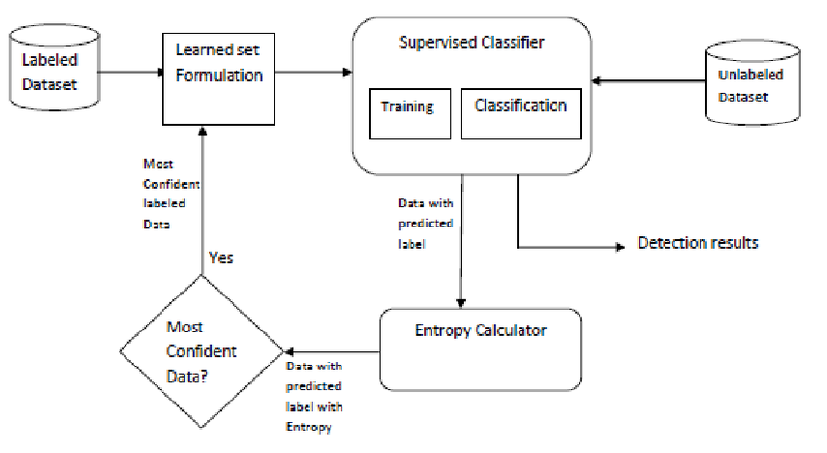
GURU NANAK INSTITUTIONS TECHNICAL CAMPUS SYSTEM ARCHITECURE

Slide 7
GURU NANAK INSTITUTIONS TECHNICAL CAMPUS MODULES
This project having the following modules:
Data Collection
Data Preparation
Model Selection
Analyze and Prediction
Accuracy on test set
Saving the Trained Model

Slide 8
GURU NANAK INSTITUTIONS TECHNICAL CAMPUS Data Collection:
This is the first real step towards the real development of a machine learning model, collecting data.
This is a critical step that will cascade in how good the model will be, the more and better data that we get, the better our model will perform.
There are several techniques to collect the data, like web scraping, manual interventions and etc.
The dataset used in this Chronic kidney disease dataset taken from UCI: https://archive.ics.uci.edu/ml/datasets/chronic_kidney_disease

Slide 9
GURU NANAK INSTITUTIONS TECHNICAL CAMPUS Data Preparation
we will transform the data. By getting rid of missing data and removing some columns. First, we will create a list of column names that we want to keep or retain.
Next, we drop or remove all columns except for the columns that we want to retain.
Finally, we drop or remove the rows that have missing values from the data set.
Split into training and evaluation sets

Slide 10
GURU NANAK INSTITUTIONS TECHNICAL CAMPUS Model Selection:
It is a supervised learning algorithm that includes more dependent variables. The response of this algorithm is in the binary form.
Logistics regression can provide the continuous outcome of a specific data. This algorithm consists of statistical model with binary variables.
Analyze and Prediction:
From the data set 19 columns are taken and the model is trained.
Model predicts the class label using predict method.
If the class label=0 (nockd), if class label =1(ckd)

Slide 11
GURU NANAK INSTITUTIONS TECHNICAL CAMPUS Accuracy on test set:
We got a accuracy of 99.83% on test set.
Saving the Trained Model:
Once you’re confident enough to take your trained and tested model into the production-ready environment, the first step is to save it in a .h5 or .pkl file using a library like pickle.
Pickle must be installed in the environment, next step is importing pickle module and dump the model into .pkl file.

Slide 12
GURU NANAK INSTITUTIONS TECHNICAL CAMPUS SOFTWARE REQUIREMENTS:
HARDWARE REQUIREMENTS:
PROCESSOR : Pentium i3 Processor
RAM : 4GB DDR RAM
HARD DISK : 500 GB
SOFTWARE REQUIREMENTS:
Operating System : Windows 7/8/10
Front End : HTML5, CSS3, JavaScript
Coding Language : Python
IDE : Jupyter notebook, Anaconda,Pycharm
Python Framework : Flask

Slide 13
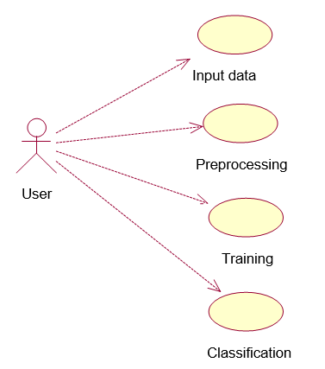
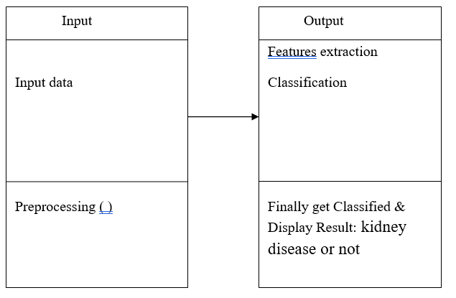
GURU NANAK INSTITUTIONS TECHNICAL CAMPUS UML DIAGRAMS Use case Diagram Class Diagram

Slide 14
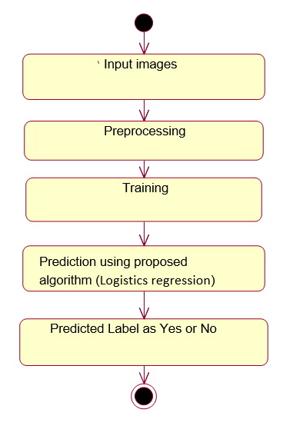
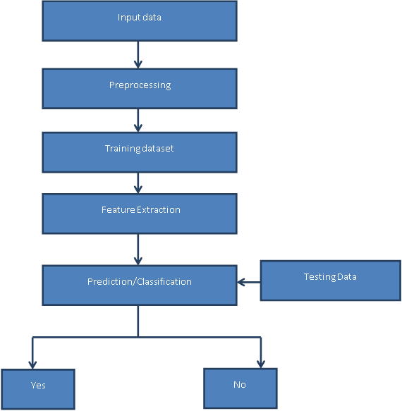
GURU NANAK INSTITUTIONS TECHNICAL CAMPUS UML DIAGRAMS Activity Daigram Data flow Daigram

Slide 15
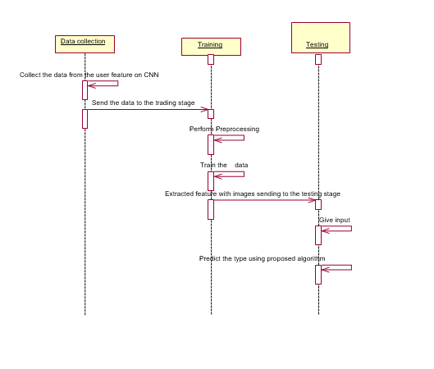
GURU NANAK INSTITUTIONS TECHNICAL CAMPUS UML DIAGRAMS Sequence Diagram

Slide 16
GURU NANAK INSTITUTIONS TECHNICAL CAMPUS CONCLUSION
The proposed CKD diagnostic methodology is feasible in terms of data imputation and samples diagnosis.
After unsupervised imputation of missing values in the data set by using KNN imputation, the integrated model could achieve a satisfactory accuracy.
Hence, we speculate that applying this methodology to the practical diagnosis of CKD would achieve a desirable effect.
In addition, this methodology might be applicable to the clinical data of the other diseases in actual medical diagnosis.
However, in the process of establishing the model, due to the limitations of the conditions, the available data samples are relatively small, including only 400 samples.
Therefore, the generalization performance of the model might be limited. In addition, due to there are only two categories (ckd and notckd) of data samples in the data set, the model can not diagnose the severity of CKD.

Slide 17
GURU NANAK INSTITUTIONS TECHNICAL CAMPUS FUTURE ENCHANCEMENT
In the future, a large number of more complex and representative data will be collected to train the model to improve the generalization performance while enabling it to detect the severity of the disease.
We believe that this model will be more and more perfect by the increase of size and quality of the data

Slide 18
GURU NANAK INSTITUTIONS TECHNICAL CAMPUS REFERENCES
[1] Z. Chen, Z. Zhang, R. Zhu, Y. Xiang, and P. B. Harrington, ``Diagnosis of patients with chronic kidney disease by using two fuzzy classifiers,'' Chemometrics Intell. Lab. Syst., vol. 153, pp. 140145, Apr. 2016.
[2] A. Subasi, E. Alickovic, and J. Kevric, ``Diagnosis of chronic kidney disease by using random forest,'' in Proc. Int. Conf. Med. Biol. Eng., Mar. 2017, pp. 589594.
[3] L. Zhang, ``Prevalence of chronic kidney disease in China: A crosssectional survey,'' Lancet, vol. 379, pp. 815822, Mar. 2012.
[4] A. Singh, G. Nadkarni, O. Gottesman, S. B. Ellis, E. P. Bottinger, and J. V. Guttag, ``Incorporating temporal EHR data in predictive models for risk stratication of renal function deterioration,'' J. Biomed. Informat., vol. 53, pp. 220228, Feb. 2015.

Slide 19
ANY QUERIES?

Slide 20
THANK YOU

