Slide 1
CONSTRUCTION ERP IMPLEMENTATION
Industry Guide: Team Members:
Ms.K.Karthika Aishwarya.S
Faculty Guide: Aneesha.A
Mrs.Janitha Krishnan Jaya Chithra.S
Mythili.G
Department of CSE, KGiSL Institute of Technology, Coimbatore

Slide 2
Abstract
This project is aimed at developing a sales and marketing for building constructions. This system can be used to store the details of the inventory, update the inventory based on the sale details, produce receipts for sales ,generate sales and inventory reports. The goal of our project is to support one time entry of information at the point where it is created and to make it available to all the participants within the organization
Department of CSE, KGiSL Institute of Technology, Coimbatore

Slide 3
Area Introduction
Python is a free and open source software.
It is a general purpose, high level, object-oriented and interpreted programming language for the web.
It is often used as a scripting language.
Python supports multiple programming paradigm including object oriented and procedural styles.
Department of CSE, KGiSL Institute of Technology, Coimbatore

Slide 4

Existing system and its disadvantage
Small organization-expensive
Complex
Need experts

Slide 5


Compatible only with Microsoft products
Inefficient for small business organizations
The software does not support any mobile app function.
Software can be confusing without the system training

Slide 6
Literature Review
Drawbacks of existing methods:
It does not update the inventory details based on sales.
It does not communicate with material and equipment suppliers, vendors, subcontractors and clients.
Department of CSE, KGiSL Institute of Technology, Coimbatore

Slide 7
Proposed System
To maintain all the items that are purchased and sold department wise in an integrated manner.
This system can be used to store the details of the inventory, update the inventory based on the sale details.
Department of CSE, KGiSL Institute of Technology, Coimbatore

Slide 8
Module Split-up
Project Module
Sales Module
Purchase Module
Warehouse/Inventory Module

Slide 9
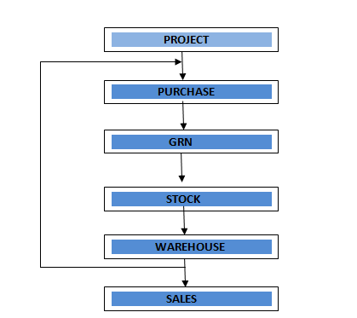
Architectural Design

Slide 10
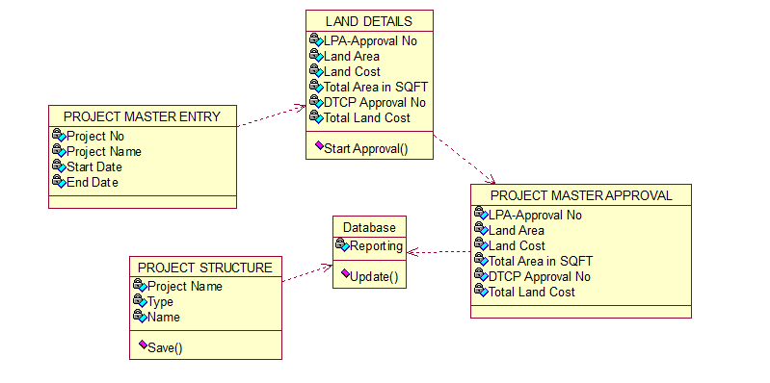
Class Diagram
Department of CSE, KGiSL Institute of Technology, Coimbatore

Slide 11
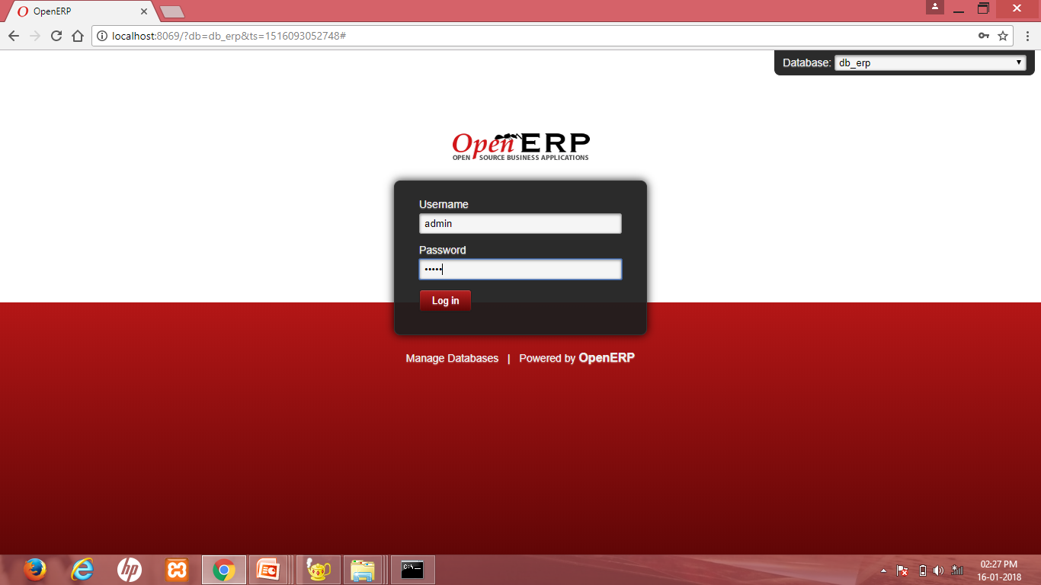
Screen shots

Slide 12
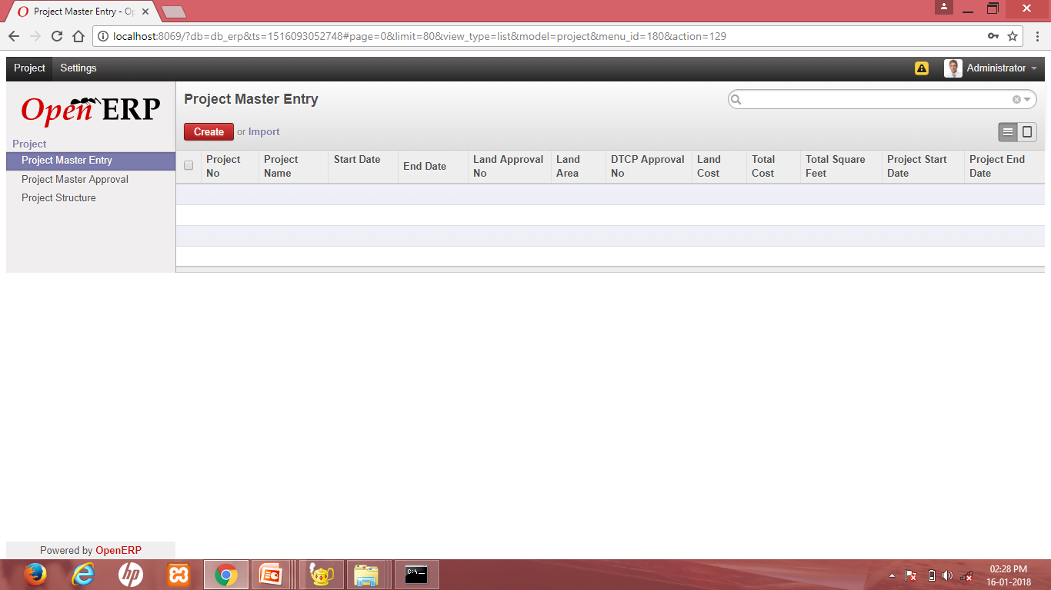

Slide 13
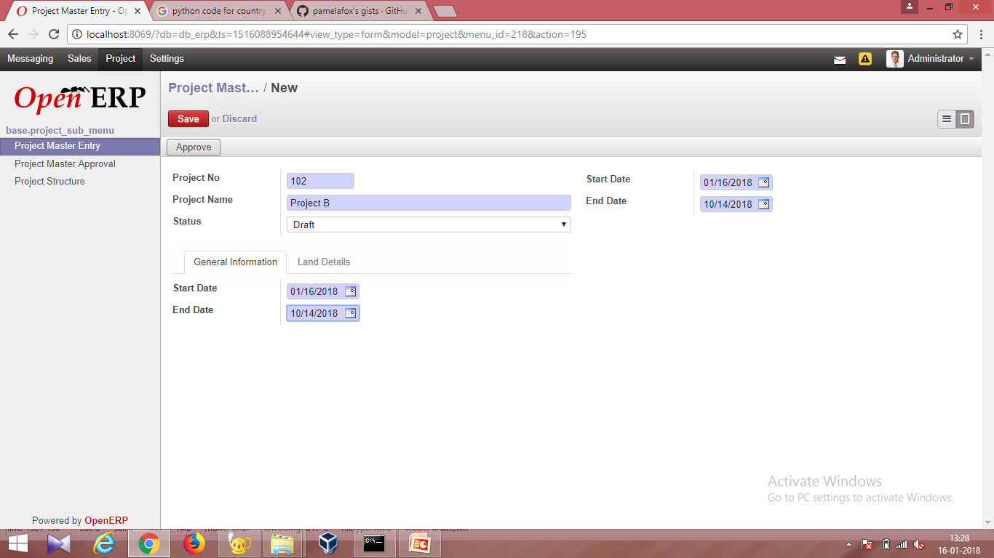

Slide 14
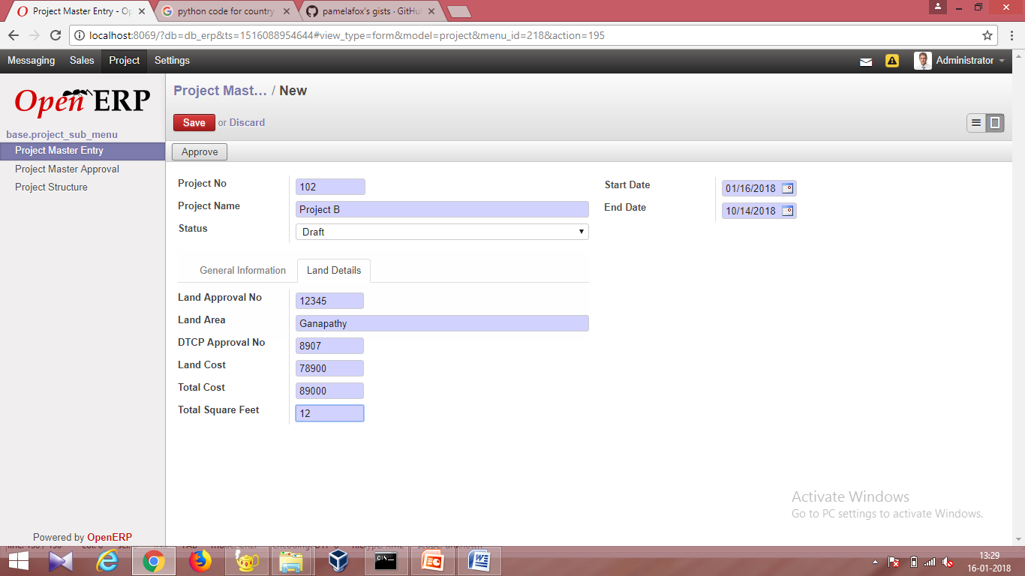

Slide 15
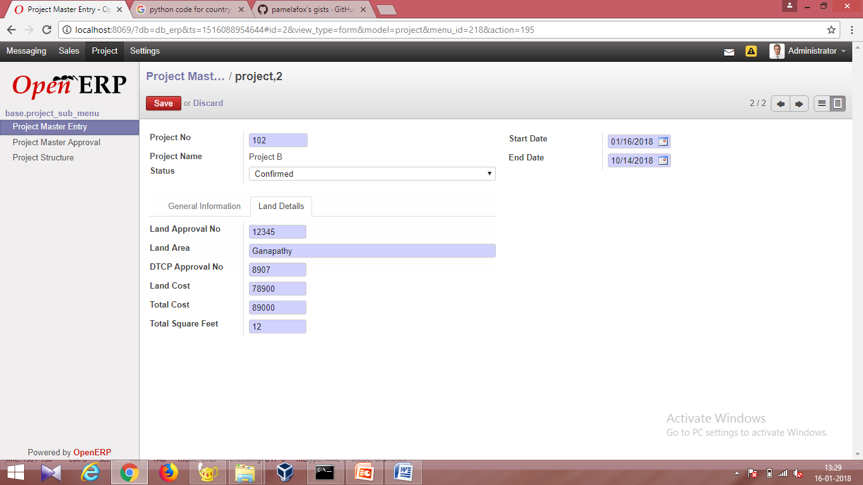

Slide 16
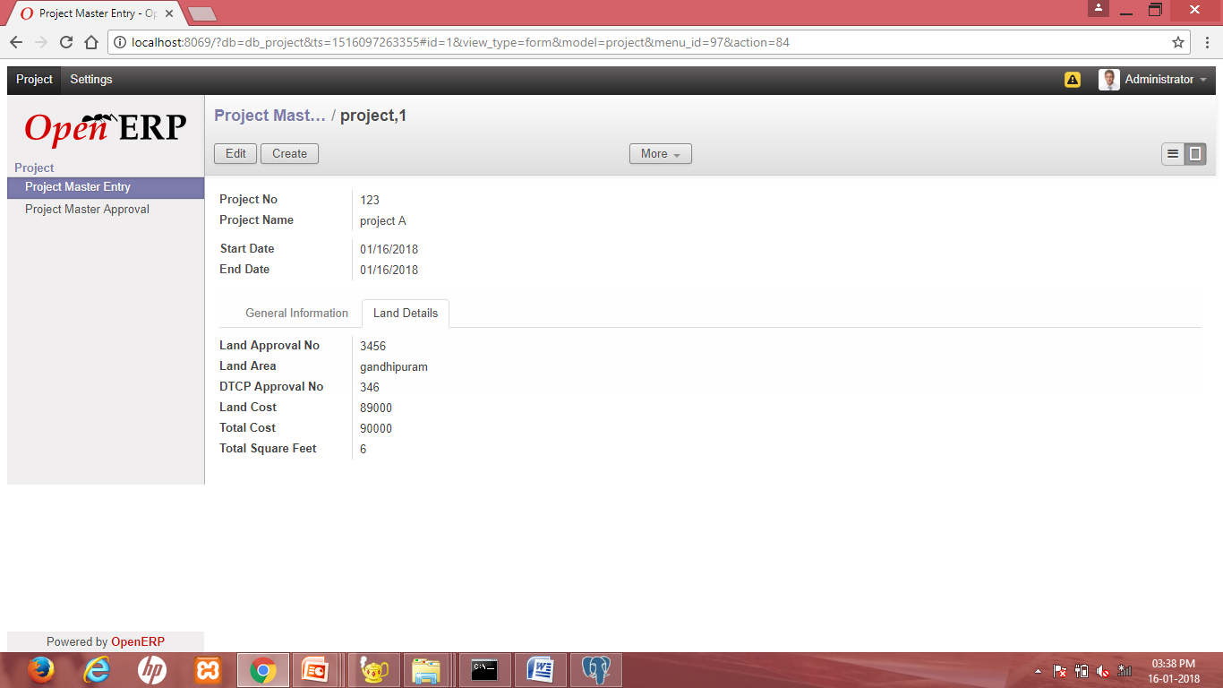

Slide 17
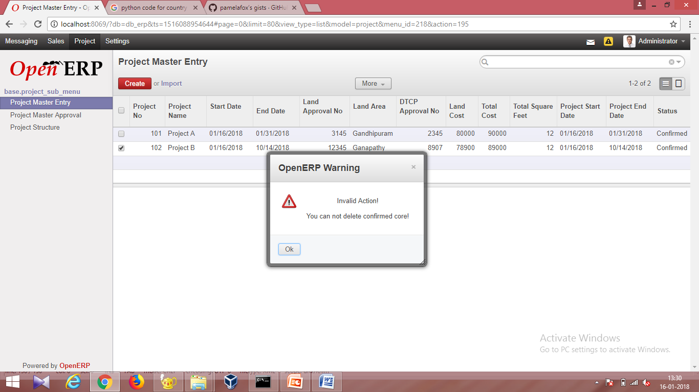

Slide 18
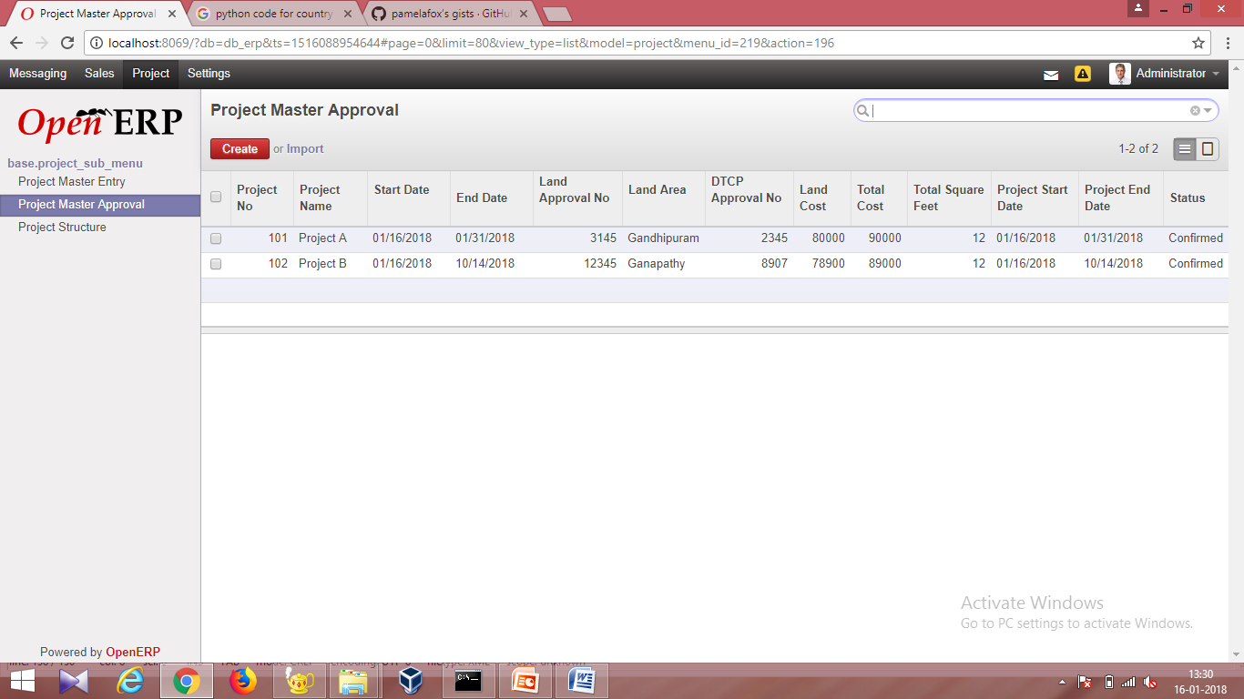

Slide 19
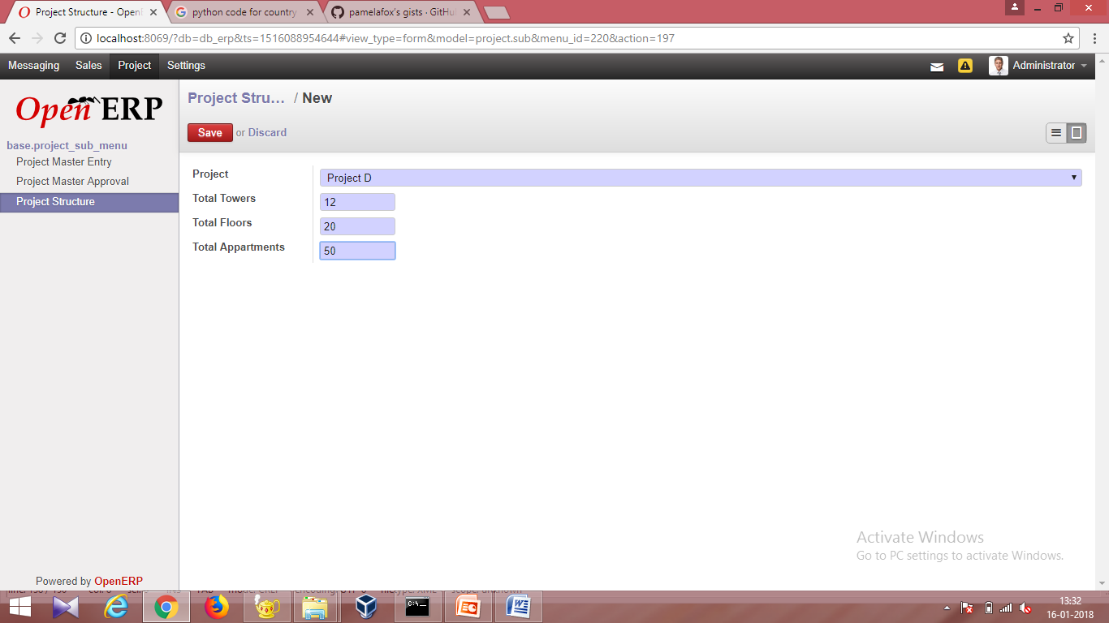

Slide 20
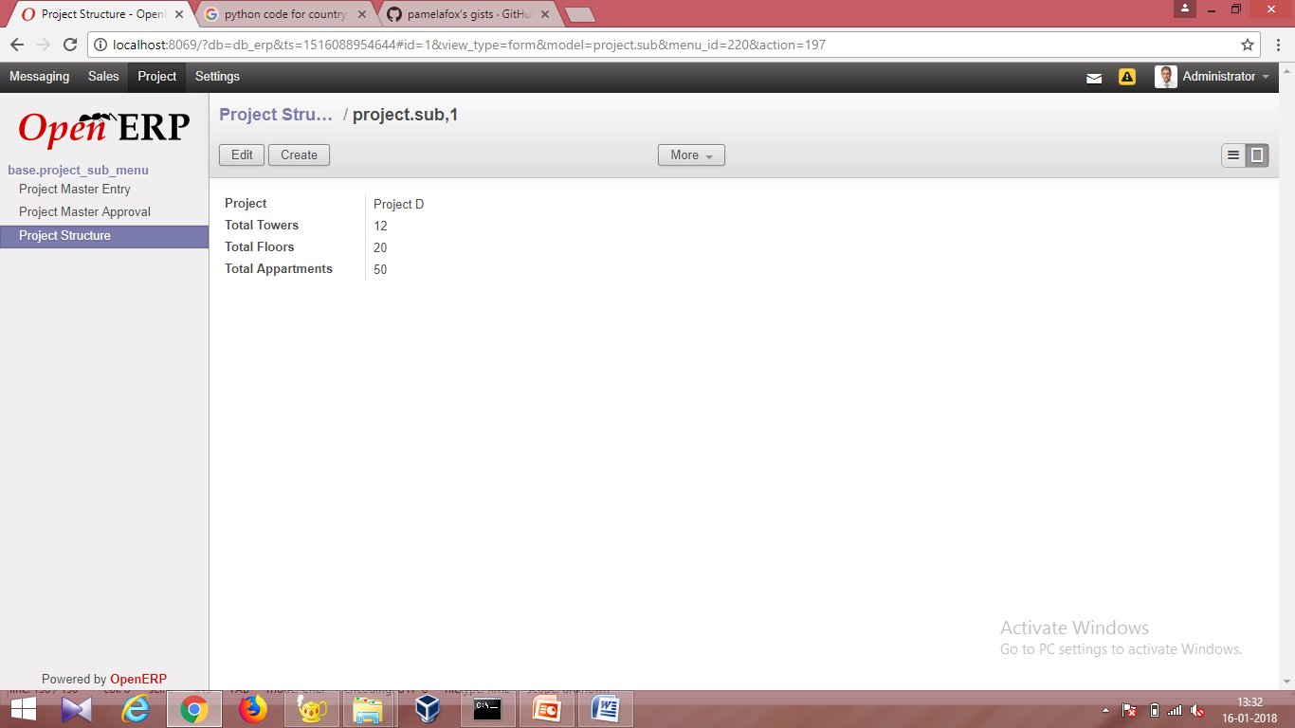

Slide 21
Thank You

