Slide 1

Exploratory Data Analysis Report
On
Aspiring mind Employment Outcome(AMEO) Dataset
Prepared By – Aishwary Dakhare

Slide 2


About me
I am a proactive, responsible and result-oriented professional. I have complted my BE( CSE ) and PGDM in Data Science & AI From COEP Pune. My Interest lies in solving technical issues,research and new technologies. I thrive in team environment and enjoy connecting with new individuals. Moreover, I excel in working under pressure and possess excellent stress management skills.
I am excited to learn data science because it is an ideal way to combine my love of technology and my passion for solving problem. There is tonne of information generated every second in today’s data driven society and I’m enthusiastic about possibility of gaining insightful knowledge from this data to inform choices and address practical problems.
I have worked on Webscrapping and after that scrapped data apply clustering algorithm in my previous internship program. Also I have worked on many individual and team projects in Data Science Domain.
I’m looking forward to connect with outstanding people in the industry.

Slide 3
Agenda of Report
Objective of the Project
Summary of the Dataset
Exploratory Data Analysis
Data Cleaning Steps
Data Manipulation Steps
Univariate Analysis
Bivariate Analysis
Conclusion
Requirements
Language : Python
Libraries : numpy, pandas, matplotlib, seaborn, statsmodels
Link for Project Repo. - https://github.com/Aishwarydakhare/EDA-on-AMCAT-Dataset

Slide 4
Objective of the Project
Analysis aims to gain insights and understand the provided dataset, focus on the relationship between various features and target variable i.e., Salary
Describe the Dataset
Identify Target value and patterns in data
Explore relationship between Dependent and independent variables
Identify Outliers and treat them.

Slide 5
Summary of Dataset
The dataset was released by Aspiring Minds from the Aspiring Mind Employment
Outcome 2015 (AMEO). The study is primarily limited only to students with engineering
disciplines. The dataset contains the employment outcomes of engineering graduates as
dependent variables (Salary, Job Titles, and Job Locations) along with the standardized
scores from three different areas – cognitive skills, technical skills and personality skills.
The dataset also contains demographic features. The dataset contains around 40
independent variables and 4000 data points. The independent variables are both
continuous and categorical in nature. The dataset contains a unique identifier for each
candidate. Below mentioned table contains the details for the original dataset.
Dataset -> https://docs.google.com/document/d/1xvo6kN5Q4QG-ezZKrNwg2YMD6S_fwlmz/edit

Slide 6
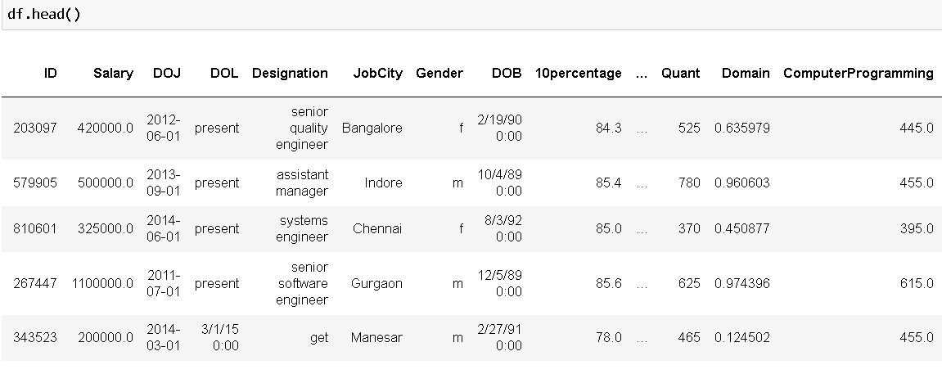
Exploratory Data Analysis
Step 1 : Data Cleaning
Remove unwanted Columns, Datatype conversion.
Step 2: Data Manipulation
Impute categorical col with mode values, check Null values and impute with median.

Slide 7
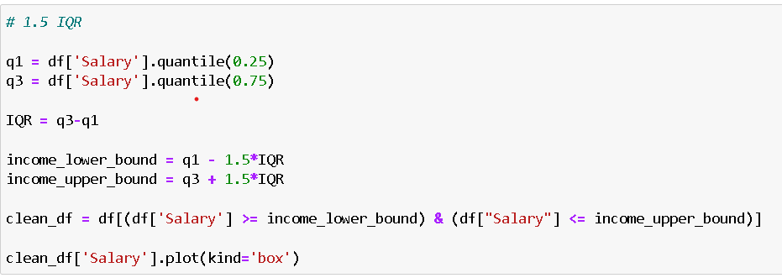
Univariate Analysis
It is for continuous feature like salary,collegeGPA,etc was done by plotting histogram,boxplot & CDF.
In most of the feature data was not normally distributed.
Bobplot gives idea of presence of Outliers in data.

Slide 8
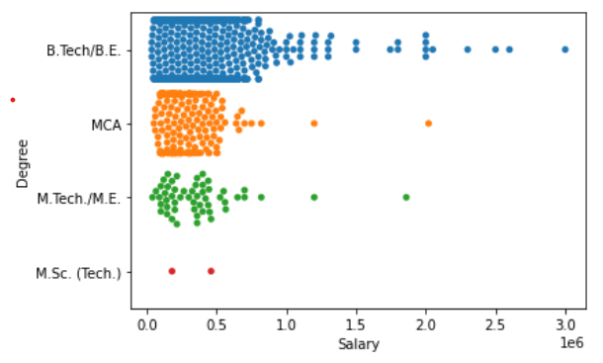
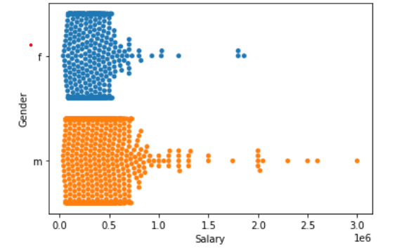
Bivariate Analysis
Consider Salary as on element and others one by one taken into consideration.
For cases like Designation , Software Engineers had the Highest Salary.
BE/B.Tech Degree having the highest salary than others for this used swarmplot.

Slide 9
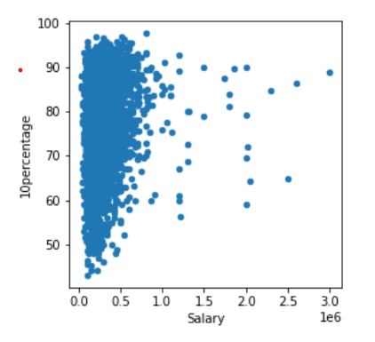
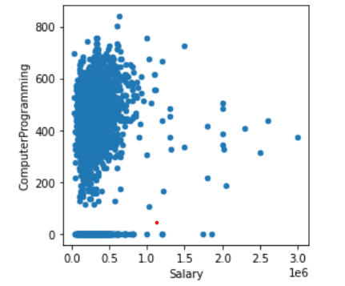
No Correlation exist between Salary and 10education but there is a correlation between ComputerProgramming and Salary.
Average Salaries for both genders are approximately equal, there is no gender bias in salary distribution.

Slide 10
Research Outcome
The Goal of the project is to analyse employee data to compare various percent metrices. It involves identifying outliers using boxplots and after that treat that outliers using IQR method.By keeping Salary as tha main target element and aim to determine cities having the high level of employee using countplots and other plots.
Overall in this analysis to determine Salaries of the tech industries and understand the policies that varies according to the academic records.
Further research deeper into insights into salary structures and talent managements.

Slide 11

THANK YOU

