Slide 1
Panache
Olívia Michalovič
Notes:
Footer

Slide 2
What is Panache?
Quarkus-specific library that simplifies the development of your Hibernate-based persistence layer.
Similar to Spring Data JPA.
Handles most of the repetitive boilerplate code for you.
Implementations of the repository and the active record pattern provide methods to create, update, and remove records, perform basic queries, and define and execute your own queries.
Notes:
Footer

Slide 3
Panache itself doesn’t require any additional configuration.
We need to configure database connection.
Panache implements the repository and the active record pattern.
Both implementations provide you with standard methods to persist, read, update and remove entity objects.
Notes:
Footer

Slide 4
The Repository Pattern
Encapsulates the logic to create, read, update and remove an entity object or aggregate as defined by Domain Drive Design.
An interface defines the repository with all logical read and write operations for a specific entity.
You just need to provide your own implementation.
The interface gets implemented by one or more classes that provide data store specific implementations of each interface method.
Notes:
Footer

Slide 5
Benefits
The pattern abstracts the data store and enables you to replace your data store without changing your business code.
The repository improves the reusability of your persistence code, especially your queries, by encouraging you to implement all persistence operations in one place. That makes them easy to find and to reuse.
The implementation of the repository pattern is relatively simple.
Notes:
Footer

Slide 6
Define Entities
Define your entities as standard JPA entities or extend Panache’s PanacheEntity or PanacheEntityBase class.
Entity class needs to be a non-final, public class, annotated with @Entity and a default constructor.
And each attribute gets mapped to a @Column with the same name.
Only thing you need to do to define a repository is to implement a class that implements the PanacheRepository<Entity> or the PanacheRepositoryBase<Entity, Id> interface.
Notes:
Footer

Slide 7
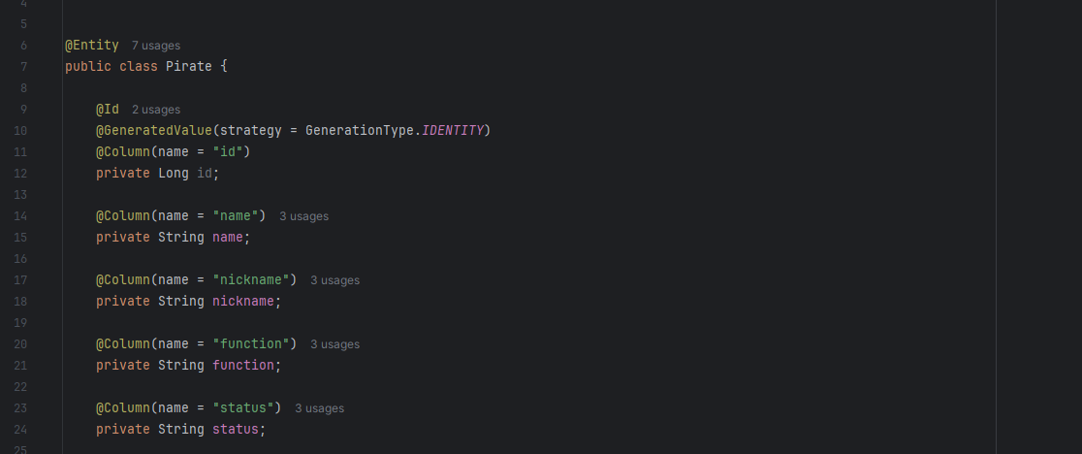
Define Entities
Notes:
Footer

Slide 8
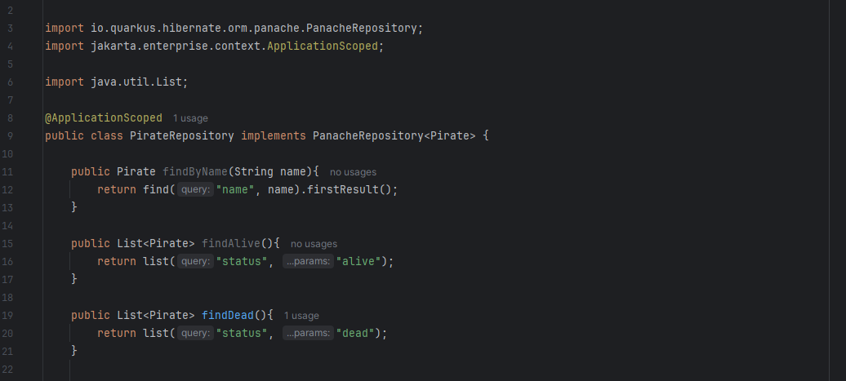
Define Entities
Notes:
Footer

Slide 9
PanacheRepositoryBase interface defines a long list of standard methods to create, read, update, and remove entities: void persist(Entity entity) and void persist(Iterable<Entity> entities) void delete(Entity entity) and delete(String query, Parameters params)
Entity findById(Id id) and Optional<Entity> findByIdOptional(Id id)
List<Entity> list(String query, Object… params)
List<Entity> list(String query, Sort sort, Object… params)
Stream<Entity> stream(String query, Object… params) long count() long count(String query, Object… params)
Notes:
Footer

Slide 10
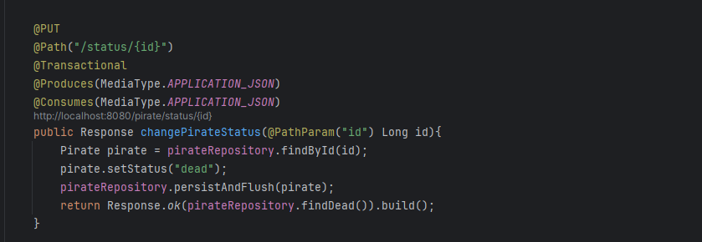
Provides several methods that you can use to execute your own query.
PanacheQuery<Entity> find(String query, Object… params)
PanacheQuery<Entity> find(String query, Sort sort, Object… params)
Notes:
Footer

Slide 11
The Active Record Pattern
Puts the main focus on the entity object, which implements the methods required to create, read, update and remove a record.
Your entity classes need to be annotated with @Entity and extend Panache’s PanacheEntity or PanacheEntityBase class to enable Panache to add its default methods.
All entity attributes have to be public, and you don’t need to provide any getter or setter methods.
In your business code, you can then call the static methods on your entity class to perform the required operation, e.g., to persist a new entity or read one or more entity objects from the database.
Notes:
Footer

Slide 12
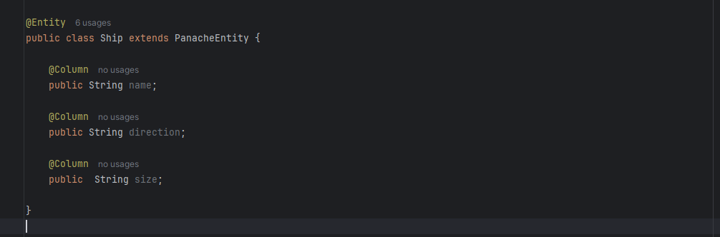
The Active Record Pattern
Notes:
Footer

Slide 13
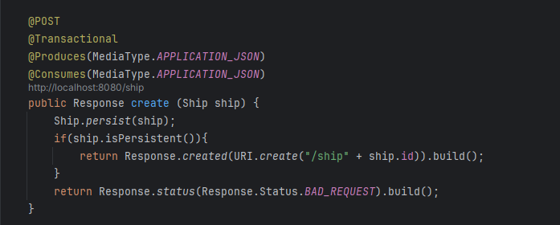
The Active Record Pattern
Notes:
Footer

Slide 14
The Active Record Pattern
Internally, Panache automatically provides getter and setter methods for all fields and rewrites your code to use the methods.
Notes:
Footer

Slide 15
Entity Relationships
@ManyToOne
@OneToOne
@OneToMany
@ManyToMany
The inverse side of a bidirectional relationship must refer to its owning side(Entity which contains the foreign key) by using the mappedBy element. (@OneToOne, @OneToMany, or @ManyToMany)
The many side of @ManyToOne bidirectional relationships must not define the mappedBy element. The many side is always the owning side of the relationship.
For @OneToOne bidirectional relationships, the owning side corresponds to the side that contains @JoinColumn i.e the corresponding foreign key.
Notes:
Footer

Slide 16
Entity Relationships
If in the DTO projection object you have a field from a referenced entity, you can use the @ProjectedFieldName annotation to provide the path for the SELECT statement. (@Embedded entity or @ManyToOne, @OneToOne relation)
Notes:
Footer

Slide 17
@OneToMany
Create one or more relationship between entities or objects.
Two entities -> Ship and Pirate that multiple pirates can be associated with a single ship, but one single ship can not be shared between two or more pirates.
One to many mapping with foreign key association.
One to many mapping with join table.
@JoinColumn, name refers to foreign key column name.
Notes:
Footer

Slide 18
@ManyToOne
Multiple entities are associated with exactly one other entity. In terms of database tables, multiple records in a table can be associated with exactly one record in another table.
@JoinColumn, name refers to foreign key column name.
Notes:
Footer

Slide 19
@ManyToMany
In a many-to-many relationship, multiple records in one table can be associated with multiple records in another table.
In the case of many-to-many relationship, it is not possible
to directly use a single foreign key to establish
the association between the two entities.
This is because both entities
are associated with multiple
instances of each other.
mappedBy parameter.
Notes:
Footer

Slide 20
HANDS ON
What do we use ?
Hibernate
PostgreSQL Explorer
Postman / Bruno
Podman
Docker
(resteasy client for API’s)
pom.xml
<dependency>
<groupId>io.quarkus</groupId>
<artifactId>quarkus-hibernate-orm-panache</artifactId>
</dependency>
<dependency>
<groupId>io.quarkus</groupId>
<artifactId>quarkus-jdbc-postgresql</artifactId>
</dependency>

Slide 21
HANDS ON
application.properties
quarkus.datasource.db-kind = postgresql
quarkus.datasource.devservices.port=5432
quarkus.datasource.devservices.db-name=postgres
quarkus.datasource.devservices.username=postgres
quarkus.datasource.devservices.password=root
quarkus.datasource.devservices.enabled=true
quarkus.hibernate-orm.database.generation = drop-and-create
If you need a field to not be persisted, use the @Transient annotation on it.

Slide 22
1) Write a POST method which receives the list of pirates on the ship and stores it in the database.
2) Add a GET method that returns a list of alive pirates.
3) Prepare a method that returns the number of living pirates on the ship.
4) Write a PUT method that changes the pirate’s name.
5) Write a GET method using SQL Query that returns a pirate with the captain function. If the captain is not on the ship, the function returns the status not found.
Notes:
Footer

Slide 23
6) Write a GET method which returns list of pirates sorted by name and status.
7) Write a POST method which receives the list of ships and stores it in the database.
8) Prepare a GET method that returns list of large ships.
9) Write a PUT method that changes the ship’s name.
Notes:
Footer

Slide 24
Resources
https://thorben-janssen.com/introduction-panache/
https://thorben-janssen.com/implementing-the-repository-pattern-with-jpa-and-hibernate/
https://quarkus.io/guides/hibernate-orm-panache
https://quarkus.io/guides/hibernate-reactive-panache
https://medium.com/@rajibrath20/the-best-way-to-map-a-onetomany-relationship-with-jpa-and-hibernate-dbbf6dba00d3
https://sohailshah20.medium.com/jpa-one-to-many-many-to-one-and-many-to-many-relationships-74ba20f7d3b1
Notes:
Footer

