Slide 1




SheCodes
Powered By
In Collaboration With
Team Name:
Sukoon
Creating an Open Innovation Platform for Stress Relief and Mental Health
Problem Title:

Slide 2
Introduction
Type In today’s fast-paced and demanding world, stress has become a ubiquitous aspect of daily life, affecting individuals across all demographics. The adverse effects of chronic stress on physical health, mental well-being, and overall quality of life are well-documented, leading to an urgent need for effective and accessible stress management solutions. Recognizing this need, we propose the development of a comprehensive stress-relieving website designed to provide users with a diverse range of therapeutic options tailored to their individual needs.
This project aims to create a holistic digital platform that integrates multiple evidence-based stress relief modalities, including audio therapy, reading therapy, laughing therapy, yoga therapy, special therapy, and professional doctor consultancy. By leveraging modern web technologies, artificial intelligence, and user-centered design principles, this website will offer a personalized and engaging experience that promotes mental well-being and helps users manage stress more effectively.

Slide 3
Problem Statement
The lack of an integrated, accessible, and personalized digital platform for comprehensive stress management leaves individuals without effective tools to address the multifaceted nature of stress, leading to ongoing negative impacts on their mental and physical health.
To address this gap, we propose the development of a holistic stress-relieving website that combines multiple evidence-based therapies, innovative technologies, and user-centered design to provide a comprehensive, personalized, and engaging solution for stress management. This platform will empower users to manage their stress effectively, improve their mental well-being, and enhance their overall quality of life.

Slide 4
Solution
To address the lack of integrated and personalized stress management resources, we propose the development of a comprehensive digital platform with the following key components:
Integrated Therapeutic Content:
Audio Therapy: Playlists of soothing music, nature sounds, and guided meditations.
Reading Therapy: A library of articles, stories, poems, and self-help materials.
Laughing Therapy: A collection of humorous videos, jokes, and funny stories.
Yoga Therapy: Video tutorials and guides for yoga and stretching exercises.
Special Therapies: Aromatherapy suggestions, art therapy activities, and guided journaling prompts.
Doctor Consultancy: Virtual consultations with certified therapists and doctors.

Slide 5
Dependencies and Show Stoppers
Dependencies
Show Stoppers
Web Development Tools and Frameworks
Hosting and Infrastructure
Integration of Third-party APIs
Compliance with Healthcare Regulations
Collaboration with Experts and Consultants
User Feedback and Testing
1.Failure to adhere to healthcare regulations and data protection laws
2. Lack of Scalability and Performance Issues
3. Poor User Experience and Usability

Slide 6
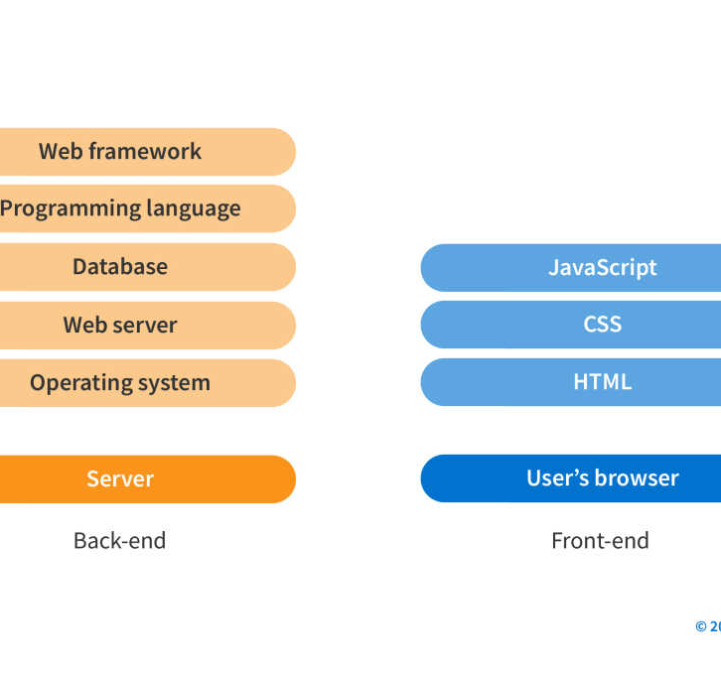
Tech Stack
Frontend Development: HTML, CSS , JavaScript
Backend Development: Node.js , Express.js, MongoDB
Authentication and Security: JSON Web Tokens (JWT), Passport.js
Real-time Communication: Socket.IO
Content Management and Delivery: WordPress , Content Delivery Network (CDN)
Data Analysis and Insights: Google Analytics
Deployment and Infrastructure: Amazon Web Services (AWS)
Development Tools and Version Control: Visual Studio Code, Git

Slide 7
Future Scope & Important Information
Expansion of Therapeutic Offerings:
Integration of Advanced Technologies:
Partnerships and Collaborations:
Incorporate emerging stress-relief modalities such as virtual reality (VR) therapy, mindfulness-based interventions, and biofeedback techniques to enhance the platform's effectiveness and appeal to a broader audience.
Explore the integration of artificial intelligence (AI) algorithms for personalized stress assessment and recommendation systems, as well as Internet of Things (IoT) devices for real-time stress monitoring and feedback
Forge partnerships with mental health professionals, wellness organizations, and technology companies to expand the platform's reach, access additional resources, and stay at the forefront of innovation in stress management solutions

Slide 8
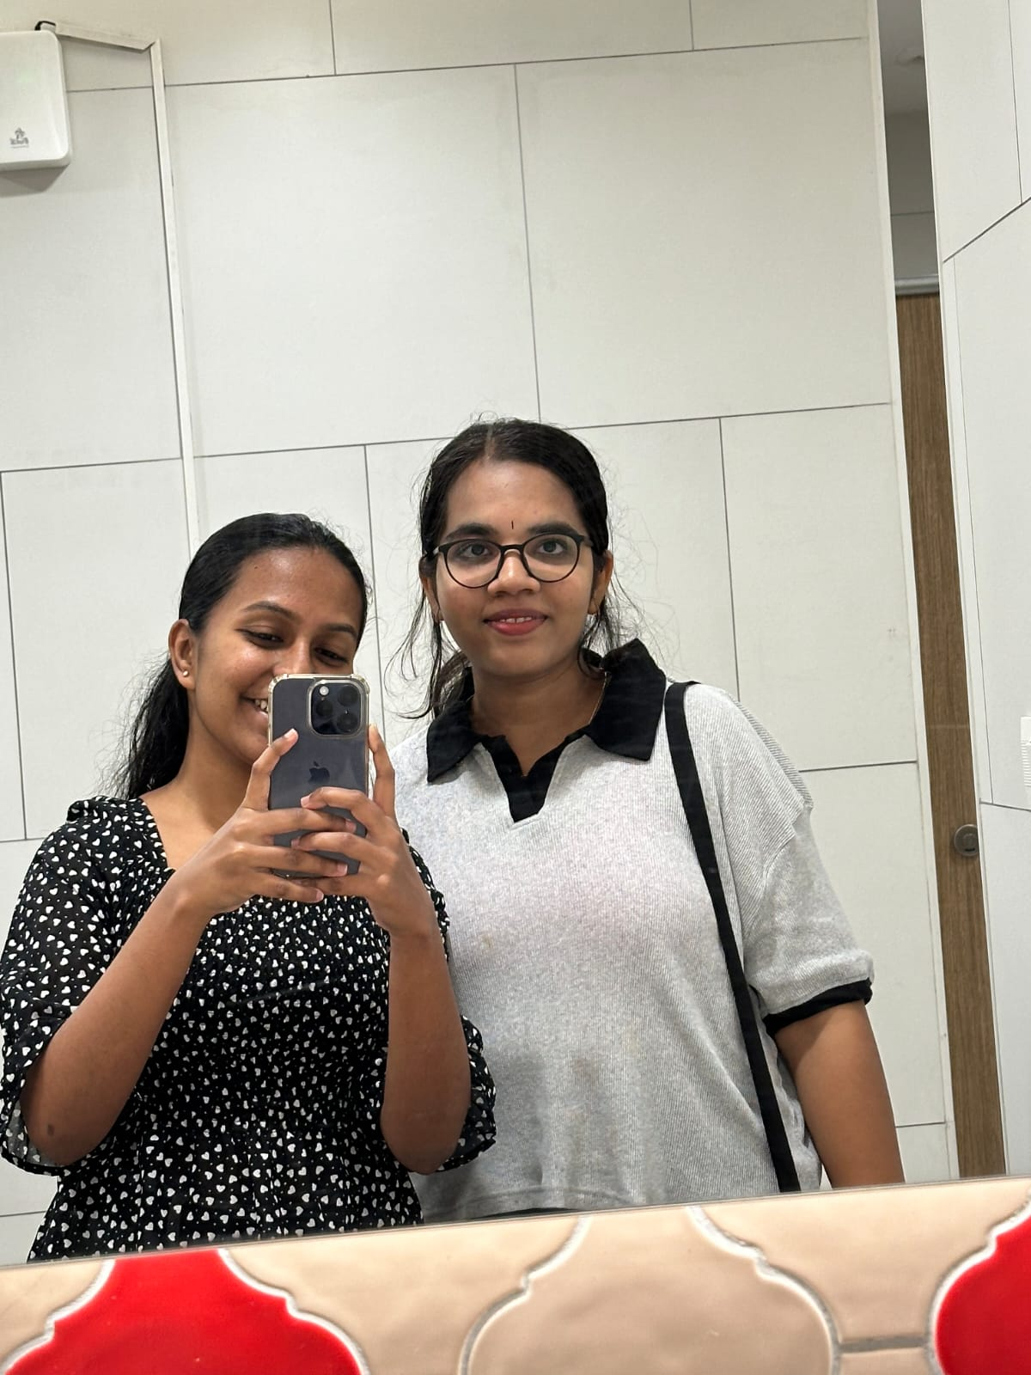
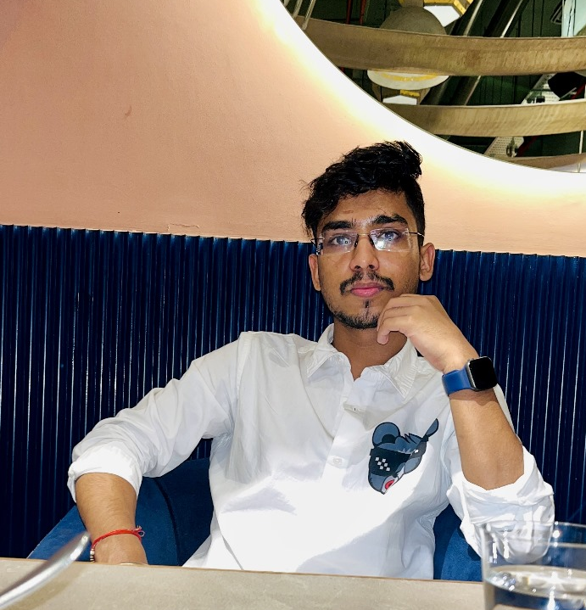


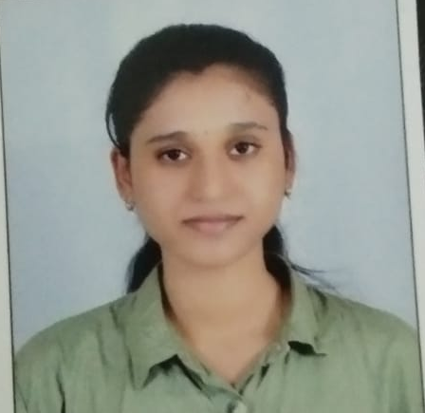
Team Members
Aisiri R
Hritik Jaiswal
Chandana B L
Full Stack Developer
Backend Developer
UI/UX Designer
Anushka Chauhan
Keerthana D
Content Manager
Data Analyst

