Slide 1
Linux
Operating System is an interface between user and computer hardware. It will handle file management, user management, disk partition and networking.
Architecture
User – interface command
Operating System
Hardware / System

Slide 2
O.S accepts the request from the user which is in high level language. Then converts the request into binary language which is understandable by the system/ hardware.
System / hardware responds to the request.
Again the o.s processes the data and gives response to the user.
Different types of o.s
Windows
Linux
Ubuntu
Fedora
Redhat
Mac os
Blackberry
Kali Linux
Android

Slide 3
System software – helps to run the application
Application software – Performs a specific task. They are on top of the system software.
Components of OS
File management
Network management
Main memory and secondary memory management
I/O device management
Security management
Command interpreter system
Process management
Linux is an open-source, multitasking, multiuser operating system.

Slide 4
History of Linux
Linux was developed by Linus Torvalds in 1991. He created a free Operating System called Kernel.
Linux operating system is a combination of Kernel and GNU software.
It is written in C language.
Linux distribution
Ubuntu
Redhat
Kali
Arch Linux
Fedora
Debian
Rocky Linux
SUSE Linux

Slide 5
1. Kernel
Linux kernel is the core part of the operating system.
It is responsible to execute the command with the help of hardware components.
It also takes care of memory allocation and processor allocation.

Slide 6
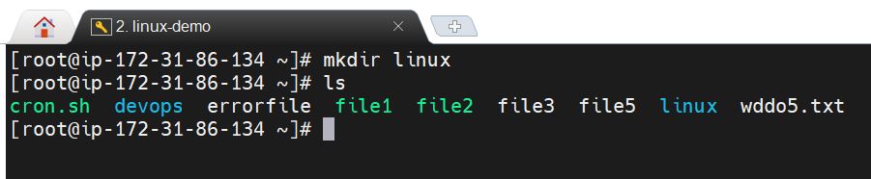
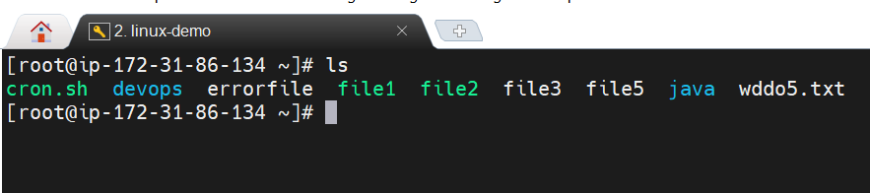
Basic Linux commands
1. mkdir - This command is used to create directories.
Syntax – mkdir <directory name>
2. ls - This command lists out the directories / files which are created inside the
current working directory.
Synax – ls

Slide 7
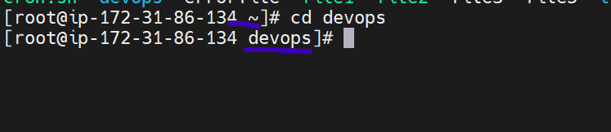
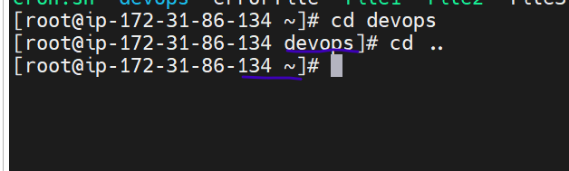
3. cd - This command is used to change the directory.
Syntax – cd <directory name>
4. cd .. - This command is used to go back to the previous working directory.

Slide 8
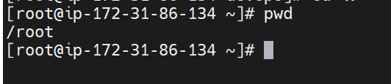
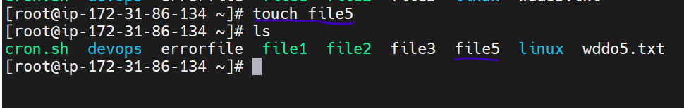
5. pwd - This command displays the current working directory.
6. touch - This command is used to create files.
Syntax – touch <filename>

Slide 9
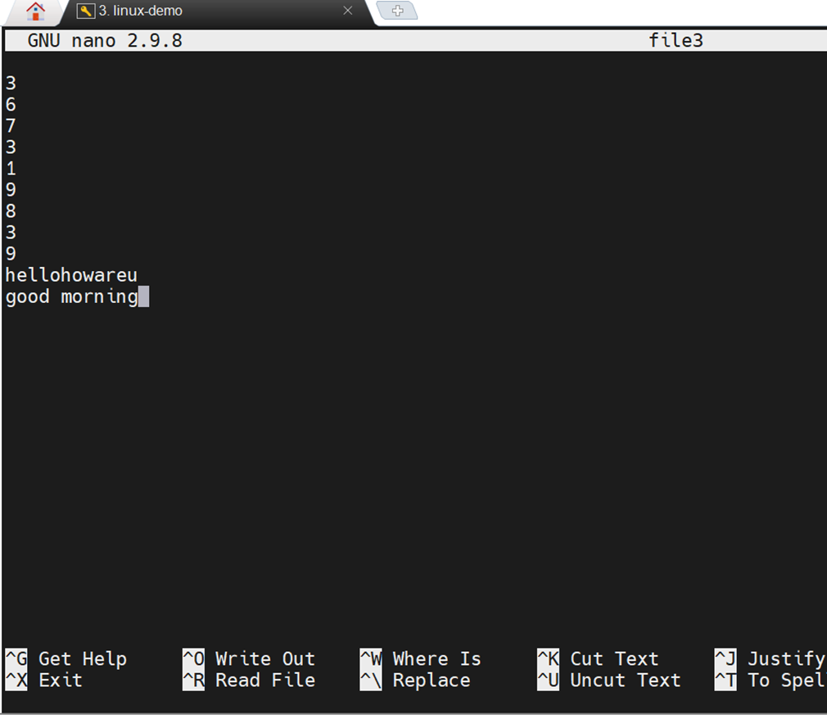
7. nano - It is an editor used to add / modify the data in a file
Syntax – nano <filename>

Slide 10
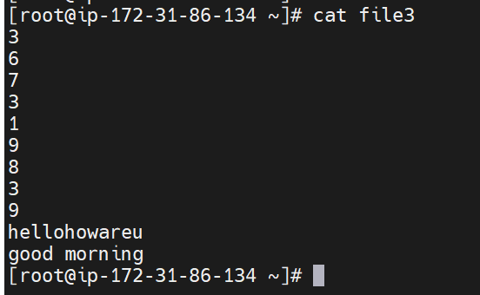
8. cat - It is used to view the contents of a file.
Syntax – cat <filename>
cat > <filename> - To override the data
cat >> <filename> - To append the data

Slide 11
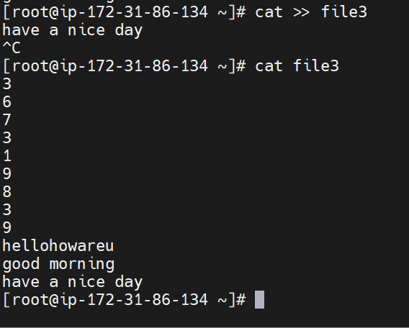
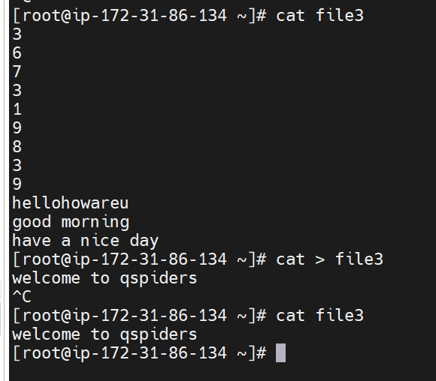

Slide 12
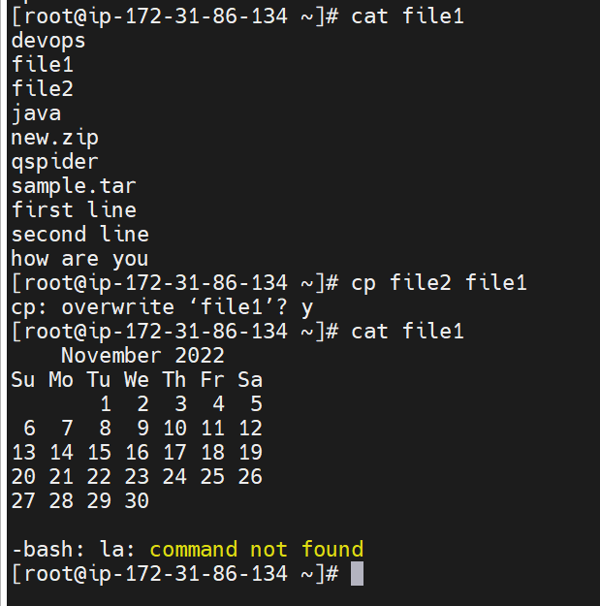
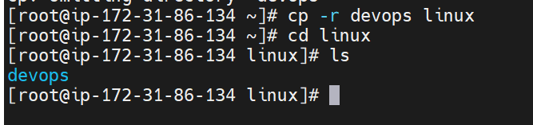
9. copy - copy command is used copy the data from one file to another file or we can copy the files from one directroy to another dir
syntax - cp <source dir> <destination-dir>
to copy the non-empty directory -
cp -r <source-dir> <dest-dir>

Slide 13
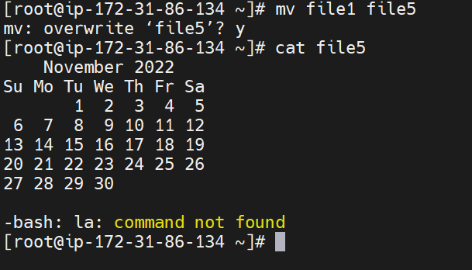
10. move - To move the data from one file to another or move the data from one dir to another dir
syntax :- mv <source-dir> <dest-dir>
11.Change the directory name or file :-
mv command we can change the file or directroy name
Syntax - mv <old-dir> <new-dir>

Slide 14
12. rm - to delete the files or directroy
syntax - rm <file-name> or <dir-name>
If you want to delete forcefully :-
syntax :- rm -f <file-name> or <dir-name>
syntax :- rm -r <file-name>
13. rmdir - to delete the directory
synatx - rmdir <dir-name>
rm -rf <dir-name> - To delete the nonempty directroy we are using
rm:- remove
-r :- recursively
f :- forcefully
rm *.txt - to delete the all .txt extension files
Example – rm file1.txt file2.txt..

Slide 15

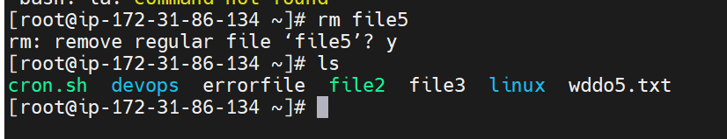
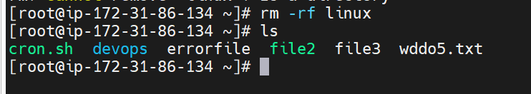

14. echo “ ” - echo it is used to print the data
Example :- echo "hello world“
printf "hello world“

Slide 16
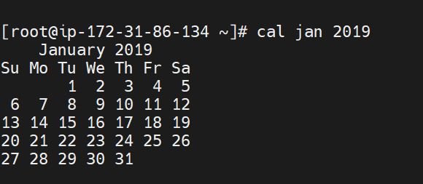
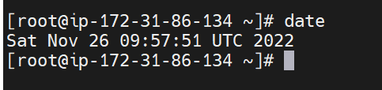
cal - displays the calendar of current month
cal <year> - displays the calendar of specified year
cal <month> <year> - displays the calendar of the specified month and year
16. date - displays the current month, time, date, min

Slide 17
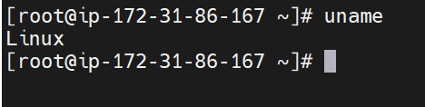
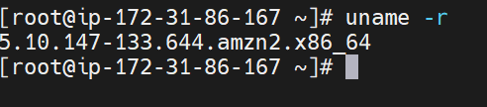
uname commands :- to know about kernal name along with the system information like version, os, machine,kernal release
1.uname :- It will print the kernal name
syntax :- uname
2.uname -r :- It is used to print the kernal release

Slide 18
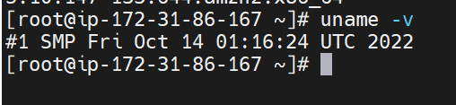

3.uname -v :- it is used to print the kernal version
4.uname -m :- it is used to print the machine name

Slide 19

5.uname -s :- To know about os
6.uname -a :- to print all the information about the system.

Slide 20
User Management :
By using this we are managing our users
In three ways we can manage the users :
------------------------------------------------
1.GUI :- Graphical user interface
2.command line
3.By modifying the users-file
/etc/passwd

Slide 21
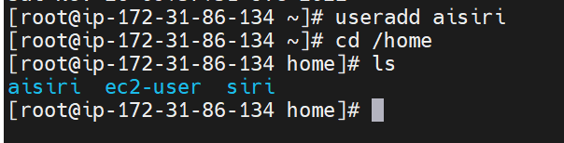
1.root :- The root user is the super user and have all the permissions
2.useradd :- it is used to create the users
synatx :- useradd <user-name>
when we create the users our os will create one directory with the name of user inside the home directory.
2.To check whether user is created or not :-
cat /etc/passwd
nano /etc/passwd

Slide 22
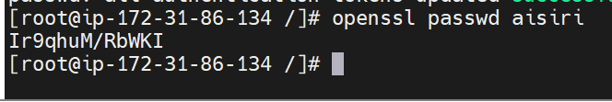
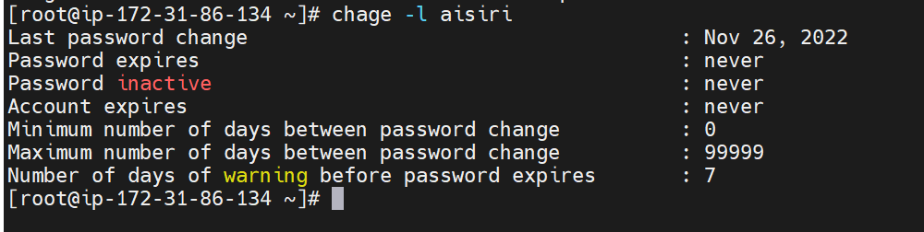
3. passwd :- It is used to set the password for the user
syntax :- passwd <user-name>
4. to get the encrypted password
syntax :- openssl passwd <user-name>
5. To get the password information
syntax :- chage -l username

Slide 23
6.To delete the user:- userdel -r <user-name>
Linux Groups :
1.groupadd :- Create the groups
syntax :- groupadd <group-name>
2.Group file :- in this file all the information regarding groups will be present
cat /etc/group
3.usermod :- it is used to add the user to groups
syntax :- usermod -a -G <group-name> <user-name>

Slide 24
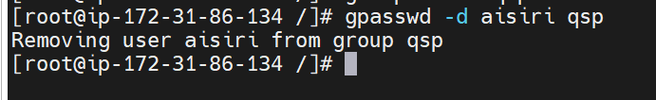
4.groupmod :- To change the group name
synatx :- groupmod -n <new-group> <old-group>
5.Remove the user from group :-
syntax :- gpasswd -d <user-name> <group-name>
6.groupdel :- To delete the groups
syntax :- groupdel <group-name>

Slide 25
File management:
In Linux OS we have default directory structure as a user. These are the files it contains.
1. /bin - It contains user binary files, executable files and linux command
2. /etc - In this location configuration files will be present..
3. /home - In this location our o.s will create the dedicated directory for user.
4. /tmp : - This directory is completely dedicated to store the temporary files.
5. /opt - It is dedicated to the 3rd party applications
6. /usr - It contains user related program files.
7. /var - It is used to store files that are constantly changing

Slide 26
File Permissions
1.Owner permissions
2.Group permissions
3.Other permissions
Permissions :- rwx
r read - 4
w write - 2
x Excute – 7
read,write,execute :
-------------------------
owner, group,others
7:- r(4) + w(2) + x(1)

Slide 27
chmod 777 <file-name>
4:- read
2:- write
1:- execute
777:
1st 7(seven) is for owner :- r+w+x
2nd 7(seven) is for groups :- r+w+x
3rd 7(seven) is for others :- r+w+x

Slide 28
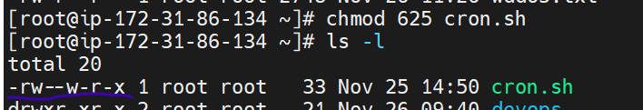
Example:
Consider the file demo and assign the permission as below
Owner – read (r) and write (w)
Group – write (w)
Others – read (r) and execute (x)
The permission will be like this, -rw--w-r-x
owner - 4(r) + 2(w) = 6
group – 2 (w)
others – 4(r) + 1 (x) =5
Command will be – chmod 625 demo

Slide 29
By using alphabets :
=,+,-
= :- Adding the permissions
+ :- add only one particular permission
:- remove the permissions
Example
Consider the file demo
chmod u=rwx,g+r,o+x demo
rwx :_ owner
r :- group
x :- others
( u – owner, g – group , o – other)
-rwxr--r-x

Slide 30
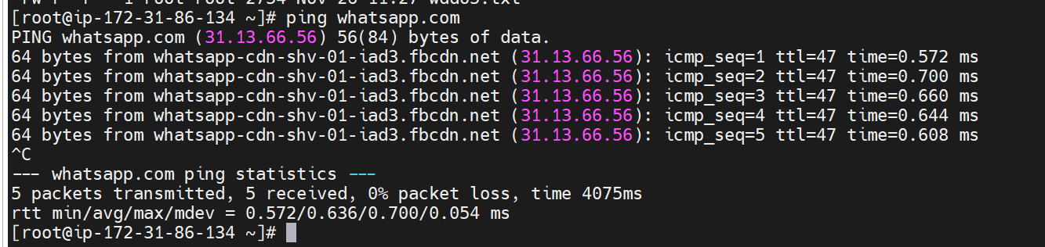
Networking Commands
scenario :- your developed one application in ur own server –Vpc
Ping - To check whether the user is able to use the application which we created in our vpc.
syntax : ping <app-name>
example : ping whatsapp.com

Slide 31
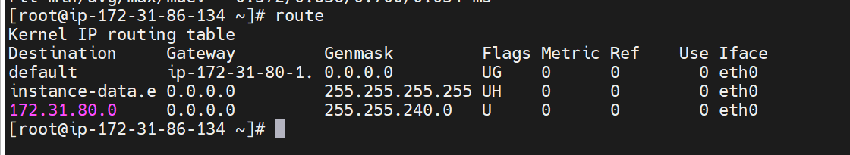
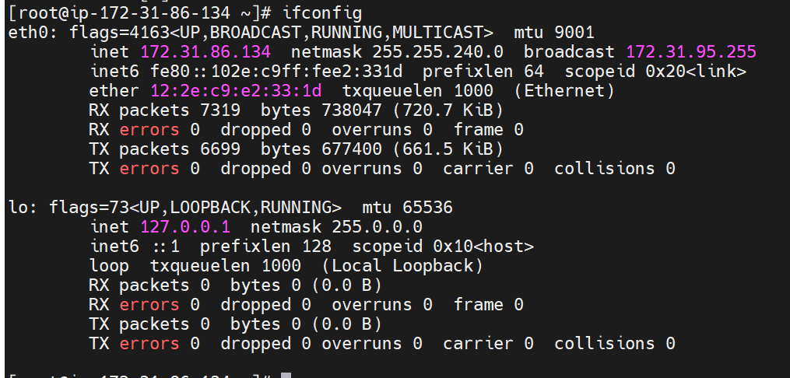
Route - To display / manipulate the routing information
syntax : route
3. Ifconfig - To get the information about respective network.
syntax : ifconfig

Slide 32
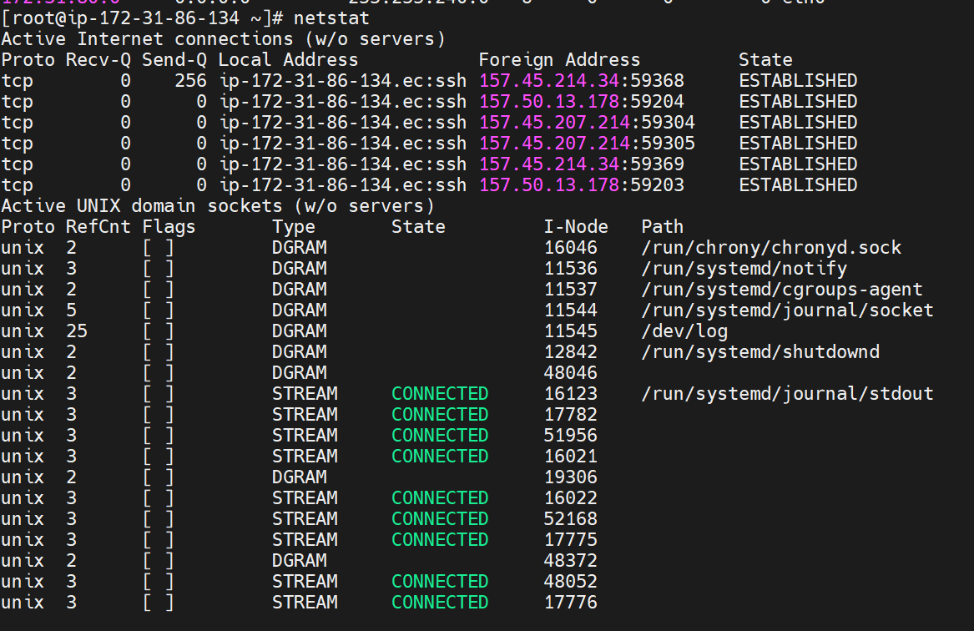
4. Netstat - To display information about network connection, routing table, interface statistics.
syntax : netstat

Slide 33
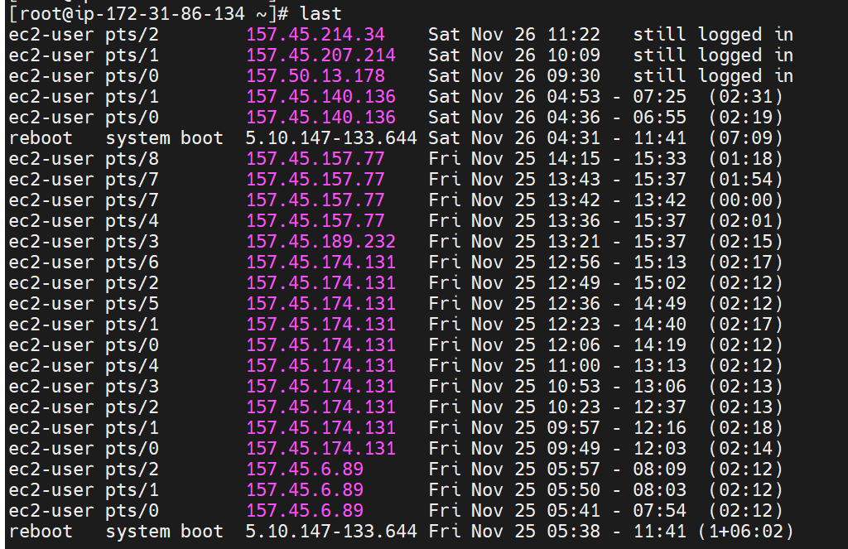
5. Nslookup – It is used to get the information about DNS server
syntax – nslookup
Last - gives information about logged in users.
syntax – last

Slide 34
File compression commands
1.tar(tape archive) :- create compressed format
syntax: tar cvf <filename.tar> <files....>
c:- Create
v:- verbosely
f :- file
Extracting the compressed files :-
synax :- tar xvf <file.tar>
tar :- tape archaive
x:- extract
v:- verbosely
f :- file

Slide 35
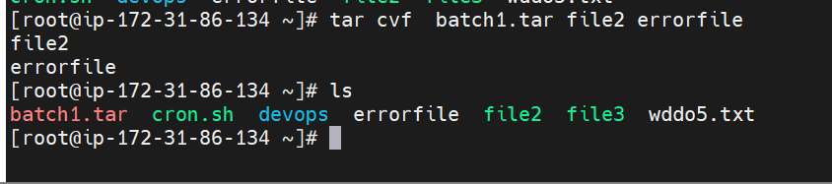
2. zip - it will store the files in compressed format without losing the data
synatx : zip <zip-filename.zip> filename1 filename2 filename3 …
extracting :
syntax - unzip <file.zip>

Slide 36
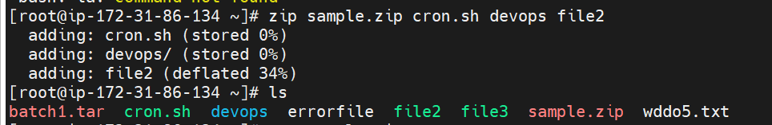
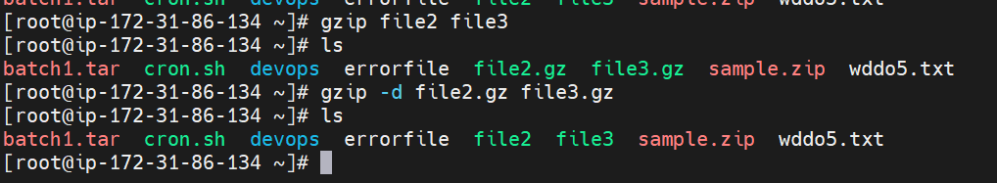
3. gzip (gnu zip ) - to zip the files individually
syntax - gzip <file-names>
Extracting :-
Syntax : gzip -d <file-name>

Slide 37
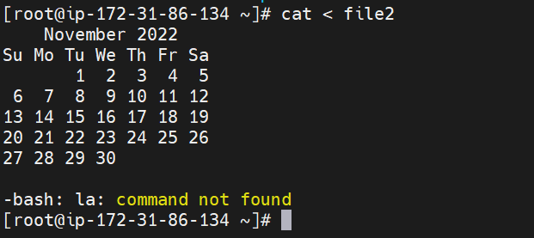
Input, output and error direction
1. Standard input(stdin) – It takes input from the standard input and displays in the terminal.
Example - cat < filename
2. Standard output (stdout) – It redirects the output to from one file to another.
Example – cal > cat file1
The output of cal command is redirected to file1

Slide 38
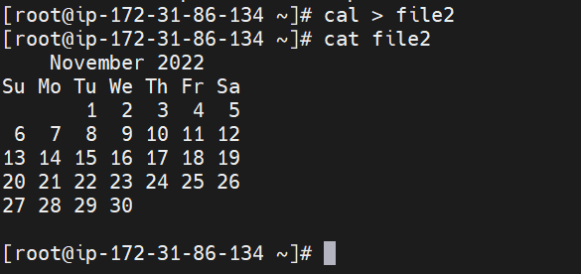
3. Standard error – To redirect the error to other file.
Example – la 2>> file1
zecho “hi” 2> file1
The error will not display on the terminal, because it will redirect to file1

Slide 39
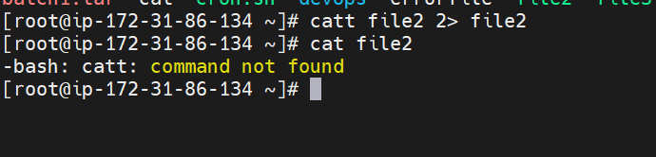

Slide 40
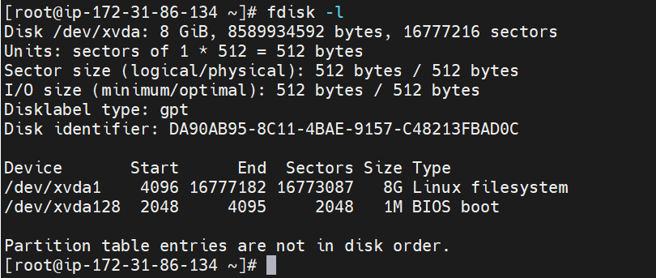
Disk utility
disk utility commands is used to monitor and manage the disk partitions.
fdisk –l - by this command we get to know the information about respective hardware.

Slide 41
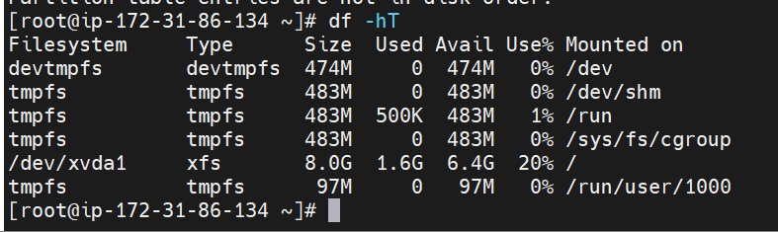
df - by using this command we will get the disk usage information
syntax – df or df –hT

Slide 42
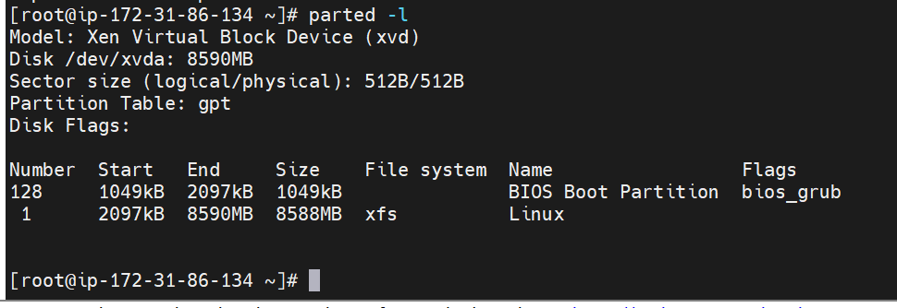
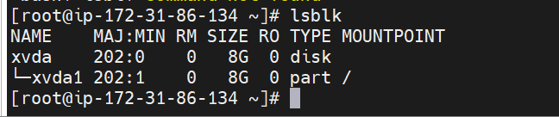
3. parted –l - by using this we will get the partotions related information, we can create or reorganize the partitions
syntax – parted –l
lsblk - prints the information regarding the disks.
syntax - lasbl

Slide 43
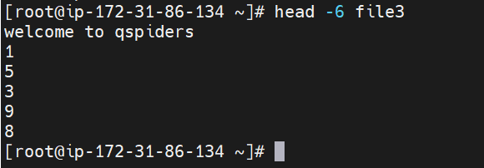
Filter commands
1. head - Head command will print starting lines
-n :- to specify the number of lines
-c :- to specify the character
syntax :- head <file-name> :- by default 10 lines

Slide 44
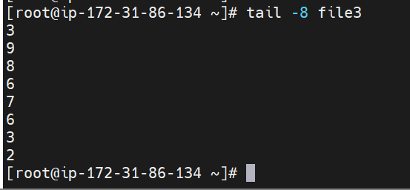
2. tail - tail command is used to print the data from end (from tail) but by defulat it will print 10 lines
-n :- to specify the number of lines
-c :- to specify the character
syntax :- tail <file-name>

Slide 45
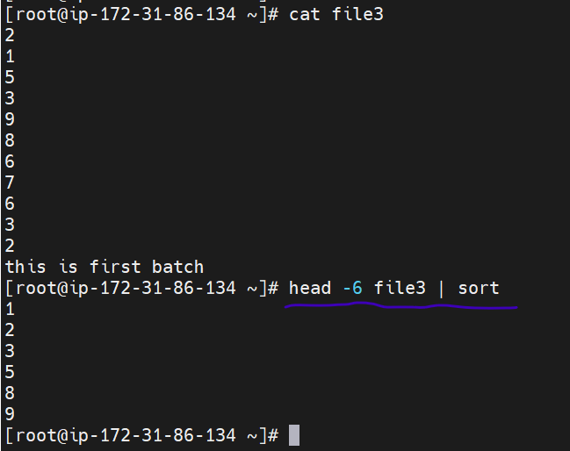
Pipeline command
1. Example – head filename | tail -3
Here , the output of head command is taken as input for tail command

Slide 46
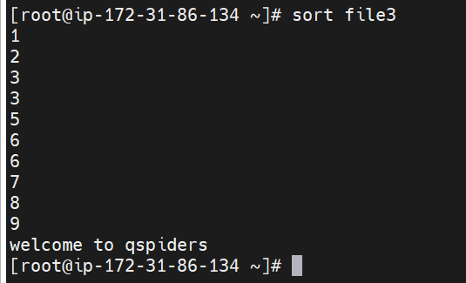
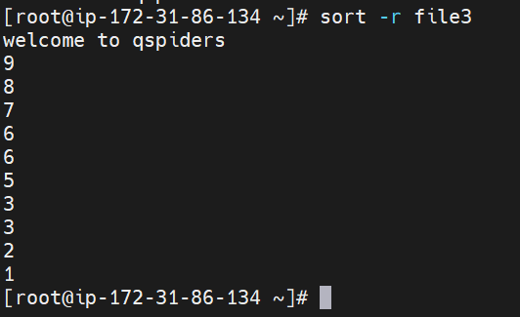
2. sort - it is used to print the data in ascending or desending order based on assci values
synatx :- sort <file>
for des :- sort -r <file-name>
for numerics :- sort -n <file-name>

Slide 47
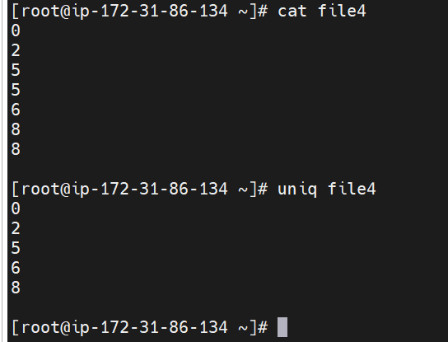
3. uniq - by using this command we can avoid/restirt the duplicate data and we can able display the unique data
-c :- to get the number of occurances
-d :- display only duplicate content

Slide 48
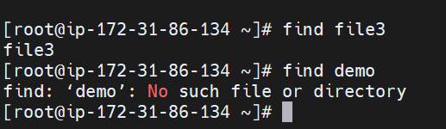
4. find - to find data or we can find the files whether the files are existing or not
5. sleep - it is used to sleep the terminal for the specified timing.
6. grep (global regular expression print )
synatx :- grep <word> <file>

Slide 49

8. tr - Translate
synatx :- tr <old data> <new-data>
9.sed (stream editor)
1.changing all :-
syntax :- sed 's/old-data/new-data/' <file-name>
example :- sed 's/s/m/' <file-name>

Slide 50
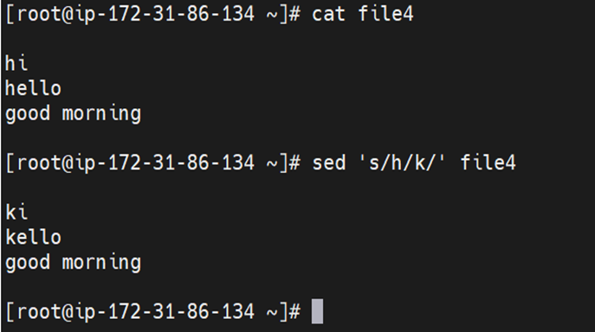
2.to print the replaced data
example :- sed 's/s/m/p' <file-name>
3.Replacing the specific lines :-
synatx :- sed '<nth line>s/old-data/new-data/p' <file-name>
example :- sed '2s/old-data/new-data/' <file-name>

Slide 51
AWK commands
Features:
it scans a file line by line.
it splits a file into multiple fields.
it formats the output lines.
it will act like a searching a specific data from the file.
synatx :- awk '/option/ {print}' <file-name>
2.to print the specified column
syntax :- awk '{print $n}' <file-name>

Slide 52
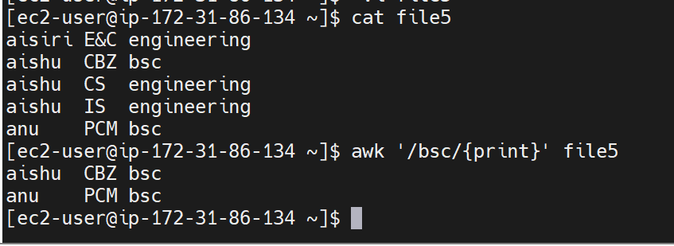

Slide 53
Crontab
It is type of job which is used to shedule the tasks
developer and test eng
Developer is working in client area (usa) :-
test eng is working in india (india) :-
Developer will inform to test eng stating that he is going deploy the build into beta server(pre-production server)
-> By using cron job our test eng will shedule the jobs based on the requirement
how will we will be using automation

Slide 54
to schedule the jobs based on the timings we use cron jobs..
* :- minutes (o-59)
* :- hour (0-23)
* :- day of the month (1-31)
* :- month of the year (1-12)
* :- day of the week (0-7). Sunday

Slide 55
step 1 :- create one shell script
cron.sh
----------------
#!/bin/bash
date >> /home/ec2-user/wddo2.txt
step 2 :- open the crontab -e for shedule the jobs
* * * * * /home/ec2-user/cron.sh
step 3 :- chmod 777 cron.sh
step 4 :- to verify
tail -f wddo2.txt

Slide 56
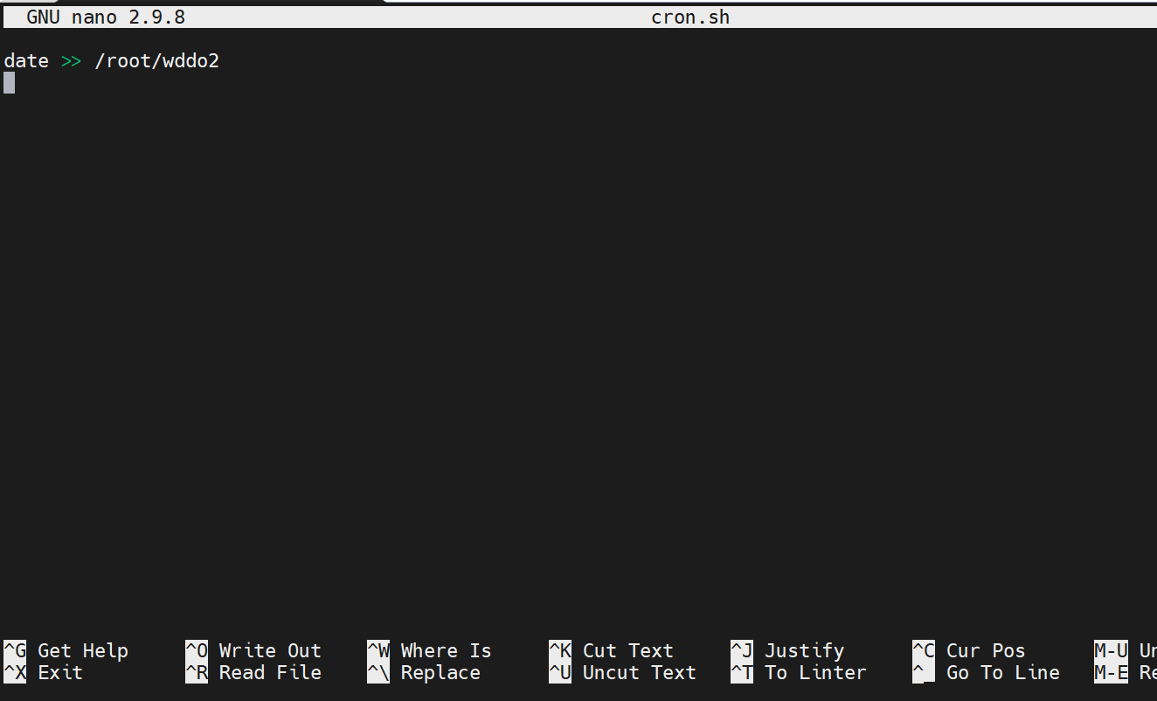
Step 1: create a shell script(ex- cron.sh) specify the file(ex-wddo2) in which you need to store the results of date command

Slide 57

Step 2: schedule the job by specifying the job.
crontab -e

Slide 58

Step 3: Give execute permission for the file
chmod 777 cron.sh
Step 4: tail –f wddo2. As you can see, for every minute it’s displaying the date (bcoz we gave date command in the script)

