Slide 1


Predicting Sepsis in ICU Patients
By Aisling Casey
Capstone Presentation
Springboard School of Data
May 2021
Earlier intervention for better health outcomes

Slide 2
Problem Identification
Context
Sepsis is a leading cause of death in US hospital patients
Solution Space
Classification of pre and non sepsis patients
Success Criteria
Accurate classification of pre and non sepsis patients in test set
Data Source
Hourly data from 40,336 ICU patients in 2 hospitals
Problem Statement: Early intervention in sepsis patients can lead to better health outcomes. Is it possible to predict sepsis in ICU patients hours before clinical diagnosis?

Slide 3
Data Structure & Source
Time (Hours) | Vital Signs 1-8 | Laboratory Values 9-34 | Demographics 35-40 | Sepsis Label 41
t₀ | … | … | … | 0
t₁ | … | … | … | 1
…. | … | … | … | 0
t_{n} | … | … | … | 0
Time (Hours) | Vital Signs 1-8 | Laboratory Values 9-34 | Demographics 35-40 | Sepsis Label 41
t₀ | … | … | … | …
t₁ | … | … | … | …
…. | … | … | … | …
t_{n} | … | … | … | …
Time (Hours) | Vital Signs 1-8 | Laboratory Values 9-34 | Demographics 35-40 | Sepsis Label 41
t₀ | … | … | … | 0
t₁ | … | … | … | 1
…. | … | … | … | 0
t_{n} | … | … | … | 0
Time (Hours) | Vital Signs 1-8 | Laboratory Values 9-34 | Demographics 35-40 | Sepsis Label 41
t₀ | … | … | … | …
t₁ | … | … | … | …
…. | … | … | … | …
t_{n} | … | … | … | …
Time (Hours) | Vital Signs 1-8 | Laboratory Values 9-34 | Demographics 35-40 | Sepsis Label 41
t₀ | … | … | … | …
t₁ | … | … | … | …
…. | … | … | … | …
t_{n} | … | … | … | …
Time (Hours) | Vital Signs 1-8 | Laboratory Values 9-34 | Demographics 35-40 | Sepsis Label 41
t₀ | … | … | … | …
t₁ | … | … | … | …
…. | … | … | … | …
t_{n} | … | … | … | …
Time (Hours) | Vital Signs 1-8 | Laboratory Values 9-34 | Demographics 35-40 | Sepsis Label 41
t₀ | … | … | … | …
t₁ | … | … | … | …
…. | … | … | … | …
t_{n} | … | … | … | …
Data made available by Physionet Computing in Cardiology Challenge 2019
Second classifier column, pre-sepsis, added

Slide 4
Sepsis Prevalence
Of 40,336 patients available in the data set, 7.27% develop sepsis at some point during their hospital stay.
Of the 1,552,210 data points in the data set, each representing an hour, 1.8% occur while a patient has sepsis.

Slide 5
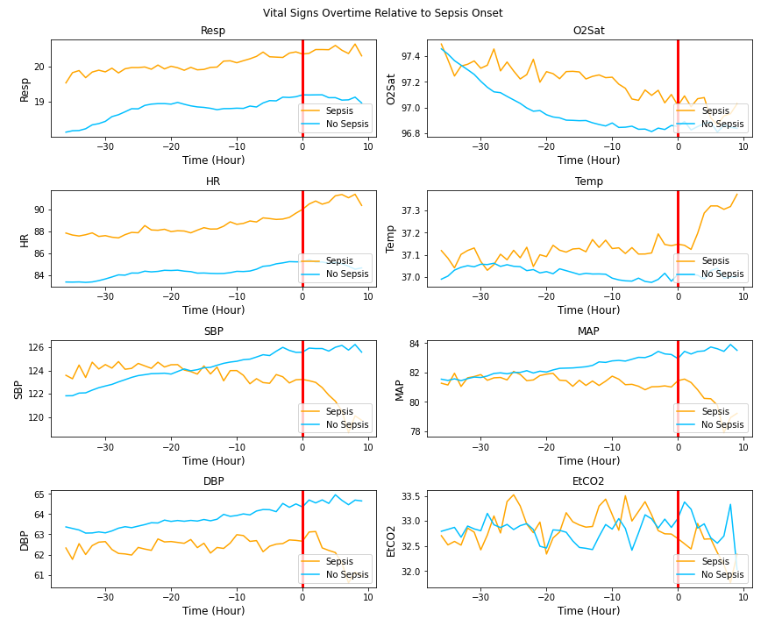
Exploratory Data Analysis: Vital Signs

Slide 6
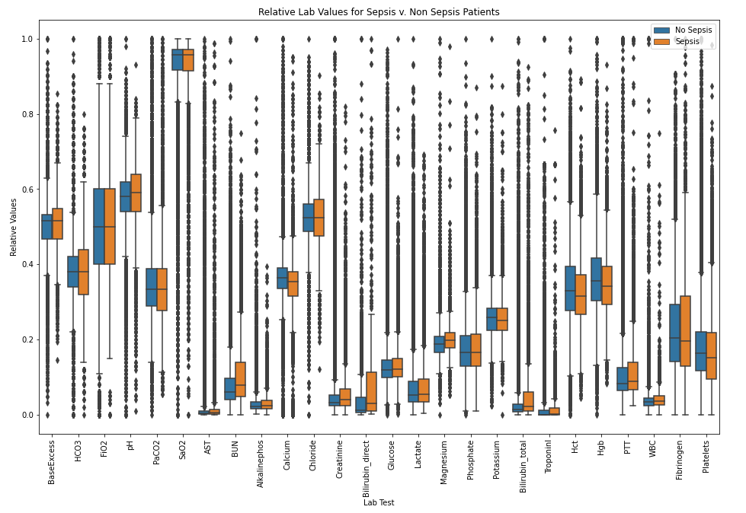
Exploratory Data Analysis: Normalized Lab Values

Slide 7
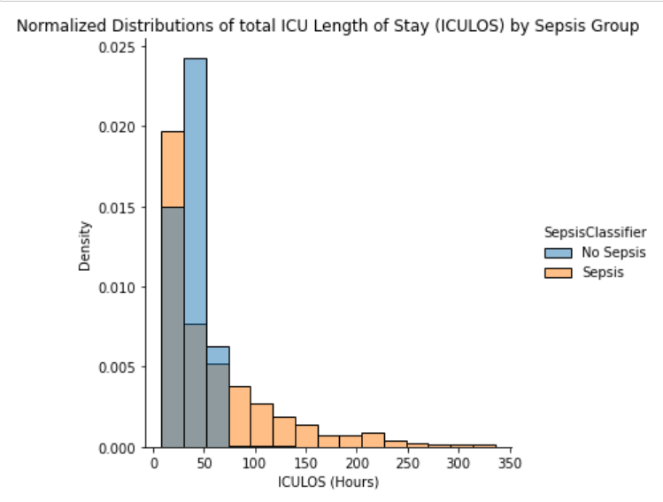
Exploratory Data Analysis: ICU Length of Stay

Slide 8
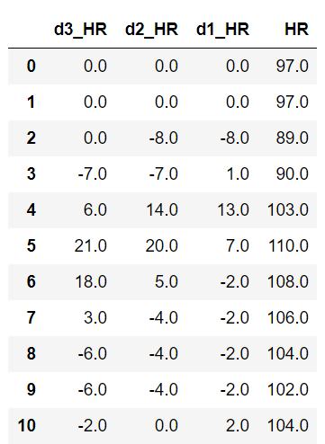
Feature Engineering
Interpolation & forward filling
Lab & Vital Sign Data
Changes in vital sign column
Past 1, 2, 3 Hours
Lab value indicator, forward filled

Slide 9
Classification Report: Testing Data, All Models
Model Results Testing Data | Logistic Regression |  | Random Forest |  | Gradient Boost |  | SVM
 | Accuracy | Sepsis F1 | Accuracy | Sepsis F1 | Accuracy | Sepsis F1 | Accuracy | Sepsis F1
Sepsis Label | .95 | .16 | 0.96 | 0.17 | 0.96 | 0.18 | 0.84 | 0.11
Pre Sepsis | .99 | .02 | 0.99 | 0.04 | 0.99 | 0.01 | x | x
Model Results Testing Data | Logistic Regression |  | Random Forest |  | Gradient Boost |  | SVM
 | Accuracy | Sepsis F1 | Accuracy | Sepsis F1 | Accuracy | Sepsis F1 | Accuracy | Sepsis F1
Sepsis Label | .95 | .16 | 0.96 | 0.17 | 0.96 | 0.18 | 0.84 | 0.11
Pre Sepsis | .99 | .02 | 0.99 | 0.04 | 0.99 | 0.01 | x | x
Model Results Testing Data | Logistic Regression |  | Random Forest |  | Gradient Boost |  | SVM
 | Accuracy | Sepsis F1 | Accuracy | Sepsis F1 | Accuracy | Sepsis F1 | Accuracy | Sepsis F1
Sepsis Label | .95 | .16 | 0.96 | 0.17 | 0.96 | 0.18 | 0.84 | 0.11
Pre Sepsis | .99 | .02 | 0.99 | 0.04 | 0.99 | 0.01 | x | x
 | Model 1: Logistic Regression |  | Model 2: Random Forest |  | Model 3: Gradient Boost |  | Model 4: SVM
 | Accuracy | Sepsis F1 | Accuracy | Sepsis F1 | Accuracy | Sepsis F1 | Accuracy | Sepsis F1
Performance Metric
Sepsis Label | .95 | .16 | 0.96 | 0.17 | 0.96 | 0.18 | 0.84 | 0.11
Pre-Sepsis | .99 | .02 | 0.99 | 0.04 | 0.99 | 0.01 | x | x

Slide 10
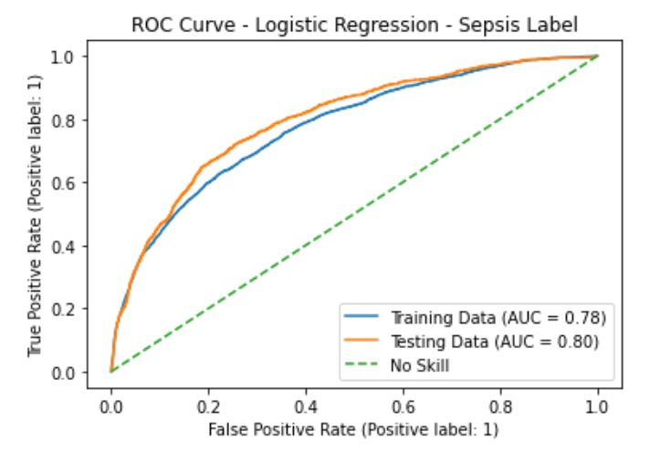
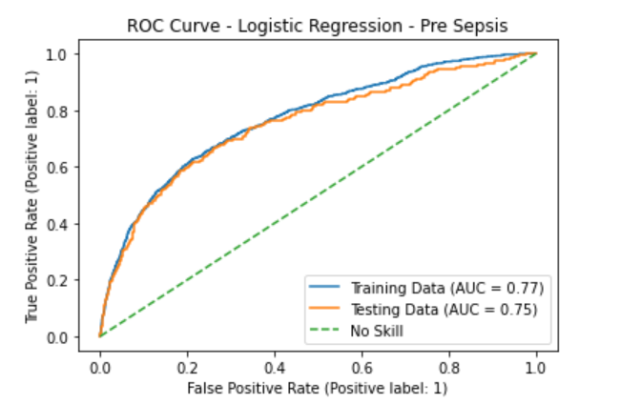
Model Results: ROC Curves

Slide 11
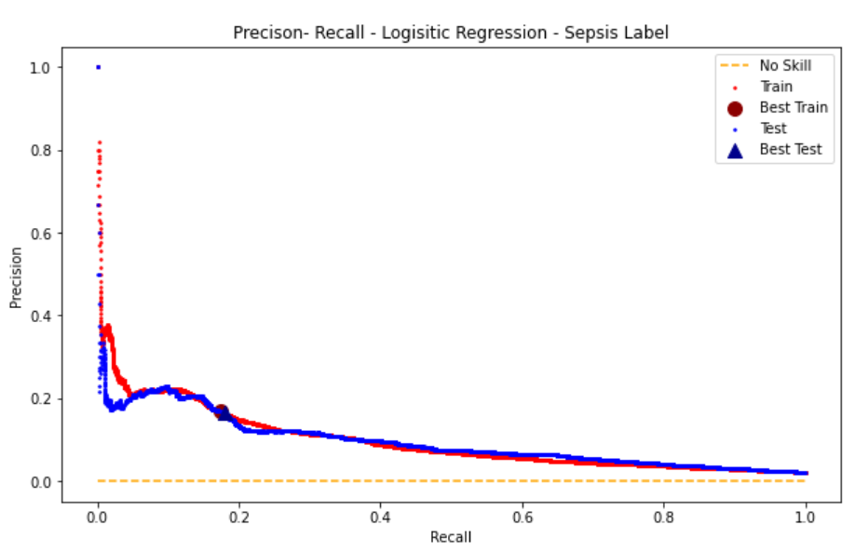
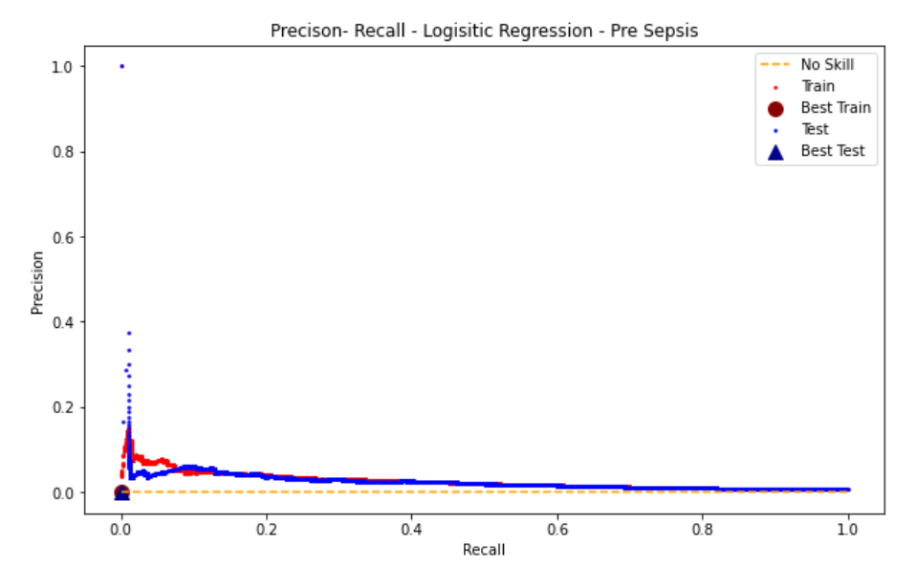
Model Results: Precision–Recall Curves
Better characterization of model performance on imbalanced classes

Slide 12
Note: Classification threshold set to 10.1%, which yields the best F1 test score on the training data set
Confusion Matrix: Sepsis Label Testing Data, Logistic Regression Model
 | Actual Non-Sepsis | Actual Sepsis
Predicted Non-Sepsis | 56151 | 1833
Predicted Sepsis | 865 | 251
 | Actual Non-Sepsis | Actual Sepsis
Predicted Non-Sepsis | 56151 | 1833
Predicted Sepsis | 865 | 251
 | Actual Non-Sepsis | Actual Sepsis
Predicted Non-Sepsis | 56151 | 1833
Predicted Sepsis | 865 | 251
 | Actual Non-Sepsis | Actual Sepsis
Predicted Non-Sepsis | 56151 | 1833
Predicted Sepsis | 865 | 251
 | Actual Non-Sepsis | Actual Sepsis
Predicted Non-Sepsis | 56151 | 1833
Predicted Sepsis | 865 | 251
 | Actual Non-Sepsis | Actual Sepsis
Predicted Non-Sepsis | 56151 | 1833
Predicted Sepsis | 865 | 251

Slide 13
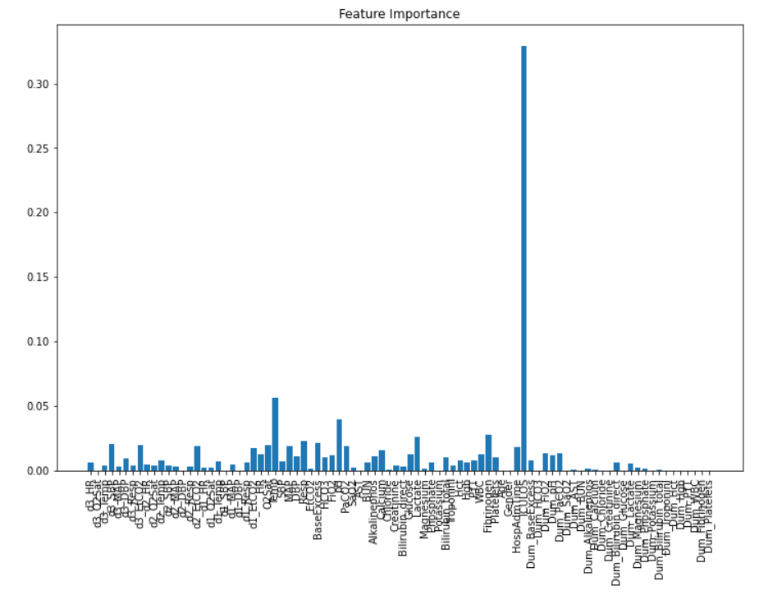
Feature Importance: Gradient Boost Model
ICU length of stay →

Slide 14
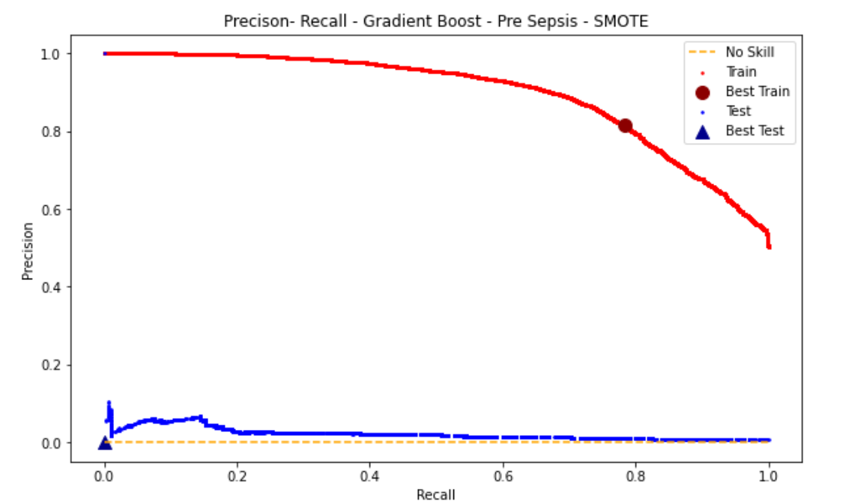
SMOTE: A technique that generates artificial data based on the minority class
What about SMOTE?
ICU length of stay →

Slide 15
Conclusion & Future Steps
Sepsis is known to manifest very differently in different people; this was evidenced by the lack of distinction in the distributions of laboratory values between groups
No model proved useful in accurately classifying sepsis patients, neither during sepsis or in the hours before it
Other groups in the competition were able to build useful models with advanced feature engineering and machine learning algorithms, such as neural nets^{[1]}
Better classification is possible, but methods more advanced than I am currently able to employ are needed.
[1] Liu, L., Wu, H., Wang, Z., Lieu, Z, Zhang, M. Early Prediction of Sepsis From Clinical Data via Heterogeneous Event Aggregation. arXiv.org. 2019 Oct 12; 1910.06792v1.

