Slide 1


Predicting Sepsis in ICU Patients
By Aisling Casey
Capstone Presentation
Springboard School of Data
June 2021
Earlier intervention for better health outcomes

Slide 2
Problem Identification
Context
Sepsis is a leading cause of death in US hospital patients
Solution Space
Classification of pre and non sepsis patients
Success Criteria
Accurate classification of pre and non sepsis patients in test set
Data Source
Hourly data from 40,336 ICU patients in 2 hospitals
Problem Statement: Early intervention in sepsis patients can lead to better health outcomes. Is it possible to predict sepsis in ICU patients hours before clinical diagnosis?

Slide 3
Data Structure & Source
Time (Hours) | Vital Signs 1-8 | Laboratory Values 9-34 | Demographics 35-40 | Sepsis Label 41
t₀ | … | … | … | 0
t₁ | … | … | … | 1
…. | … | … | … | 0
t_{n} | … | … | … | 0
Time (Hours) | Vital Signs 1-8 | Laboratory Values 9-34 | Demographics 35-40 | Sepsis Label 41
t₀ | … | … | … | …
t₁ | … | … | … | …
…. | … | … | … | …
t_{n} | … | … | … | …
Time (Hours) | Vital Signs 1-8 | Laboratory Values 9-34 | Demographics 35-40 | Sepsis Label 41
t₀ | … | … | … | 0
t₁ | … | … | … | 1
…. | … | … | … | 0
t_{n} | … | … | … | 0
Time (Hours) | Vital Signs 1-8 | Laboratory Values 9-34 | Demographics 35-40 | Sepsis Label 41
t₀ | … | … | … | …
t₁ | … | … | … | …
…. | … | … | … | …
t_{n} | … | … | … | …
Time (Hours) | Vital Signs 1-8 | Laboratory Values 9-34 | Demographics 35-40 | Sepsis Label 41
t₀ | … | … | … | …
t₁ | … | … | … | …
…. | … | … | … | …
t_{n} | … | … | … | …
Time (Hours) | Vital Signs 1-8 | Laboratory Values 9-34 | Demographics 35-40 | Sepsis Label 41
t₀ | … | … | … | …
t₁ | … | … | … | …
…. | … | … | … | …
t_{n} | … | … | … | …
Time (Hours) | Vital Signs 1-8 | Laboratory Values 9-34 | Demographics 35-40 | Sepsis Label 41
t₀ | … | … | … | …
t₁ | … | … | … | …
…. | … | … | … | …
t_{n} | … | … | … | …
Data made available by Physionet Computing in Cardiology Challenge 2019
Second classifier column, pre-sepsis, added

Slide 4
Sepsis Prevalence
Of 40,336 patients available in the data set, 7.27% develop sepsis at some point during their hospital stay.

Slide 5
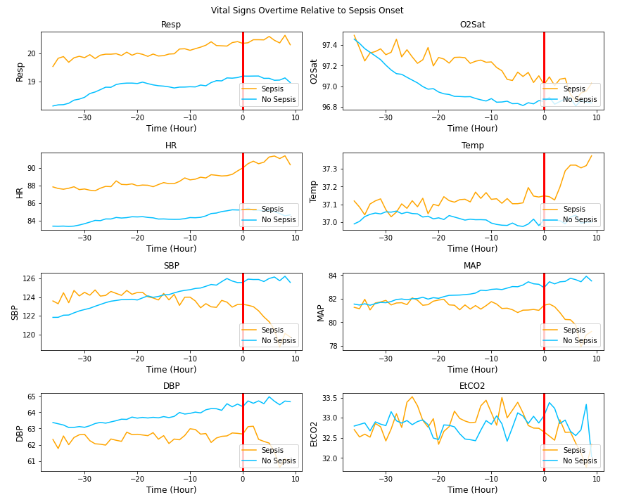
Exploratory Data Analysis: Vital Signs

Slide 6
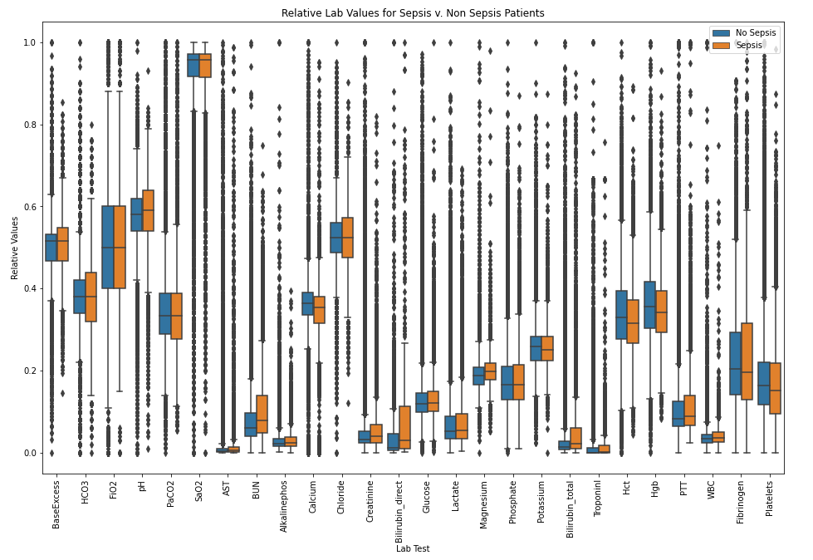
Exploratory Data Analysis: Normalized Lab Values

Slide 7
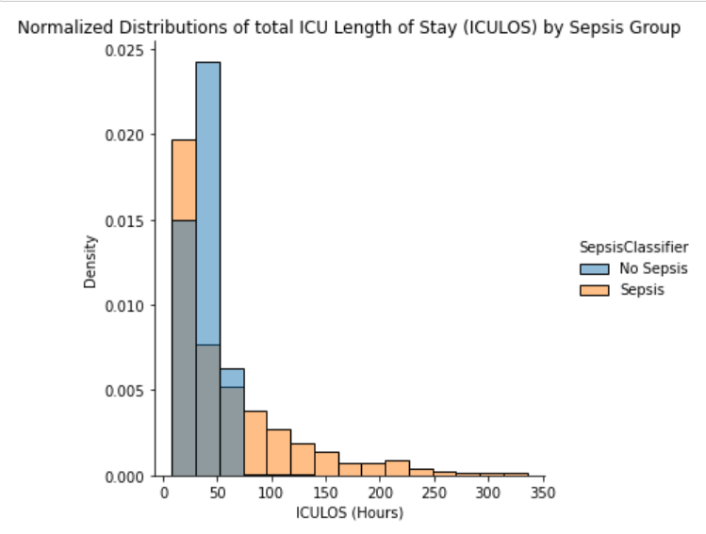
Exploratory Data Analysis: ICU Length of Stay

Slide 8
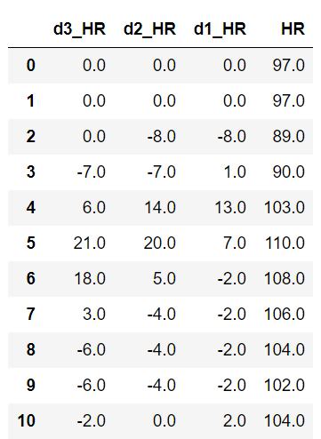
Feature Engineering
Interpolation & forward filling
Lab & Vital Sign Data
Changes in vital sign column
Past 1, 2, 3 Hours
Lab value indicator, forward filled

Slide 9
Final Model Results
Classification Scheme 1: Hourly Classification
Hour by hour classification of a patient being in the pre-sepsis period or not.

Slide 10
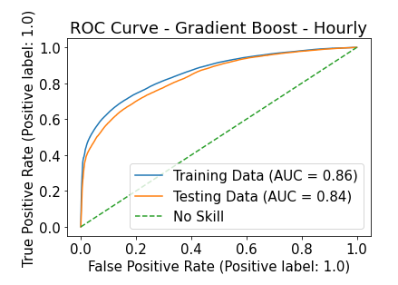

Slide 11
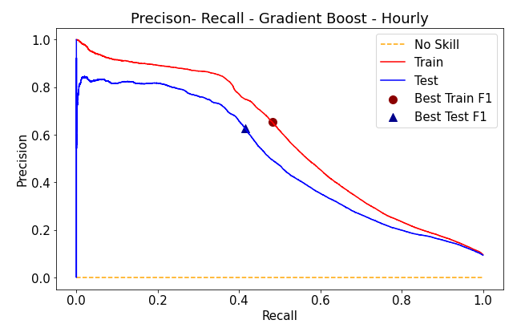
Train AUC: 0.581
Test AUC: 0.496
Precision – Recall shows performance on imbalanced data better than ROC

Slide 12
Confusion Matrix: Hourly
Actual | Predicted
 | 0 | 1 | 0 | 1 | 0 | 1
0 | 82% | 17.9% | 97.5% | 2.5% | 98.4% | 1.6%
1 | 32.1% | 67% | 58.5% | 41.5% | 62.9% | 37%
Threshold | 10% |  | 21.6% |  | 30%
Actual | Predicted
 | 0 | 1 | 0 | 1 | 0 | 1
0 | 82% | 17.9% | 97.5% | 2.5% | 98.4% | 1.6%
1 | 32.1% | 67% | 58.5% | 41.5% | 62.9% | 37%
Threshold | 10% |  | 21.6% |  | 30%
Actual | Predicted
 | 0 | 1 | 0 | 1 | 0 | 1
0 | 344789 | 75264 | 409363 | 10690 | 413244 | 6809
1 | 13861 | 29275 | 25214 | 17922 | 27140 | 15996
Threshold | 10% |  | 21.6% |  | 30%
Actual | Predicted
 | 0 | 1 | 0 | 1 | 0 | 1
0 | 82% | 17.9% | 97.5% | 2.5% | 98.4% | 1.6%
1 | 32.1% | 67% | 58.5% | 41.5% | 62.9% | 37%
Threshold | 10% |  | 21.6% |  | 30%
Actual | Predicted
 | 0 | 1 | 0 | 1 | 0 | 1
0 | 82% | 17.9% | 97.5% | 2.5% | 98.4% | 1.6%
1 | 32.1% | 67% | 58.5% | 41.5% | 62.9% | 37%
Threshold | 10% |  | 21.6% |  | 30%
Actual | Predicted
 | 0 | 1 | 0 | 1 | 0 | 1
0 | 82% | 17.9% | 97.5% | 2.5% | 98.4% | 1.6%
1 | 32.1% | 67% | 58.5% | 41.5% | 62.9% | 37%
Threshold | 10% |  | 21.6% |  | 30%
Actual | Predicted
 | 0 | 1 | 0 | 1 | 0 | 1
0 | 82% | 17.9% | 97.5% | 2.5% | 98.4% | 1.6%
1 | 32.1% | 67% | 58.5% | 41.5% | 62.9% | 37%
Threshold | 10% |  | 21.6% |  | 30%

Slide 13
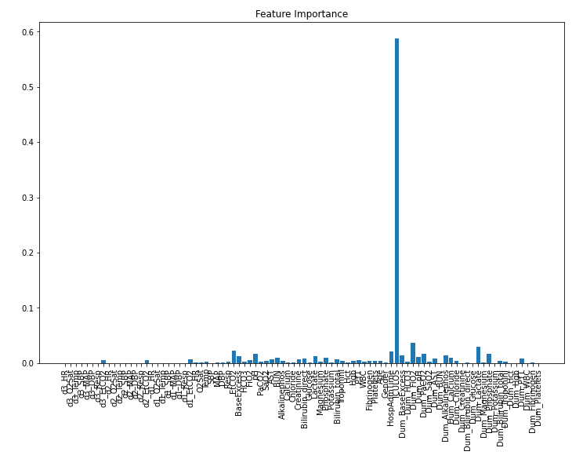
ICU length of stay →

Slide 14
Final Model Results
Classification Scheme 2: By-Patient Classification
Non-sepsis patient classified with any positive hourly predictions, or a sepsis patient with positive prediction at any point in pre-sepsis period : 1
Non-sepsis patient with no positive predictions, or a sepsis patient with positive prediction only during/after sepsis or not at all: 0

Slide 15
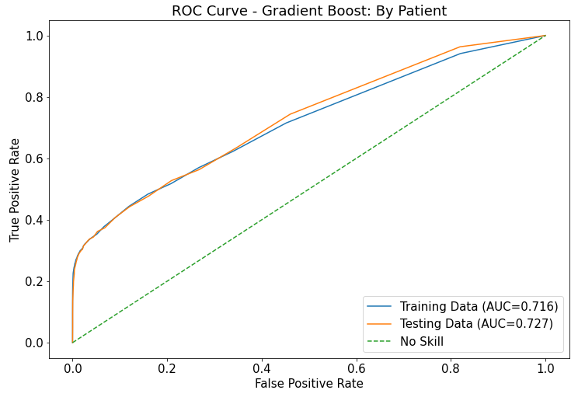

Slide 16
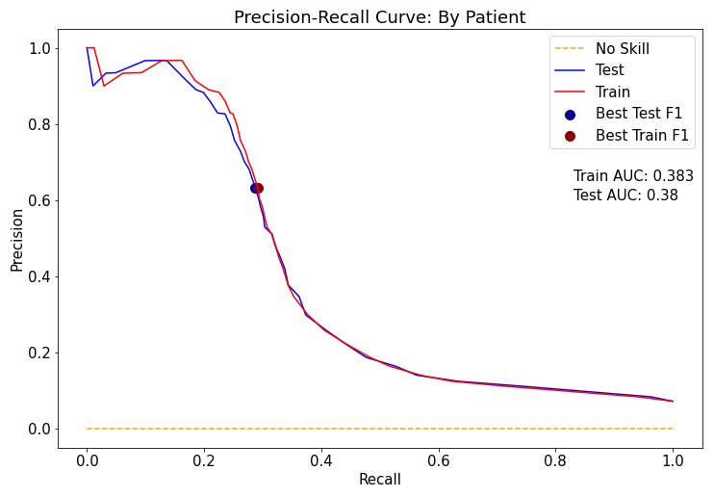
ICU length of stay →
Step drop off in precision when looking at patient classification results

Slide 17
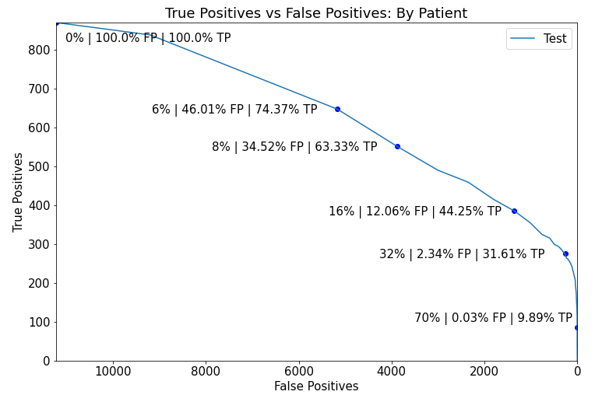

Slide 18
Confusion Matrix: Patient Level
Actual | Predicted
 | 0 | 1 | 0 | 1 | 0 | 1
0 | 18.1% | 81.9% | 76% | 24% | 97.9% | 2.1%
1 | 3.7% | 96.3% | 45.9% | 54.1% | 69.7% | 30.3%
Threshold | 4% |  | 11% |  | 34%
Actual | Predicted
 | 0 | 1 | 0 | 1 | 0 | 1
0 | 18.1% | 81.9% | 76% | 24% | 97.9% | 2.1%
1 | 3.7% | 96.3% | 45.9% | 54.1% | 69.7% | 30.3%
Threshold | 4% |  | 11% |  | 34%
Actual | Predicted
 | 0 | 1 | 0 | 1 | 0 | 1
0 | 18.1% | 81.9% | 76% | 24% | 97.9% | 2.1%
1 | 3.7% | 96.3% | 45.9% | 54.1% | 69.7% | 30.3%
Threshold | 4% |  | 11% |  | 34%
Actual | Predicted
 | 0 | 1 | 0 | 1 | 0 | 1
0 | 2030 | 9201 | 8534 | 2697 | 10996 | 235
1 | 32 | 838 | 399 | 471 | 606 | 264
Threshold | 4% |  | 11% |  | 34%
Actual | Predicted
 | 0 | 1 | 0 | 1 | 0 | 1
0 | 18.1% | 81.9% | 76% | 24% | 97.9% | 2.1%
1 | 3.7% | 96.3% | 45.9% | 54.1% | 69.7% | 30.3%
Threshold | 4% |  | 11% |  | 34%
Actual | Predicted
 | 0 | 1 | 0 | 1 | 0 | 1
0 | 18.1% | 81.9% | 76% | 24% | 97.9% | 2.1%
1 | 3.7% | 96.3% | 45.9% | 54.1% | 69.7% | 30.3%
Threshold | 4% |  | 11% |  | 34%
Actual | Predicted
 | 0 | 1 | 0 | 1 | 0 | 1
0 | 18.1% | 81.9% | 76% | 24% | 97.9% | 2.1%
1 | 3.7% | 96.3% | 45.9% | 54.1% | 69.7% | 30.3%
Threshold | 4% |  | 11% |  | 34%

Slide 19
Use Cases
The by-patient classification schema is used because it more accurately reflects how the model will perform across all patients, regardless of ICU length of stay. It is used for the following scenarios.
Sepsis Concern Eliminator
4% | TPR .96| FPR .81
Indicates if a patient is very unlikely to develop sepsis
Elevated Sepsis Intervention Warning
11% | TPR .54| FPR .24
Sepsis risk elevated; patient should be monitored closely
Critical Sepsis Intervention Warning
34% | TPR .30| FPR .02
Sepsis eminent; clinician should treat for sepsis

Slide 20
Conclusions & Future Directions
Sepsis is known to manifest very differently in different people
Nonetheless, the selected gradient boost model had skill in distinguishing groups
The elevated sepsis intervention use case is the most feasible, because it could augment clinician’s decisions, while not being relied upon too greatly
For actual clinical use, a model that could predict sepsis onset with greater precision and within a specific time frame is needed
Recurrent neural net models have seen more success in this, as they can process sequences of data^{[1]}
[1] Liu, L., Wu, H., Wang, Z., Lieu, Z, Zhang, M. Early Prediction of Sepsis From Clinical Data via Heterogeneous Event Aggregation. arXiv.org. 2019 Oct 12; 1910.06792v1.

