Slide 1

Convolutional Neural Networks

Slide 2
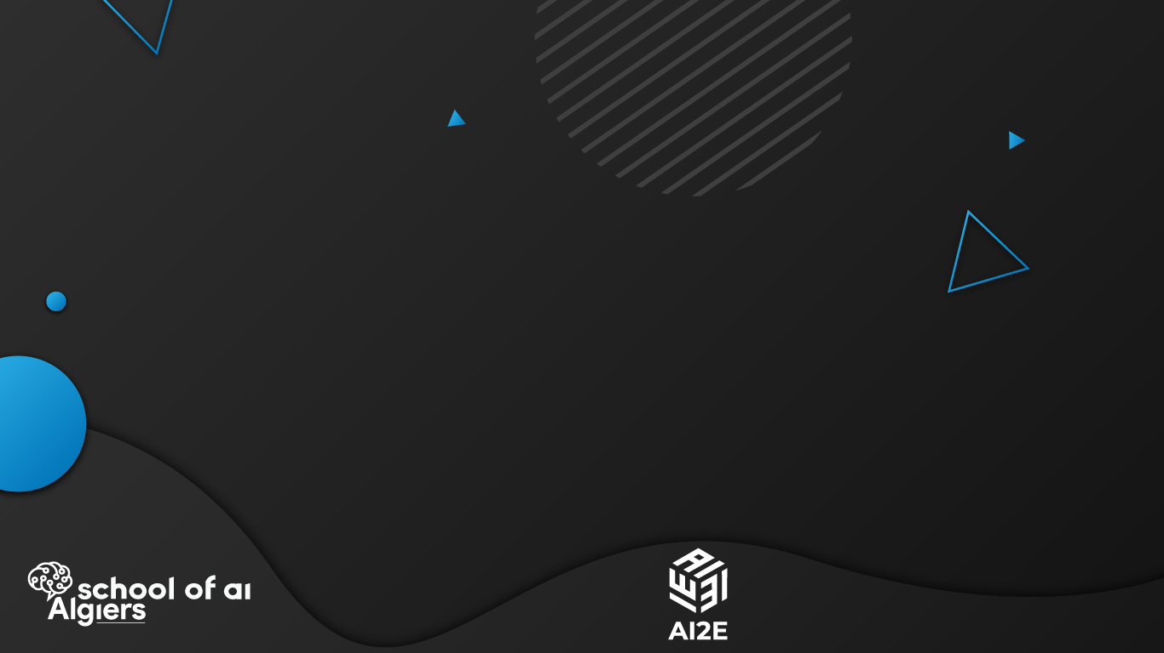
“If We Want Machines to Think, We Need to Teach Them to See” — Fei-Fei Li

Slide 3

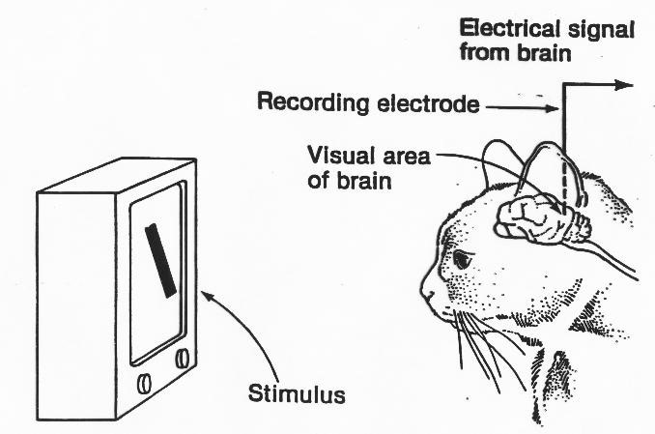
Experiments of Hubel & Wiesel (1960s)

Slide 4
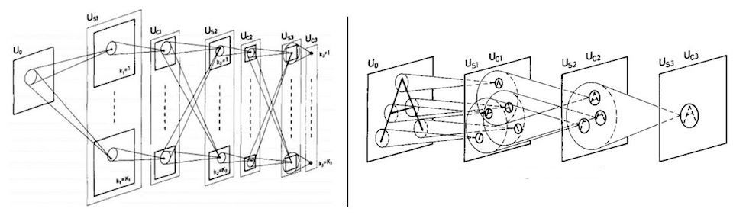
Fukushima’s Neocognitron (1982)

Slide 5
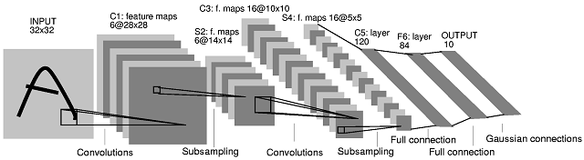
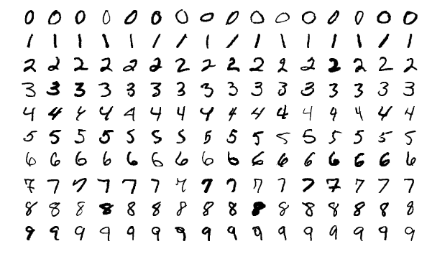
LeNet (1998)

Slide 6
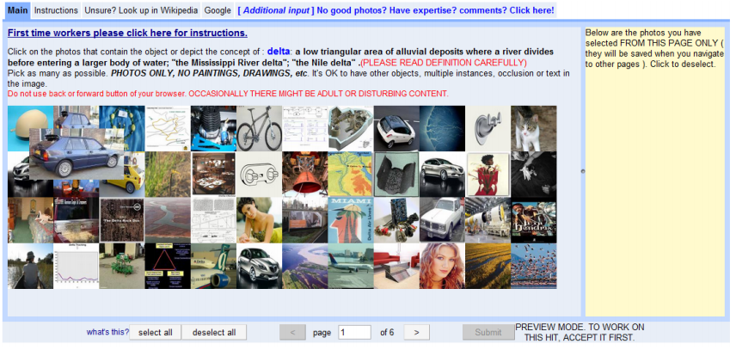
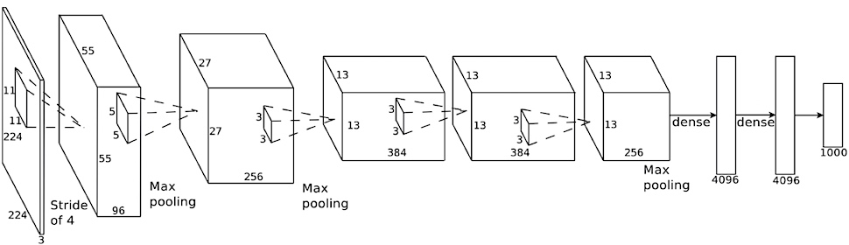
AlexNet (2012)

Slide 7
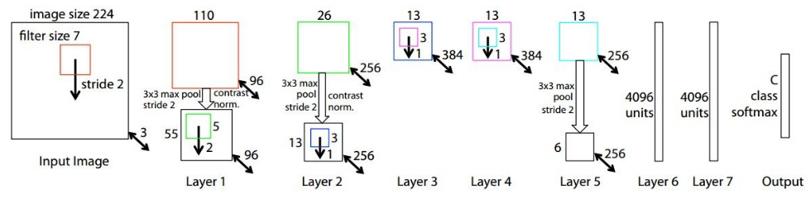
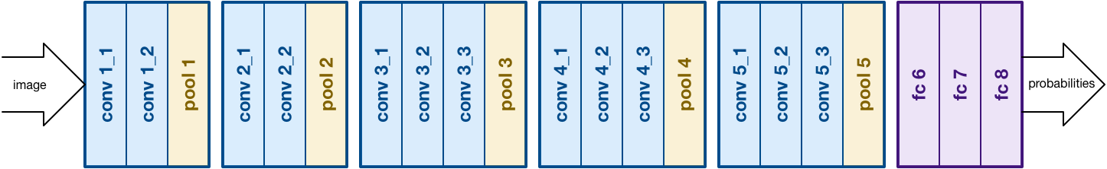
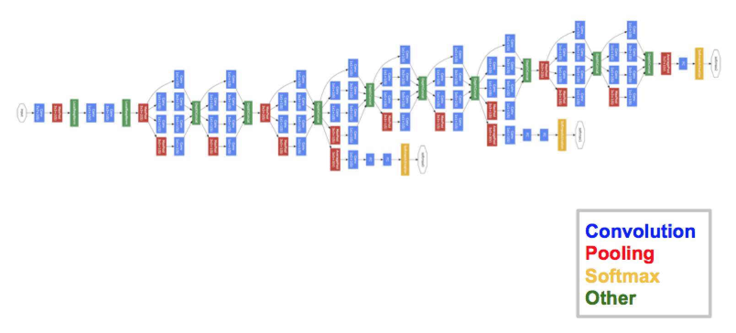
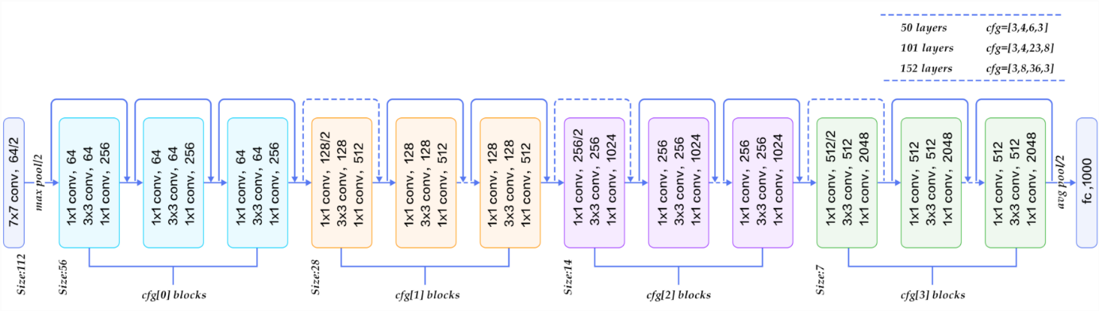
ZFNet(2013) (error rate of 14.8% )
VGGNet (2014) the most preferred choice in the community for extracting features from images
GoogLeNet/Inception(2014) (error rate of 6.67%)
ResNet(2015) (error rate of 3.57%)

