Slide 1

AI2E : Workshop 11
RL : Q-Learning!

Slide 2

WHOA!
MADJDA ZERROUK
5th year student at ESI
Mobile developer at Yassir

Slide 3

01
02
From Classique ML to RL
What’s RL
03
04
RL In The Practice
Q-Learning
A global View
Analogy , elements ,mathematics categories
Use sectors , Challenges and limitation
Definition , process , a practical case

Slide 4
01.
From Classique ML to RL
A global View

Slide 5
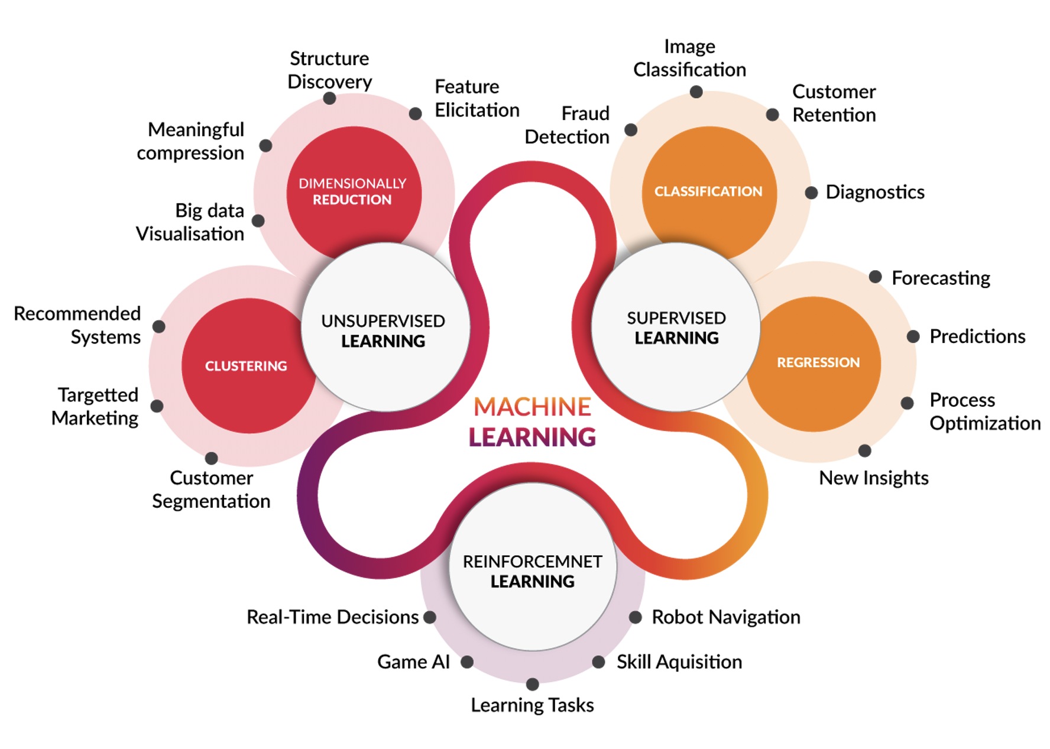

Slide 6
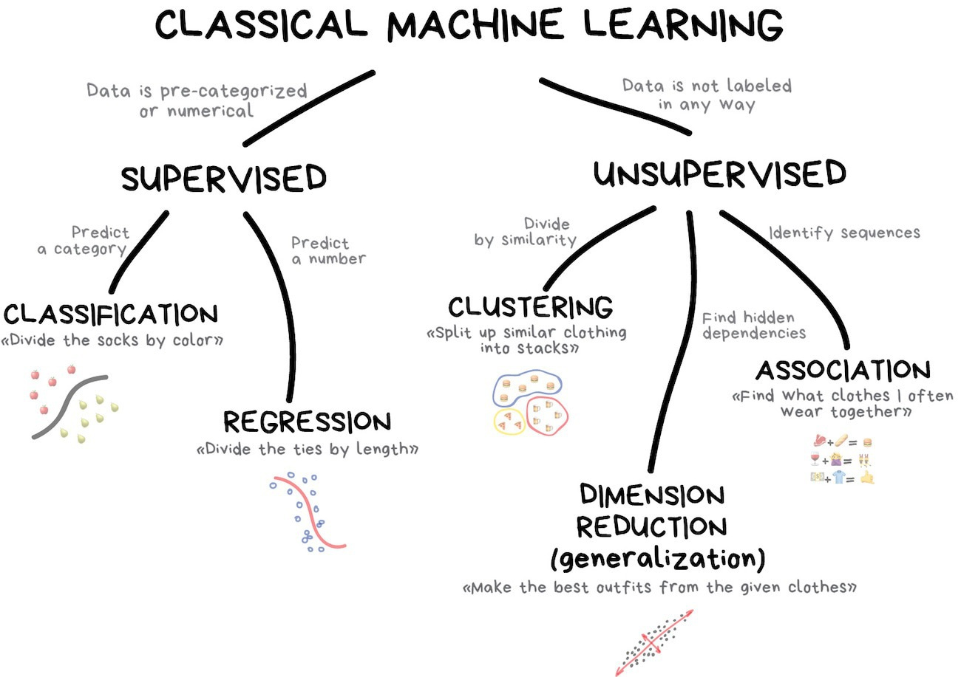
Machine learning is defined as the part of machine science, or the capabilities of a system or software that has evolved automatically over time based only on the data of learning.
Classic Machine Learning: Supervised and Unsupervised Learning
Classic ML has several limitations: Data (Quality and Quantity), preprocessing, etc.

Slide 7
Subclass of Machine Learning and an approach linked to Artificial Intelligence that pushes the machine to learn what to do in a certain state so as to maximize the total reward.
RL In General
Data in the form of actions & states
Several algorithms and methods implement RL & speed up the learning process.

Slide 8
02.
What’s RL
Analogy , elements , mathematics , categories

Slide 9
“a way of programming agents by reward and punishment without needing to specify how the task is to be achieved”
[Kaelbling, Littman, & Moore, 96]

Slide 10
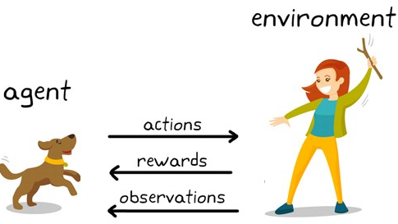
RL’s Analogy

Slide 11
The dog represents "The Agent" who is exposed to “The Environment” which can be your house / garden
Dog’s reaction when using a specific word to change its state is analogous to “The action”
“The Policy” is the strategy of choosing an action based on a state while awaiting better results
RL’s Elements
The situations they encounter are analogous to ”The States”.
After the transition, the dog may receive a reward or penalty in return.

Slide 12
The standard model of reinforcement learning includes an agent that interacts with an environment through actions that generate a new state, the environment also responds with a reward: a numerical value that the agent aims to maximize.
More formally ...

Slide 13
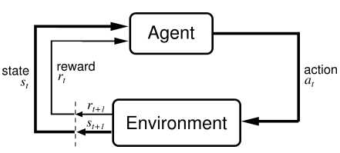
More formally ...
Notes:
1. Observe state, st
2. Decide on an action, at
3. Perform action
4. Observe new state, st+1
5. Observe reward, rt+1
6. Learn from experience
7. Repeat

Slide 14
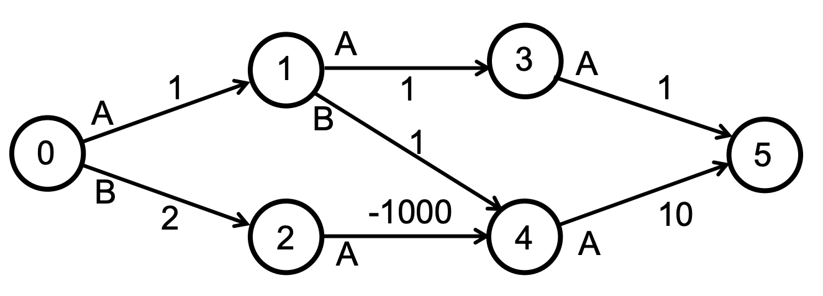
RL’s mathematics
A set of states, S = {s1, s 2, ... , s n }
A set of actions, A = {a1, a 2, ... , a m }
A reward function, R: S × A × S → ℜ
A transition function, P : S x A x S → [0,1]
Markov Decision Processes

Slide 15
We want to learn a policy, π: S → A that maximize the sum of rewards
Order policies by how much reward they see
1. 0 →1 →3 →5 = 1 + 1 + 1 = 3
2. 0 →1 →4 →5 = 1 + 1 + 10 = 12
3. 0 →2 →4 →5 = 2 – 1000 + 10 = -988
RL’s mathematics
Policy

Slide 16
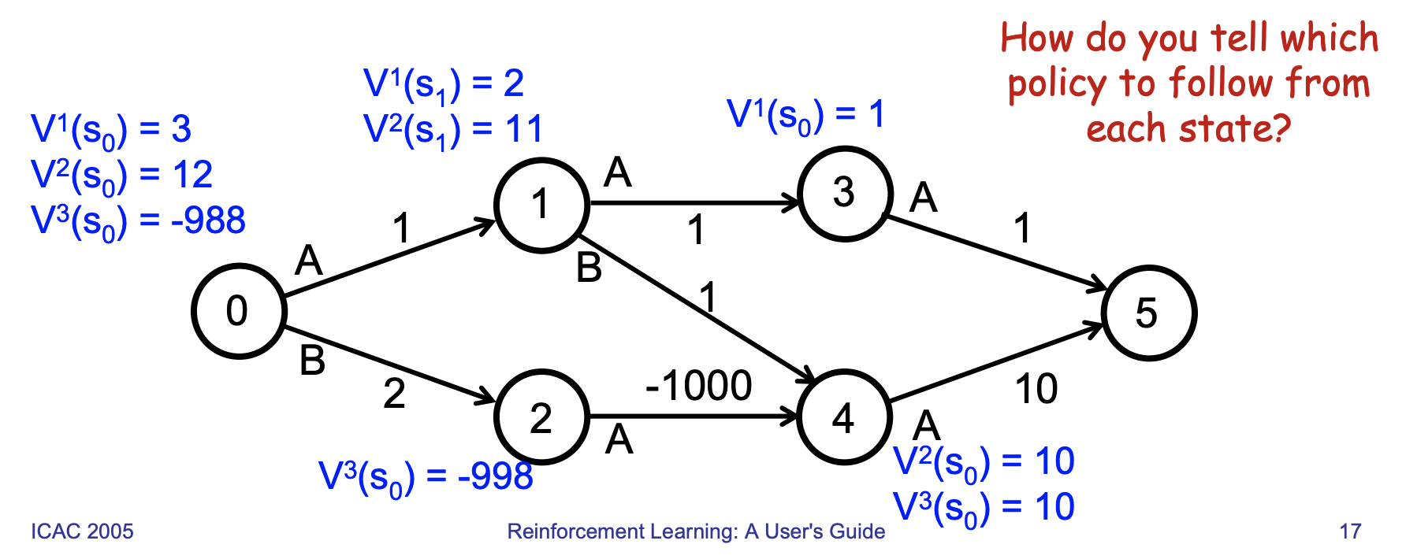
We can associate a value with each state
For a fixed policy
How good is it to run policy π from that state s This is the state value function, V
RL’s mathematics
State value function V

Slide 17
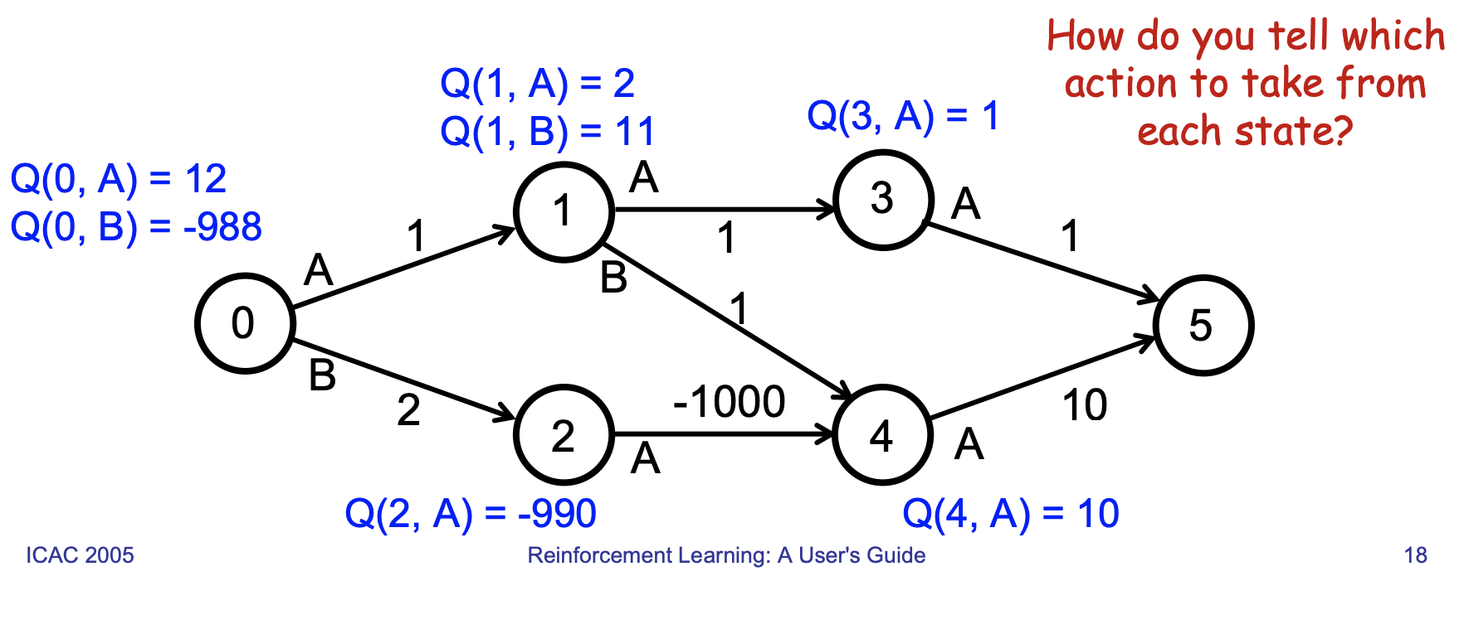
We can define value without specifying the policy Specify the value of taking action a from state s and then performing optimally
This is the state-action value function, Q
RL’s mathematics
State-action value function, Q

Slide 18
REINFORCEMENT
LEARNING
MODEL BASED
The agent learns from an environment-related model
This model is essentially based
on the general concept and the factors of the system
MODEL FREE
RL’s categories
Value Based
The agent knows what to choose
based on rewards (the strategy of
exploration is well defined)
The basis of RL, suitable for discreet environments & complex problems
Policy Based
No exploration strategy
is defined, self-decision
It works with continuous actions
Notes:
In policy iteration algorithms, you start with a random policy, then find the value function of that policy (policy evaluation step), then find a new (improved) policy based on the previous value function, and so on. In this process, each policy is guaranteed to be a strict improvement over the previous one (unless it is already optimal). Given a policy, its value function can be obtained using the Bellman operator.
In value iteration, you start with a random value function and then find a new (improved) value function in an iterative process, until reaching the optimal value function. Notice that you can derive easily the optimal policy from the optimal value function. This process is based on the optimality Bellman operator.
In some sense, both algorithms share the same working principle, and they can be seen as two cases of the generalized policy iteration. However, the optimality Bellman operator contains a maxoperator, which is non linear and, therefore, it has different features. In addition, it's possible to use hybrid methods between pure value iteration and pure policy iteration.
Source: stackoverflow

Slide 19
03.
RL In The Practice
Use sectors , Challenges
and limitation

Slide 20
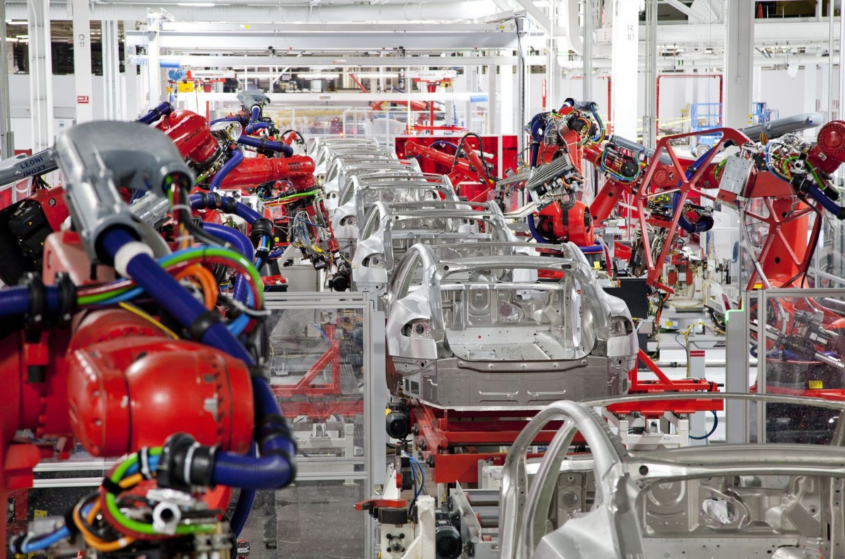


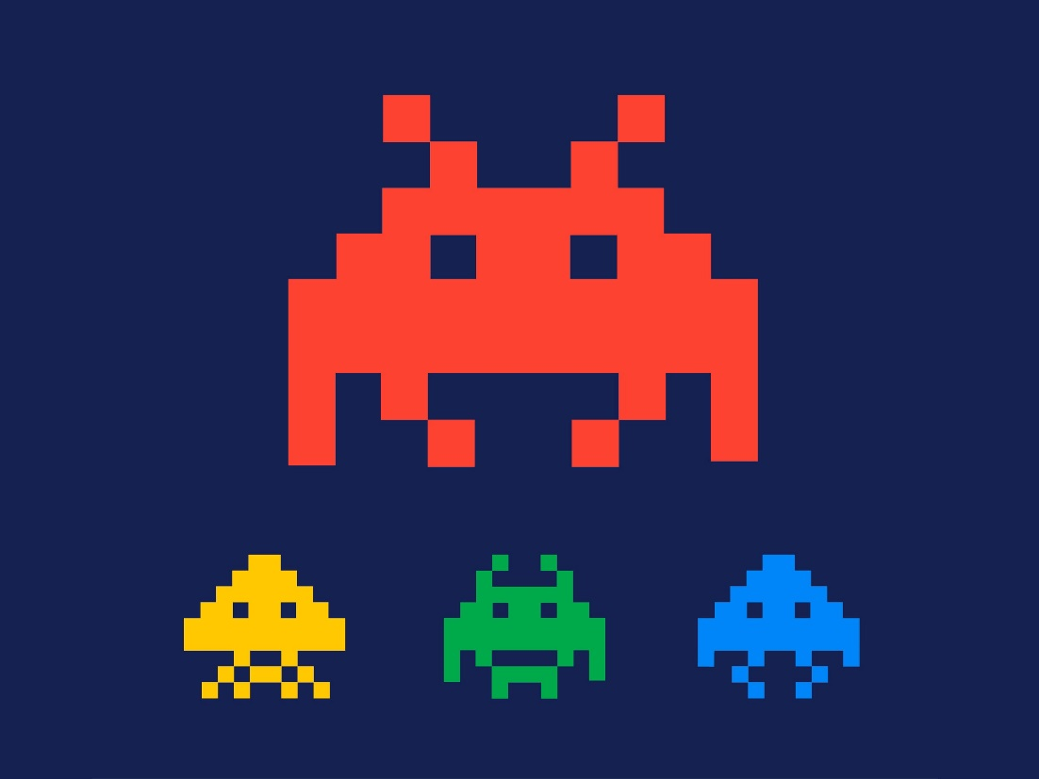
Use sectors
MANUFACTURING
ENERGY SYSTEMS
FINANCE
GAMES SOLVING
Robots use RL to perform a certain mission
RL is used to assess the security of electrical power systems and to develop control and protection systems.
Stock management, evaluation of business decisions
The agent tries to beat his record every time Atari games .. Etc.
20

Slide 21
EXPLORATION
STABILITY OF
LEARNING
MULTILEARNING
GENERALISATION
RL’s challenges
How to exploit the environment? When should the agent stop?
Environments are dynamic Adding new states and actions
Trying to apply RL in complex areas through the use of multi-agents who train separately at the same time
Reinforcement learning is strongly linked to the environment,

Slide 22
Q-Learning
04.
Definition , process ,
a practical case

Slide 23
Q-learning is a non-political reinforcement learning algorithm (Free model value-based)
It seeks to find the best action to take given the current state.
Q-learning iteratively approximates the state-action value function, Q
Keep an estimate of Q(s, a) in a table
More specifically, Q-learning seeks to learn a policy that maximizes the total reward.
Definition

Slide 24

The Quality
What does the ‘Q’ represent?
=> How useful a given action is for obtaining a future reward.

Slide 25
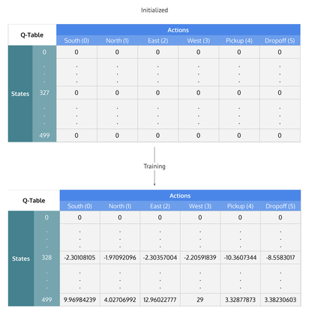
When q-learning is executed, we create what is called a Q table or matrix that follows the form of [state, action] and we initialize our values to zero. We then update and store our q values after an episode. This Q table becomes a reference table allowing our agent to select the best action according to the Q value.
Q-TABLE

Slide 26
Q(s, a) ← (1 - α)Q(s, a) + α(r + γmax _{a’} Q(s’, a’))
Update formula
γ (gamma) is the discount factor (0≤γ≤1)
It is multiplying the future expected reward, It controls the importance of the future rewards versus the immediate ones. The lower the discount factor is, the less important future rewards are, and the Agent will tend to focus on actions which will yield immediate rewards only.
α (alpha) represents the learning rate (0 <α≤1).
As in supervised learning environments, α is the extent to which Q values are updated with each iteration.

Slide 27
Update Q-table with theprevious formula
Initialize Q(s, a) to small random values, ∀s, a (It can be zeros)
Update Q-table with theprevious formula
Q-Learning process
Observe next state, s’, and reward, r
Observe state, s & Pick an action, a
Pick an action, a by referencing the Q-table with the maximum value (max) OR by random (epsilon, ε)

Slide 28
LET’S PRACTICE !

Slide 29
THANK YOU FOR ATTENDING

