Slide 1

AI2E : Workshop 7
Recurrent Neural Networks !

Slide 2

RIAD BESNALEM 5th year student at ESI
MOHAMED BOUSRI 5th year student at ESI

Slide 3

01
02
Sequence models
Why RNNs
03
04
What is Recurrent Neural Networks
Solution for Vanishing gradient
An exciting area in DL
Can’t we just use standard NNs?
Definitions, types and time traveling!
NN Architectures as a solution

Slide 4
01.
Sequence models
An exciting area in DL

Slide 5

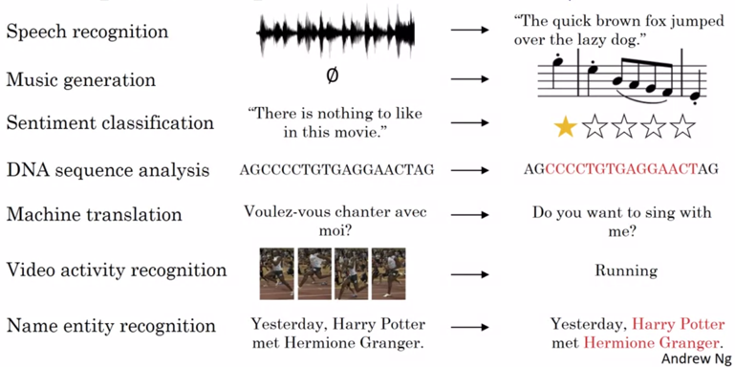
Sequence Data Examples
Notes:
Introduction and relation with rnns
Exemples of sequence data :
1. speech recognition(input sequence, output :sequence)
2. music generation(input integer, nothing, output :sequence)
3.sentiment classification (input sequence, output :integer…)
4. machine traslation(input sequence, output :sequence)
5. video activity recognition(input sequence, output :word)
6. Name entity recognition(input sequence, output :names)

Slide 6
02.
Why RNNs
can’t we just use standard NNs?

Slide 7
Two Main Reasons To Use RNN
Input layer size can change
Pass the feature learned
1
2

Slide 8
03.
What is Recurrent Neural Networks

Slide 9
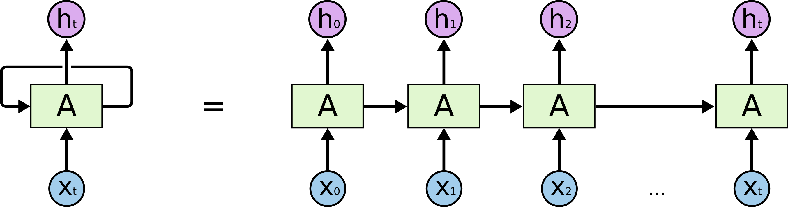
RNN is a type of neural networks, a feed-forward architecture used for sequential data with a variable length such as sentences or chronological series.

Slide 10
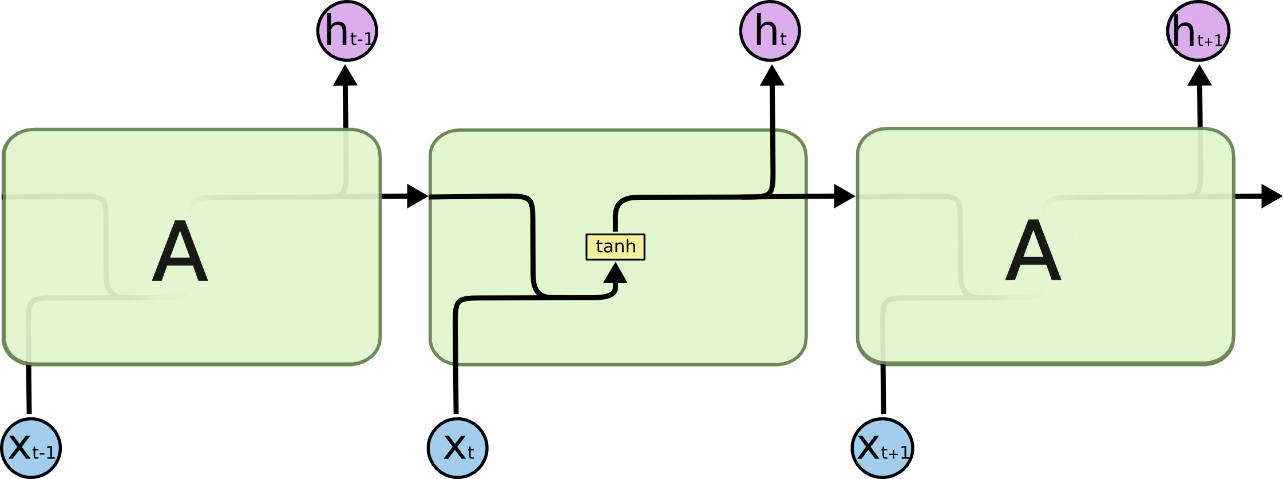

Slide 11
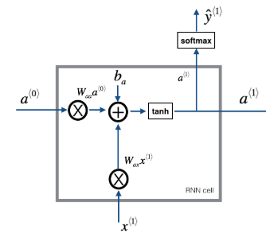
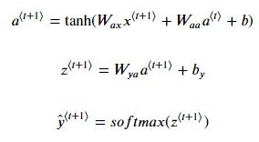

Slide 12
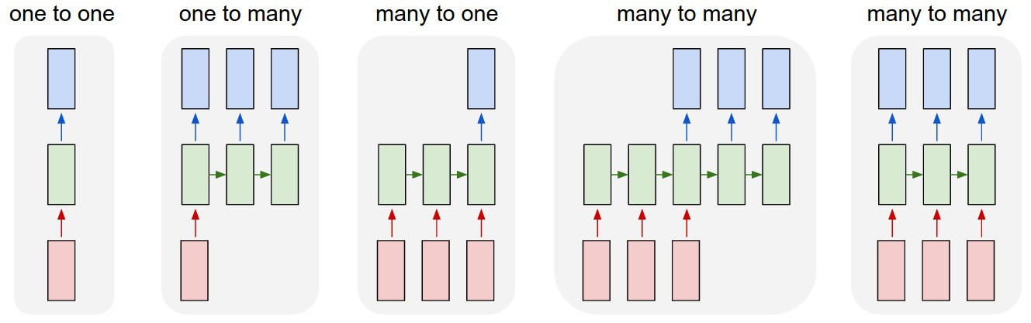
RNN Types
The Unreasonable Effectiveness of Recurrent Neural Networks

Slide 13
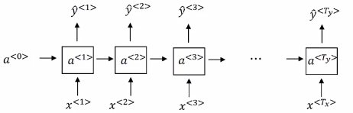
Bring your time machines… Backpropagation through time!
L1
L2
L3
Lt

Slide 14
04.
Solution for Vanishing gradient
NN Architectures as a solution

Slide 15
What is the Vanishing Gradient Problem
The dinosaurs which lived millions of years ago and…, were not able to survive.
Notes:
Vanishing gradient

Slide 16

LSTM

Slide 17
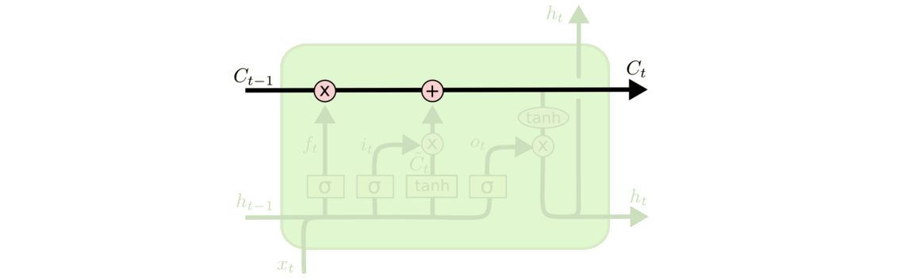
Cell state

Slide 18
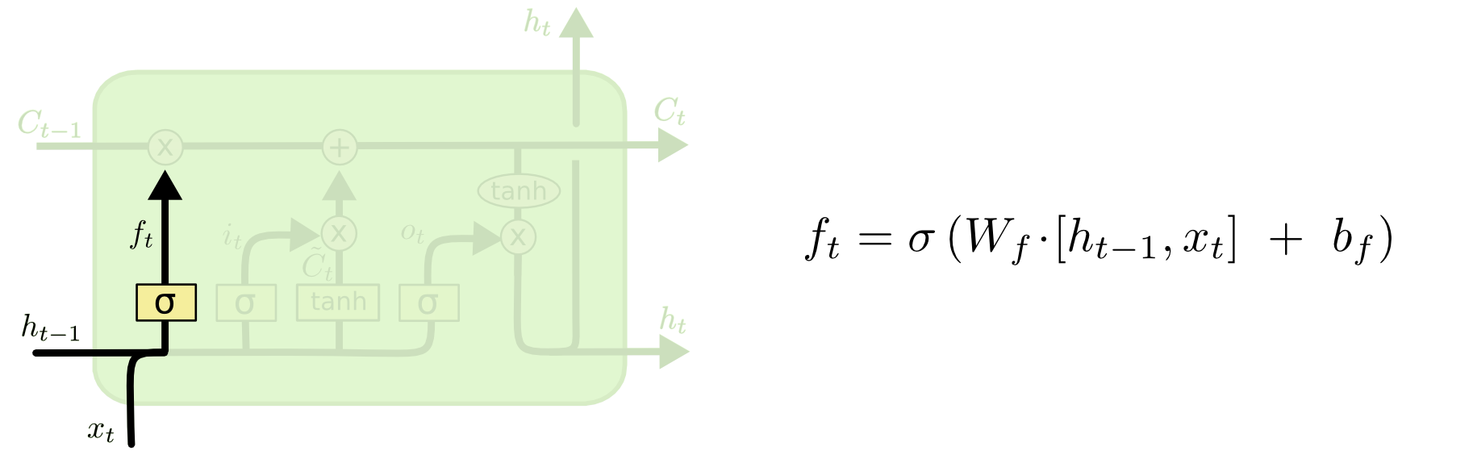
Forget gate
Harry approaches and then she takes out her wand…

Slide 19
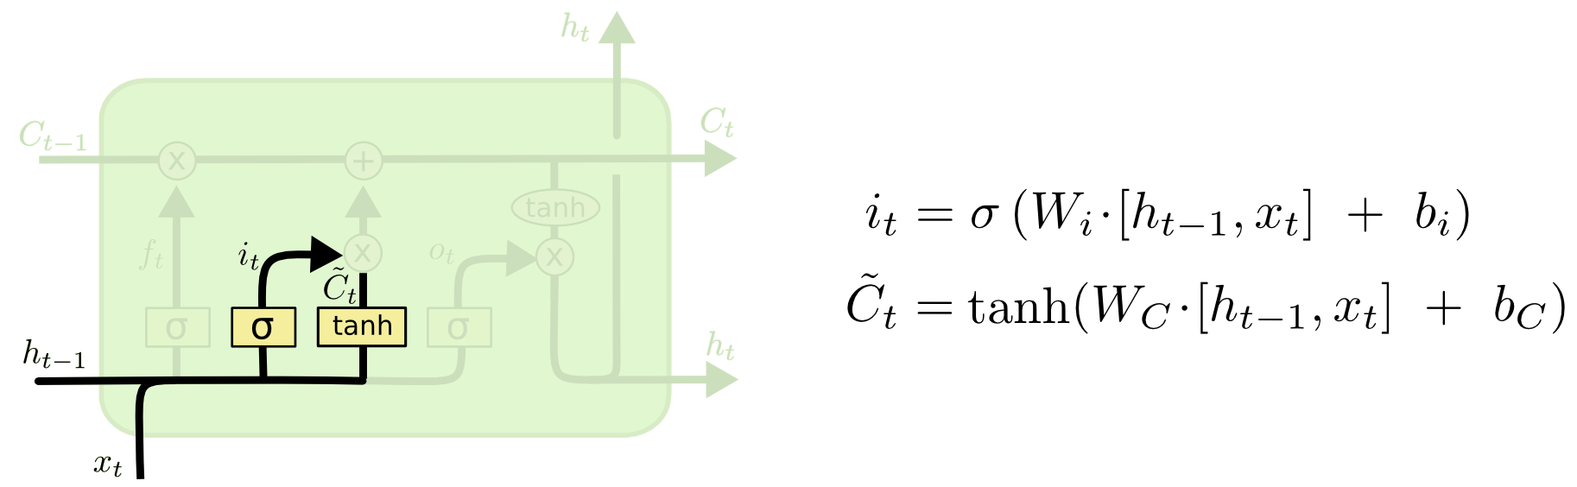
Input gate
Harry approaches and then she takes out her wand…

Slide 20
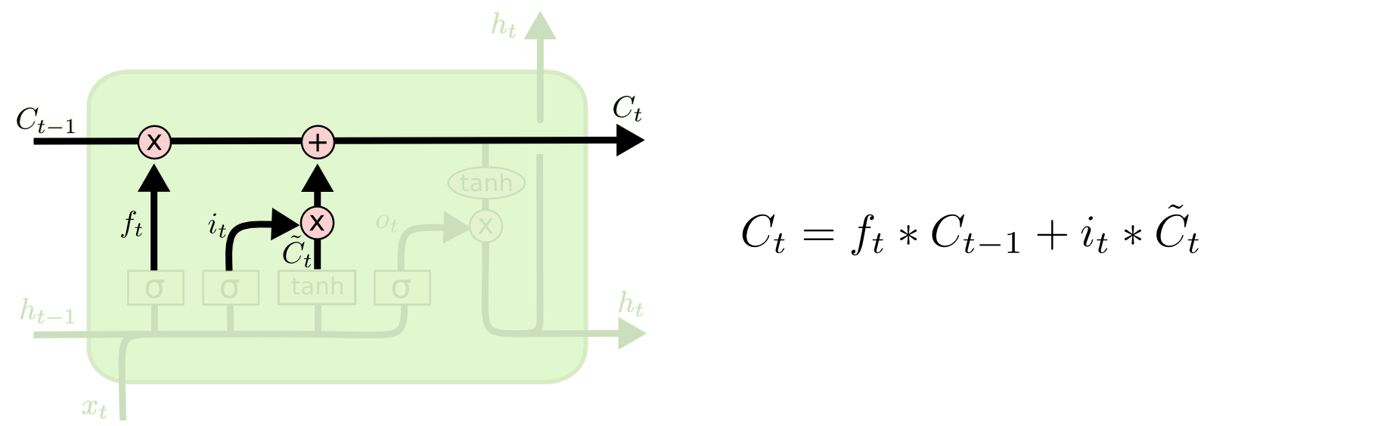
Update gate
Harry approaches and then she takes out her wand…

Slide 21
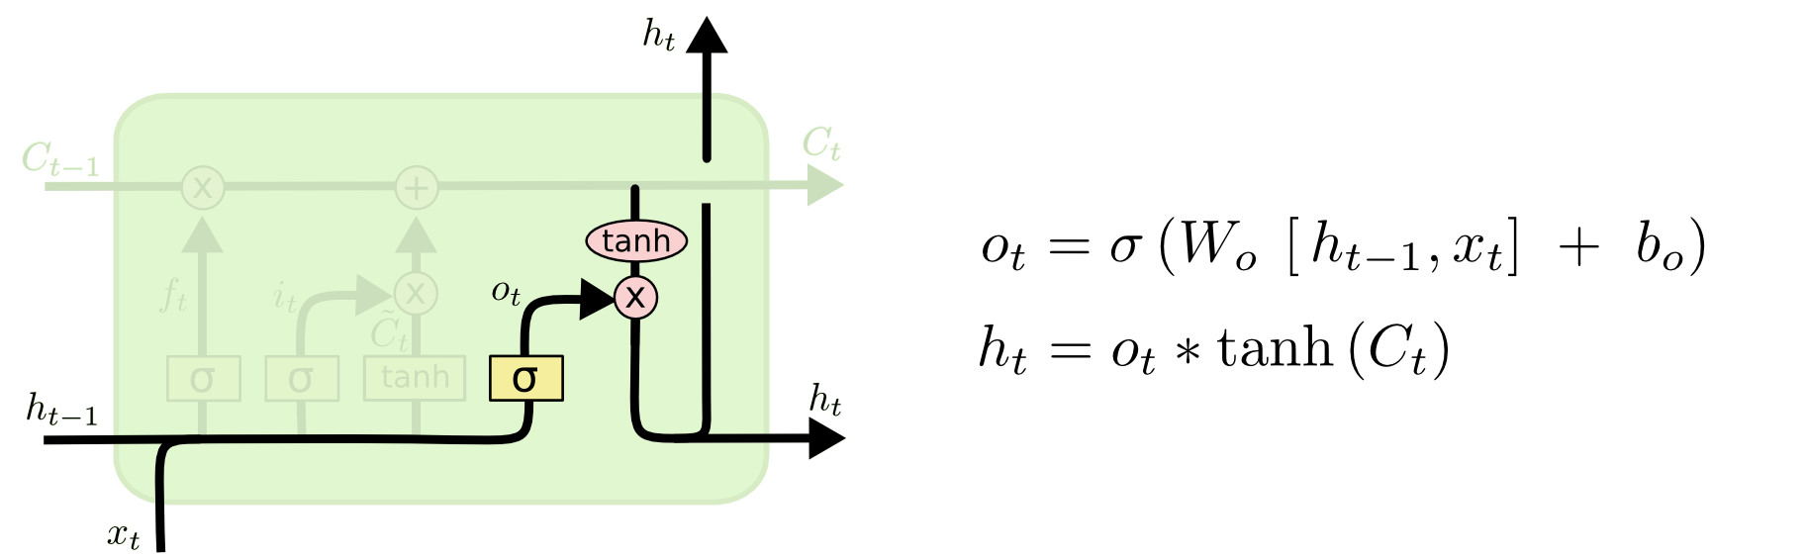
Filtering the cell state
Harry approaches and then she takes out her wand…

Slide 22
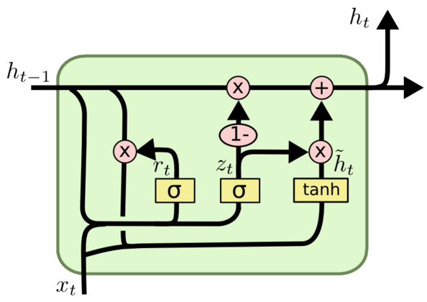
GRU

Slide 23
More to explore!
Language models
Deep RNNs
Word embeddings
Auto-Encoder
Attention mechanism
Word2vec

Slide 24
Let’s practice!

