Slide 1
AISWARIYA S
au711721104007

Slide 2
PROJECT TITLE
Liver Disease Prediction System - Using ANN

Slide 3
AGENDA
This project aims on developing a system to predict the presence of liver disease by using a model that is trained using real time data set of the patients affected .
1) Preprocessing Real-Time Patient Data:
- Cleansing and organizing the dataset.
- Handling missing values and outliers.
- Normalizing features for model training.
2) Developing and Implementing Prediction Models:
- Building Genetic Algorithm (GA) and Artificial Neural Network (ANN) models.
- Training models on preprocessed dataset.
- Evaluating model accuracy using confusion matrix.

Slide 4

PROBLEM STATEMENT
Design and implement an accurate predictive model to detect liver diseases using a combination of genetic algorithm (GA) and artificial neural network (ANN). The objective is to build a robust system capable of predicting the probability of liver diseases using clinical, genetic, and imaging data.
The model will prioritize feature selection and hyperparameter optimization to achieve accuracy in disease prediction. Additionally, consider the practical applicability of the model in clinical settings and address any ethical and privacy concerns.

Slide 5

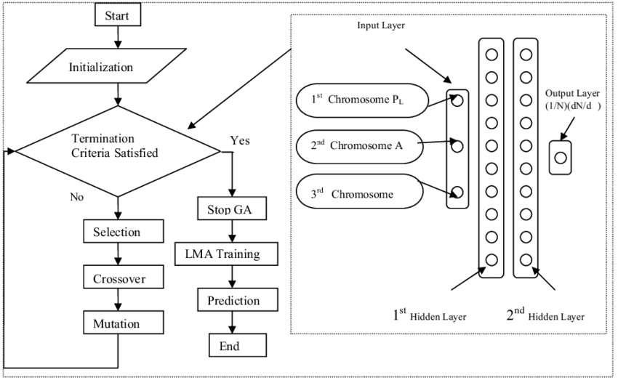
PROJECT OVERVIEW
Our goal is to create a precise prediction model for liver diseases. For that we're combining genetic algorithms (GA) and artificial neural networks (ANN) and using clinical, genetic, and imaging data for training and testing. We'll measure how well our model works using accuracy, precision, recall, and ROC curves. In the future, we are aiming to work with healthcare experts and explore more data sources to make our model even better.
Visual representation:

Slide 6
Who are the End Users ?
Patients
Healthcare institutions
Hepatologists (Liver Specialists)
Researchers
Public health authorities

Slide 7
SOLUTION AND ITS VALUE PROPOSITION
Our solution offers a system for predicting liver disease using real-time patient data, powered by advanced machine learning models including Genetic Algorithm and Artificial Neural Networks (ANNs).
1) Early Detection:
1. Our system identify early signs and risk factors associated with liver disease, 2. Enabling timely intervention and treatment to improve patient outcomes.
2) Precision Medicine:
Tailored predictions allow personalized treatment plans.
Clinicians can focus on high-risk patients, optimizing resource allocation.
3) Reduced Healthcare Costs:
Early diagnosis minimizes hospitalization and invasive procedures.
Cost-effective management benefits healthcare systems.

Slide 8
The Wow Factor in Your Solution
Hybrid Approach:
The integration of genetic algorithms (GA) and artificial neural networks (ANN) is a powerful combination.
GA optimizes feature selection and hyperparameters, while ANN captures complex patterns.
This combination enhances prediction accuracy and robustness.
Multi-Modal Data Fusion:
Leveraging diverse data sources—clinical records, genetic profiles, and medical images—sets the solution apart from others.
Clinical Applicability:
Our solution bridges the gap between research and practice.
Clinicians can use the model for early disease detection, personalized treatment, and resource allocation.
Ethical Considerations:
Addressing privacy concerns and ensuring informed consent demonstrates responsibility.
Ethical AI implementation is crucial, especially in healthcare.

Slide 9
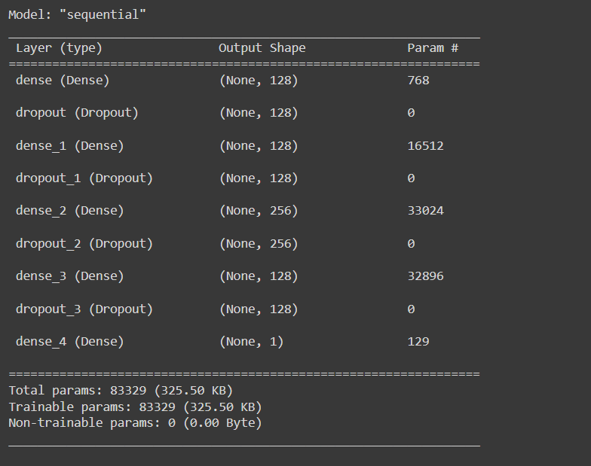
Results

Slide 10
Results

Slide 11
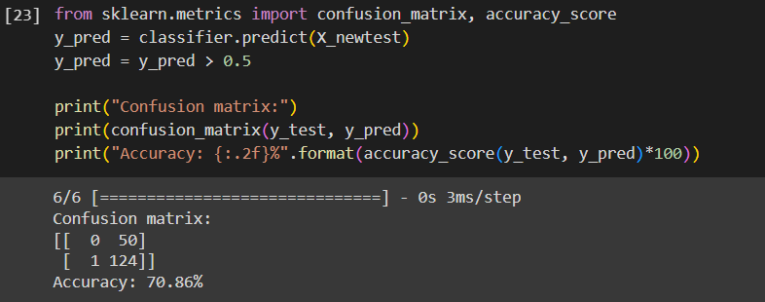
Accuracy of the model
Demo Link: https://github.com/Aiswariya3a/gen_ai_nm

