Slide 1
FinBank Ltd — Risk & Compliance Summary
Assessment Date: 2025-09-09
Scope: ISO 27001, GDPR, PCI DSS

Slide 2
Top Risks
R2 — Employee Laptops (Workstations) | Score: 16 (High)
R1 — Customer Payment Data (Web App DB) | Score: 15 (High)
R4 — Third-Party Payment Processor | Score: 12 (High)

Slide 3
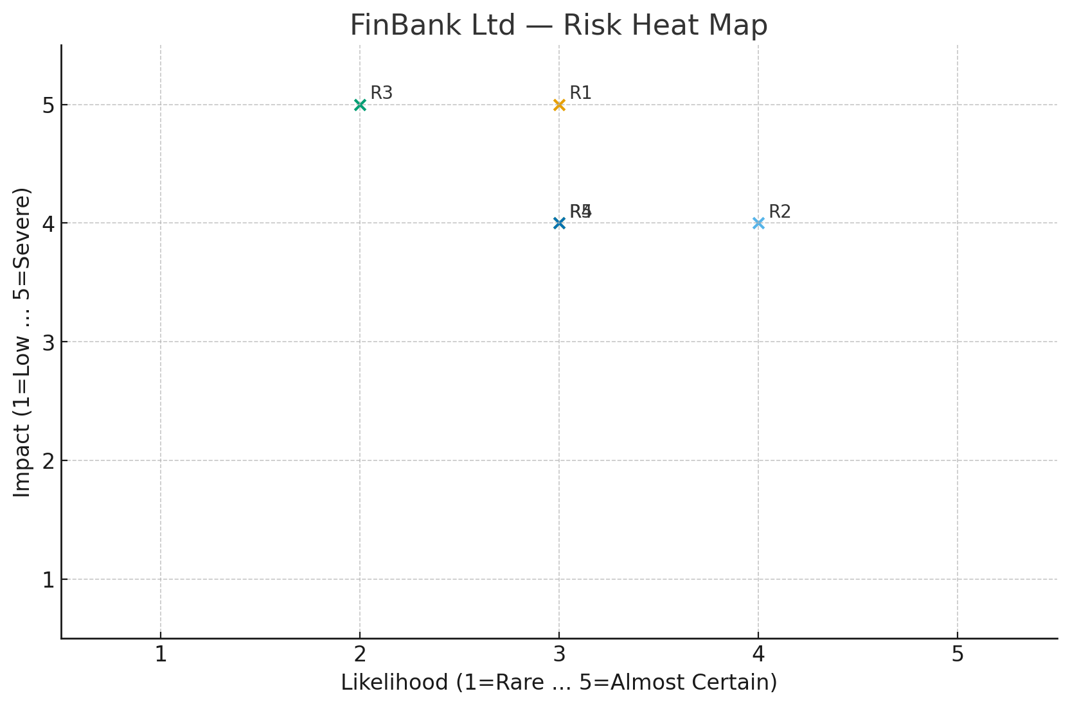
Risk Heat Map

Slide 4
90-Day Risk Treatment Roadmap
• Complete MFA rollout to 100% of users
• Deploy and tune WAF; schedule quarterly web app pentests
• Enforce cloud storage guardrails (no public buckets, encryption)
• Formalize vendor risk reviews and SLAs
• Implement DSAR workflow with SLA tracking

