Slide 1
Software Testing Life Cycle
a sequence of specific activities conducted during the testing process to ensure software quality goals are met.
STLC involves both verification and validation activities.
Software Testing is not just a single/isolate activity, i.e. testing. It consists of a series of activities carried out methodologically to help certify your software product.
STLC Phases
There are following six major phases in every Software Testing Life Cycle Model (STLC Model):
Requirement Analysis
Test Planning
Test case development
Test Environment setup
Test Execution
Test Cycle closure

Slide 2
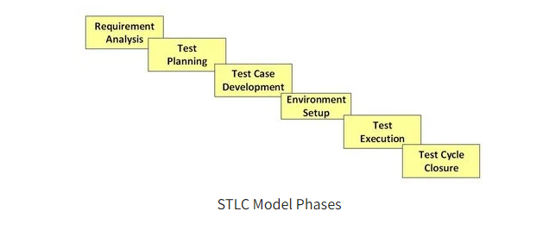

Slide 3
What is Entry and Exit Criteria in STLC?
Entry Criteria: Entry Criteria gives the prerequisite items that must be completed before testing can begin.
Exit Criteria: Exit Criteria defines the items that must be completed before testing can be concluded

Slide 4
Requirement Phase Testing
also known as Requirement Analysis.
test team studies the requirements from a testing point of view to identify testable requirements and the QA team may interact with various stakeholders to understand requirements in detail.
Activities in Requirement Phase Testing
Identify types of tests to be performed.
Gather details about testing priorities and focus.
Prepare Requirement Traceability Matrix (RTM).
Identify test environment details where testing is supposed to be carried out

Slide 5
Test Planning in STLC
Senior QA manager determines the test plan strategy along with efforts and cost estimates for the project.
Moreover, the resources, test environment, test limitations and the testing schedule are also determined.
The Test Plan gets prepared and finalized in the same phase.
Test Planning Activities
Preparation of test plan/strategy document for various types of testing
Test tool selection
Test effort estimation
Resource planning and determining roles and responsibilities.
Training requirement

Slide 6
Test Case Development Phase
involves the creation, verification and rework of test cases & test scripts after the test plan is ready.
Initially, the Test data is identified then created and reviewed and then reworked based on the preconditions.
Then the QA team starts the development process of test cases for individual units.
Test Case Development Activities
Create test cases, automation scripts (if applicable)
Review and baseline test cases and scripts
Create test data (If Test Environment is available)

Slide 7
Test Environment Setup
decides the software and hardware conditions under which a work product is tested.
It is one of the critical aspects of the testing process and can be done in parallel with the Test Case Development Phase.
Test team may not be involved in this activity if the development team provides the test environment.
Test Environment Setup Activities
Understand the required architecture, environment set-up and prepare hardware and software requirement list for the Test Environment.
Setup test Environment and test data
Perform smoke test on the build

Slide 8
Test Execution Phase
carried out by the testers in which testing of the software build is done based on test plans and test cases prepared.
The process consists of test script execution, test script maintenance and bug reporting.
If bugs are reported then it is reverted back to development team for correction and retesting will be performed.
Test Execution Activities
Execute tests as per plan
Document test results, and log defects for failed cases
Map defects to test cases in RTM
Retest the Defect fixes
Track the defects to closure

Slide 9
Test Cycle Closure
is completion of test execution which involves several activities like test completion reporting, collection of test completion matrices and test results.
Testing team members meet, discuss and analyze testing artifacts to identify strategies that have to be implemented in future, taking lessons from current test cycle.
The idea is to remove process bottlenecks for future test cycles.
Test Cycle Closure Activities
Evaluate cycle completion criteria based on Time, Test coverage, Cost, Software, Critical Business Objectives, Quality
Prepare test metrics based on the above parameters.
Document the learning out of the project
Prepare Test closure report
Qualitative and quantitative reporting of quality of the work product to the customer.
Test result analysis to find out the defect distribution by type and severity.

Slide 10
