Slide 1
OpenAPI Generator
Aiswarya Kinattukara Kalam
245182

Slide 2
OpenAPI Generator
A code generation tool that takes an OpenAPI Specification (formerly known as Swagger) and generates server stubs, client SDKs, and API documentation.
It takes an OpenAPI Specification as input and generates code artifacts.
Benefits: Faster development, increased consistency, reduced errors.
Supports multiple languages and frameworks.
Customizable and flexible to fit our project's needs.

Slide 3
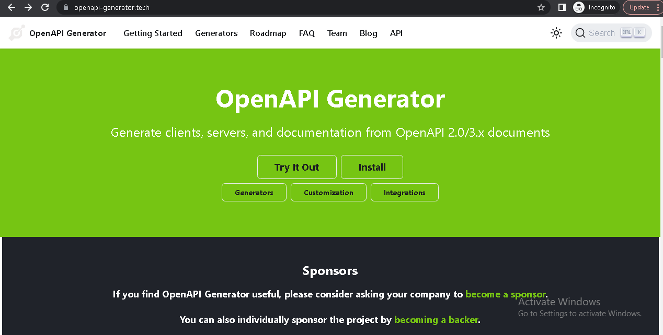
Fig:OpenAPI Generator

Slide 4
Key Features
Code Generation:
Generates client libraries, server stubs, and API documentation.
Supports multiple programming languages and frameworks.
Helps accelerate API development by automating repetitive tasks.
Customization and Flexibility:
Configurable templates and generators.
Customization options for generated code, such as library versions, formatting, and naming conventions.
Extendable with custom code templates and modules.

Slide 5
SpringBoot with OpenAPI Generator
Spring Boot and OpenAPI Generator make a powerful combination for developing RESTful APIs.
Spring Boot simplifies application development, while OpenAPI Generator provides standardized documentation, client SDKs, and server stubs.
By leveraging these tools, developers can save time, ensure API contract adherence, and enhance the overall development experience.

Slide 6
Getting Started with Spring Boot and OpenAPI Generator
Define the API: Create or import an OpenAPI Specification file (in YAML or JSON format) that describes your API's endpoints, request/response models, and other relevant information.
Generate Code: Use OpenAPI Generator to generate the server stubs and client SDKs by running a command or using a Maven/Gradle plugin.
Implement Business Logic: Customize the generated server stubs by adding your application-specific business logic and validations.
Build and Run: Use Spring Boot's build and run commands to compile your application and start the server.
Test and Document: Use the generated API documentation to test your API endpoints and update any additional documentation as needed.

Slide 7
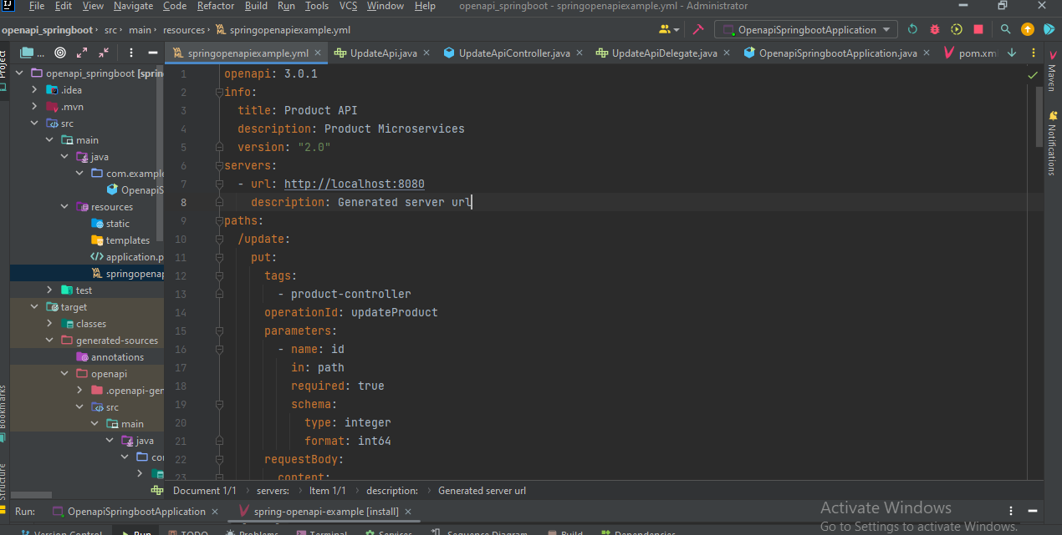
Fig : YAML File

Slide 8
Advantages of OpenAPI Generator
Rapid Development: Enable quick setup and development of RESTful APIs.
Standardized API Documentation: OpenAPI Generator generates interactive API documentation based on the OpenAPI Specification
Client SDK/Code Generation: Generate client SDKs in various programming languages, reducing the effort required to consume the API for different platforms.
Server Stub Generation: Generate server stubs with basic API implementation, saving development time and ensuring adherence to the API contract.
Extensibility: OpenAPI Generator provides a plugin architecture, allowing developers to create custom code generators and add additional functionality as needed.

Slide 9
References
GitHub Link :
https://github.com/AiswaryaKUdayakumar/OpenAPI_Generator_SpringBoot_Seminar
(SpringBoot Generator with OpenAPI Generator-Code)
Youtube : https://www.youtube.com/watch?v=t4jaTC7QjMg
https://youtube.be/GJOwJrqIV-8
https://youtu.bu/Qok653w524g
OpenApi Generator Official Site : https://openapi-generator.tech/

