Slide 1
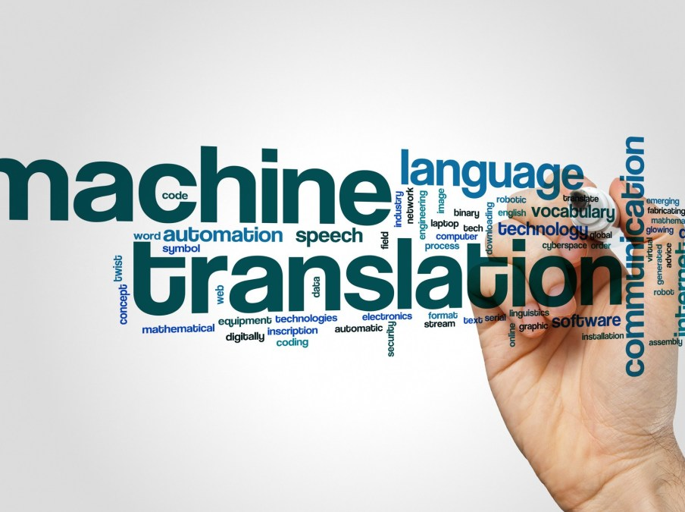


NEURAL MACHINE TRANSLATION
- Aiswarya Ramachandran

Slide 2

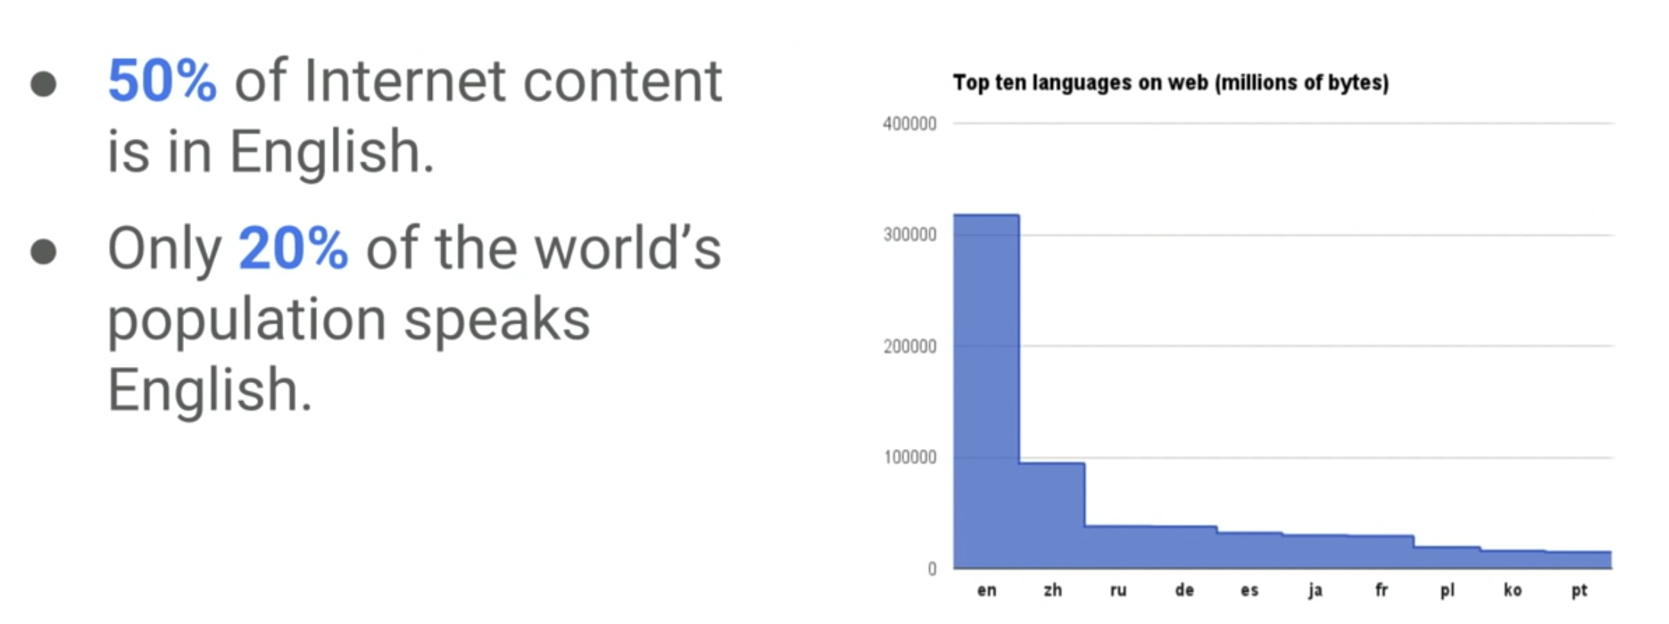
WHY IS MACHINE TRANSLATION IMPORTANT?
ARE TRANSLATIONS ONLY FOR COMPANIES LIKE GOOGLE?

Slide 3

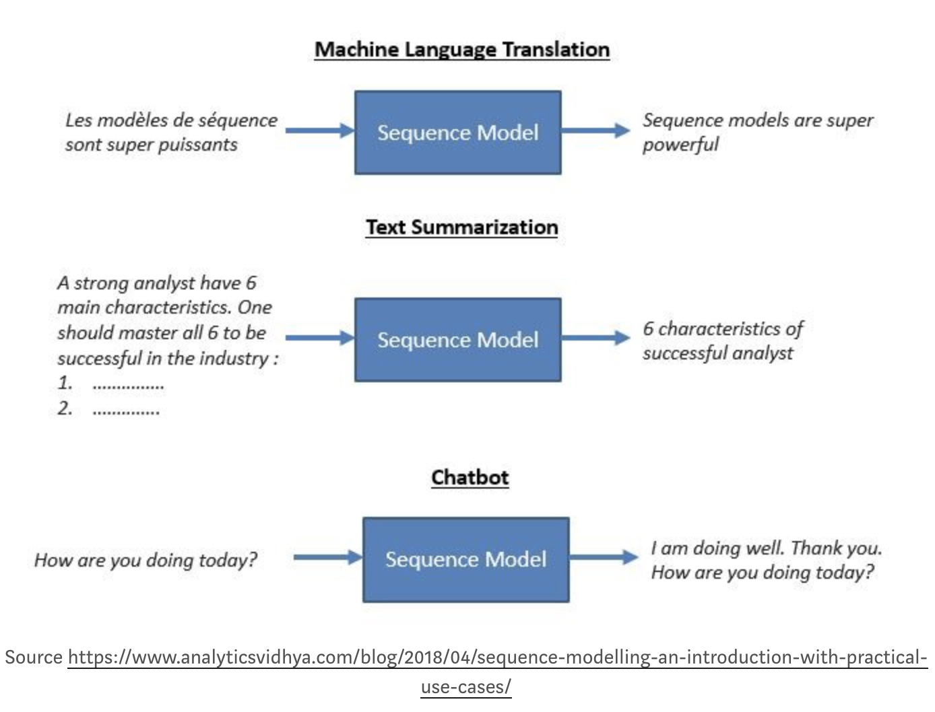
WHAT IS SEQUENCE TO SEQUENCE MODELLING?

Slide 4
Problem Statement
Translate Text from English to Hindi using Seq2Seq Modelling
We are using Word Level Translation
The data for this problem is available on Kaggle
The methodology used here can be extended to any sequence to sequence problem

Slide 5
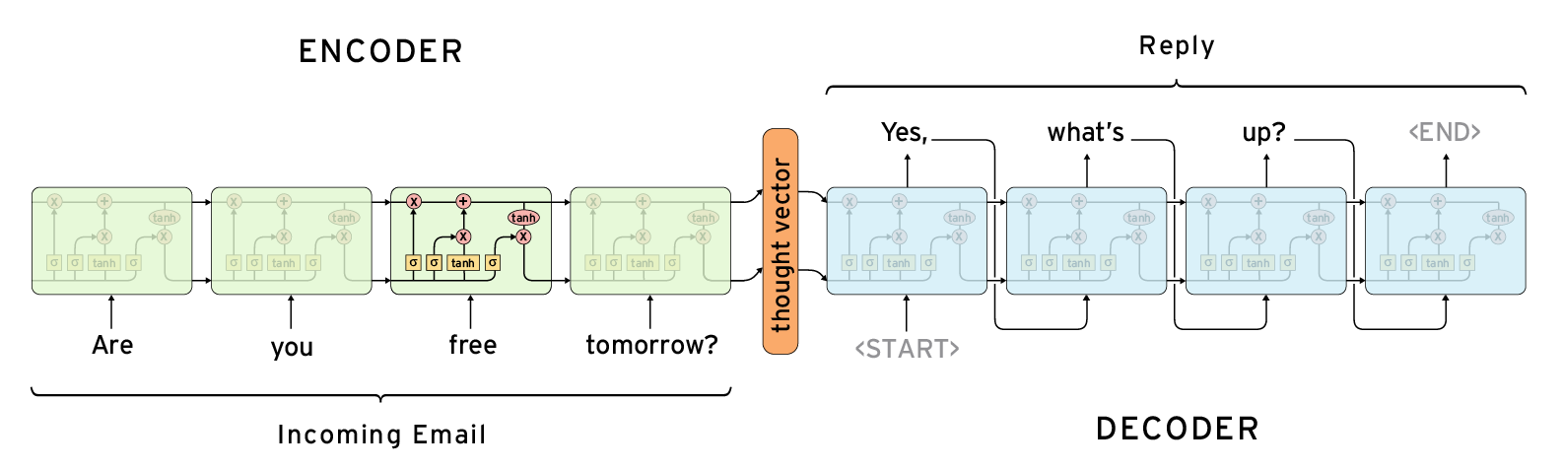
ENCODER-DECODER ARCHITECTURE

Slide 6
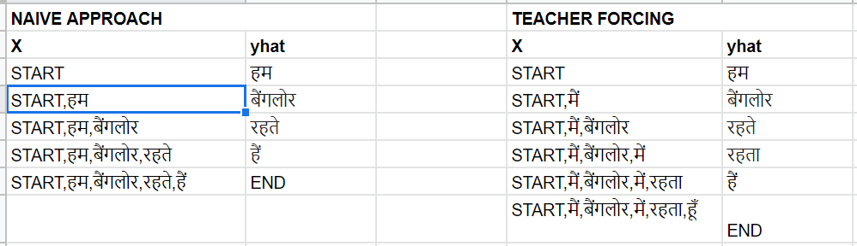
TEACHER FORCING DURING TRAINING
Decoder behaves differently in Training and Inference
During training, we use a mechanism called Teacher Forcing
“Teacher Forcing is a mechanism in which during the training the model receives the ground truth output y(t) as input at time t+1”
Consider the following example:
मैं बैंगलोर में रहता हूँ

Slide 7
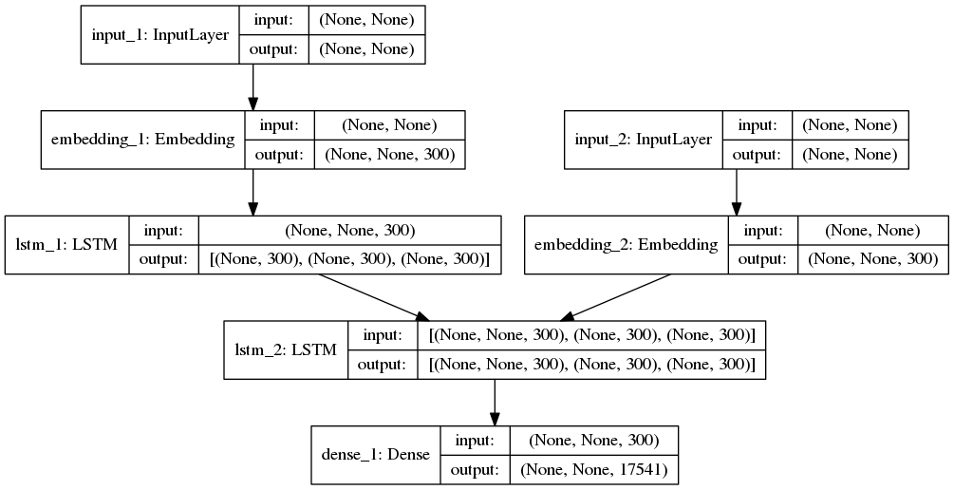
ARCHITECTURE OF THE MODEL

Slide 8
CONCLUSION
Add more data
Attention Mechanisms can be used to reduce the loss
Use Dropouts and other regularization techniques
Use Bidirectional LSTMs in the Encoder or multilayered LSTMs
Use Beam Search
Use BLEU Score to evaluate the model

