Slide 1
Telecom Churn Case Study SUBMISSION
Group Name:
Raghu Devata - DDA1610101
Aiswarya Ramachandran - DDA1610178
Asutosh Subudhi –DDA1610069
Vinodkumar Varanasi - DDA1610179

Slide 2
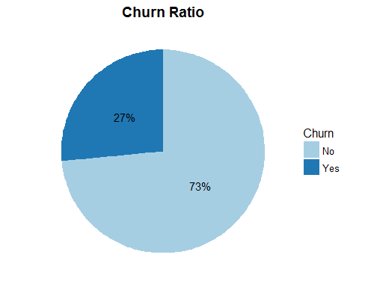
Business and Data Understanding
“Firm X” is a leading telecom company in the country. Major part of its revenue is via providing internet services.
But the company is losing customers due to heavy marketing and
promotion schemes by other companies.
The challenge for the company is to predict if a customer would
churn or not. Also, understand the factors affecting the churn.
The data contains the below information:
Demographic Information
Services Availed by the customer
Overall Expenses
Final dataset contains 7043 records and 21 variables after merging.

Slide 3
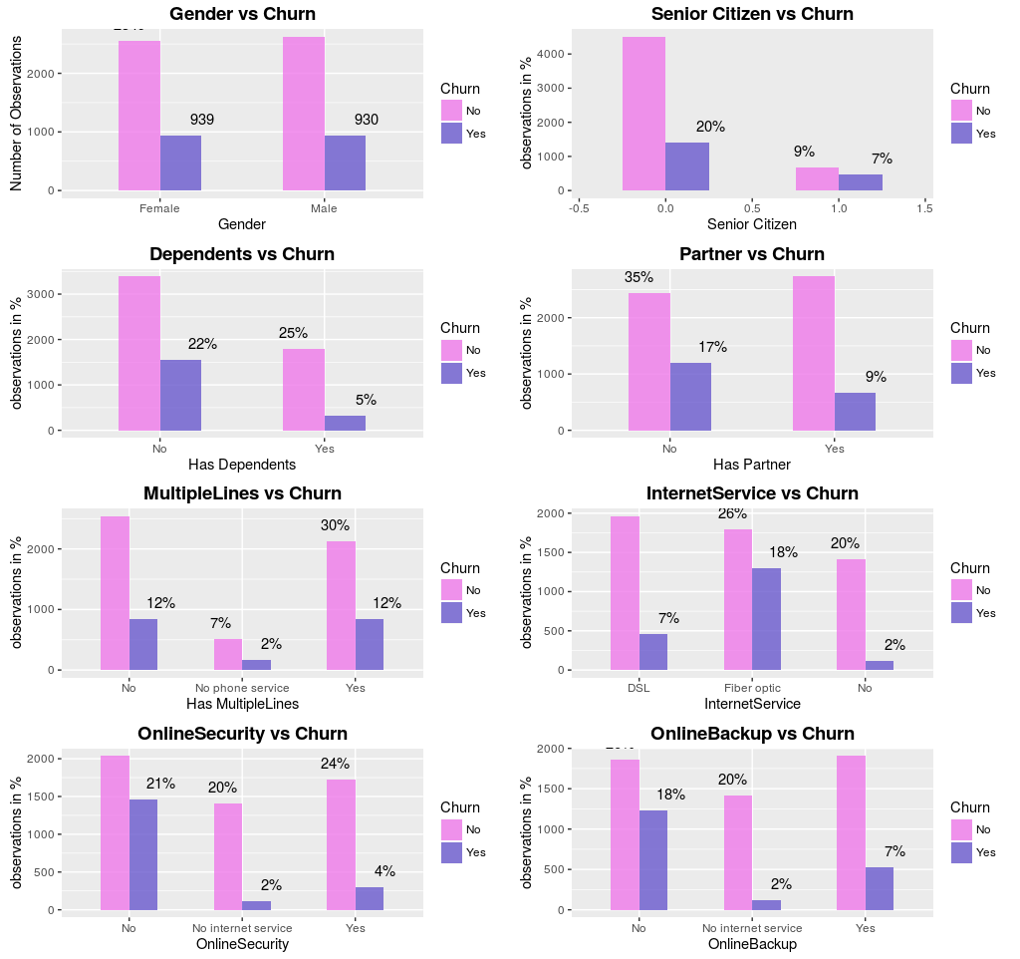
Exploratory Data Analysis
Gender not significant factor for Churn
In Around 16% Senior Citizen,Churn Rate is 44% . Senior Citizen have higher tendency to churn.
Churn Rate is higher for those, who do not have a partner
Lower Churn Rate for those with dependents
87% of the people have Phone Service.
Slightly higher churn rate among those with no phone service
Slightly Higher churn rate among those with Multiple Lines.
Higher Churn Rate for those who have Opted for Fibre Optic, No Device Protection or No Online Backup or Security
Churn Rate For Those with No Internet Service is 45%

Slide 4
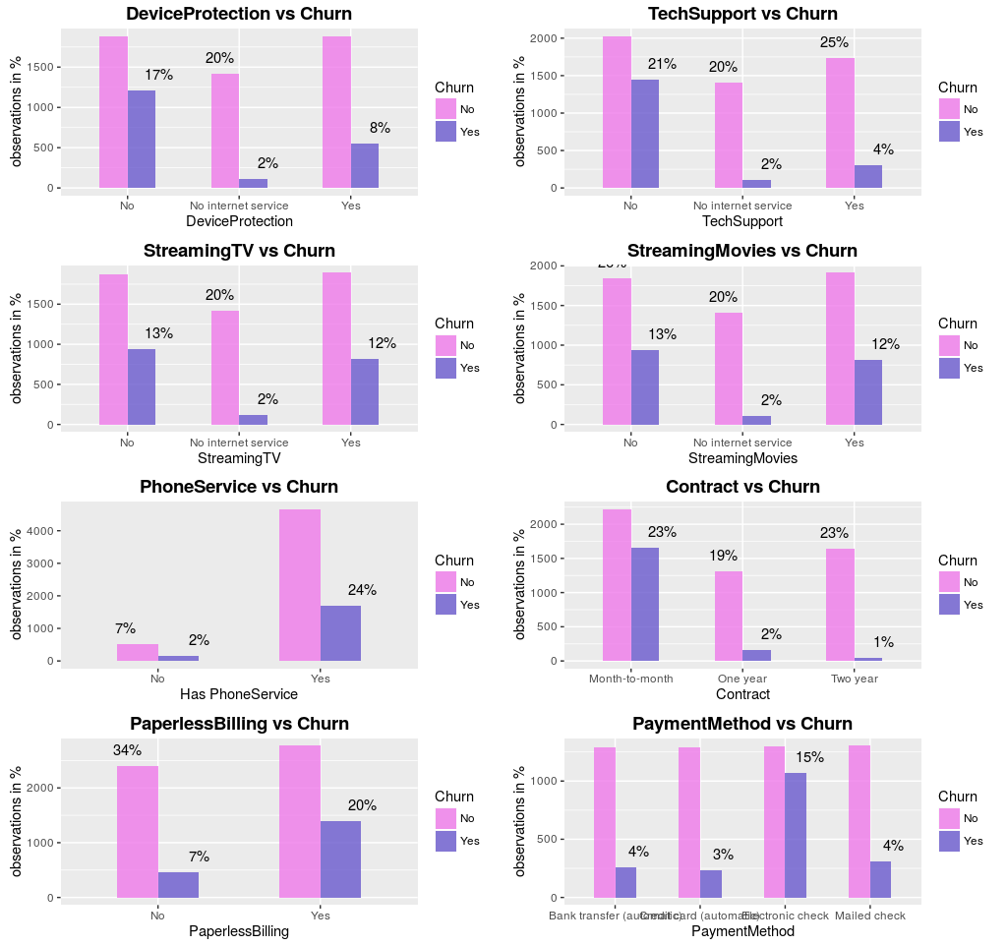
Exploratory Data Analysis
People who opted out of Tech Support are likely to Churn
Those who opted out of Streaming Movies are more likely to Churn
Highest Churn Rate for Month-to-Month Contract
~35% of the People who opted for Paperless Billing, churn.
~50% churn Rate for who has paid by Electronic Check

Slide 5
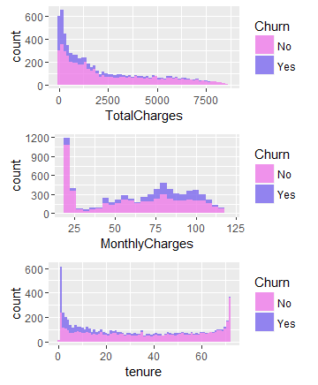
Exploratory Data Analysis
People who pay higher Monthly Charges, tend to churn more
People who churn, pay lower Total Charges.
Lower Tenure Churn is higher

Slide 6
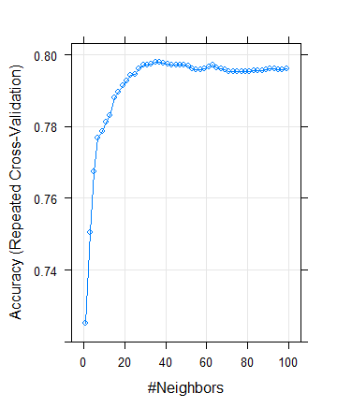
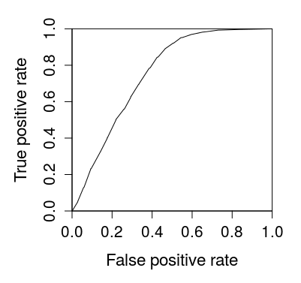
KNN Model
Cross Validation gives, the optimal value of k as 37
KNN has very Low Sensitivity. This is mostly because, KNN finds the majority class closest to the data point and most of the points in our data set belong to class “No Churn”.
We conclude that KNN is both computationally complex and not suited for imbalanced classification.
Accuracy | Sensitivity | Specificity
0.7965 | 0.5383 | 0.8898

Slide 7
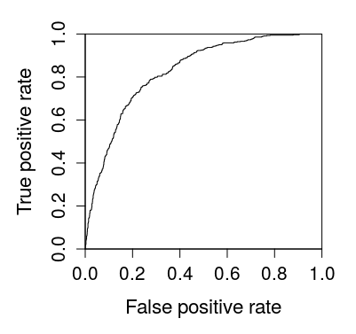
Naive Bayes Model
Has an AUC of 0.8270526
Irrespective of the Threshold, Naïve Bayes, gives good Accuracy as well as Sensitivity.
Threshold | Accuracy | Sensitivity | Specificity
0.3 | 0.7331 | 0.7914 | 0.7120
0.5 | 0.7534 | 0.7594 | 0.7513
0.7 | 0.769 | 0.7255 | 0.7848

Slide 8
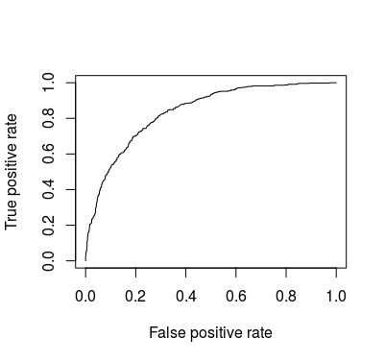
Logistic Regression Model
Model has an AUC is 0.8375956
Threshold | Accuracy | Sensitivity | Specificity
0.3 | 0.7623 | 0.7607 | 0.7628
0.5 | 0.8002 | 0.5252 | 0.8995
0.7 | 0.7665 | 0.17813 | 0.97902

Slide 9
Logistic Regression Model
Variables | How they effect Churn from EDA | Coefficient
SeniorCitizen | From EDA, we have observed that SeniorCitizen=1 indicates more Churn. | 0.35455
tenure | Lower Tenure,Higher Churn. | -0.90491
MultipleLines.xYes | Higher Churn Rate for those having Multiple Lines | 0. 34376
InternetService.xFiber.optic | Customers who opt for Fibre Optic Have higher Churn Rate | 0. 81192
InternetService.xNo | Those Who Opted out off Internet Service have Lower Churn Rate | -0.59547
StreamingMovies.xYes | Higher Churn for Those who Stream Movies. | 0.40844
Contract.xOne.year | Month-Month Contract people have Highest Churn, while It is lower for One Year and Two Year Contract | -0.75167
Contract.xTwo.year | Month-Month Contract people have Highest Churn, while It is lower for One Year and Two Year Contract | -1.60610
PaperlessBilling | People Who opt for Paperless Billing (~45%) Churn | 0.34596
PaymentMethod.xElectronic.check | Customers who pay by Electronic Check have the Highest Tendency to Churn | 0.45585
Intercept | If all parameters are constant between two customers, there is less likelihood of churning. | -2.05359
The final Model has 10 variables, all of which are significant.
The AIC of the model is 4158.2
The Null Deviance is 5704.4
The Residual Deviance is 4136.2
The c-statistic for the training data is 0.8424092
The c-statistic for test data is 0.8375956
Higher c-statistic indicates higher concordant pairs and hence a good model
The KS Statistic for the training data is 0.1732252, which is in the 2nd Decile
The KS Statistic for test data is 0.2839565, which is in the 3rd decile.
KS Statistic below the 4th decile, indicates a very good model.

Slide 10
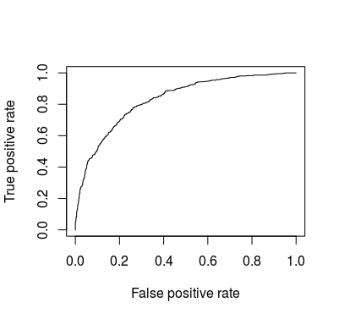
SVM Model
The optimal cost obtained using cross validation was 0.1
The AUC is 0.8302524
Threshold | Accuracy | Sensitivity | Specificity
0.3 | 0.7643 | 0.7148 | 0.7822
0.5 | 0.7809 | 0.6542 | 0.8267
0.7 | 0.7918 | 0.5936 | 0.8634

Slide 11
Conclusion
Need to maximize the sensitivity of the model, as identification of customer churn is more important for better customer retention.
Low threshold leads to high sensitivity, hence opted threshold value as 0.3
For Threshold Value = 0.3,
.
Logistic Regression has better accuracy and good Sensitivity , so we can make LR as our final model
Model | Accuracy | Sensitivity | Specificity | AUC
KNN | 0.7965 | 0.5383 | 0.8898 | 0.7512381
Naive Bayes | 0.7331 | 0.7914 | 0.7120 | 0.8270526
Logistic Regression | 0.7623 | 0.7607 | 0.7628 | 0.8375956
SVM | 0.7643 | 0.7148 | 0.7822 | 0.8302524
Winner

