Slide 1
Automated Essay Grading
Natural Language Processing - UE16CS333
TEAM L:
Aditya R (01FB16ECS030)
Aiswarya Sriram (01FB16ECS036)
Akshara S(01FB16ECS045)
Aneesh Bhat(01FB16ECS056)

Slide 2
INTRODUCTION
Essays are an important expression of academic achievement, but it is expensive and time consuming to grade them by hand. We believe that automated scoring systems can yield fast, effective and affordable solutions.
Hence, our project, automatic essay grading systems will be designed to compare the efficacy and cost of automated scoring to that of human graders.

Slide 3
PROBLEM STATEMENT
The project aims to develop an automated essay assessment system using machine learning techniques by classifying a corpus of textual entities into small number of discrete categories, corresponding to possible scores.
Regression techniques will be utilized for training the model along with making the use of various other machine learning models.
We intend to measure performance of our dataset by comparing the obtained values with the tagged values using Cohen’s Kappa coefficient and MAE.
We have implemented our model using Python.

Slide 4
APPROACH
Dataset
We will use essays provided for an automated essay scoring competition sponsored by the Hewlett Foundation.The authors of the essays were American students in grades seven through ten. An average essay length between 150 and 550 words. Each essay is graded by at least three humans. The cleaned dataset extracted has 21633 rows and 7 columns and is of size 17.1Mb.

Slide 5
APPROACH
Pre-processing:
Our dataset documents the essay id, essay set and the tagged score for each essay. We extract the essay and tagged score (domain_score1) from the dataset and run our models on it. In order to preserve originality of the essay we attempted not to modify the essays too much during preprocessing. We removed stop words and performed stemming on the essays.

Slide 6
APPROACH
We used two linguistic models to tackle our problem statement,
Word2Vec
Tf-idf vectorizer
We later fed the results of these models to an SVR and an LSTM model and measured the performance of our dataset by comparing the obtained values with the tagged values using Cohen’s Kappa coefficient and MAE (Mean absolute error)

Slide 7
APPROACH
Pickle is the standard way of serializing objects in Python.We used the pickle operation to serialize our machine learning algorithms and saved the serialized format to a file. We later loaded this file to deserialize our model and used it to make new predictions.
We have two pickle files, one for Tf-idf and one for Word2Vec.

Slide 8
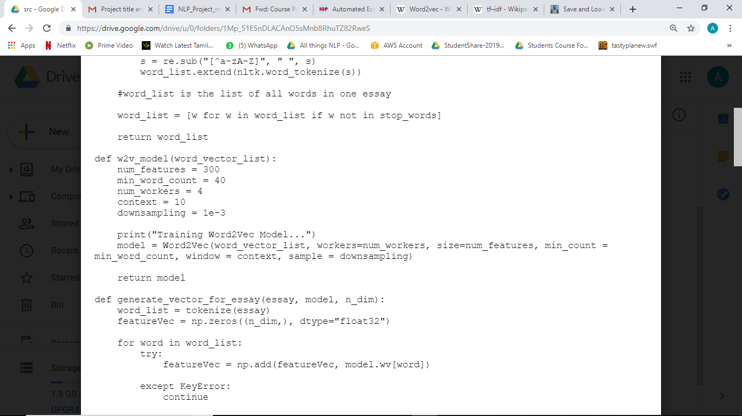
APPROACH
Word2Vec
Word vectors are positioned in the vector space such that words that share common contexts in the corpus are located in close proximity to one another in the space.Hence Word2Vec is a good model to check the relevance of the essays.
Each essay generates a vector of size 300. The parameters used for the model are:

Slide 9
APPROACH
Tf-idf
Term frequency–inverse document frequency, is a numerical statistic that is intended to reflect how important a word is to a document in a collection or corpus. The tf–idf value increases proportionally to the number of times a word appears in the document and is offset by the number of documents in the corpus that contain the word, which helps to adjust for the fact that some words appear more frequently in general.
The tf-idf model outputs a vector of size 38237 and hence we perform dimensionality reduction using Truncated SVD and reduce the size to 300.

Slide 10
APPROACH
SVR and LSTM:
After the vectors were generated from the two models (word2vac and tf-idf vectorizer) we split our data for testing and training and then fed them to two machine learning models. We split the data with test size as 0.2 and then make sure that they were of compatible data types.
(i) SVR: Support vector Regression
(ii) LSTM: Long Short term memory
The model uses the mean_squared_error loss metric and the rmsprop optimizer and is trained over 50 epochs with a batch size of 64.

Slide 11
RESULTS
NLP Approach | ML Models | Kappa score | Time taken
Word2Vec Model | SVR | 0.874 | 100.389 s
 | LSTM | 0.958 | 286.935 s
Tf-idf (after truncated SVD) | SVR | 0.937 | 95.410 s
 | LSTM | 0.959 | 271.194 s

Slide 12
Conclusion:
We see that the tf-idf model which uses a dense vector performs better than the Word2vec model overall (for both LSTM and SVR)
We also see that LSTM performs better than SVR as it has a higher Kappa score.
Closer the Kappa score is to 1, greater is the inter rater agreement.
Closer it is to 0, more the disagreement

Slide 13
REFERENCES
The Hewlett Foundation: Automated Essay Scoring :
https://hewlett.org/newsroom/hewlett-foundation-sponsors-prize-to-improve-automated-scoring-of-student-essays/
Automated Essay Grading Using Machine Learning: Manvi Mahana, Mishel Johns, Ashwin Apte, Stanford University
http://cs229.stanford.edu/proj2012/MahanaJohnsApte-AutomatedEssayGradingUsingMachineLearning.pdf

