Slide 1
Kubernetes – Minikube Cluster

Slide 2
Use Cases
Use Case
1. Deploy any Postgres operator on Kubernetes cluster/minikube.
2. Create the Postgres or any database instance deployment manifests using helm chart
3. Deploy the Postgres instance or any database (helm chart) using any GIT-Ops tools( FluxCD/ArgoCD).
4. Create a sample application to read data from Postgres or any databases which is deployed on Kubernetes/minikube cluster.

Slide 3
Prerequisites
WSL
> Enabling windows for WSL feature
> WSL Installation - Ubuntu
Kubectl
Docker Desktop
Minikube
Helm
GitOps

Slide 4
Use Case 1: Minikube Installation and Postgres Deployment

Slide 5
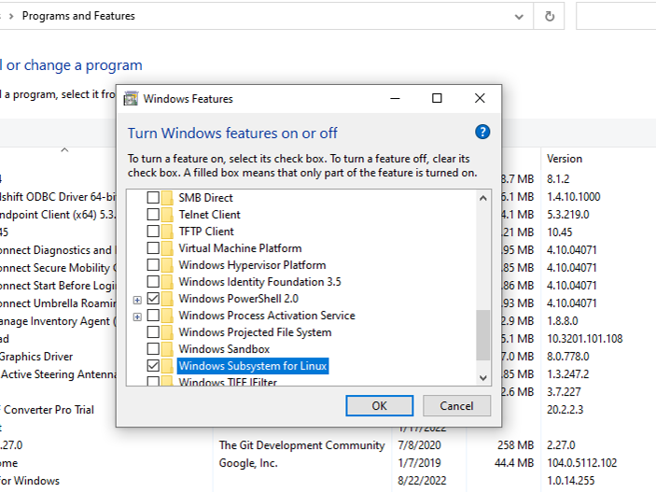
Windows Feature update to Enable WSL

Slide 6
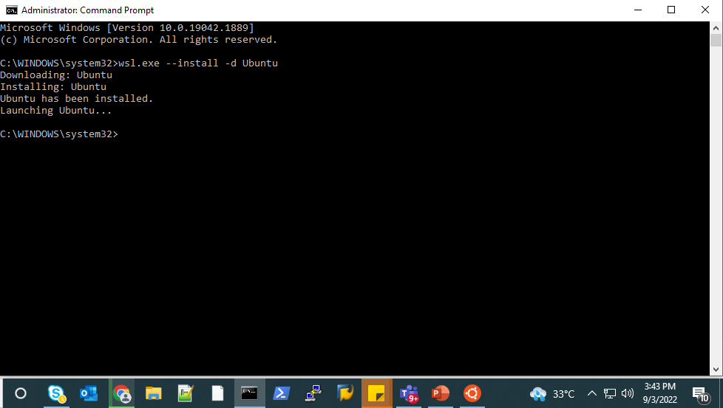
Installing WSL – Ubuntu
Command: wsl.exe --install -d Ubuntu (distribution name)

Slide 7
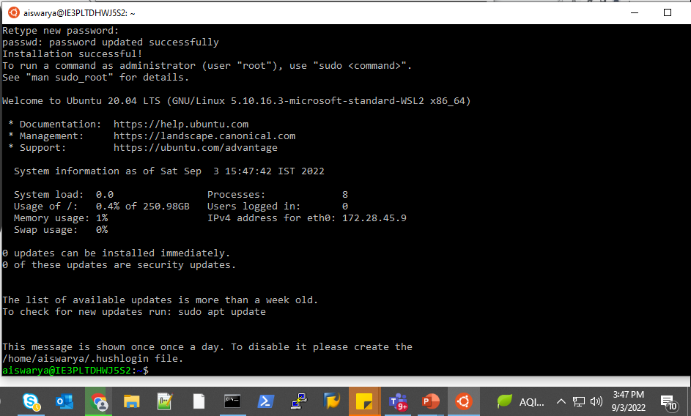
Setting logins for Ubuntu
Once installed we need to set the user and password for the newly installed Linux distribution
User ID: Aiswarya
Pswrd: *****

Slide 8
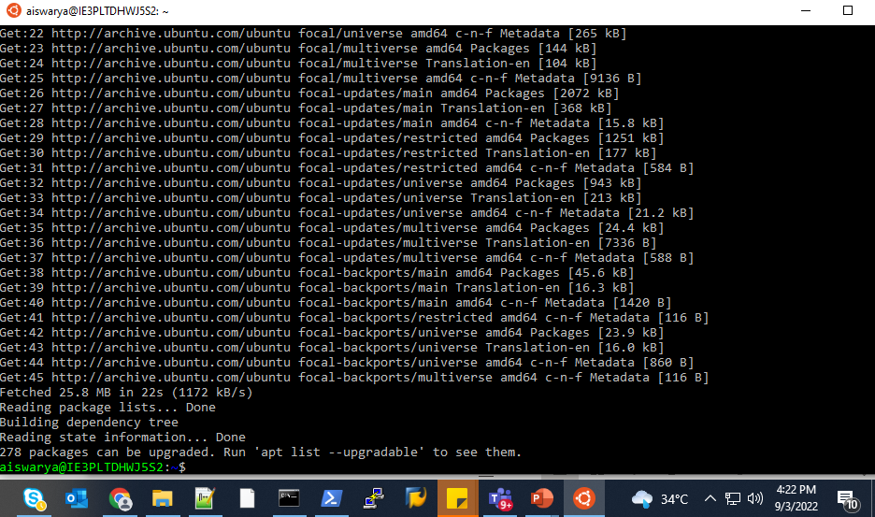
Updating Ubuntu for any latest
Update ubuntu for any latest version (sudo apt update)
Install using the update by running sudo apt upgrade -y

Slide 9
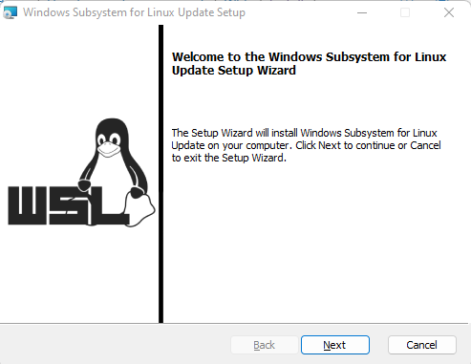
WSL Update Setup
Get the latest and run it from https://aka.ms/wsl2kernel

Slide 10
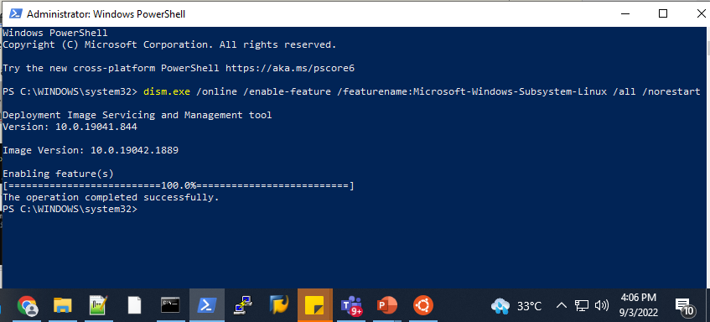
To enable the Linux system for windows run this in PowerShell
Command: dism.exe /online /enable-feature /featurename:Microsoft-Windows-Subsystem-Linux /all /norestart

Slide 11
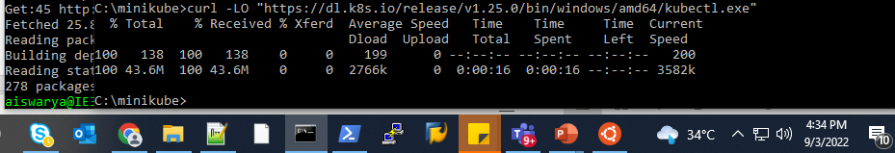
Installing Kubectl
Kubectl Installation Command:
curl -LO "https://dl.k8s.io/release/v1.25.0/bin/windows/amd64/kubectl.exe"

Slide 12
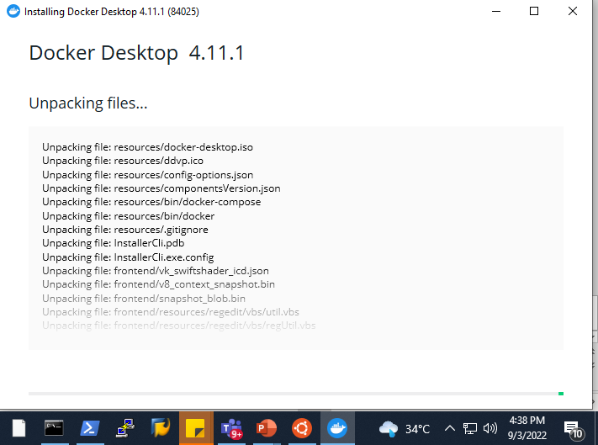
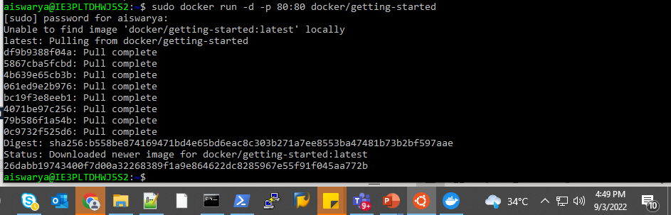
Installing Docker Desktop
Download the latest docker for windows desktop and Install it.
Test run with simple docker by running docker run -d -p 80:80 docker/getting-started

Slide 13
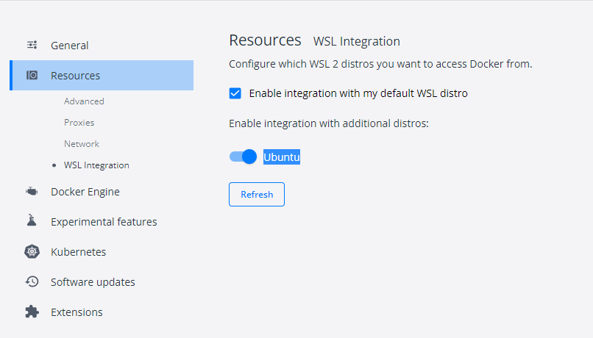
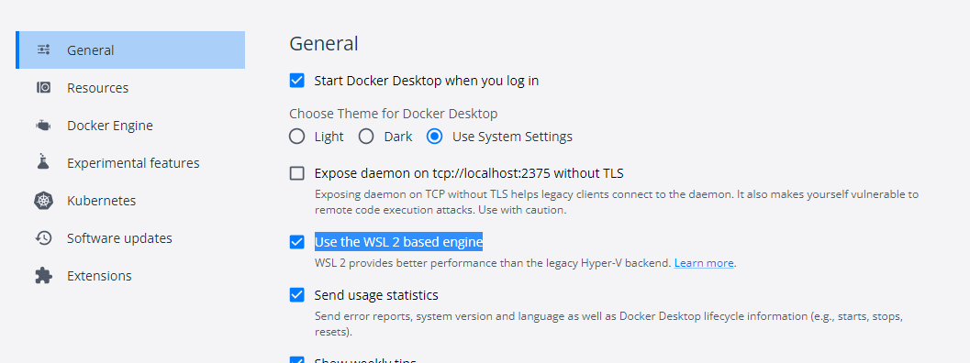
Docker Desktop Settings for Ubuntu WSL
Enable WSL based Engine
Enable Docker Integration with Ubuntu

Slide 14
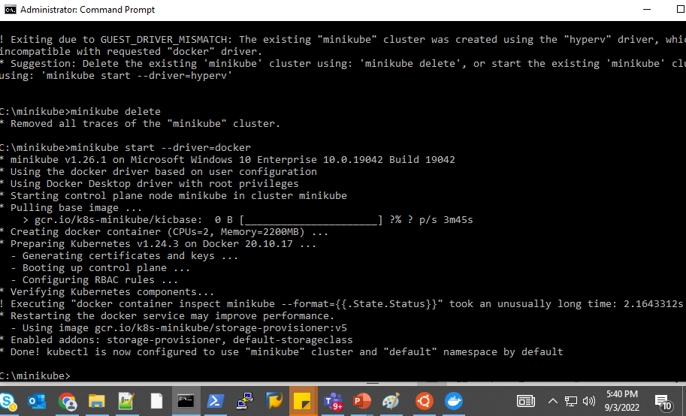
Minikube Installation | Minikube Start
Get the latest Minikube from github repository. Rename the file as minikube.exe
Run: minikube start --driver=docker (or minikube start)

Slide 15
Use Case1 Continuation: Manual Postgres deployment

Slide 16
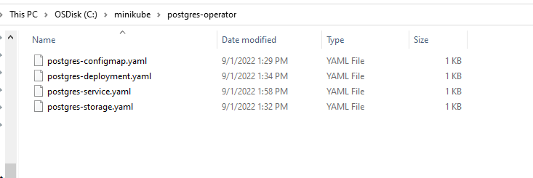
Required Postgres Yaml Files - Manual

Slide 17
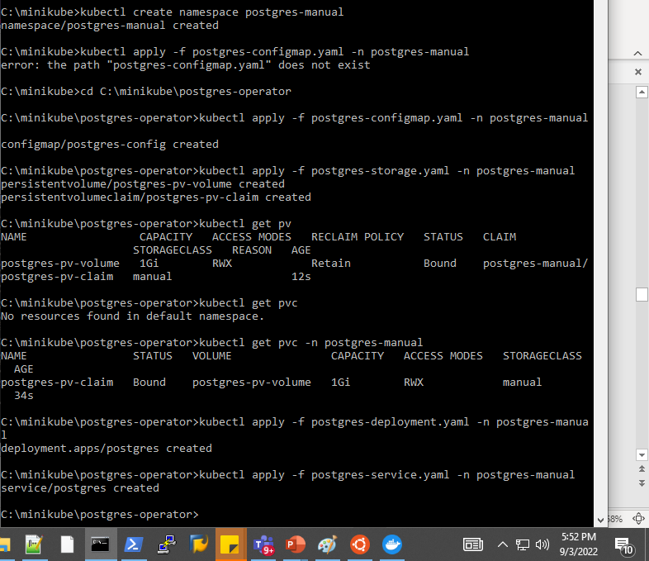
Applying Yaml Files
Created namespace postgres-manual
Applied all Yamal files in that namespace
Run the deployment
create service

Slide 18
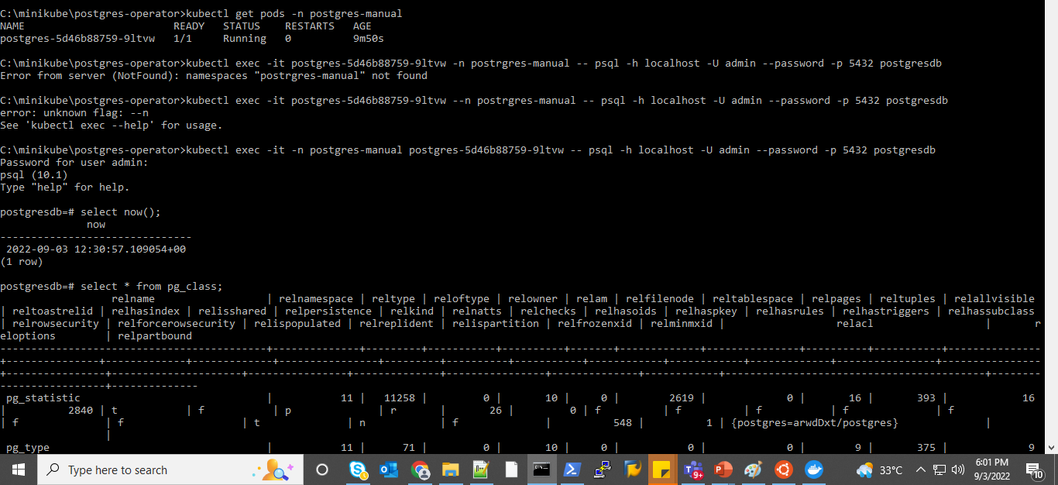
Access the Postgres Operator

Slide 19
Use Case 2: Helm - Postgres deployment

Slide 20
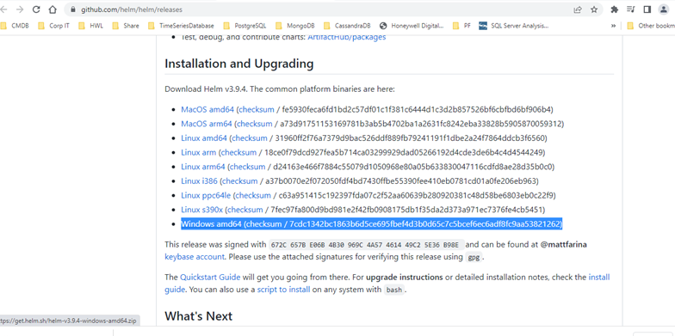
Download Helm
Latest version from GitHub
Add the path to the environmental Variable

Slide 21
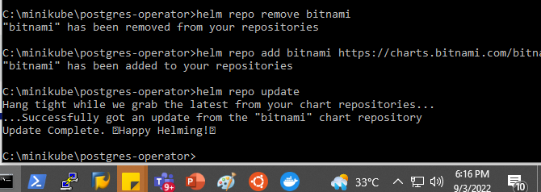
Adding Helm repository
Used Bitnami repo

Slide 22
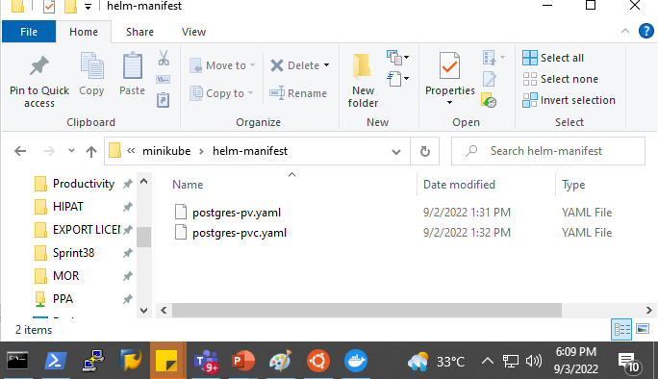
Required Yaml Files - Helm
Create PV and PVC Yaml files for helm Postgres

Slide 23
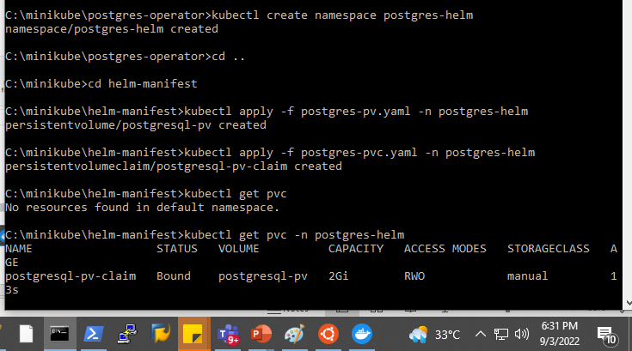
Apply Yaml Files
Created Namespace postgres-helm.
Apply PV and PVC files

Slide 24
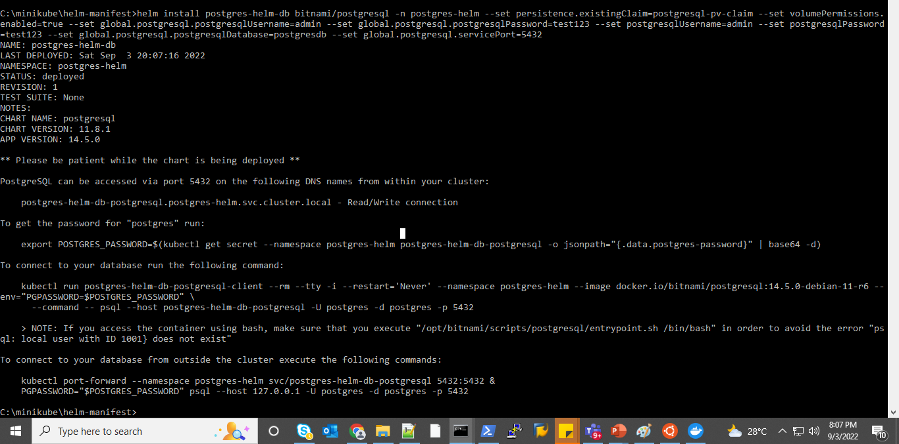
Install helm manifest of Postgres
Install Postgres using helm manifest

Slide 25
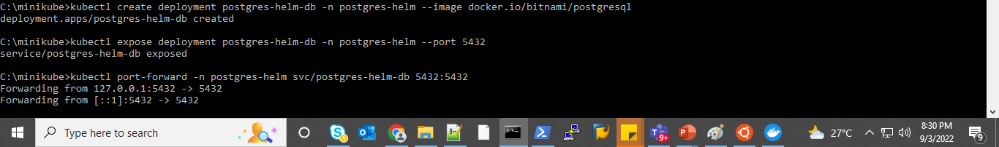
Deployment and Exposing the Service
Deploy
Expose the service

Slide 26

Try Connecting to the helm – Postgres database

Slide 27
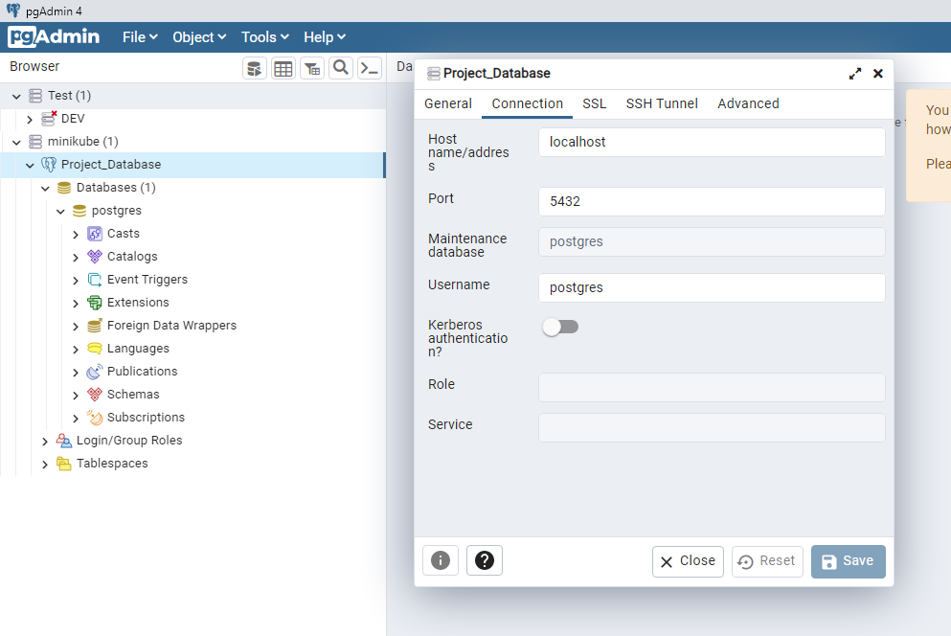
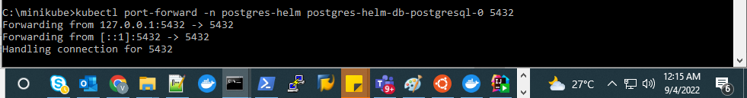
Accessing minikube Postgres outside cluster
Port forwarding to enable it to get accessed by other instances/ application tools
I tried accessing it through PG_ADMIN tool. I could make connections.

Slide 28
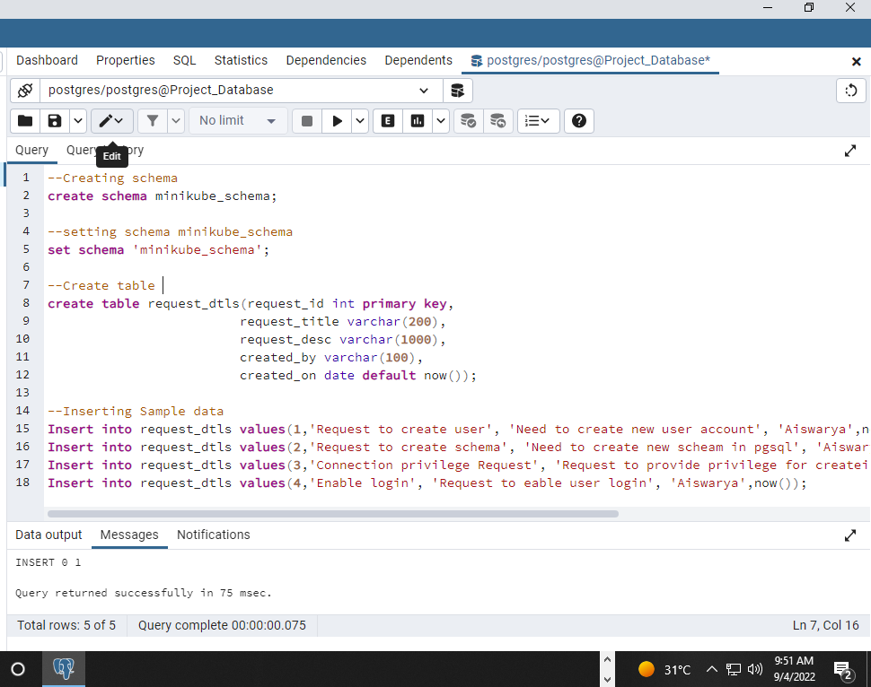
Tested by adding table

Slide 29
Use Case4: Application to connect Postgres Service

Slide 30
Application Used
Java Base Application
Tool: IntelliJ
Spring Boot

Slide 31
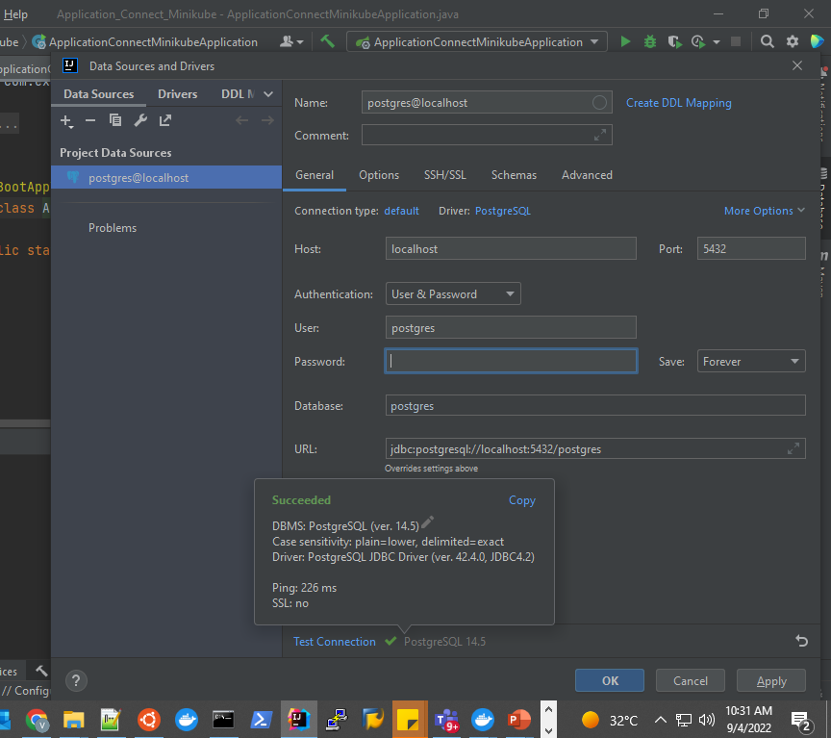
Establishing Connection
Added Postgres data source running in minikube.
Able to make a successful connection.

Slide 32
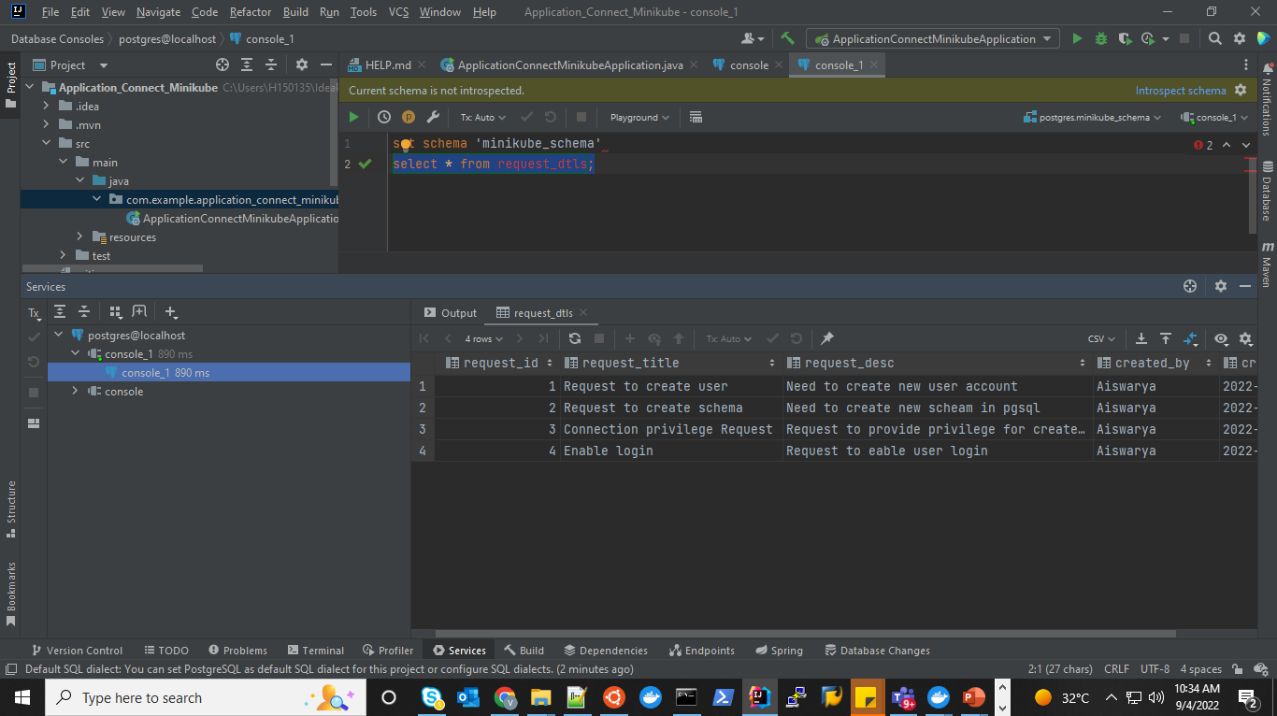
Accessing the table in IntelliJ

Slide 33
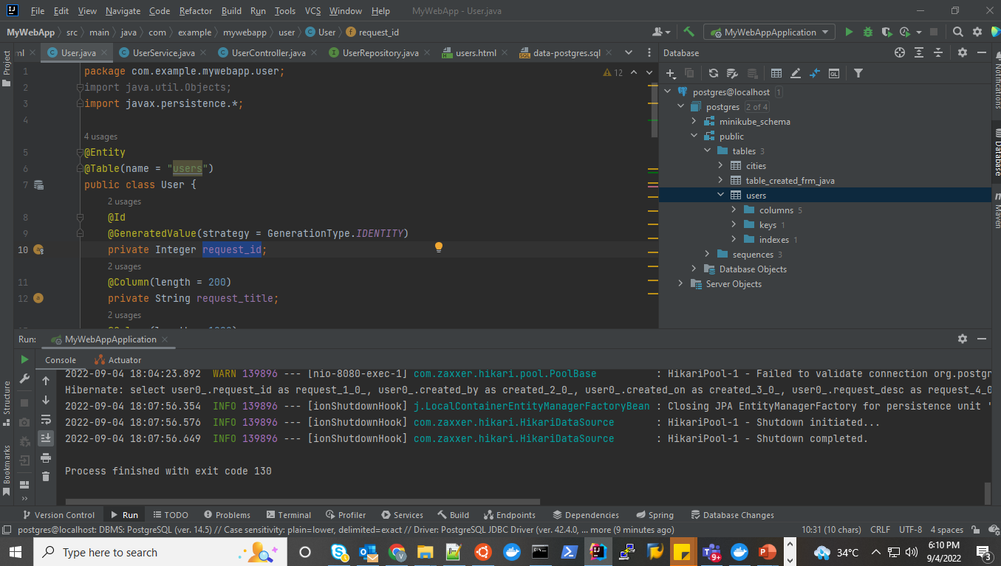
Creating Users Entity in Java Class

Slide 34
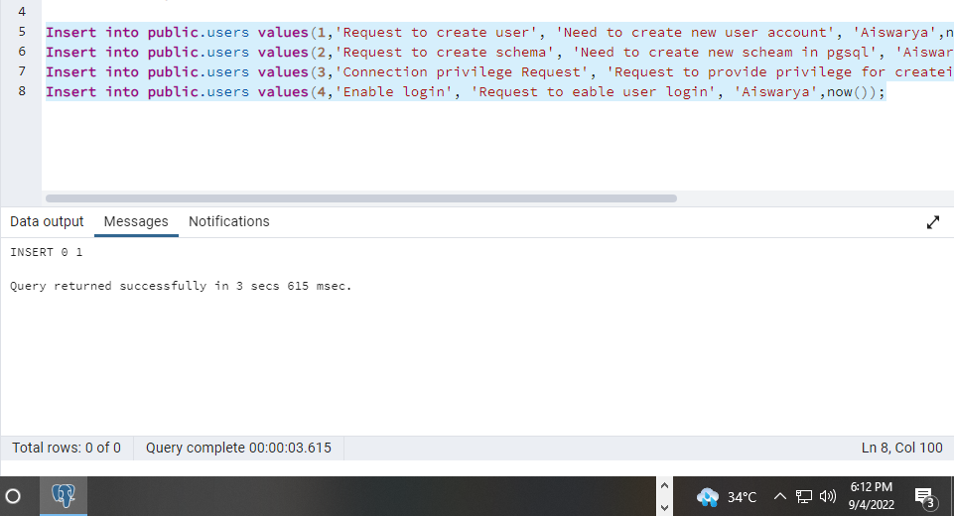
Insert Data to User Entity

Slide 35
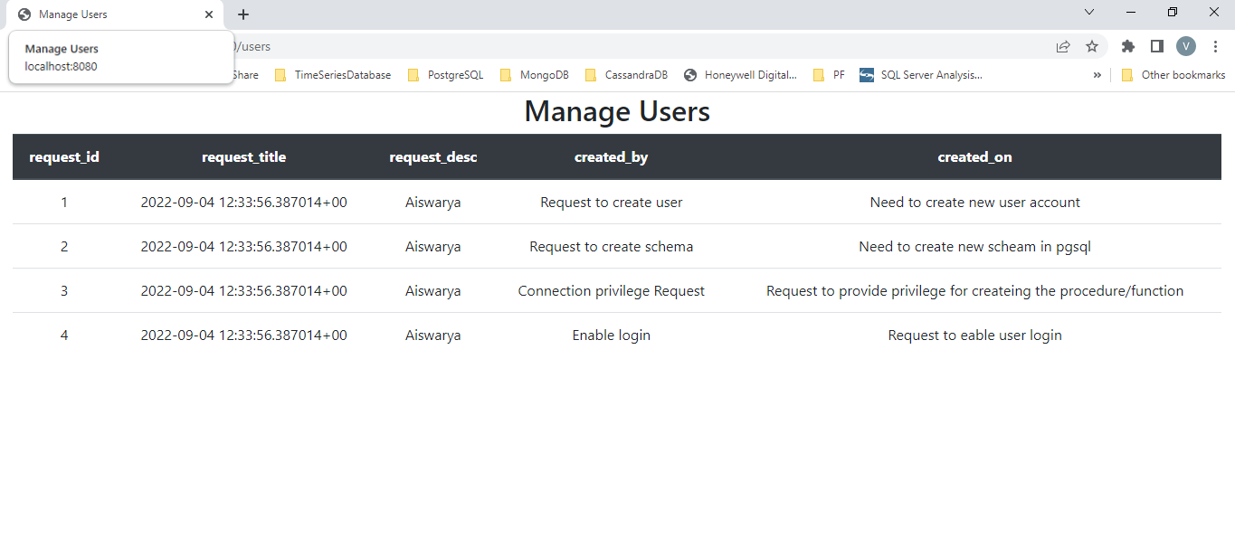
Accessing Local Host of IntelliJ to show Data retrieved from Minikube Postgres

Slide 36
Use Case3: Argo CD

Slide 37
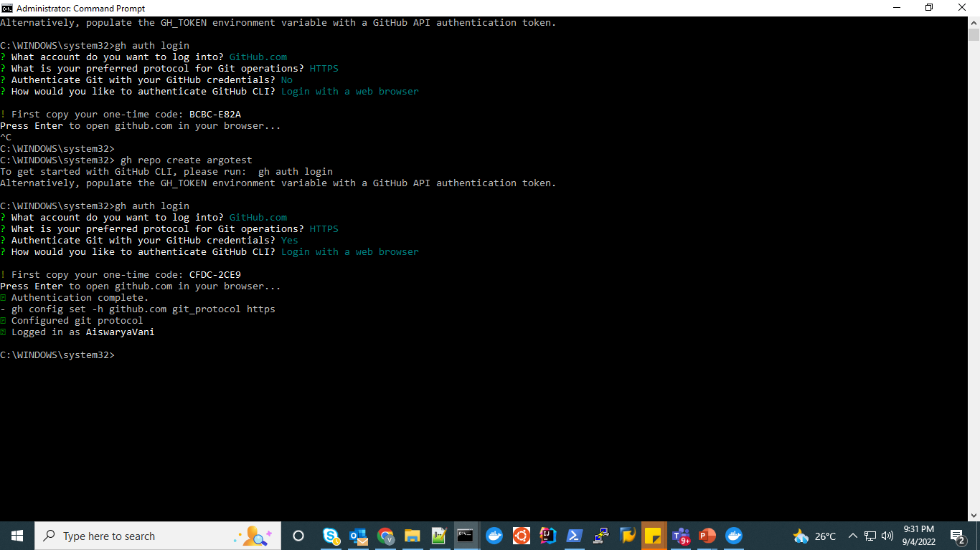
Prerequisites
Git installation in windows.
GitOps User Account
Git repository
Helm Argo CD Repo

Slide 38
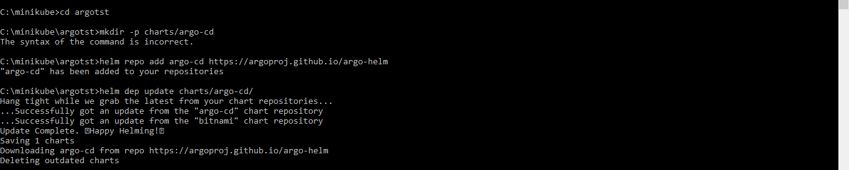
Add Argo-helm repository

Slide 39
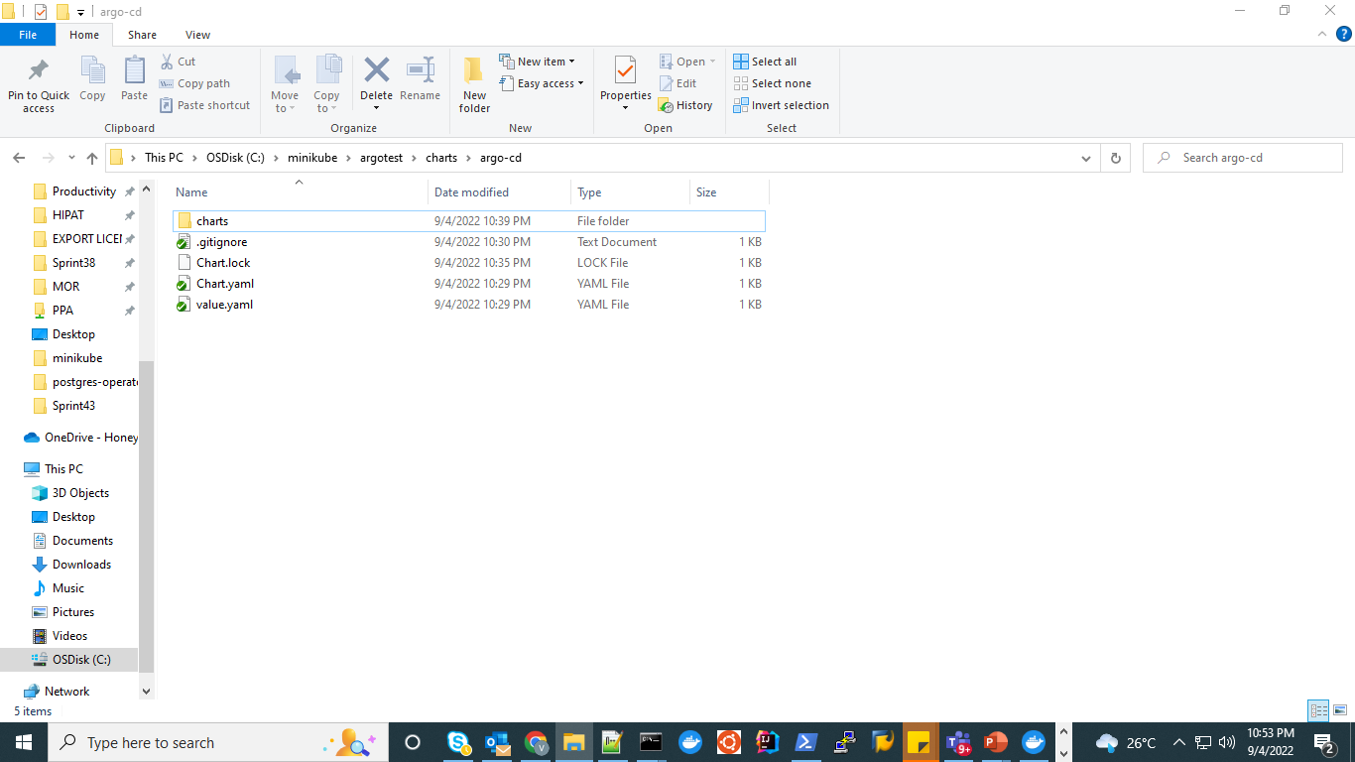
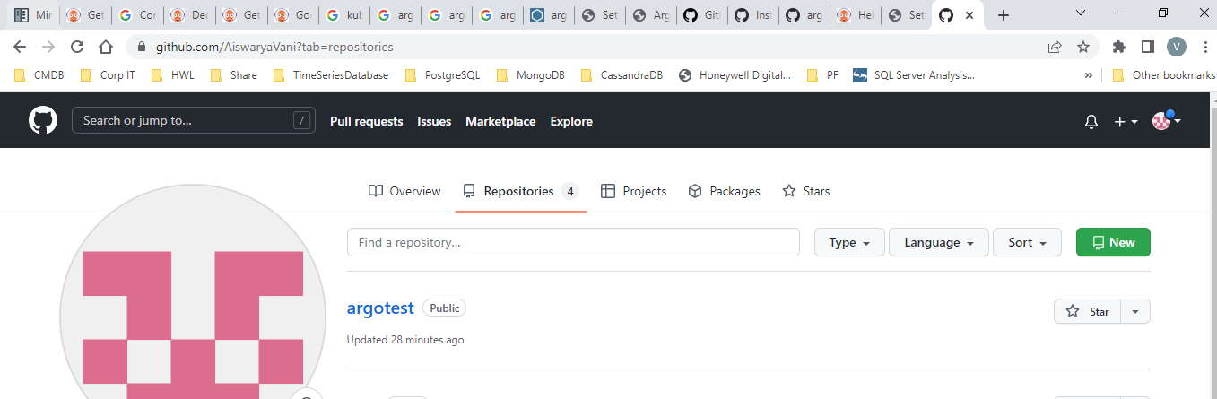
Push to Git Repository

Slide 40
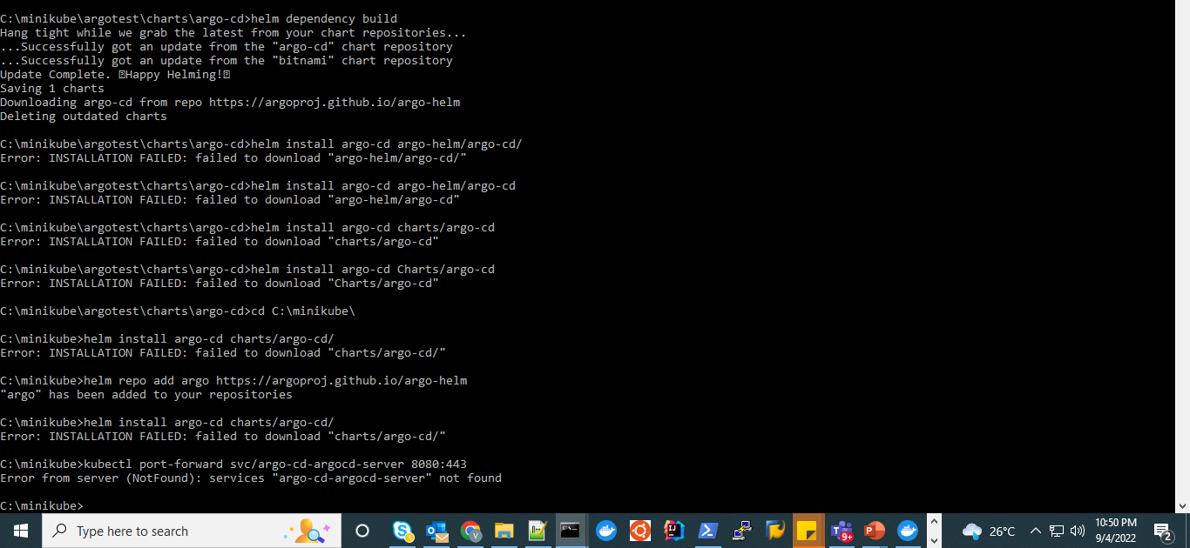
Installation Error

Slide 41
Further Steps for ArgoCD
To get ArgoCD Passwords:
Default User is admin. To get ArgoCD password run the below command and decode the password.
kubectl get secret argocd-initial-admin-secret -o jsonpath="{.data.password}" | base64 –d
echo ##password | base64 --decode

Slide 42
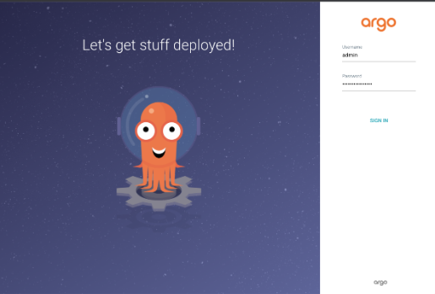
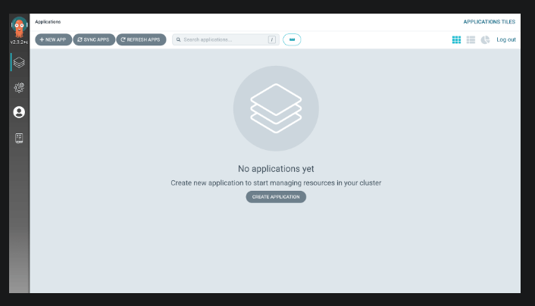
Launch ArgoCD - local Host
Port Forward, get the URL and launch ArgoCD using local host.
kubectl port-forward svc/argo-cd-argocd-server 8080:443

Slide 43
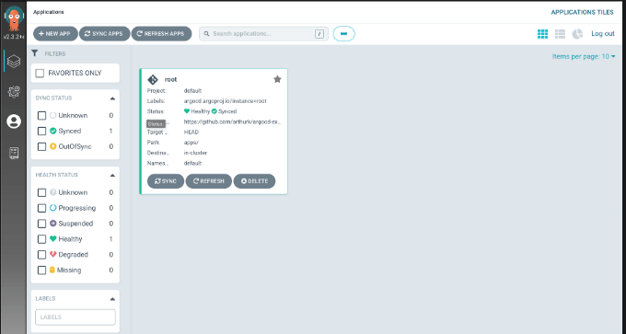
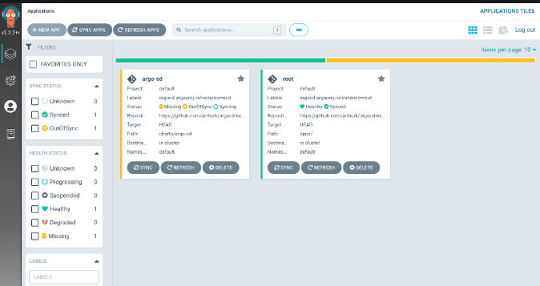
Creating Root file
Create Application manifest files - apps/templates/root.yaml.
Set the source as Git repository and destination as cluster location and apply the file.
To deploy our root application, we need to push the files to our Git repository and apply the manifest.
To let Argo CD manage itself - Put the application manifest files in apps/templates/argo-cd.yaml.

Slide 44
Helm Postgres in ArgoCD using GitOps
Create application manifest file in apps/templates/postgresdb.yaml
Source as git repository where we have the postgres application yaml file and destination as the K8s cluster url.
Push the Postgres application Yaml file to Git Repository.
Postgres will show now in the Argo Web UI.

Slide 45
Appendix
Errors Faced
ArgoCD Error Details

Slide 46
Port forwarding Issue and fixes applied
Error while trying to port forward the deployment
Pod does not exist error: Fixed by searching for the Pod first and then port forward by picking the pod name from the below query.
Commands Used
kubectl get pods -n postgres-helm
######Working fine
kubectl port-forward -n postgres-helm postgres-helm-db-postgresql-0 5432

Slide 47
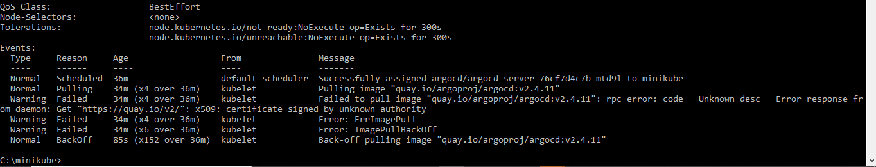
AgroCD Pods Issue
Also tried installing ArgoCD using below command. Argo Pods are not running.
kubectl apply -n argocd -f https://raw.githubusercontent.com/argoproj/argo-cd/stable/manifests/install.yaml --insecure-skip-tls-verify=true
--Ran below script to get the error Details
kubectl describe pod argocd-server-76cf7d4c7b-mtd9l -n argocd

