Slide 1
AIR QUALITY MANAGEMENT
MODULE 2

Slide 2
Effects of air pollution on human health
Adverse effects of air pollution may be divided into two classes-acute and
chronic effects
Accute effects
Short-term exposure to air pollutants at high concentrations
Fast effects on humans
Chronic effects
Become evident only after continuous exposure to low concentration of air pollutant

Slide 3
Factors affecting human health
Nature of the pollutant
Concentration of the pollutant
Duration of exposure
State of health of the receptor
Age group of the receptor

Slide 4
Effect of air pollution on human health
Eye irritation- due to NO_{X}, O₃, PAN, smog, particulates etc
Irritation of the respiratory tract – due to SO_{X}, NO_{X}, O₃, CO etc
Pollens- can initiate asthmatic attack
High concentrations of SO₂, NO₂, SPM and photochemical smog- chronic pulmonary diseases like bronchitis and asthma
CO + hemoglobin - cardiovascular and pulmonary diseases
Hydrogen fluoride – Fluorosis and mottling of teeth

Slide 5
Effect of air pollution on human health
Polycyclic organiccompounds, aliphatic hydrocarbons – cause cancer
Dust particles – cause silicosis, asbestosis
Heavy metals like lead may entered to lungs cause poisoning- high concentration can damage liver and kidney- can cause abnormality in fertility and pregnancy- mental development of children gets affected
Exposure to radioactive isotopes- Iodine 131, Phosphorous 32, Cobalt 60, Radium 226 – cause anemia, leukemia, cancer, shortening of life span and genetic defects.

Slide 6
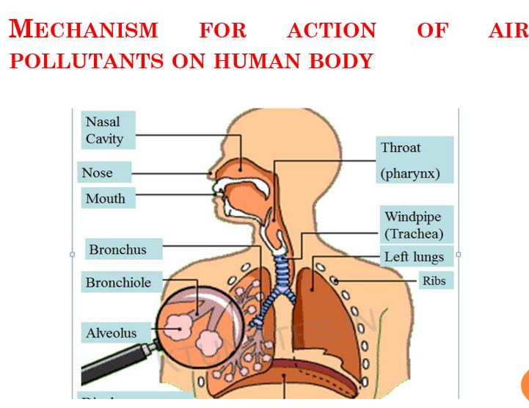

Slide 7
Respiratory system is composed primarily of two lungs and the air passages lead to them.
The air passages begin at the nose and mouth, and include the windpipe (trachea) and its two branches passages known as bronchi.
The bronchi divide into smaller bronchi and further into bronchioles (smallest segment of bronchi).
At the end of bronchioles are the countless tiny air sacs known as alveoli.
Alveoli are the functional units of the lung where oxygen and carbon dioxide are exchanged.

Slide 8
Respiratory Effects-Particulate Matter
Particulate matter inhaled may be deposited in various regions of the respiratory system depending on particle size.
Particles above 10 µm are almost wholly retained in the nose.
Those below 10 µm escape entrapment and generally pass through the upper respiratory system.
Fine particles in the size range 0.5 to 5 µm are deposited as far as in the bronchioles, but few reach the alveoli.

Slide 9
Respiratory Effects-Particulate Matter
The walls of the bronchi and bronchioles are lined with fine hair-like structures called cilia.
These are responsible for removing such fine particles along with the mucous by moving them up to the larynx where they may be eliminated by swallowing.
The health risk is primarily from the deposition of the particles 0.5 µm in the alveoli where they cause damage to the respiratory organs.

Slide 10
Respiratory Effects-Particulate Matter
The toxic effect of particles can be grouped into three categories:
Interference of inert particles with the clearing mechanisms of the respiratory tract
The effect includes a slowing of ciliary beat and mucus flow in the bronchial tree.
Particles act as carriers of adsorbed toxic gases such as SO₂ and produce synergistic effects.

Slide 11
Particles may be intrinsically toxic because of their physical or chemical characteristics:
Such particles belong to metals which are usually found in the atmosphere in trace quantities
Of all the trace metals found in the atmosphere, the one present in largest concentration is lead. In addition to lead, cadmium, nickel and mercury represent known and widespread health hazards.

Slide 12
Health effect- Lead
Source: Auto exhaust (from gasoline), paints, storage batteries, pipes
Lead is a neurotoxin whose poisoning results in convulsions, delirium, coma, severe and irreversible brain damage, and death.
Inhaled lead is far more serious than the ingested lead.
The fine particles emitted by automobile are retained within the lungs and are absorbed by body with an efficiency of about 40 per cent.

Slide 13
Body responds to any kind of lead intake by excreting it in the urine as much as possible and the remainder is stored primarily in the bones.
At elevated blood lead levels, the production of haemoglobin is impaired resulting in oxygen starvation and anemia.
High lead levels in the blood causes behavioural disorders in children and adults.
Health effects: Neurotoxin, affects blood system behavioural disorders, death

Slide 14
Health effect- Cadmium
Sources: Coal, zinc mining, incineration of plastic containers, refining of metals, tobacco smoke
Cadmium is a potential health hazard due to its presence in urban atmosphere and cigarettes smoke.
Cigarette smoking constitutes a major source for cadmium accumulation in the body.
The natural cadmium levels in air vary from 0.002 µg/m³ to much higher values of about 0.3 µg/m³ found near zinc smelters.
Cadmium inhibits the performance of certain enzymes thereby producing hypertension in humans.

Slide 15
Exposure to fumes or oxides of Cadmium is known to cause cardiovascular diseases.
In addition, cadmium can interfere with proper zinc and copper metabolism in the body
Very little is known about the fate and distribution of cadmium in the environment.
It has a very long biological half-life and, therefore, tends to accumulate in the human body.
Some of the chronic effects are kidney and liver damage and even death.
Health effects: Cardiovascular disease and hyper tension, interference with zinc and copper metabolism, kidney damage

Slide 16
Health effect- Nickel
Sources: Combustion of coal, diesel and residual oils, tobacco smoke, chemicals and catalysts, steel and non-ferrous alloys manufacture
The adverse effects of nickel are caused mainly due to nickel carbonyl which is formed when finely divided nickel is emitted into an atmosphere containing carbon monoxide.
Nickel carbonyl is also formed in tobacco smoke.

Slide 17
Within the lung the carbonyl complex breaks down and deposits finely
divided nickel, which may be the main cause of cancer in the lungs.
Nickel carbonyl cause changes in the alveoli of the lungs, resulting in respiratory damage symptoms.
Health effects: Respiratory symptoms, lung cancer (as nickel carbonyl)

Slide 18
Health effect- Mercury
Sources: Combustion of fossil fuels, evaporation from ore mining, exhausts from metal Smelters, chloralkali cells, paints, pharmaceuticals.
Mercury is present in gaseous form in the atmosphere because of its relatively high vapour pressure.
The gaseous mercury is washed from the air by rain; a portion of it enters the aquatic systems and the remaining is bound to the soil over the land.
In both cases the inorganic mercury is generally converted into its methyl or dimethyl compounds by the action of bacteria.

Slide 19
The physiological effects of mercury poisoning include neurological damage, chromosomal aberrations, and even death.
Methylmercury can penetrate the membranes separating the bloodstream from the brain, causing injury to cerebellum and the cortex.
Effects are blurring of vision and numbness.
Another insidious effect of methylmercury is that it can cross the placental barrier in pregnant woman.
High levels of mercury can build up in the fetus without the mother showing any illness. The effects are congenital birth defects or the death of the fetus.

Slide 20
Health effect- Gaseous Pollutants
Sulphur dioxide
Irritant gas which affect mucous membranes
SO₂ oxides to SO₃
Both the above gases form sulphuric acid
SO₃-strong irritant
Causes bronchospasm (Bronchospasm or a bronchial spasm is a sudden constriction of the muscles in the walls of the bronchioles.)

Slide 21
Carbon monoxide
Is having strong affinity for combining with haemoglobin to form Carboxyhaemoglobin and this reduces the ability of haemoglobin to carry blood to the various organs of the body
CO has about 200 times affinity than oxygen to combine with haemoglobin
Affects the central nervous system
Responsible for heart attack and high mortality rate

Slide 22
Oxides of Nitrogen
The major oxides of nitrogen which affect human health are nitric oxide (NO)
and nitrogen dioxide (NO₂).
NO is not an irritant and at concentrations that occur in the atmosphere, it does not show any adverse health effects.
NO₂ is relatively insoluble and upon inhalation can reach the moisture-filled alveoli of the lungs.
There it is converted to nitrous and nitric acids which are highly irritating and cause damage to lung tissues.

Slide 23
Long term exposure to NO concentrations of the order of 1ppm leads to emphysema and biochemical alterations in the blood.
Nitrite combine with haemoglobin to form methamoglobin to reduce oxygen carrying capapcity of the blood

Slide 24
Photochemical Oxidants
The major oxidant produced in photochemical smog is ozone.
There is a definite increase in airway resistance in some people exposed to concentrations as low as 0.1 ppm.
Many other oxidants produced in photochemical smog, particularly the peroxyacyl nitrates, causes eye irritations.
Oxidants such as peroxyacetyl nitrate and peroxybenzoyl nitrate irritate nose and throat, and cause chest constriction. 'The one with the lowest threshold is peroxybenzyl nitrate, having a value of 0.005ppm for 5 minutes exposure.

Slide 25
Effect of air pollution on animals

Slide 26
Effect of air pollution on animals
In the case of animals we are concerned primarily with a two-step process:
Accumulation of airborne contaminants on or in vegetation or forage that serves as their feed and,subsequent effects of the ingested herbage on animals
Not every exposure to air pollution is by inhalation, the animal ingests the contaminant after deposition.

Slide 27
Effect of air pollution on animals
Altered animal behavior: Chemicals and heavy metals have a direct influence on the social and mating behaviors of animals.
Diseases and Mortality: Organ toxicity arising from CFCs and NH₃, volatile organic compounds (VOC), Mercury, CO, NOx, and SO₂ is a silent killer, taking the lives of wildlife.
Biodiversity loss: excess deposition of airborne nitrogen (N) in the form of ammonia is among the main stressors to biodiversity
Change in species distribution: Industrial air pollution can cause a change in the abundance of a particular species.

Slide 28
Effect on pets
Household pets suffer an increased risk of tumors when exposed to polluted air over an extended period of time.
Dogs undergo cough, nose and throat diseases.
Particulate matter in the air has been linked to cardiac arrest in dogs and veterinarians sometimes attribute pet deaths to the effects of air pollution.

Slide 29
Effect on Birds
Birds are affected directly by coal power production exhaust, which can damage birds’ respiratory systems.
Discoloration of birds occurs due to the trace amount of black carbon in the air
Ozone and nitrogen oxides cause direct, irreversible damage to birds lungs.
Exposure to polycyclic aromatic hydrocarbons (PAHs), toxic chemicals emitted by traffic, may cause reduced egg production and growth impairments in birds.

Slide 30
Effect on Fish
Acid rain falling in rivers and streams causes pH levels to decrease, killing fish that are sensitive to pH fluctuations.
Acidic rivers and streams can cause respiratory distress in fish.
Acidic water is generally clearer, causing a temperature and light increase in the water, resulting in the relocation of native fish that need a cooler and darker habitat in order to survive.

Slide 31
Effects of Air-Pollutants on Farm Animals
Important contaminates that affect the live-stock are :
(i) fluorine
(ii) arsenic
(iii) lead
Out of these contaminants, fluorine proves to be the worst pollutant, since cattle and sheep are found to be more susceptible to consumption of fluorine.

Slide 32
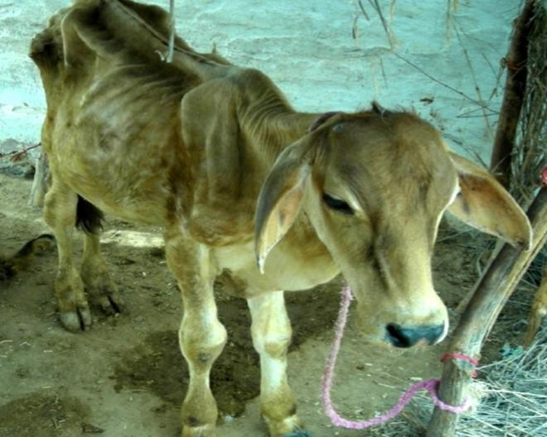
Acute effects of fluoride
➢ Lack of appetite, weight loss, health declination, diarrhea, muscle weakness and may be death.
Chronic effects of fluoride
➢ Bone deformity, for example overgrowth of bone.
➢ Malnutrition, retardation in growth.

Slide 33
Arsenic
➢ Arsenic present in coal and iron ores, causes poisoning of livestock near industrial region.
➢ Acute effects of Arsenic
• Severe salivation, thirst, vomiting, uneasiness, irregular pulse and respiration
• Abnormal temperature and convulsion, death may occur in few hours or days.
➢ Chronic effects of Arsenic
• Depressing effect on central nervous system.
• Thickening of skin, anemia, paralysis and may be death.

Slide 34
Lead
Lead contamination in the atmosphere occurs on the account of various industries, such as smelters, coke ovens, and other coal based industries.
➢ Acute effects of lead
Prostration, staggering and inability to rise, loss of appetite, diarrhea.
➢ Chronic effects of lead
Paralysis of muscles of throat area and difficulty in breathing

Slide 35
Effect of air pollution on vegetation

Slide 36
Effect of air pollution on vegetation
The most obvious damage caused by air pollutants to vegetation occurs in the leaf structure.
The surface of a leaf is covered by a waxy layer known as the cuticle.
In between the waxy layer is the epidermis, a single layer of cells forming the surface skin of leaf.
It's chief functions are the protection of the inner tissues from excessive moisture loss and the admission of carbon dioxide and oxygen to these internal tissues.

Slide 37
Effect of air pollution on vegetation
The leaf surface is penetrated by a large number of openings called stomata.
Each stoma is protected by a pair of guard cells, which control the opening and closing stoma.
The internal tissues of the leaf are the palisade, the spongy mesophyll, and the conducting tissues, or veins, which carry water, minerals and food.
As far as air pollution is concerned, the most vulnerable part is the stomata through which gases diffuse to the surface of the cells within the leaf.

Slide 38
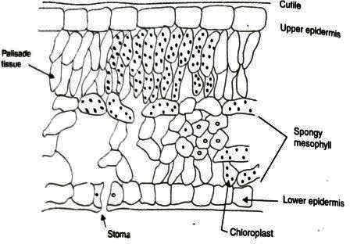

Slide 39
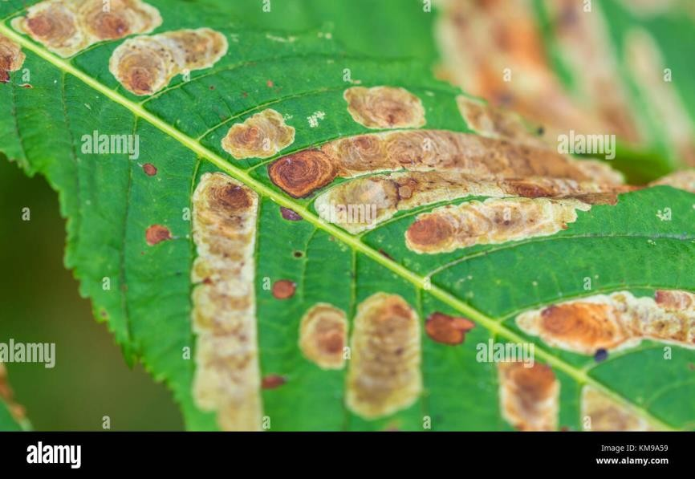
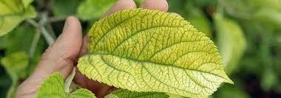
Air pollution effects on vegetation
Necrosis – dead areas on a leaf structure
Chlorosis – reduction or loss of chlorophyll leads to yellowing

Slide 40
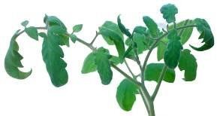

Epinatsy – downward curvature of leaf due to high
growth on upper surface
Abscission- dropping of leaf

Slide 41
Effect of SO₂
It is a phytotoxicant above 0.2ppm.
It causes bleaching of leaves and necrosis.
It affects photosynthesis and and reacts with moisture in tree.
Effect of Fluorine
It is a phytotoxicant above 0.3ppm.
It causes damages to fruits and flowers.
Lowers the value of crop.
It causes necrosis at leaf tip.

Slide 42
Effect of Ozone
It is a phytotoxicant above 0.2ppm.
It causes leisons (small isolate dead spots) on upper surface of leaf, premature aging, suppressed growth, collapse of leaf.
It also causes necrosis and bleaching.
Effect of Oxides of Nitrogen
Nitric acid and oxides of nitrogen absorbed by plants causes leisons on leaves
Causes suppressed growth of leaf, bleaching of leaf
Also causes brown margins and brownish black spots on leaves

Slide 43
Effect of Ammonia
It causes necrosis and chlorotic margin
At higher concentrations leisons also formed
Effect of Ethylene
It causes injury to leaves of sensitive plants
The effects are epinasty, curling, chlorosis, leaf abscission and growth retardation
Effect of PAN
Bronzing of lower leaf surface
Causes suppressed growth
Especially attacks young leaves

Slide 44
Effect of air pollution on materials

Slide 45
Impacts of Air Pollution on Building Materials and Structures
The impact of air pollution on building materials is significant, reducing the service life of buildings.
Particulates such as soot, dust and fumes spoil painted surfaces, fabrics and buildings, and because of their abrasive nature, particulates can cause damage to exposed surfaces when they are driven by wind at high velocities.
The degradation of building and building materials is more due to manmade air pollutants than the natural pollutants.

Slide 46
Types of air pollution-related damages
Discolouration
Material loss
Black crust formation
Structural failure
Abrasion action

Slide 47
Effects on Metals
Atmospheric corrosion of metals is generally an electrochemical process only occurring when the surface is wet.
The most important parameters for the corrosion which are humidity, precipitation, temperature and levels of atmospheric pollutants.
The atmospheric pollutants, SO₂ causes most damaging for the corrosion of metals.
In coastal regions chlorides play a significant role as it accelerates the corrosion of metals.
Ozone may be important in accelerating some reactions.
Nonferrous metals are also subject to corrosion, but to a lesser degree than ferrous metals.

Slide 48
Effects on Concrete
Cement is the major binding agent used in concrete.
Cement is an alkaline material which is susceptible to acid attack.
Badly prepared concrete led to steel corrosion, cracks will develop.
The system becomes more accessible to the attack by SO₂.
The corrosion products of steel occupy a greater volume than the steel.

Slide 49
Effects on Paints
Damage to paint and polymeric materials can occur from acidic deposition and from photochemical oxidants, particularly ozone (O3).
The most serious impact studied involves the influence of SO₂ on paints with CaCO₃ fillers.

Slide 50
Effects on Polymers
O₃ is known to damage some polymeric materials such as plastics and rubbers.
When rubber is under tension, O₃ attacks the C=C and break the bonds.
The number of cracks and the depth of the cracks in rubber under tension are related to ambient concentrations of O₃.

Slide 51
Effects On The Environment
Haze, like smog, is a visible type of air pollution that obscures shapes and colors.
Hazy air pollution can even muffle sounds.
Air pollution can directly contaminate the surface of bodies of water and soil.
Sulfur dioxide and nitrogen oxide particles in the air, can create acid rain when they mix with water and oxygen in the atmosphere.

Slide 52
Effects On The Environment
When acid rain falls to Earth,
it damages plants by changing soil composition; degrades water quality in rivers, lakes and streams; damages crops;
and can cause buildings and monuments to decay.
Air pollutants in the form of Greenhouse gases (CO₂ and CH₄), raises the temperature of the earth.

Slide 53
Greenhouse Effect
The greenhouse effect is the process through which heat is trapped near Earth's surface by substances known as 'greenhouse gases’.
Greenhouse gases consist of carbon dioxide, methane, ozone, nitrous oxide, chlorofluorocarbons, and water vapor.
Part of what makes Earth so amenable is its natural greenhouse effect, which maintains an average temperature of 15 °C (59 °F)
The level of carbon dioxide in Earth’s atmosphere has been rising consistently for decades and traps extra heat near Earth's surface, causing temperatures to rise.

Slide 54
The Greenhouse Effect Process
Solar radiation enters the Earth's atmosphere.
The Earth's surface absorbs the radiation and heats up.
Infrared radiation is emitted from the Earth's surface.
Greenhouse gases absorb the infrared radiation, trapping heat.
The trapped heat warms the planet.

Slide 55
Effects of the Greenhouse Effect
Global warming and climate change
Rising sea levels
Extreme weather events (heatwaves, droughts, floods)
Impacts on ecosystems and biodiversity

Slide 56
Reducing the Greenhouse Effect
Reduce greenhouse gas emissions:
Transition to renewable energy sources
Increase energy efficiency
Electrify transportation
Carbon capture and storage technologies
Sustainable land use practices

Slide 57
Indoor Air Pollution

Slide 58
Indoor Air Pollution
The indoor environment represents an important micro-environment in which people spend a large part of their time each day.
Pollutants can be 5-100 times greater than outdoors.
Most common:– Radon, cigarette smoke, carbon monoxide, nitrogen dioxide, formaldehyde, pesticides, lead, cleaning solvents, ozone, and asbestos
Notes:
Average person: 80-90% of time indoors (home, office, vehicle, buildings)
Vulnerable populations (children, elderly, chronically ill): >95% indoors
Why indoor air matters:
Most significant air exposure for most people, Concentrated pollutants in small spaces,, Multiple pollution sources unique to indoors

Slide 59
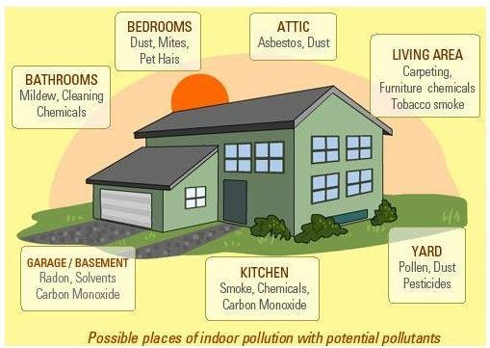

Slide 60
Sources and Impact of indoor air pollution
POLLUTANTS FROM NATURAL SOURCES
Pollutant | Major Sources in the Home | Possible Health Impacts
Radon – Colourless, tasteless, and odourless gas that comes from the radioactive decay of uranium or radium. | Earth and rock under buildings Some earth-derived building materials Groundwater; well-water from private supplies | No immediate symptoms. Long term exposure causes lung cancer. Causes estimated 20,000 lung-cancer deaths yearly. Smokers are at higher risk of developing radon induced lung cancer

Slide 61
POLLUTANTS FROM NATURAL SOURCES
Pollutant | Major Sources in the Home | Possible Health Impacts
Biological Contaminans– Molds, mildews and fungi, bacteria, viruses, dust mites | House dust Infected humans or animals Bedding Poorly maintained humidifiers, dehumidifiers & air conditioners (Stagnant water in devices) Wet or moist surfaces Carpets and home furnishings | Allergies and asthma Headaches Eye, nose and throat irritation Colds, flu, and pneumonia
Notes:
Carpets and home furnishings:
Dust accumulation in fabric
Moisture retention (from spills, humidity)
Mold and mildew growth
Dust mites thrive in fiber
Multiple contaminants concentrated

Slide 62
POLLUTANTS FROM COMBUSTION (BURNING)
Pollutant | Major Sources in the Home | Possible Health Impacts
Carbon Monoxide (CO) – Colourless, odourless gas produced by incomplete combustion of all carbon fuels. | Heating equipment (furnaces, water heaters, fuel-fired space heaters)–natural gas, kerosene Wood or coal stoves Fireplaces Cook tops and ovens Charcoal grills Engines (gasoline, diesel) Tobacco smoke | Headaches, drowsiness, dizziness Impairment of human respiration, vision & brain functioning, nausea, mental confusion Symptoms often mistaken for the flu Very high levels can cause death

Slide 63
POLLUTANTS FROM COMBUSTION (BURNING)
Pollutant | Major Sources in the Home | Possible Health Impacts
Respirable Suspended Particulates (RSP) – Particles small enough to inhale that come in a variety of sizes, shapes, and levels of toxicity. | Wood-burning stoves, fireplaces Unvented kerosene space heaters Gas-fired ranges, furnaces, water heaters Vacuum cleaning and house dust Tobacco smoke Soap powders, pollen, dust, cleaning and cooking sprays | Eye, nose, and throat irritation Respiratory infections and bronchitis Emphysema Lung cancer

Slide 64
POLLUTANTS FROM COMBUSTION (BURNING)
Pollutant | Major Sources in the Home | Possible Health Impacts
Environmental Tobacco Smoke: Second-hand smoke exhaled by smokers, also called side stream smoke. | Cigarettes Cigars Pipes | Eye, nose and throat irritation Respiratory irritation (wheezing, coughing) Bronchitis and pneumonia (particularly in children) Increased risk of emphysema, lung cancer, and heart disease

Slide 65
Pollutants from Man-Made Sources
Pollutant | Major Sources in the Home | Possible Health Impacts
Asbestos – A natural mineral fiber used in various building materials. All homes more than about 20 years old are likely to have some asbestos. | Damaged or deteriorating ceiling, wall, and pipe insulation Vinyl-asbestos floor material Fireproof gaskets in heat shields, wood stoves, and furnaces Acoustical materials Thermal insulation and Exterior siding | No immediate symptoms Chest, abdominal and lung cancers and asbestosis Asbestos can cause lung cancer, especially among smokers 600 to 1,000 U.S. deaths yearly are asbestos- related-mostly from workplace exposure
Notes:
Asbestos- Fire resistance, Insulation properties, Strength, Low cost, Chemical inertness

Slide 66
Pollutants from Man-Made Sources
Pollutant | Major Sources in the Home | Possible Health Impacts
Volatile Organic Chemicals (VOCs) – Airborne chemicals contained in many household products | Aerosol sprays, hair sprays, per fumes, solvents, glues, cleaning agents, fabric softeners, pesticides, paints, moth repellents, deodorizers, and other household products Dry-cleaned clothing Tobacco smoke | Eye, nose, throat irritation Headaches Loss of coordination Confusion Damage to liver, kidneys, and brain Various types of cancer

Slide 67
Pollutants from Man-Made Sources
Pollutant | Major Sources in the Home | Possible Health Impacts
Formaldehyde – Pungent gas released into air | Pressed wood products(plywood, panelling, particle board) Urea-formaldehyde foam wall insulation Carpets, draperies, furniture fabrics Paper products, glues, adhesives Some personal care products, Tobacco smoke | Allergic reactions Eye, nose and throat irritation Headaches Nausea, dizziness, coughing Cancer Sensitivity varies widely

Slide 68
Pollutants from Man-Made Sources
Pollutant | Major Sources in the Home | Possible Health Impacts
Lead – Natural element once used as a component in gasoline, house paint, solder and water pipes. | Household dust from lead paint Lead-based paint Water from lead or lead-soldered pipes or brass fixtures Soil near highways/ lead industries Hobbies such as working with stained glass and target shooting Lead-glazed ceramic ware Some folk medicines | Damage to brain, kidneys, and nervous system Behavioural and learning problems Slowed growth Anaemia Hearing loss Large doses can be fatal

Slide 69
Sick Building Syndrome

Slide 70
Sick building syndrome (SBS) is a condition in which people in a building suffer from symptoms of illness or become infected with chronic disease from the building in which they work or reside.
Sick Building Syndrome is used to describe the condition in which the building occupants experience acute health discomforts that appear to be linked with to the time spend in a building, but no specific illness or cause can be identified.
This is a condition affecting office workers.
Notes:
Key characteristics:
Temporal relationship: Symptoms appear/worsen while in building; improve after leaving
Non-specific symptoms: Multiple diverse symptoms (not fitting one disease pattern)
No identifiable cause: Medical investigation finds no specific illness
Reversibility: Symptoms resolve after leaving building
Recurrence: Symptoms return when person returns to building

Slide 71
Possible risk factors of Sick Building Syndrome
Psychological factors
Stress:
Work-related stress increases symptom reporting
Deadlines, workload, interpersonal conflicts all increase SBS symptoms
Low staff morale:
Unhappy workforce reports more symptoms
Negative workplace culture increases symptom perception
Job dissatisfaction linked to SBS

Slide 72
Possible risk factors of Sick Building Syndrome
Ergonomic Factors
Improper use of display screen equipment:
Computer screens at wrong height
Keyboard/mouse positioning awkward
Causes neck, shoulder, back strain, Contributes to headaches and general discomfort
Poor lighting that causes glare or flicker on visual display units (VDUs):
Fluorescent lights
Glare on computer screens causes eye strain
Improper lighting levels (too bright or too dim)
Causes headaches, eye strain, fatigue

Slide 73
Possible risk factors of Sick Building Syndrome
Cleanliness
Poor standards of cleanliness in the working environment:
Dust accumulation, Inadequate vacuuming/cleaning, Mold growth in hidden areas, Pest control issues
Chemical Pollution
Airborne chemical pollutants such as those from cleaning materials or furniture, or ozone produced by photocopiers and printers
Airborne Particles
Dust: From soil, textiles, skin cells
Carpet fibers: Released during foot traffic and vacuum cleaning
Fungal spores: From mould growth
Pollen: Entering with outdoor air
Tobacco smoke particles (in buildings where smoking occurs)

Slide 74
Possible risk factors of Sick Building Syndrome
High temperature or changes in temperature throughout the day:
High temperature increases discomfort
Heat stress increases fatigue
Temperature increases VOC off-gassing from materials
Humidity
Low humidity:
Dries mucous membranes;
Eye, nose, throat dryness etc
High humidity:
Promotes mold growth, Bacterial growth potential etc
Poor ventilation:
Insufficient outdoor air intake (most critical factor)
Pollutants accumulate instead of being diluted
CO₂ builds up (normal metabolic byproduct)
High CO₂ causes drowsiness, headaches

Slide 75
Factors governing the indoor air quality problem
Air exchange rate - How many times per hour the entire room air volume is replaced.
Indoor rate of removal of pollutants-
Outdoor concentration of air pollutant- Outdoor pollution enters building through outdoor air intake. Bad outdoor air → Bad indoor air (even with good ventilation)
Infiltration and exfiltration rate.
Infiltration: Uncontrolled outdoor air entering building through cracks, gaps, unsealed penetrations
Exfiltration: Conditioned air escaping building through same paths

