Slide 1
AIR QUALITY MANAGEMENT
MODULE 4

Slide 2
AIR QUALITY MONITORING
Sampling and measurement of air pollutants is called Air Quality Monitoring
An integral component of any pollution control programme
The information so obtained is helpful in monitoring and implementing control measures for reducing pollutant concentrations
Through monitoring, the current trends in air quality can be evaluated by comparing the data with the regulated standards
Notes:
Air Quality Monitoring, which simply means measuring the pollutants in our air.
You can't fix a problem if you don't know how big it is,
so monitoring is the first and most important step in any plan to clean up the air.
By collecting this data, we can see if the air is getting better or worse and compare
our results to the legal safety limits (standards)

Slide 3
AIR QUALITY MONITORING
The information so obtained is helpful in implementing control measures and assessing the effects of air pollution control strategies
The monitoring programmes of governmental agencies are usually designed for assessing long term pollution trends, but is often necessary to obtain short term sampling to establish the existence of particularly high levels of air pollutants
Notes:
Checking Our Work Monitoring is like a "test grade" for our pollution laws.
When we pass a new rule to limit smoke from a factory, we use monitoring to see if that rule actually worked to clean the air.
2. The Long View (Trends) Government groups usually set up stations that stay in one place for many years. This helps us see "long-term trends"—like whether a city's air has improved over the last 10 years because of better car engines.
3. The Short View (Spikes) Sometimes, we can't wait years for an answer. We use "short-term sampling" to catch sudden, dangerous spikes in pollution. For example, if there is a massive traffic jam or a fire, we need to know right now if the air is safe for people to breathe at that exact moment.

Slide 4
Measurement of air quality generally fall into two classes:
1. Stack sampling
Deals with pollutants emitted from a source such as smoke stack
Provides information on the nature and quantities of various pollutants that are emitted into the atmosphere
2. Ambient air quality measurement
Pollutant levels in ambient (surrounding) atmosphere are measured
Used to:
i. Determine the areas and time periods when the levels of pollution exceeds the acceptable values
ii. Evaluate parameters for air pollution modeling
iii. Establish and evaluate control measures
Notes:
there are two main places where we test the air to see how dirty it is.
1. At the Source (Stack Sampling) This is like testing the "exhaust pipe" of a factory. We put sensors right inside the tall chimneys (stacks) to see exactly what kind of chemicals are coming out and how much is being released every second. This tells us if a specific factory is following the rules.
2. In the Neighborhood (Ambient Measurement) "Ambient" air is just the normal air all around us that we breathe every day. We set up stations in parks, near roads, or in residential areas to:
Find the Danger Zones: Figure out exactly where and when the air becomes unhealthy for people.
Check the Math: Use the real-world numbers to see if our computer models (the ones that predict where smoke goes) are actually correct.
Plan the Cleanup: Decide if we need to add more trees, limit cars, or change factory rules to keep the air safe.

Slide 5
Ambient Air Sampling
Probably the most important objective of any air sampling exercise is to obtain a genuine and representative sample.
In addition, the sampling should be carried out long enough and at a rate that allows collection of an analytically measurable sample.
This is due to the fact that the concentrations of pollutants in the ambient air are small.
There are both likely to be extremely gaseous and particulate air pollutants whose concentrations occur at levels below one milligram per cubic metre of air.
Notes:
How to Catch a Good Sample
In simple language, this slide explains that catching air pollution is hard because there is so little of it in the vast sky.
Getting a "Genuine" Sample The most important rule is that your sample must be "real". If you want to know the air quality of a whole city, you can't just take a sample right next to a bus exhaust pipe, or the data will be wrong. You need a sample that represents the actual air people are breathing everywhere.
2. The "Slow and Steady" Rule Because pollutants are so spread out, we can't just "grab" a quick breath of air and expect to find much. We have to let our machines run for a long time (sometimes 24 hours) to pull enough air through the filters so that we have enough "dust" or "gas" to actually weigh in a lab.
3. Why is it so hard? Air is huge, and pollution is tiny. Most pollutants exist at levels below 1 milligram in a whole cubic meter of air. To visualize this, imagine trying to find one specific grain of sugar dissolved in a giant swimming pool—you have to check a lot of water to find it.
4. Gases and Dust This rule applies to both gases (like invisible fumes) and particulates (like tiny bits of soot or dust). Both are found in such small amounts that our sampling tools must be very sensitive and run for a long time.

Slide 6
Ambient Air Sampling
In some cases the pollutants collected by normal air pollutants sampling methods may be reactive and this results in changes after collection.
Hence, special measures are necessary to minimize such changes.
For example, SO₂ may be oxidised to SO₃ and carrying out the analysis for SO₂ can be misleading in the absence of precautions to prevent the oxidation.
Usually, a reducing agent such as isopropanol used as a medium for collecting SO₂, which inhibits the formation of SO₃.
Notes:
Keeping the Sample Fresh
In simple language, this slide explains that some pollutants are "active" and try to change into something else the moment we catch them.
1. The "Changing" Problem Imagine you catch a specific bug to study it, but by the time you get to the lab, it has turned into a butterfly. You wouldn't know what the original bug looked like. Air pollutants like Sulphur Dioxide (SO2​) do this—they react with oxygen in the air to become Sulphur Trioxide (SO3​).
2. Why This is a Problem If SO2​ turns into SO3​ inside your sampling bag or bottle, your lab results will show a very low amount of SO2​. This is "misleading" because it makes the air look cleaner than it actually was when you caught it.7
3. The Solution: "Preservatives" To stop this from happening, we use special chemicals to "freeze" the pollutant in its original state.
Reducing Agents: We use a chemical like isopropanol.
How it works: The isopropanol acts like a shield that prevents oxygen from turning the SO2​ into SO3​. This keeps the sample "fresh" until the scientist can measure it in the lab.

Slide 7
Ambient Air Sampling
It is, therefore ideal and desirable to perform the analysis on the unchanged atmosphere, if possible, using continuous automatic analyzers.
Such instruments are available for some pollutants and many more are at varying stages of development and evaluation.
However, the conventional air sampling methods are still popular and widely used.
Notes:
Lecture Note: Modern Machines vs. Traditional Methods
In simple language, this slide compares "high-tech" automatic sensors with the "old-school" manual ways of testing air.
1. The Perfect Way (Automatic Analyzers) The best way to test air is to measure it exactly as it is in the sky, without ever catching it in a bag or bottle. We use continuous automatic analyzers for this. These are machines that suck in air and give you a digital reading of the pollution levels every second.
2. Why Automatic is Better
No Changes: Since the machine tests the air immediately, the pollutants don't have time to change or react (like we saw in the last slide).
Live Data: You get a constant stream of information instead of waiting for a lab report.
3. The Reality Check Even though automatic machines are great, we don't have them for every type of chemical yet. Many are still being tested or invented in labs.
4. Why We Still Use "Old-School" Methods Because automatic machines are very expensive and complicated, most people still use conventional methods. These are the manual ways of catching air in a container and taking it to a laboratory. They are cheaper, easier to set up, and have been trusted by scientists for a long time.

Slide 8
Ambient Air Sampling
A typical air sampling system consists of:
A pump
To draw air sample through the system
A flowmeter
Measure air flow through sample collector
Can be positioned either upstream or downstream from collector if pressure drop across the collector is low, but when this is not the case , flowmeter must be placed upstream(fig b) (otherwise serious errors can result)
Notes:
The "Vacuum Cleaner" for Air
In simple language, this slide describes the machine we use to catch pollution. It works a lot like a vacuum cleaner, but it needs to be much more precise.
1. The Pump (The Muscle) The pump is the engine of the system. Its only job is to provide the "sucking" power to pull outside air into the machine so we can test it.
2. The Flowmeter (The Speedometer) The flowmeter tells us exactly how much air is entering the machine. This is very important because if we don't know how much air we sucked in, we can't calculate how much pollution is in it.
3. Where to put the Flowmeter? This is a tricky but important rule:
Easy Breathing (Low Pressure Drop): If the air flows through the filter easily, you can put the flowmeter before or after the filter.
Hard Breathing (High Pressure Drop): If the filter is very thick or gets clogged, it creates a "pressure drop". In this case, you must put the flowmeter before the filter (upstream).
Why? If you put it after a clogged filter, the air becomes thinner (less pressure), and the flowmeter will give you a wrong, "ghost" reading that ruins your experiment.

Slide 9
Ambient Air Sampling
3. Sample collector
Function is to retain the desired pollutant either alone or as a mixture.
The pollutant thus collected is analyzed at a later stage.
Choice of type of collector to be used is governed by nature of pollutant and method of analysis
Individual sample collectors are generally grouped into two categories:
i. Those used to collect gaseous pollutants
ii. Those used to collect particulate pollutants
Notes:
he sample collector is the most important part of the machine because it is the "trap" that catches the dirt in the air.
1. How it Works Think of the collector like a specialized sponge. As the pump pulls air through, the collector holds onto the pollutants (the "desired" stuff we want to study) and lets the clean air pass through. We then take this "sponge" to a lab later to see what it caught.
2. Choosing the Right Tool You can't catch a fish with a butterfly net. Similarly, you have to pick your collector based on what you are looking for:
If you are looking for dust or soot, you use a filter.
If you are looking for invisible gases (like SO2), you might use a bottle of liquid that "soaks up" the gas.
3. The Two Big Groups Scientists split collectors into two main teams:
Gaseous Collectors: These are for invisible fumes and smells.
Particulate Collectors: These are for solid bits like dust, smoke, and pollen.

Slide 10
General requirements for sampling site selection:
The location of an air monitoring station is critical and depends on several factors:
Purpose of monitoring
Number and type of instruments required
Duration of measurements
Should be easily accessible
Notes:
we can't just drop a monitoring machine anywhere; we have to plan carefully based on what we want to find out.
1. What is the Goal? (Purpose) Before picking a spot, you must ask: "Why am I doing this?". Are you trying to see how much smoke a specific factory is making? (Put it near the factory). Or are you trying to see if the air in a whole city is safe for kids? (Put it in a central park or near a school).
2. What Tools are Needed? Some machines are small and run on batteries, while others are as big as a refrigerator and need a lot of electricity. You need to make sure your chosen site has enough space and the right power outlets for the specific instruments you are using.
3. How Long Will it Stay There? (Duration) If you are only testing the air for one day, you might just use a portable tripod. But if you want to monitor the air for ten years to see long-term trends, you need to build a permanent, weather-proof shed to protect the equipment.
4. Can You Get to It? (Accessibility) The site must be easy to reach. Scientists need to visit the station regularly to change filters, download data, and fix broken parts. If the site is on a locked rooftop or in the middle of a swamp, it will be too hard to maintain, and the data will be lost.

Slide 11
Collection of Gaseous Air Pollutants
Several methods are available for collection of gaseous air pollutants from ambient atmosphere.
The common ones are:
Grab sampling
Absorption in liquids
Adsorption on a solid material
Condensation or freeze-out sampling.
Notes:
1. Grab Sampling (The "Quick Catch") As we discussed before, this is like catching a "handful" of air in a bag or a bottle. It’s fast, but only works well if the air is very dirty.
2. Absorption in Liquids (The "Bubbler") This is one of the most common methods. We bubble the air through a bottle filled with a special liquid. The gas we want to measure gets "soaked up" by the liquid, while the rest of the air just passes through. It’s like how a sponge soaks up water but leaves the floor dry.
3. Adsorption on a Solid (The "Sticky Filter") Note the spelling—Adsorption with a "d". In this method, the gas doesn't soak into something; it sticks to the surface of a solid material, like activated charcoal. Imagine throwing a tennis ball at a wall covered in glue; the ball (the gas) sticks to the surface.
4. Condensation / Freeze-out (The "Ice Trap") We pull the air through a tube that is kept extremely cold (often using liquid nitrogen or dry ice). The cold temperature turns the gas into a liquid or a solid (like frost on a window), which we can then collect and study.

Slide 12
Grab Sampling
In "grab" sampling the sample is collected by filling an evacuated flask or an inflatable bag.
Plastic bags have been widely used for grab sampling and tor storage before analysis.
Bag sampling is subject to losses caused by moisture condensation or diffusion through the walls of the bag.
The losses can be minimized by performing the analysis immediately following collection.
Grab samples may be taken using rigid wall containers made from glass or stainless steel.
These containers are first evacuated and then filled by allowing air to enter.
Notes:
. Soft Containers (Bags) One of the most common ways to grab air is using a special plastic bag. It’s cheap and easy to carry. You just pump the air in until the bag is full.
2. The Problem with Bags: "Leaking and Sweating" Bags aren't perfect. Two things can ruin your sample:
Diffusion: Some tiny gas molecules can actually seep through the plastic walls of the bag and escape.
Condensation: If the air is humid, "sweat" (water droplets) can form inside the bag. Some pollutants get trapped in these water drops, so they don't show up in the gas test.
The Fix: To avoid these losses, you should test the air in the lab immediately after catching it.
3. Hard Containers (Rigid Walls) If you need something stronger than a bag, you use containers made of glass or stainless steel.
How it works: These containers are "evacuated," meaning all the air is sucked out first to create a vacuum.
The Catch: When you get to the site, you simply open a valve. The vacuum pulls the outside air in instantly, and then you seal it shut.

Slide 13
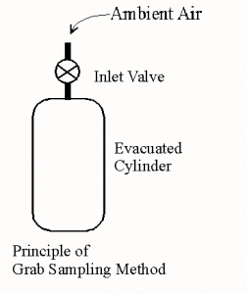
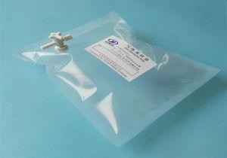
Grab Sampling
Notes:
Figure A: Inflatable Bag (Soft Container)
This figure shows a flexible, leak-proof plastic bag (often made of a material called Tedlar).
How it works: A small, battery-operated pump is connected to the bag's valve. The pump sucks in the surrounding air and blows it into the bag until it is full, like blowing up a balloon.
Key Feature: It is very lightweight and easy to carry into tight spaces or remote areas.
The Problem: Because the walls are made of thin plastic, some gases can slowly leak out (diffusion), or water vapor can turn into liquid drops inside the bag (condensation), which might ruin the sample if not tested quickly.
Figure B: Evacuated Rigid Container (Hard Container)
This figure shows a strong, solid bottle, usually made of thick glass or stainless steel (often called a Summa Canister).
How it works: Before going to the site, a powerful laboratory pump is used to suck all the air out of the bottle, creating a vacuum (an empty space).
The "Grab": When the scientist is at the location, they simply turn a valve on the top. Because there is a vacuum inside, the outside air rushes in instantly to fill the empty space. No pump is needed at the site.
Key Feature: These are much tougher than bags. Because the walls are made of steel or glass, the gas cannot leak out through the walls, making them better for storing samples for a longer time.

Slide 14
Grab Sampling
Alternatively, a container may be filled with water and then used as a collector simply by draining away the water which is replaced by the air sample.
Many problems associated with bag samples are common to rigid containers also (like condensation). To prevent this the containers are often heated by wrapping them with heating tapes or nichrome wires(which act like tiny electric heaters) during sampling.
Notes:
to fill a container and how we keep the sample "perfect" while it's inside.
1. The Water Displacement Method Imagine you have a bottle full of water. If you turn it upside down and let the water pour out, air has to rush in to take its place.
We use this simple trick to catch air! We fill a container with water, take it to the polluted site, and drain the water.
As the water leaves, the air from that specific spot is pulled inside.
Note: This only works for gases that do not dissolve in water.
2. The Problem: "Cold Walls" Just like a cold soda can gets "sweaty" on the outside, a cold sampling container can get "sweaty" on the inside (condensation).
If water droplets form inside the container, some pollutants might get trapped in that water.
This would mean when the lab tests the gas, the numbers will be too low because some of the pollution is stuck in the "sweat".
3. The Solution: Electric Blankets for Bottles To stop this condensation, we keep the containers warm.
We wrap the glass or metal bottles in heating tapes or nichrome wires (which act like tiny electric heaters).
By keeping the bottle warm, we ensure no water drops form, and the pollutant stays in the air where we can measure it.

Slide 15
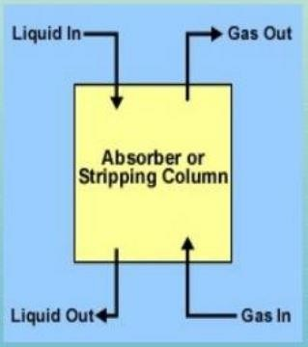
Absorption in Liquids
Absorption of gaseous pollutants in to a liquid medium is a probably the most commonly employed method of collecting the samples.
Absorption separates the desired pollutant from air either through direct solubility in the absorbing medium or by chemical reaction.
Notes:
The "Liquid Trap"
In simple language, absorption is like using a liquid filter to "wash" the pollution out of the air.
1. Why is it so popular? This is the "gold standard" for many gas tests because it is relatively cheap, reliable, and allows us to concentrate the pollution from a large volume of air into a small bottle of liquid.
2. How the Separation Works The goal is to pull the gas molecules out of the air and keep them in the liquid. This happens in two ways:
Method 1: Direct Solubility (Like Sugar in Water) Some gases naturally like to dissolve in certain liquids. For example, if you bubble air containing ammonia through water, the ammonia will naturally stay in the water while the clean air passes through.
Method 2: Chemical Reaction (The "Permanent Lock") Sometimes, we use a liquid that "attacks" the gas. When the gas touches the liquid, they react to form a new, stable chemical. This is even better because once the gas has reacted, it can't accidentally escape back into the air.
3. The Goal By the end of the sampling period, the air is gone, but the pollutants are "stuck" in the liquid. We take this liquid to the lab, and because the pollutants are now concentrated in a small bottle, they are much easier to measure accurately.

Slide 16
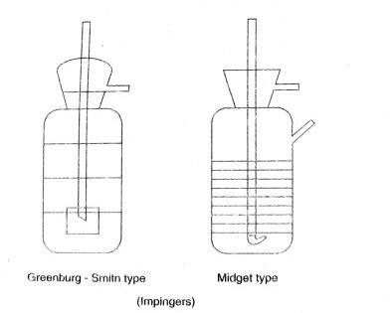
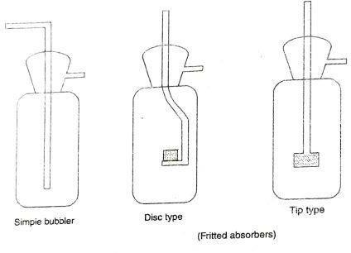
Absorption in Liquids
Device | Bubble Size | Best Use
Simple Bubbler | Huge | Easy-to-catch gases
Disc/Tip (Fritted) | Tiny | Very difficult gases (High efficiency)
Greenburg-Smith | Medium (Fast) | High-speed, large-scale testing
Midget | Medium (Small) | Portable/Personal testing
Fig. 2 Gas absorbing devices
Notes:
1. Simple Bubbler This is the most basic version. It works like blowing through a straw into a glass of water. It creates large bubbles that rise quickly. Because the bubbles are big and fast, it isn't very efficient for catching gases that don't dissolve easily.
2. Disc and Tip Types (The "Micro-Bubblers") These use a frit (porous glass).
Disc Type: The air passes through a flat disc at the bottom, creating a wide "wall" of tiny bubbles.
Tip Type: Only the very end of the tube is porous.
Why they are better: Tiny bubbles have a huge amount of surface area. Think of it like this: one big bubble has a "skin" that touches the liquid, but if you break that big bubble into 1,000 tiny ones, there is 1,000 times more "skin" touching the liquid. This makes the trap much more effective.
3. Greenburg-Smith Impinger This is a "heavy-duty" collector. The air is pulled through a very narrow opening at the bottom of the tube so fast that it actually "blasts" against the bottom of the flask. This "collision" forces dust and gases into the liquid.
4. Midget Impinger As the name suggests, this is a small version. It is designed to be used with smaller, battery-operated pumps that a scientist can carry around. It is the most common tool for checking air quality in workplaces or specific small areas.

Slide 17
Absorption in Liquids
Many different types of collectors are in use, ranging from simple bubbles to complex devices which provide a high degree of gas-liquid contact.
Some of these devices are shown in in Fig. 2.
One such device is the fritted-glass absorber where the gas stream is broken up into extremely small bubbles, thus promoting an intimate contact between the gas and the liquid.
Frits designated "coarse" (50-µm pore size) are most often used for air sampling.
The glass frit can become blocked and is often difficult to clean after use; therefore, it is often advisable to pre-filter the air prior to sampling.
Notes:
Maximizing the "Contact"
In simple language, if we want to catch all the pollution, the air bubbles need to touch as much liquid as possible for as long as possible.
1. The Goal: Tiny Bubbles As we saw in Fig. 2, the fritted-glass absorber is the star of the show for efficiency. By forcing air through a "frit" (a porous glass piece), the air is shattered into millions of tiny bubbles.
Why it works: Tiny bubbles stay in the liquid longer and have a much larger surface area than one big bubble. Scientists call this "intimate contact".
2. The "Coarse" Standard The holes in these glass frits come in different sizes. For air sampling, we usually use the "coarse" type, which has holes about 50 μm (micrometers) wide. This size is the "Goldilocks" zone—it makes bubbles small enough to be efficient but doesn't require a massive pump to push the air through.
3. The Problem: Clogging Because the holes in the frit are so tiny, they act like a filter and can easily get "choked" by dust or soot in the air.
4. The Solution: Pre-Filtering To protect the expensive glass frit, we often add a pre-filter at the very start of the system. This filter catches the "big chunks" of dust so only the gas and clean air reach the frit, keeping the system running smoothly.

Slide 18
Absorption in Liquids
Probably the most widely used collector is the impinger.
In the impinger, the gas stream is impinged at high velocity onto a flat surface thus
providing good contact between the gas and the liquid.
The flat surface can be the bottom of the collector or a specially designed plate.
The common impingers are the Greenburg-Smith and the midget types.
These devices can handle sample flow rates of about 30 and 3 litres per minute respectively.
Impingers can collect gases with efficiencies often approaching those of fritted-glass collectors and unlike the latter they are easy to clean and maintain.
Notes:
1. How it Works (The Impact) Instead of just making bubbles, the impinger shoots the air through a very skinny tube at a very high speed. The air "impinges" (slams) against a flat surface—either the very bottom of the glass jar or a special plate placed in the way. This crash forces the pollutants to stay in the liquid while the air bounces away and leaves the bottle.
2. Big vs. Small (Flow Rates)
Greenburg-Smith: This is the big brother. It can handle 30 L/min of air, which is quite a lot for a glass collector.
Midget Type: This is the smaller version, handling only 3 L/min. It is much easier to carry around for field work.
3. Why Scientists Love Them While fritted-glass bubblers are slightly more efficient at catching gases, they are a nightmare to clean because the tiny holes get clogged. Impingers are just smooth glass tubes. They are almost as efficient but much easier to wash and reuse, which makes them the most popular choice for everyday air testing.

Slide 19
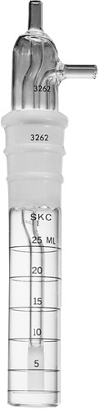
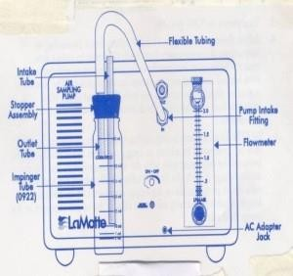
Absorption in Liquids
Notes:
1. Figure 1: The Air Sampling Train (Left) This diagram shows the "engine" of the operation.
The Pump: This is the box that creates the suction needed to pull air from the outside into our collector.
Flowmeter: This is the glass tube with a little ball inside. It tells the scientist exactly how much air is being pulled through every minute (measured in Liters per minute).
The Path: Air enters the Intake Tube, travels through the Impinger Tube where it bubbles in the liquid, and the "cleaned" air exits through the Outlet Tube toward the pump.
2. Figure 2: The Graduated Impinger (Right) This is a close-up of a real Midget Impinger used in the laboratory.
Measurement Lines: Note the lines and numbers (5, 10, 15, 20, 25 mL) on the side of the glass. These are "graduations."
Why they matter: After the test is done, some of the liquid might have evaporated. Scientists use these lines to see exactly how much liquid is left.
Precision: Knowing the exact amount of liquid is critical. If you have 10 units of pollution in 10 mL of liquid, it is a different concentration than 10 units in 5 mL. These lines help ensure the lab math is perfect.

Slide 20
Adsorption on Solids
This method is based on the tendency of gases to be adsorbed on the
surface of solid materials.
The sample air is passed through a packed column containing a finely divided solid adsorbent on whose surface the pollutants are retained and concentrated.
The most commonly used solid adsorbents are granular porous solids such as activated charcoal and silica gel with very large surface area. .
Notes:
"Adsorption" (with a "d") is different from "Absorption" (with a "b"). While absorption is like a sponge soaking up water, adsorption is like dust sticking to a piece of tape.
1. How it Works We use a small tube (a column) packed with special solid grains. As the air flows through this tube, the gas pollutants "stick" to the surface of these grains. The air itself passes right through, but the pollution is left behind, stuck to the solid.
2. Why Solids? We use special materials like activated charcoal or silica gel.
These aren't just regular solids; they are "porous," meaning they are filled with millions of microscopic tunnels and holes.
Because of all these tiny holes, a single gram of activated charcoal can have a surface area larger than a football field!.
More surface area means more "sticky" space to catch and concentrate the pollutants.
3. Concentrating the Sample This method is excellent because it "concentrates" the pollution. You can pull air through the tube for hours, catching every tiny bit of gas. By the end, all that gas is trapped in one small tube, making it very easy for the lab to find and measure.

Slide 21
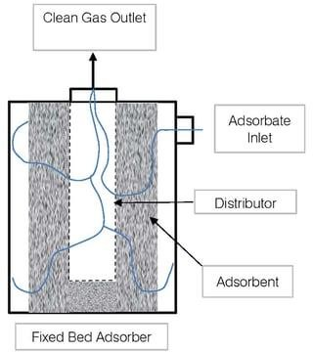
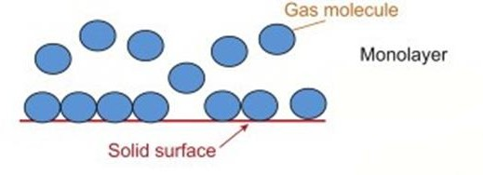
Adsorption on Solids
Notes:
Explaining the Fixed Bed Adsorber
In simple language, this figure shows a "Solid Trap" where gas pollutants are physically stuck onto the surface of a material like charcoal.
1. How the Adsorber Works (Figure 3) The diagram illustrates a Fixed Bed Adsorber, which acts like a specialized filter for gases.
Adsorbate Inlet: This is where the "dirty" air containing gas pollutants enters the machine.
The Distributor: Once inside, this part spreads the air out evenly so it doesn't all rush through one spot.
The Adsorbent (The Bed): The air travels through a "bed" of solid particles (like activated charcoal or silica gel). These solids have a very large surface area, acting like millions of tiny magnets that pull the gas molecules out of the air and hold them on their surface.
Clean Gas Outlet: After the pollutants are trapped on the solid surface, the clean air exits through the top.
2. Adsorption vs. Absorption It is important to remember the difference between these two "traps":
Absorption (with a B): The gas dissolves into the liquid (like sugar in water).
Adsorption (with a D): The gas sticks onto the surface of a solid (like dust on a piece of tape).
3. Why it is Effective Because the adsorbent material is finely divided (broken into tiny grains), there is an incredible amount of surface area for the pollutants to grab onto. This allows the machine to "concentrate" the pollutants in a very small space, making them easy to analyze later.

Slide 22
Adsorption on Solids
After adsorption, the sample gases are desorbed for analysis.
This may be accomplished by heating the adsorbent to volatilise the trapped material
or by washing it with a liquid solvent.
Analysis of the gases can be done in a number of ways.
Most organic vapours are analysed by gas chromatographic technique which directly uses the adsorption principle.
But because of many problems associated with desorption of the gases, adsorptive sampling is not much used for pollutant measurements.
Notes:
Releasing the Trapped Gas
In simple language, once you have caught the pollution on your "sticky" solid, you have to get it back off so you can test it. This process is called Desorption.
1. How to "Unstick" the Gas Since the gas is stuck tight to the charcoal or silica gel, we have two main ways to release it:
Heat it up: Just like water turns to steam when heated, we bake the solid grains until the trapped pollutants turn back into a gas and float away into a testing machine.
Wash it away: We use a special chemical liquid (a solvent) to rinse the solid grains. The pollutants prefer the liquid over the solid, so they jump into the liquid to be carried away.
2. Testing with Gas Chromatography For most organic vapors (like fumes from gasoline or paint), we use a machine called a Gas Chromatograph.
Interestingly, this machine works on the same principle as the collector!.
It pushes the gas through a long, thin tube that makes different chemicals "stick" for different amounts of time. This allows us to separate and identify exactly what was in the air.
3. The Downside Even though it sounds great, this method isn't used as much as liquid absorption.
Why? Because "unsticking" the gas (desorption) is difficult.
Sometimes the gas is stuck so hard it won't come off, or it changes chemically when we heat it up, which gives us the wrong results.

Slide 23
Freeze-out Sampling
In freeze-out sampling a series of cold traps, which are maintained at progressively lower temperature, are used to draw the air sample whereby the pollutants are condensed.
The traps are brought to the laboratory, the samples are removed, and analysed by means of
Gas chromatography
Infrared or ultraviolet spectrophotometry
Mass spectrometry
By wet chemical means
Notes:
The "Deep Freeze" Method
In simple language, this method is like making "pollutant ice cubes." We use extreme cold to turn gases back into liquids or solids so we can collect them.
1. How it Works: The Temperature Staircase We pull the air through a chain of containers called cold traps. Each container in the chain is colder than the one before it.
The First Trap: Might be cooled with ice to catch water vapor.
The Middle Traps: Might use dry ice to catch certain chemicals.
The Last Trap: Might use liquid nitrogen to catch gases that only freeze at incredibly low temperatures.
2. Why use a "Series" (Chain)? We use progressively lower temperatures to separate the pollutants as we catch them. If we went straight to the coldest temperature, everything (including the moisture in the air) would freeze at once and clog the system. By stepping the temperature down, we catch different pollutants in different bottles.
3. Lab Analysis Once the sampling is done, the scientist carefully seals the frozen traps and takes them to the lab. As the traps warm up, the pollutants are removed and tested using high-tech machines like a Mass Spectrometer or Infrared Spectrophotometry to see exactly what was caught.

Slide 24
Freeze-out Sampling
Though the method is potentially useful for trapping a large number of pollutants for analyses, it is inconvenient to assemble the freeze-out traps; also, there is the problem of accumulation of ice resulting from the condensation of water vapour which leads to eventual plugging of the system.
For these reasons, the technique is not generally used for routine sampling purposes.
Coolant | Temp. attained (degree Celsius)
Ice-water | 0
Ice-salt | -21
Dry ice and acetone | -79
Liquid air | -147
Liquid oxygen | -183
Liquid nitrogen | -196
Notes:
while "freezing" pollution sounds like a great idea, it is very difficult to do in the real world outside of a laboratory.
1. The "Ice Jam" Problem The biggest enemy of this method is actually water vapor (humidity) in the air.
As the air hits the first cold trap, the water turns into ice.
Over time, this ice builds up like a frozen "plug" inside the glass tubes.
Once the tube is plugged, the air can no longer flow through, and the sampling stops completely.
2. Too Much Equipment Assembling a "freeze-out train" is a major chore.
You need multiple glass traps, special insulated buckets (Dewar flasks), and dangerous cooling liquids like liquid nitrogen or chunks of dry ice.
Carrying all this heavy, fragile glass and freezing chemicals to a messy construction site or a busy street is just not practical for daily "routine" testing.
3. The Verdict Because it is so "inconvenient" and prone to "plugging," scientists usually only save this method for very special research projects, not for everyday air quality monitoring.

Slide 25
Collection of Particulate Pollutants
Particulate pollutants in the atmosphere are grouped generally into those that
Settle out due to the force of gravity
Remain suspended as aerosols.
The first category, consisting of large particles of size greater than 10 µm diameter, can be collected using sedimentation techniques, while for the second category containing particles of smaller size more sophisticated techniques like filtration, impingement, and electrostatic and thermal precipitation are used.
Notes:
Catching Dust and Aerosols
In simple language, we have finished talking about gases and are now moving on to "Particulates"—the solid or liquid "bits" floating in the air.
1. Heavy vs. Light Particles We separate these bits into two main groups based on how they behave in the air:
The "Fallers" (Sedimentation): These are large, heavy particles (bigger than 10 μm). Gravity is strong enough to pull them down, so they eventually "settle out" like dust on a table.
The "Floaters" (Aerosols): These are tiny particles that are so light they stay suspended in the air almost indefinitely.
2. How We Catch the Big Stuff Because the large particles fall on their own, we use sedimentation techniques. This is often as simple as putting out a "dustfall jar" and waiting for the gravity to do the work.
3. How We Catch the Tiny Stuff Since the tiny aerosols won't just fall into a jar, we have to "force" them out of the air using more complex methods:
Filtration: Passing air through a paper or mesh filter.
Impingement: Blasting the air against a surface (like we saw with the Greenburg-Smith).
Electrostatic/Thermal: Using electricity or heat to "push" the particles toward a collection plate.
Summary of Particulate Gr

Slide 26
Collection of Particulate Pollutants
Most instruments used for monitoring either class of particulates are merely collectors whose function trap the dust so that it can be taken to a lab.
The analysis of the weight or number of particles is done in lab separately.
Notes:
Catching vs. Counting
In simple language, the machines we use in the field usually don't give us a "final answer" on how much pollution there is; they are just high-tech "catchers".
1. The Collector's Job Whether we are catching heavy dust (greater than 10 μm) or tiny aerosols, the instrument’s only job is to pull those particles out of the air and hold onto them (on a filter, in a liquid, or on a plate).
2. The Lab's Job (Separate Analysis) Once the sampling time is finished, the scientist takes the "captured" material back to a clean laboratory to do the real math. This is done in two main ways:
By Weight (Gravimetric): The most common way. You weigh the filter before the test and after the test. The difference is the weight of the pollution caught.
By Number: For very tiny or dangerous particles (like asbestos), scientists use powerful microscopes to actually count how many individual "specs" are in a specific area.
3. Why "Separate" is Better Because field conditions (wind, humidity, heat) are messy, it is much more accurate to do the sensitive weighing and counting in a controlled lab environment where there is no vibration or dust to ruin the results.

Slide 27
Sedimentation (Dustfall Jar)
The simplest device used for sampling particles larger than 10 µm in diameter is the dustfall collector.
A typical collector consists of a plastic jar of about 20 to 35 cm height and 10 to 15 cm diameter at the base with a slight inward tapering of the walls from top to bottom.
A holder is provided to ensure safe and upright positioning of the collector.
The sample is deposited over a period of one month and the material is dried and weighed.
Usually, only water-insoluble dustfall is reported in mg/cm² or in tons/km².
Notes:
We leave the jar in an open area, and the heavy particles (larger than 10 μm) naturally fall into it.
Note: Sometimes a small amount of liquid or fungicide is added to the bottom of the jar to keep the dust trapped and prevent algae from growing during the month.
3. Reporting the Results After 30 days, we take the jar to the lab, dry out any liquid, and weigh the remaining solid "dirt."
Water-Insoluble: We usually only count the stuff that doesn't dissolve in water (like sand, soot, or grit).
Units: Because we are measuring how much dust falls over a huge area, we report it in mg/cm2 (for small spots) or tons/km2 (for an entire city).

Slide 28
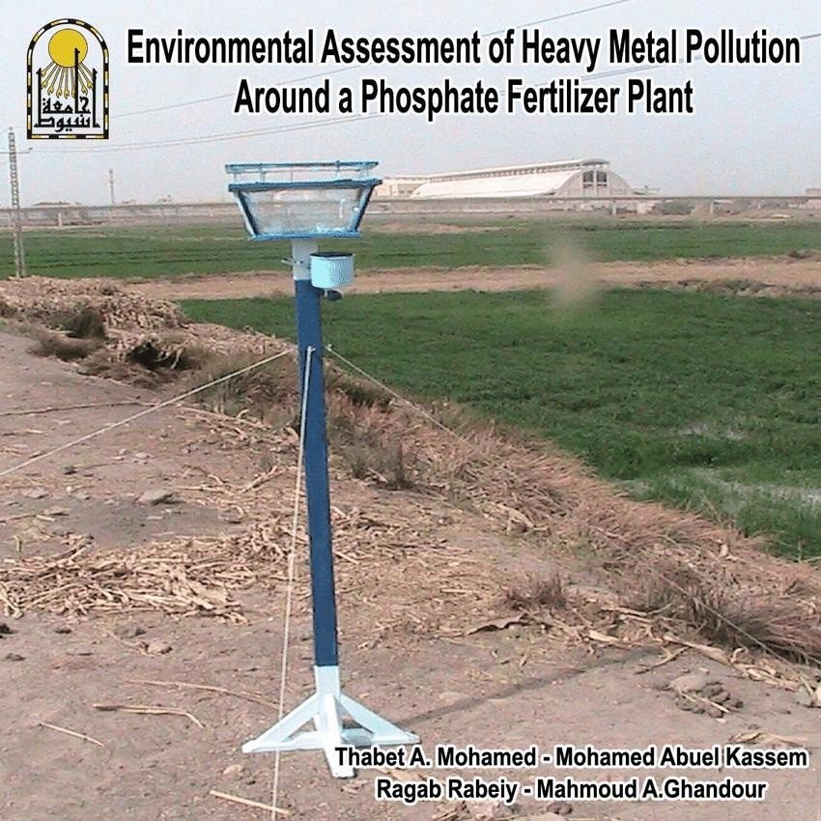
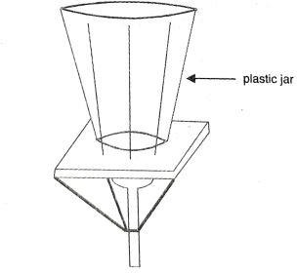
Sedimentation (Dustfall Jar)
Fig. 3 Dustfall collector for particulate measurement

Slide 29
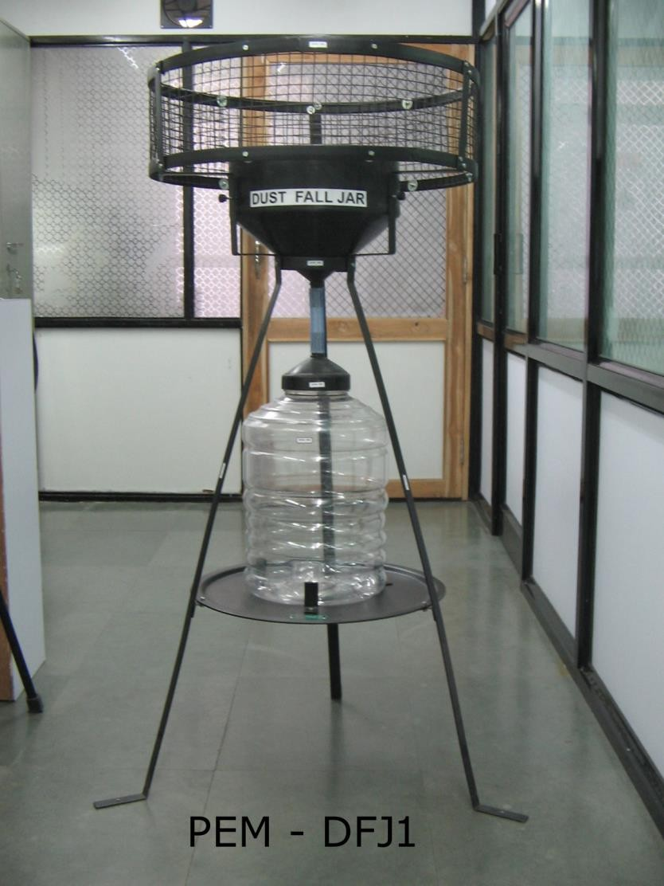
Sedimentation (Dustfall Jar)
Fig. 3 Dustfall collector for particulate measurement

Slide 30
Sedimentation (Dustfall Jar)
Since dust particles larger than 10 µm are seldom carried for distances in excess km, dustfall stations must be closely spaced for any meaningful data.
The method simple and inexpensive and requires no electrical method power or moving parts.
However, the method lacks precision and is selective and usually nonrepeatable (non-repeatable means that if you ran the exact same test again under the same conditions, you would likely get a different result.).
Hence, it may only be used to show pollution trends in a specific region over a period of time.
Notes:
1. The "Distance" Problem Heavy particles (greater than 10 μm) are like tiny pebbles; they don't float very far before falling.
Because they drop so quickly, a jar on one street corner might catch a lot of dust from a nearby construction site, while a jar just a few blocks away stays clean.
To get a real "map" of a city's pollution, you have to put these stations very close together.
2. Why We Use It: Simple and Cheap The biggest advantage is that it is "low-tech".
No Power: You can leave it in a remote field or on a rooftop without needing a battery or a plug.
No Moving Parts: There are no motors to break or filters to clog. This makes it very inexpensive to maintain for long periods.
3. The Scientific Weakness Despite being easy to use, it is not a "precise" scientific tool.
Non-repeatable: If you put two jars right next to each other, they might catch different amounts of dust because a single gust of wind or a bird landing nearby can change the results.
Trends only: It’s best for looking at the "big picture"—for example, seeing if a city has more dust this year than it did last year.
Summary of Dustfall Characteristics

Slide 31
Selection of sampling site
Dust fall collectors should be placed at a height of 3m to 15m above ground level.
No stack or chimney should be present in the vicinity of the site.
Whenever higher buildings in the immediate vicinity cannot be avoided, the top of building should be more than 30 degrees above the sampling point.
It should not have any interference from the buildings or any other higher objects.
It should have easy accessibility but shall have security so as to avoid any tampering.
It should have a free exposure so that the sample is collected by gravity setting only.

Slide 32
High-volume Filtration (The hi-vol. sampler)
The high volume filtration method is popular for measurement of the mass concentration of
suspended particles smaller than 10 µm.
The sampler, universally known as "hi-vol”
In this method, a known volume of air is sucked by a high speed blower through a fine filter and the increase in weight due to the trapped particles is measured.
The filter, usually made of fibrous or granular material, provides a dense porous medium through which an air stream must change direction in a random fashion, allowing the entrained particles to impact on the filter material.
A typical glass fibre filter used in the air samplers has an efficiency of over 99 per cent for particles of size 0.3 µm and it is moderately effective for trapping particles of as small size as 0.05 µm.
Notes:
the Hi-Vol is an "active" vacuum cleaner for the sky. It is designed to catch the tiny aerosols that are too light to fall by gravity.
1. The High-Speed Blower The machine uses a powerful motor to suck in a huge amount of air. Because we know exactly how much air the blower pulls (the "known volume"), we can calculate exactly how much pollution is in every cubic meter of air.
2. The Filter "Maze" The filter is not just a screen with holes; it is a thick, messy forest of glass fibers.
As the air is sucked through, it has to twist and turn to get through the fibers.
The tiny particles are moving too fast to make those sharp turns, so they "impact" (crash) into a fiber and get stuck.
3. Incredible Efficiency Even though we are looking for particles smaller than 10 μm, these glass fiber filters are powerful enough to catch almost everything (99%) down to 0.3 μm—which is about 200 times thinner than a human hair.
4. Analysis (Weight) As we learned earlier, this is a collector.
We weigh the filter in the lab before the test.
We run the machine (usually for 24 hours).
We weigh the dirty filter again.
The difference in weight tells us the total mass of the particles.

Slide 33
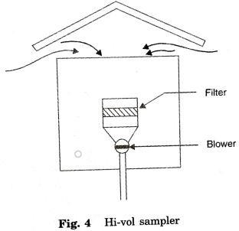
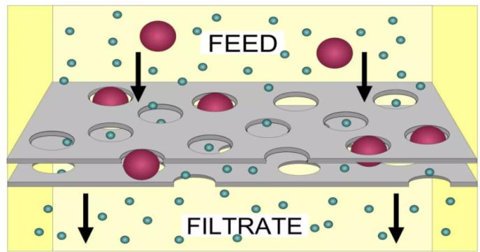
High-volume Filtration (The hi-vol. sampler)

Slide 34
High-volume Filtration (The hi-vol. sampler)
The sampling time is generally 24 hours.
During this period, over 2000 m³ of air is sucked through the filter.
The analysis is gravimetric (based on weight).
The particulate level is generally expressed in terms of µg/m³ of air.
Notes:
this method is much faster and more aggressive than the dustfall jar. Instead of waiting a month for dust to fall, we pull a massive amount of air through a filter in just one day.
Gravimetric Analysis As with the dustfall jar, we use the gravimetric method.
We weigh the clean filter before the 24 hours start.
We weigh the dirty filter after the 24 hours end.
The difference is the total mass of the trapped particles.

Slide 35
High-volume Filtration (The hi-vol. sampler)
Based on typical results of such a sampling, the following example would illustrate the calculation:
Air flow through clean filter = 1.7 𝑚 ^{3/}𝑚𝑖𝑛
Air flow through the filter at the end of the test = 1.4 𝑚 ^{3/}𝑚𝑖𝑛
Average air flow = 1.55 𝑚 ^{3/}𝑚𝑖𝑛 = 2232 𝑚 ³ in 24 hrs
Weight of the clean filter = 5.000 g
Weight of the filter after exposure = 5.348 g
Weight of the particulate dust = 0.348 g= 0.348 x 10⁶ µg
Suspended particulate concentration
0.348 x 10⁶ µg
3
=
= 156 µg/𝑚
2232 𝑚 ³

Slide 36
Tape Sampler
Another popular method of sampling particulate level of the atmosphere is the
soil-haze particle sampler.
In this method, a known volume of air is passed through a paper tape which is advanced in discrete time intervals from a supply reel to a take-up reel.
During the sampling period, the tape is held stationary. The sampling time could be varied from as little as 10 minutes per sample to 2 hours, depending upon the amount of particulates.
Notes:
2. Flexible Timing Unlike the Hi-Vol which usually runs for 24 hours straight, this sampler can take "snapshots".
Dirty Areas: If there is a lot of smoke or haze, we might set it for only 10 minutes so the filter doesn't get too clogged to read.
Clean Areas: In very clean air, we might leave it for 2 hours to make sure enough dust gathers to be visible.
3. The Result: A Visual Timeline When the test is done, you have a roll of paper with a series of dark circles.
A dark circle means high pollution during that time slot.
A light circle means lower pollution.
This is excellent for seeing peaks in pollution, such as during morning rush hour traffic.

Slide 37
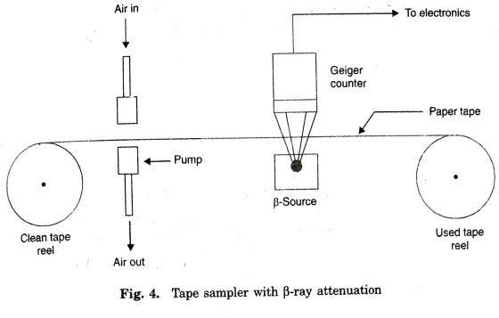
Tape Sampler

Slide 38
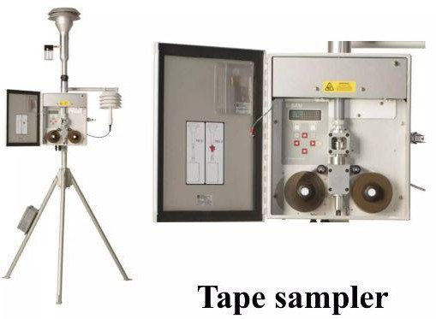
Tape Sampler

Slide 39
Tape Sampler
The air is passed through a nozzle and the particulates are collected on the
paper tape forming a spot.
Spots so obtained are evaluated by analysing the amount of light that can be transmitted through the spot.
The measurement is reported as "COH/1000 ft" where COH is known as the coefficient of optical haze, calculated as:
𝐶𝑂𝐻
𝐴
𝑇 𝑉
= 𝑙𝑜𝑔 ^{𝑇0}
10⁵ (1)
1000𝑓𝑡

Slide 40
Tape Sampler
𝑇₀= the transmittance of clean tape (100%) (amount of light transmitted through clean filter tape)
T = the percentage of light transmitted through the spot,
A = area of the spot in square feet,
V = volume of the sample in cubic feet or the product of the average sample flow and the sampling time.(total volume of air that was sucked through that specific spot)
The coefficient of haze index is based upon an optical property and this method is quite different from the standard methods of representing the particulate mass concentration.
Hence, some guidelines are required for interpreting the COH values in terms of the degree of pollution.
Notes:
Optical Property vs. Mass
Mass Methods (Hi-Vol): These tell you how many milligrams of "stuff" are in the air.
Optical Methods (Tape Sampler): These tell you how much the air blocks light.

Slide 41
Tape Sampler
Table 2 Interpretation of COH index
COH | Degree of Pollution
0-0.9 | Light
1-1.9 | Medium
2-2.9 | Heavy
3-3.9 | Very heavy
4-4.9 | Extreme heavy
A more realistic analysis of the spot is based upon ᵦ-ray attenuation from which the mass concentration of the particulates can be estimated. Here a beam of ᵦ-particles of constant source with intensity 𝐼₀ is passed through the tape.
39
Notes:
The beta-ray attenuation method is considered more "realistic" because it can actually estimate the physical mass of the dust on the tape.
Instead of a light bulb, we use a small radioactive source that emits electrons (beta particles).
Attenuation simply means "weakening".
When these beta-particles hit the dust on the tape, some of them are blocked or absorbed.
Color Blind: Light transmission is affected by the color of the dust (black soot blocks more light than white silica).
Mass Focused: $\beta$-rays are blocked based on the atomic mass of the material. This means it doesn't matter if the dust is black, white, or red—the machine can tell how much "weight" is there.
. The Intensity ($I_0$)
$I_0$ is the starting strength of the beam.
By measuring how much that intensity drops after passing through the dusty tape, we can calculate the exact thickness and mass of the particulate layer.

Slide 42
Tape Sampler
By measuring the intensities 𝐼_{𝑐} and 𝐼_{𝑝} , of the radiation that has passed through a clean tape and through the spot respectively, the mass of the particulate matter per unit area of the spot can be evaluated according to Eq. (2):
1
𝐼_{𝑐}
𝐼
𝜇_{𝑝} = _{𝑘} 𝑙𝑛
(2)
𝑝
where k is a constant which depends on the energy of the ᵦ-particles; the intensity of radiation can be measured by a Geiger counter.
Notes:
The Geiger Counter Instead of a simple light sensor, we use a Geiger counter. It is highly sensitive and can count every individual beta particle that makes it through the tape, providing a very precise measurement of the particulate mass per unit area (μp).

Slide 43
Tape Sampler
The mass concentration of the particulate in the air 𝜌_{𝑝}, is then given by,
𝐴
𝑉
𝜌_{𝑝} = 𝜇_{𝑝}
(3)
where. A is the area of the spot and V is the volume of the sample in appropriate units.

Slide 44
Impingement
Mechanism of Separation: In an impinger, particulates are separated from the airstream through high-velocity collision against a flat surface.
Wet Impingement: This method is specifically used to collect particulates into a liquid phase.
Collection Process:
The air-stream is directed at high speed onto a flat surface submerged in a liquid.
The gas stream breaks into small bubbles upon impact.
Particles are trapped as the gas flow abruptly changes direction, forcing contact between the
particles and the liquid.
Standard Equipment: The Greenburg-Smith type impinger is a standard tool for this method.
Performance: It achieves an impressive 90% to 99% efficiency for particles with a size equal to or greater than 1 μm.
Notes:
How an Impinger Works
In simple language, if the Hi-Vol is a "vacuum" and the Tape Sampler is a "spot-maker," the Impinger is like a scrubber that washes the air.
1. The Mechanics of Collision The device forces air through a narrow tube at very high speeds.
At the end of the tube is a flat surface (an "impaction plate").
The air is light enough to make a sharp turn around the plate, but the heavier dust particles have too much momentum; they crash (collide) into the surface and get trapped.
2. Wet Impingement In "wet" impingement, the impact plate is submerged in a liquid (usually water or a specific chemical solvent).
When the air hits the liquid, it breaks into tiny bubbles.
As these bubbles rise through the liquid, the particles inside them are forced to touch the liquid and stay there. This is great for collecting particles that might be soluble or for analyzing the chemicals on the dust.
3. Efficiency of the Greenburg-Smith Impinger The Greenburg-Smith is a world-standard design.
It is incredibly effective (up to 99%) at catching particles as small as 1 μm.
For context, 1 μm is roughly the size of a single bacterium.

Slide 45
Impingement
Operating Principle: Dry impingers utilize the principle of impaction on a dry surface for the collection of particulate matter.
Efficiency Characteristics:
They are less efficient than wet devices for trapping smaller particles, specifically those less
than 2 μm in size.
Key Advantages:
Samples are collected directly onto the surface.
Eliminates the need for secondary processes such as filtration or the evaporation of
liquids.
Specialized Application: Certain dry impingers, known as cascade impactors, are specifically designed for particle size measurements

Slide 46
Impingement
Multi-Stage Design: A typical cascade impactor consists of 5 to 10 collection stages arranged in a vertical stack.
Operating Principle: The sample airstream is forced through a series of jets (nozzles), directing pollutant particles against collection surfaces placed normal (perpendicular) to the airflow.
Size Segregation:
Early Stages: Use lower jet velocities to capture larger particles with high momentum.
Later Stages: Use progressively higher jet velocities to capture smaller particles with lower momentum.
Final Collection: A backup filter is placed after the last stage to trap any ultra-fine particles that remain in the airstream
Notes:
The cascade impactor is the gold standard for understanding not just how much dust is in the air, but what size it is. This is critical because smaller particles (like PM2.5) penetrate deeper into the human lungs than larger particles.
1. Momentum and Impact
Large particles are like heavy trucks; they cannot turn quickly. Even when the air turns to go around a plate, their momentum carries them straight into the surface.
Small particles are like agile birds; they follow the air's "slipstream" and dodge the plates in the early, slower stages.
2. Increasing the "Speed Limit" As you move down the "cascade," the nozzle holes get smaller. According to fluid dynamics, as the area decreases, the velocity increases. This extra speed gives the tiny particles enough "kick" (momentum) to finally crash into the lower plates.
3. The Analytical Result At the end of the sampling period, the scientist weighs each of the 5 to 10 plates.
Top Plate Weight: Mass of large particles (e.g., > 10 μm).
Middle Plate Weight: Mass of medium particles (e.g., 2.5 – 10 μm).
Bottom Filter Weight: Mass of the finest sub-micron particles.

Slide 47
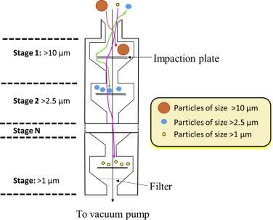
Impingement- Cascade Impactor
Cascade Impactor

Slide 48
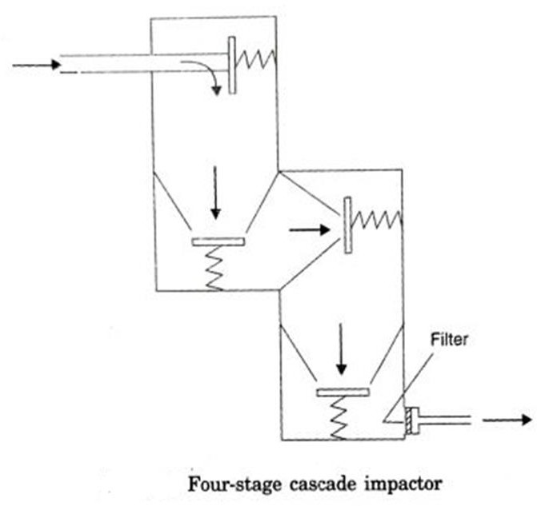
Impingement
After sampling, the material collected at each individual stage is analyzed for both its total weight and its chemical composition.
Cascade impactors are reported to be capable of sizing particles down to 0.2 μm.
High Efficiency: An efficiency of 100% has been obtained for particles as small as 0.6 μm.

Slide 49
Electrostatic Precipitation
Air sampling can be performed using the principle of electrostatic precipitation, where particles are separated by electrical charges.
Several types of portable commercial precipitators are available in the market for field use.
During operation, a negative charge is imparted to a wire placed axially inside a positively charged cylinder.
When a particle-laden airstream passes through the cylinder, the particles acquire a negative charge via a corona discharge from the central wire.
The negatively charged particles migrate toward the inner surface of the positive cylinder, where they are collected for chemical or microscopic analysis.

Slide 50
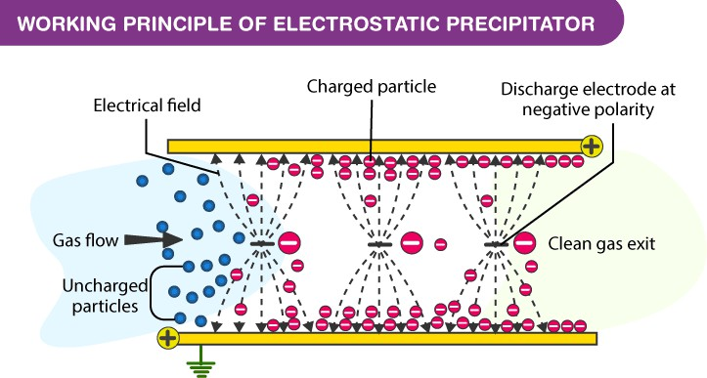
Electrostatic Precipitation

Slide 51
Electrostatic Precipitation
Separation Range: Small, portable samplers designed for field operation exhibit excellent separation characteristics for particles in the size range of 0.01 to 20 µm.
These devices are not as widely used for ambient air sampling as standard filters.
Ideal Use Case: They are significantly more suitable for source sampling, particularly in environments where the particle loading is relatively high.
In "source sampling" (such as inside a factory or near a smokestack), regular filters would clog almost instantly. The electrostatic design allows for continuous collection even under heavy pollutant loads.

Slide 52
Thermal Precipitation
Thermal precipitators operate on the principle that small particles, under the influence of a strong temperature gradient between two surfaces, tend to move towards the lower temperature.
As particles move toward the colder zone, they get deposited on the colder of the two surfaces.
Gradient Intensity: These temperature gradients are normally of the order of 3000 °C per centimeter.
To maintain such high gradients, the gas velocity through the sampling device must be kept low.
Sampling Rate: The flow rate is usually between 10 and 200 ml per minute, depending on the specific type of device used.
Notes:
If the air moves too fast, the temperature gradient is "washed away" or neutralized; hence, the extremely low sampling rates (ml/min) are necessary to ensure the particles have enough time to migrate to the cold plate.

Slide 53
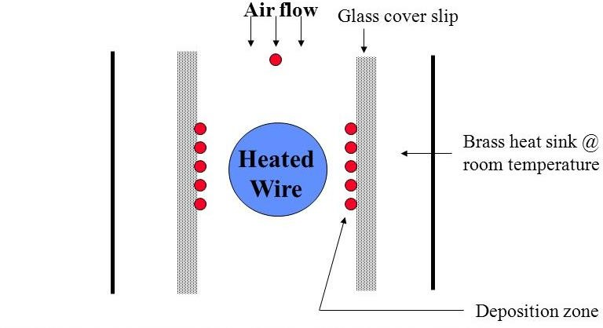
Thermal Precipitator

Slide 54
Thermal Precipitation
High Collection Efficiency: The collection efficiencies of thermal precipitators are remarkably high for small particles.
Size Range: These devices are virtually 100% efficient for particles ranging from 10 µm down to 0.01 µ
The particles are collected on a grid or a thin microscope cover glass for later analysis.

Slide 55
Stack Sampling
A method of collecting representative samples of pollutant-laden air at the place of origin to determine the total amount of pollutants emitted into the atmosphere from a given source in a given time.
The primary goal of stack sampling is to determine emission levels from plant processes.
Regulatory Compliance: This ensures that facilities are in compliance with emission limits set by authorities to prevent environmental air pollution.

Slide 56
Selection of sampling site
Whenever possible, the sampling point should be positioned at a distance of 5 to 10 diameters downstream from any obstruction (like elbows or dampers).
It should also be located 3 to 5 diameters upstream from any similar disturbance to ensure stable flow.
The physical size of the sampling point (port) typically ranges from 7 to 10 cm in diameter to fit the testing probes..
In many cases, multiple sampling is required to obtain a truly representative sample of the stack emissions.
For circular stacks (large industrial chimney), traverse samples should be used, consisting of two sets of traverse points taken 90 degrees apart within the same plane.

Slide 57
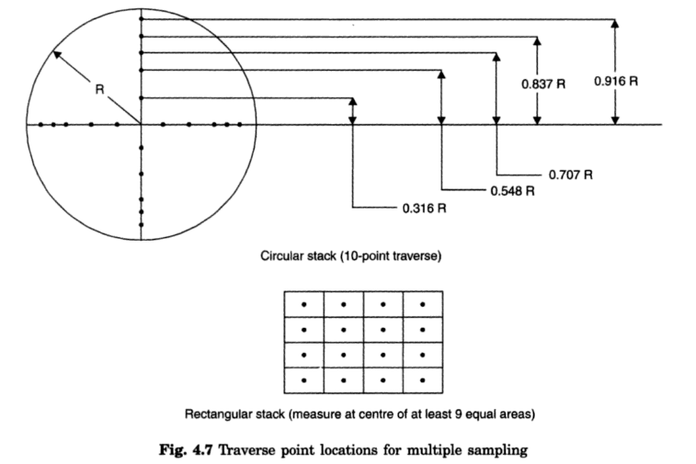
Diagrammatic representation of sampling points in a stack

Slide 58
In circular stacks, traverse points are located at the center of equal annular areas across two perpendicular diameters
In case of rectangular stacks, the area may be divided into 12 to 25 equal areas and the centres for each area are fixed.
Cross sectional area of stack (sq.m) | No of points
0.2 | 4
0.2 to 2.5 | 12
2.5 and above | 20

Slide 59
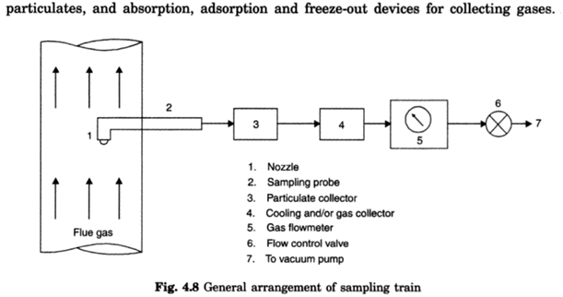
Sampling System
Stack sampling is carried out by diverting a part of gas stream through a sampling train of which a general arrangement is shown below

Slide 60
Sampling System
The sampling train consists of a nozzle placed in the gas stream, a sampling probe, particulate and gas collection devices, a flow measuring device, and a prime mover (such as a vacuum pump or ejector).
The nozzle at the end of the probe is normally sharp-edged, pointing inward from the outside edge to ensure a clean "cut" of the air stream.
The traversing probe is usually constructed from stainless steel and is often lined with glass or Teflon to prevent chemical reactions with the sample.
For sampling hot gases above 400°C, probes are equipped with a circulating coolant system.
This cooling prevents the combustion of collected particles inside the probe and protects filtration materials from exceeding their maximum allowable temperatures.

Slide 61
Sampling System
Measurement Devices: Flow measurements within a sampling train can be made using specialized devices such as a rotameter or an orifice meter.
If the total volume of gas sampled is required for analysis, a dry gas meter is utilized.
These measurement devices are normally placed after the collection devices (filters and impingers) but upstream of the vacuum pump.
Positioning the meter before the pump ensures that any leak in the vacuum pump does not cause errors in the recorded gas volume measurements.

Slide 62
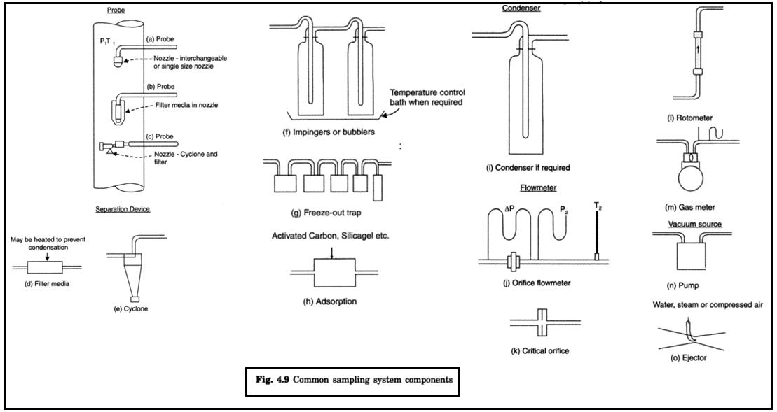
Notes:
(a) Standard Probe: Features an interchangeable or single-size nozzle at the tip.
(b) In-Stack Filter: Shows a probe where the filter media is located directly inside the nozzle, protecting the rest of the train from heavy dust.
(c) Cyclone Probe: Includes a cyclone and filter combination for separating larger particles before the sample enters the probe line.
2. Separation and Collection Devices
These components (Middle Left) remove particulates and chemical pollutants from the air stream:
(d) Filter Media: May be heated to prevent condensation of moisture which could interfere with the sample.
(e) Cyclone: Uses centrifugal force to separate solid materials.
(f) Impingers/Bubblers: Glass containers often used in a temperature-controlled bath to absorb gaseous pollutants into a liquid.
(g) Freeze-out Trap: Used to condense and collect pollutants by cooling them to very low temperatures.
(h) Adsorption: Uses materials like Activated Carbon or Silica Gel to trap gas molecules on a solid surface.
3. Gas Conditioning and Flow Measurement
Before measuring the volume, the gas must be conditioned:
(i) Condenser: Removes water vapor if required.
(j) Orifice Flowmeter: Measures the pressure drop ($\Delta P$) to calculate the flow rate.
(l) Rotameter: A simple visual device to monitor the instantaneous rate of flow.
(m) Gas Meter: Specifically a dry gas meter used when the total volume of the sampled gas is required.
4. Vacuum Sources (Prime Movers)
The "suction" that pulls the gas through the system is provided by:
(n) Pump: A standard mechanical vacuum pump.
(o) Ejector: Uses high-pressure water, steam, or compressed air to create suction without moving mechanical parts.

Slide 63
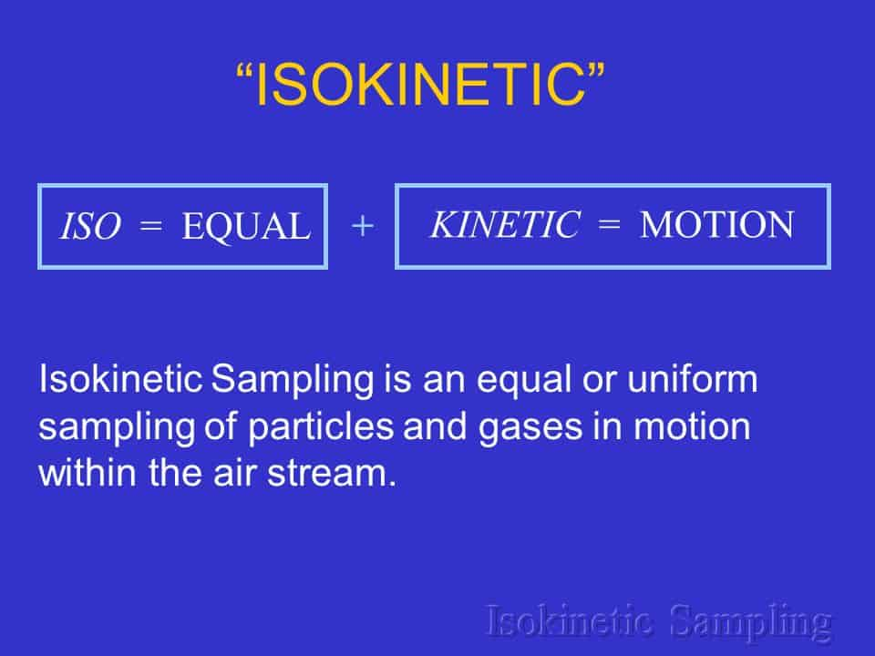
Isokinetic Sampling
Isokinetic sampling is a widely used method for stack emission testing, designed to collect representative samples of particulate matter (dust) and gases from the stack.
It ensures that the velocity of the sampled gas entering the nozzle is the same as the stack gas velocity, minimizing bias in the collected data.

Slide 64
Principle of Isokinetic Sampling:
The principle of isokinetic sampling is based on the Venturi effect, which states that when the velocity of a fluid increases, its pressure decreases.
Isokinetic sampling aims to achieve the same velocity in the sampling nozzle as the stack gas velocity, allowing the particulate matter and gases to enter the nozzle without any bias or distortion.
Notes:
when the nozzle velocity matches the stack velocity, the gas streamlines enter the probe straight and undisturbed. The ratio of dust to gas in your sample is identical to the ratio in the stack

Slide 65
Isokinetic Sampling
The primary objective is to obtain representative particulate sampling where the sample captured reflects the true ratio of air to dust in the stack.
If sampling velocity is greater than velocity in duct (Super-isokinetic) then tube will suck extra particles, collecting higher percentage of smaller particles, the sampling will have a lower mass concentration
If the sampling velocity is less than velocity in duct (Sub-isokinetic) then tube will became pressurized and particles will want to be expelled from the tube. The particles more easily dispelled are small particles resulted into collection of larger particles ,PM has a higher mass conc

Slide 66
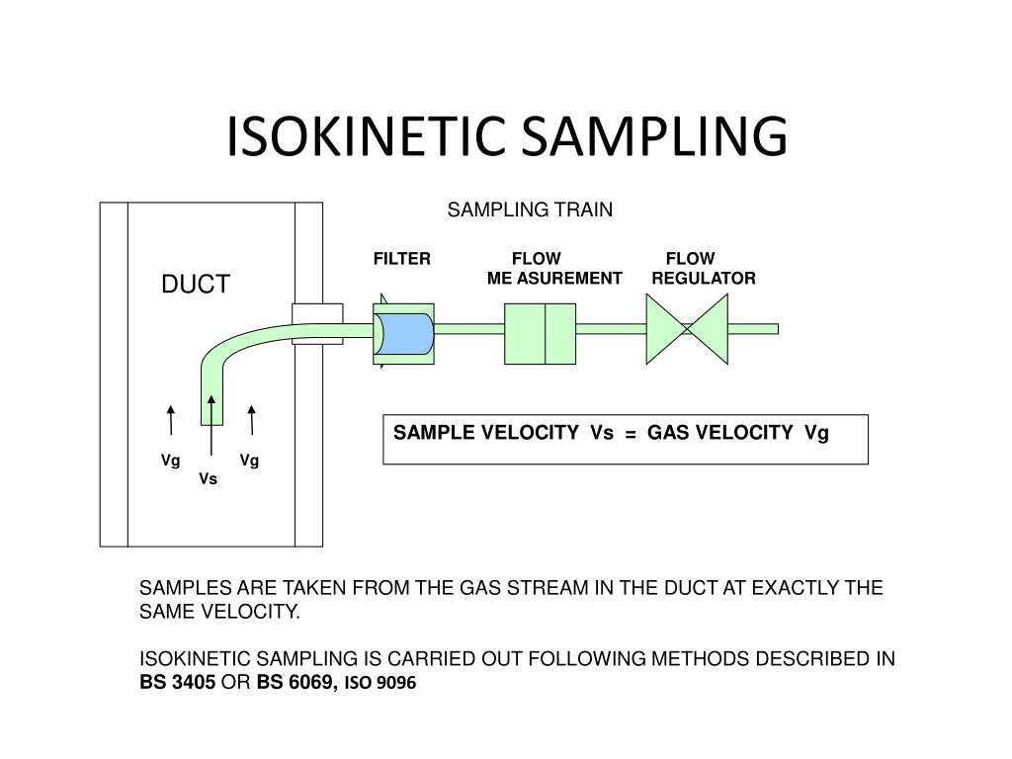

Slide 67
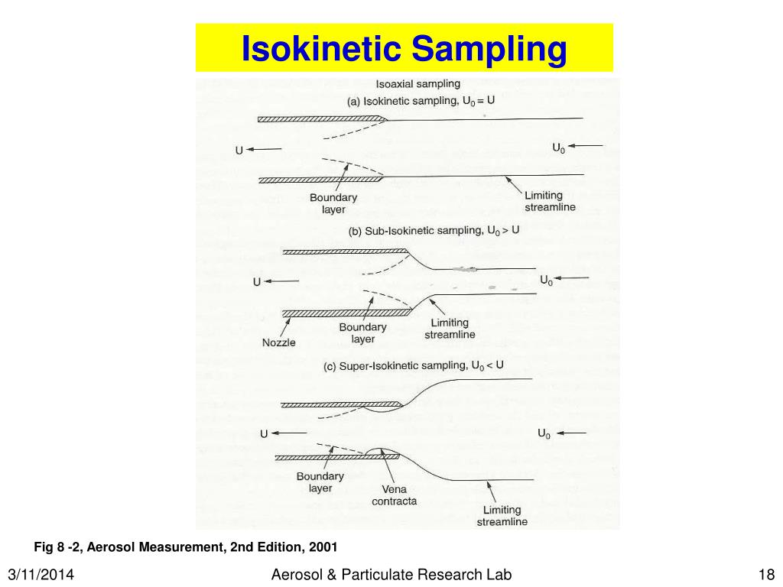

Slide 68
Advantages of Isokinetic Sampling:
This method provides representative and accurate measurements of stack emissions.
It minimizes bias in the collected data by precisely matching the gas velocity in the stack with the sampling flow rate.
Isokinetic sampling is widely accepted by regulatory authorities for official compliance monitoring
Limitations of Isokinetic Sampling:
The process requires skilled operators and meticulous equipment calibration to function correctly.
It can be difficult to achieve isokinetic conditions when dealing with extremely high or very low gas velocities.
The method may not be suitable for stacks where the gas conditions (velocity, temperature, or pressure) are highly variable.

Slide 69
Gaseous Sampling
The basic routine for obtaining a gas sample from stack emissions is similar to that employed in sampling of particulate matter.
The sampling is much easier because it is not necessary to sample at isokinetic conditions.
The sample can be withdrawn from the stack at a constant rate independent of the flow rate in the stack.

Slide 70
Ambient air quality
Ambient air quality refers to the condition or quality of the air that surrounds us in the outdoors.
The National Ambient Air Quality Standards are the official benchmarks for outdoor air quality.
These standards are set by the Central Pollution Control Board (CPCB) and are applicable across the entire nation.
The CPCB was granted the power to set these standards under the Air (Prevention and Control of Pollution) Act, 1981.

Slide 71
Ambient Air Quality Standards in India
The Air Act of 1981 was enacted by the Central Government with the primary objective of arresting the deterioration of air quality.
The Air (Prevention and Control of Pollution) Act 1981 describes the main functions of the Central Pollution Control Board (CPCB) as follows:
Advisory Role: To advise the Central Government on any matter concerning the improvement of air quality and the prevention, control, and abatement of air pollution.
National Planning: To plan and execute a nationwide programme for the prevention, control, and abatement of air pollution.
Support to State Boards: To provide technical assistance and guidance to the various State Pollution Control Boards.

Slide 72
Ambient Air Quality Standards in India
Research and Investigation: To carry out and sponsor investigations and research related to the prevention, control, and abatement of air pollution.
Data Management: To collect, compile, and publish technical and statistical data related to air pollution across the nation.
Quality Standards: To lay down and annul standards for the quality of air.
Legal Empowerment: The mandate provided under the Air Act explicitly empowers the CPCB to set these critical standards for air quality.

Slide 73
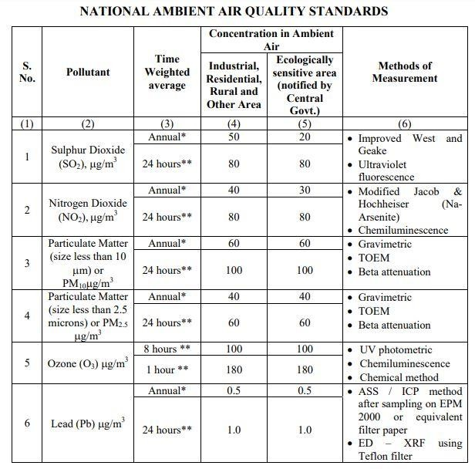
Ambient Air Quality Standards in India

Slide 74
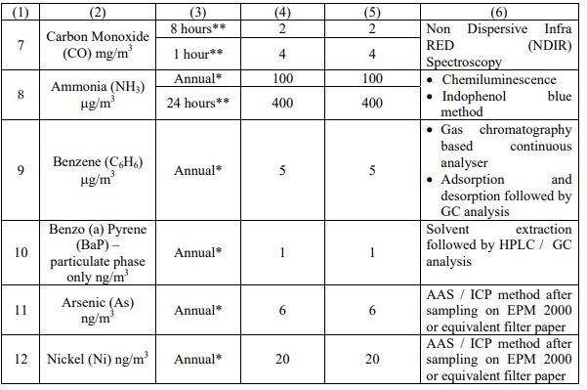
Ambient Air Quality Standards in India

Slide 75
Ambient Air Quality Standards in India (protocol)
Monitoring ambient air quality requires a standardized schedule to ensure the data is statistically significant and representative of long-term exposure.
Annual Measurement Requirements: To calculate the annual arithmetic mean, a minimum of 104 measurements must be taken in a year at a specific site.
Sampling Frequency: These measurements are typically taken twice a week, with each sample covering a 24-hour period at uniform intervals.
Compliance Threshold: Monitored values (whether 24-hourly, 8-hourly, or 1-hourly) must comply with the standards 98% of the time in a year.
Allowance for Exceedance: Pollutant levels may exceed the limits 2% of the time, but these exceedances must not occur on two consecutive days of monitoring

Slide 76
National Air Quality Index
The Air Quality Index (AQI) is a tool designed to communicate complex environmental data to the public in a simple, easy-to-understand format.
Simplification of Data: It transforms complex air quality measurements of eight specific pollutants into a single number (index value), accompanied by a nomenclature and a color code.
Public Awareness: Its primary goal is to disseminate air quality information in a form that the general public can quickly interpret to understand potential health impacts.

Slide 77
National Air Quality Index
The measurement of air quality under this system is based on the following eight pollutants:
Particulate Matter (PM10): Dust and debris with a size less than 10 micrometers.
Particulate Matter (PM2.5): Fine particles with a size less than 2.5 micrometers.
Nitrogen Dioxide (NO2)
Sulphur Dioxide (SO2)
Carbon Monoxide (CO)
Ozone (O3)
Ammonia (NH3)
Lead (Pb)

Slide 78
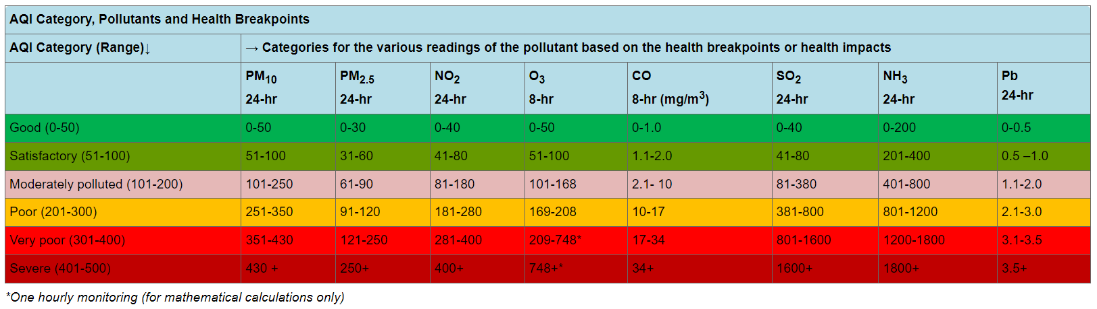
National Air Quality Index
AQI has six categories of air quality. These are: Good, Satisfactory, Moderately Polluted, Poor, Very Poor and Severe.
The AQI values and corresponding ambient concentrations (health breakpoints) for the identified eight pollutants are as follows:

Slide 79
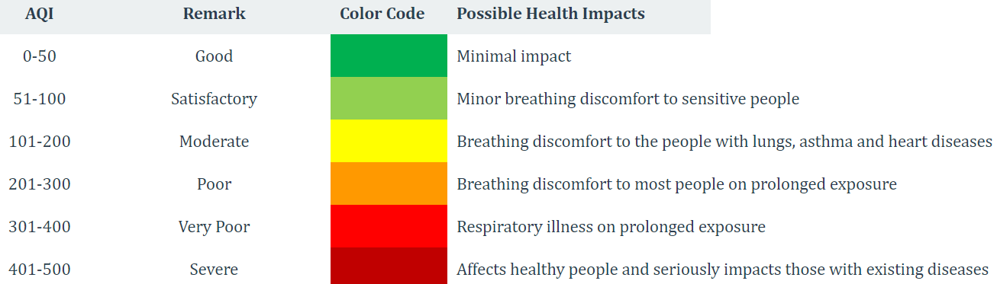
The AQI values and their associated health impacts are as follows:

Slide 80
National Air Quality Index
The Air Quality Index (AQI) is designed to be a simple, intuitive tool for the common man to judge the air quality within his vicinity, often described as a system of "One Number, One Colour, One Description".
AQI index values can vary depending on the time of the day.
The final AQI value for a city reflects the status of the worst-performing pollutant among the eight monitored i.e. higher reading in one city can be due to high concentration of PM whereas in some other city it may be due to SO2
Even if the other 7 pollutants have a safe or benign reading, if one pollutant is in the “poor” category then AQI will be in the “poor” category.

Slide 81
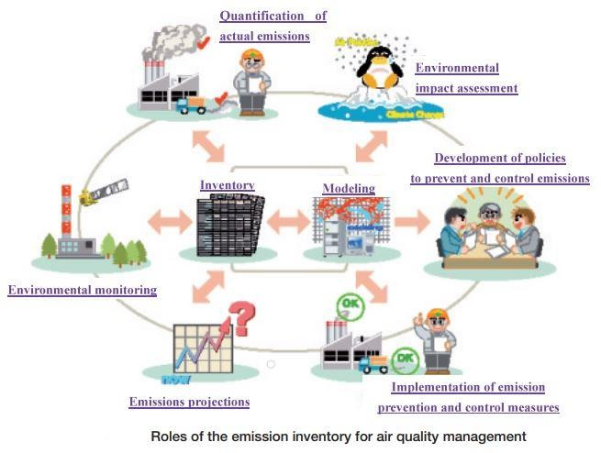
Emission Inventory
An emissions inventory is a database that lists, by source, the amount of air pollutants discharged into the atmosphere during a year or other time period.
An emission inventory usually contains the total emissions for one or more specific greenhouse gases or air pollutants, originating from all source categories in a certain geographical area and within a specified time span, usually a specific year.

Slide 82
Emission Inventory
An emission inventory is generally characterized by the following aspects:
Why: The types of activities that cause emissions
What: The chemical or physical identity of the pollutants included, and the quantity thereof
Where: The geographic area covered
When: The time period over which emissions are estimated
How: The methodology to use
Emission inventories are compiled for both scientific applications and for use in policy processes

Slide 83
Emission Inventory
Identification of all major emission sources and reliable estimation of
emission quantities of significant pollutants like PM10, NOx, SO2, CO, etc.
Adequate representation of various factors influencing emissions, such as, land use, socio-economic structure, spatial & temporal distribution of source activities vis-à-vis pollutants.
Evaluation of time weighted emissions and their distribution for modelling needs.

Slide 84
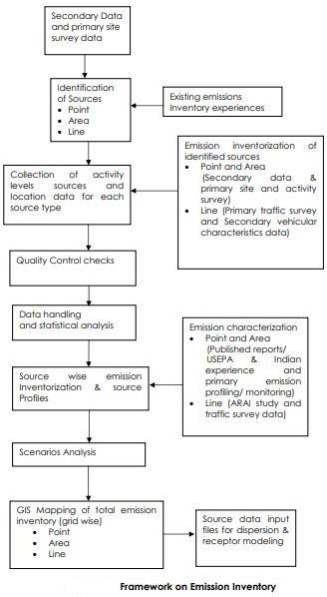

Slide 85
Emission Inventory
In general, anthropogenic emissions of air pollutants are estimated by the following basic formula for each source, when it is difficult to measure it directly.
Emission = Emission Factor x Activity Data
Example:
the amount of fuel burnt (fuel combustion).
the distance of vehicle travelled (exhaust gas emissions from vehicles).
the rates of the production of the commodity (industrial process without combustion)
SOx emission per the amount of fuel burnt, calculated based on the sulfur content of fuel, the sulfur retained in the ash and the reduction achieved by emission control technology (fuel combustion) .
NOx emission per distance (exhaust gas emissions from vehicles).
SOx emission per the amount of copper smelted (copper smelting)
64

Slide 86
Emission Inventory
Emission factors
Emission factors are the average rate of emission of a pollutant per unit of activity data for a given sector.
When there is no emission factor reflecting the actual local situation, default values in manuals are used.
However, if the default factor is considered to be inappropriate, it is preferable to obtain an emission factor that reflects the real situation by direct measurement.
The rates of reduction and propagation of technical measures have to be reflected in the factor or the formula, because introduction of countermeasures reduces the emission.

Slide 87
Emission Inventory
Activity data
Activity data give a measure of the scale of activity causing the emissions.
The necessary data basically can be collected from statistics and surveys

Slide 88
Emission Inventory
An emission inventory can be utilized for the following purposes
Quantitative understanding of actual emissions
The quantitative emission estimates provided by an inventory promote a better understanding of the actual emissions and help to raise the awareness of both policy makers and the general public.
Through this process, the major emission sources can be identified, priorities for emission reduction defined and any data gaps requiring further work are revealed

Slide 89
Emission Inventory
Use for modelling activity
Emissions data allocated geographically and temporally can be used as input data for atmospheric transport and deposition models.
The resulting air concentration and deposition estimates obtained by modelling, after verification with monitoring data on the ground and/or data from satellite observations, will be important information for air quality management decision- making.
Further useful information can be provided by estimates of the likely adverse impacts (to humans, animals, crops and natural ecosystems), which may be assessed from the modelled deposition and concentration of pollutants.

Slide 90
Emission Inventory
Use for future projections and setting of targets
A current emission inventory can be used as the basis for estimating future emissions according to projected likely changes in socio-economic indices (e.g. population growth, economic growth, changes in energy use per unit activity), lower emission factors (e.g. by introduction of better control measures), fuel switching and so forth.
Estimated future emissions provide important information for setting emissions targets.

Slide 91
Emission Inventory
Use for the consideration of possible reduction measures
An emission inventory enables the likely effects of introducing various prevention and control measures within different source sectors to be assessed and compared, both now and in the future.
Combined with knowledge of costs of the different options, this also enables the most cost-effective emission reduction measures to be identified.

Slide 92
Emission Inventory
Use for planning of policy and measures and their follow-up
Emission inventory data can be regarded as an index similar to the various indices used for gauging changes in economic activity.
The trend of such an index allows us to judge whether we should introduce or reinforce regulations, economic measures or technical measures to control air pollutant emissions.

