Slide 1
1. Clinvar

Slide 2
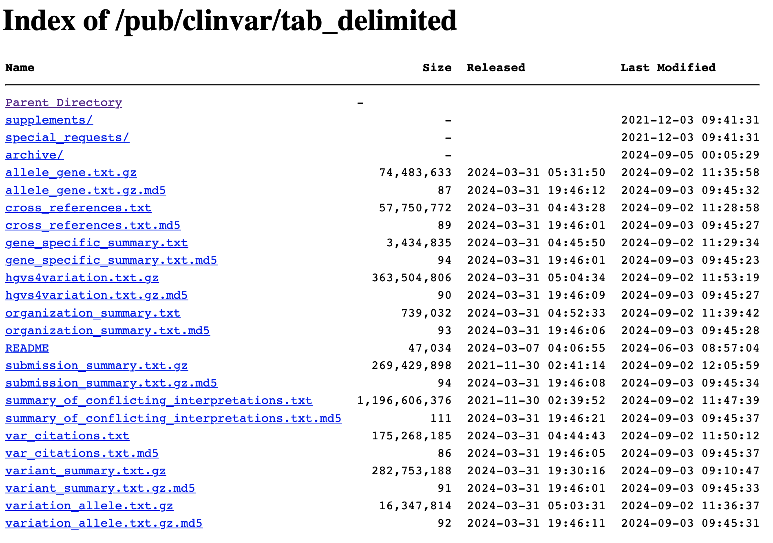
Variants from Clinvar were downloaded from its FTP site in 02.09.2024

Slide 3
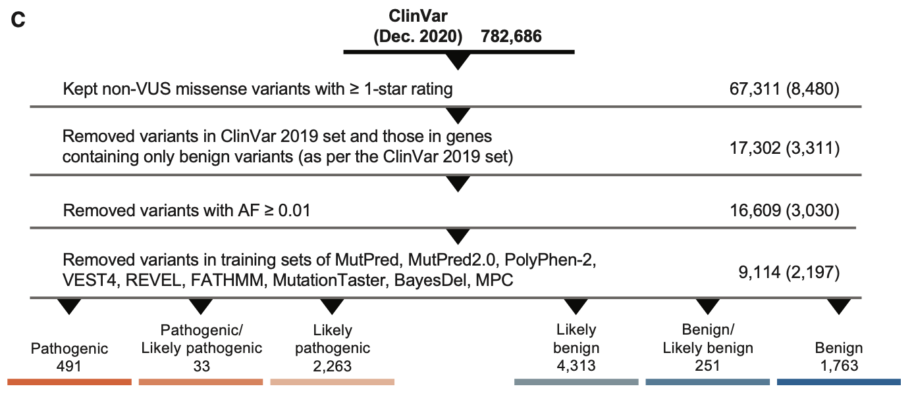
Figure 1, Pejaver et al. 2022

Slide 4
Pejaver et al. 2022 study filters:
Only missense variants with an allele frequency (AF) below 0.01 in the Genome Aggregation Database (gnomAD v.2.1) were first retained
Genes with at least one pathogenic variant of any type in ClinVar were first retained
For each variant, the gnomAD exomes global AF was used. When this was unavailable, the gnomAD genomes global AF was used.
all VUSs, variants with a zero-star review status, i.e., without any detailed review information, and those with conflicting classifications were excluded.
Additional filter for our study:
Keep submissions from 2021 to 2024

Slide 5
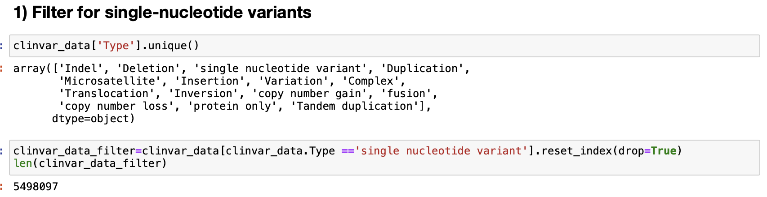
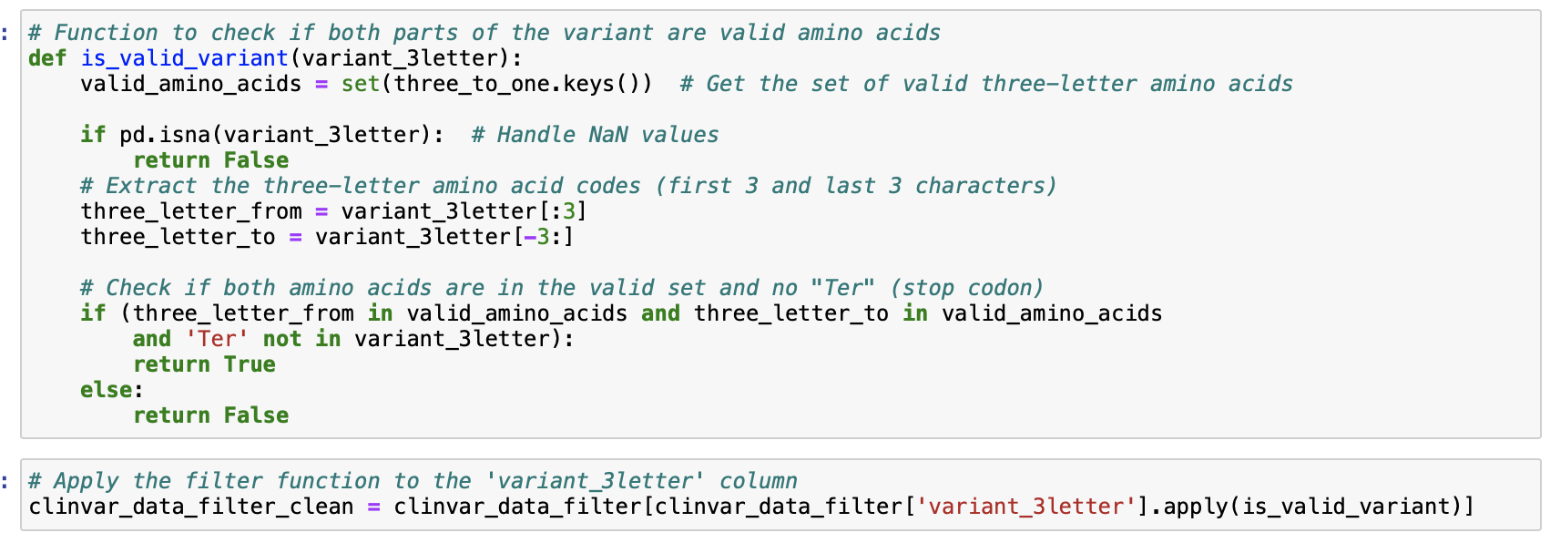
Filter: Remove if there is no “missense variant” information (NaNs, Ter, etc.)

Slide 6
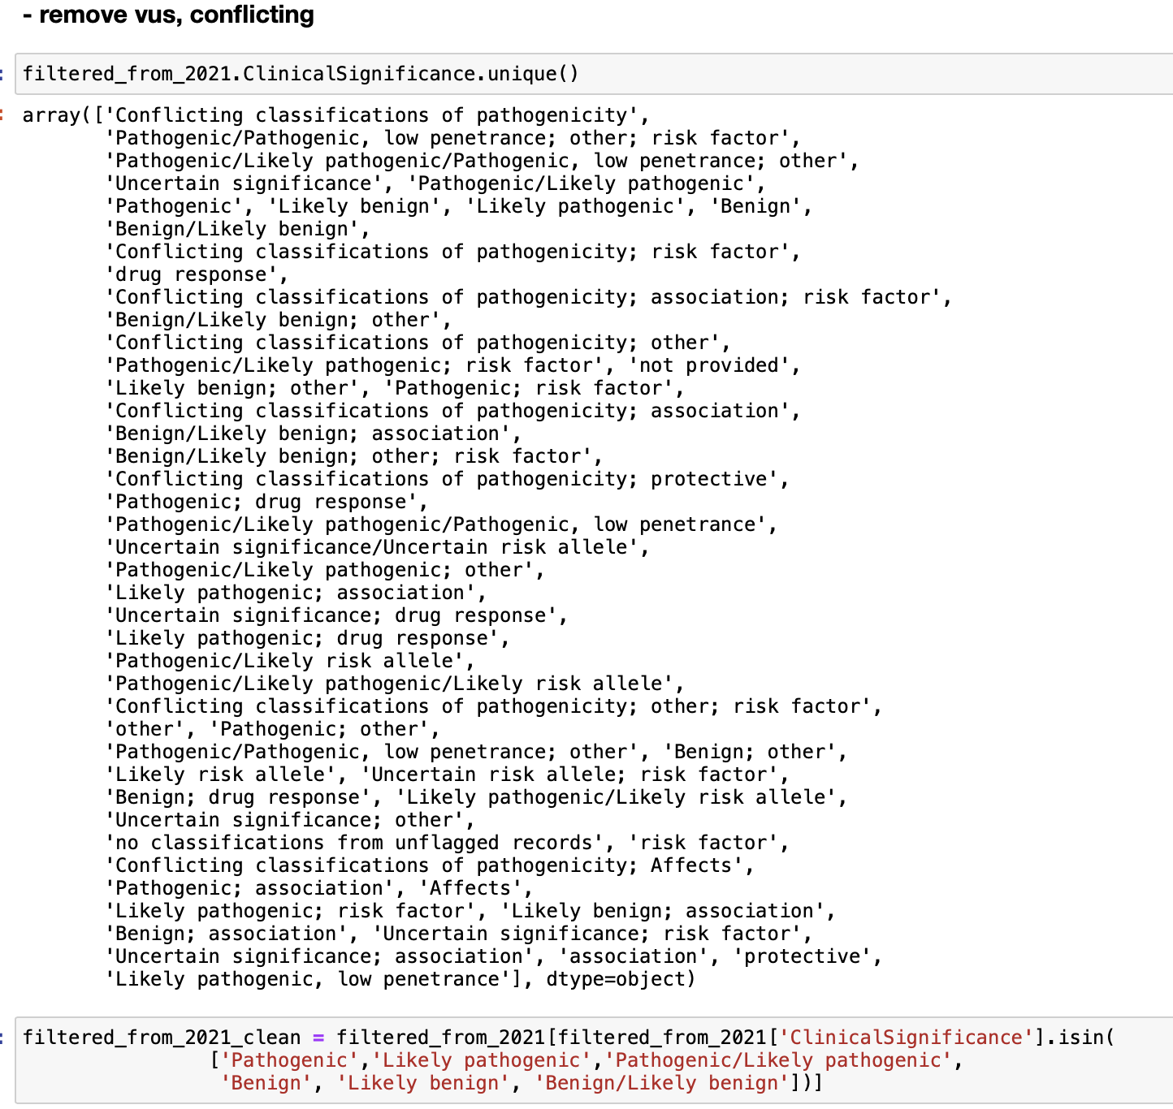
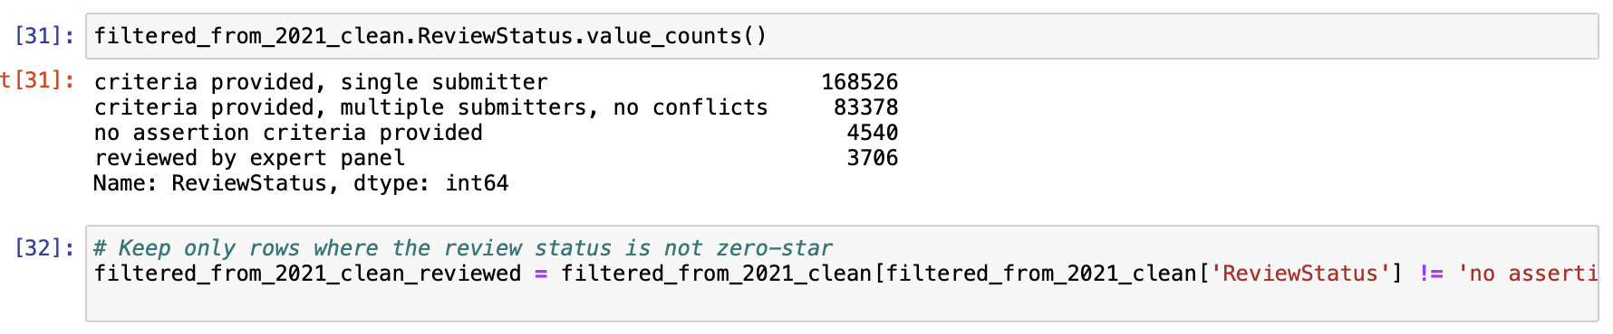
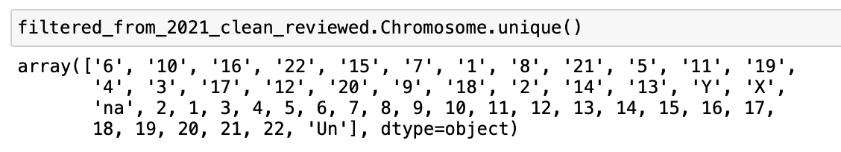
Filter: Remove if there is no Chromosome info

Slide 7
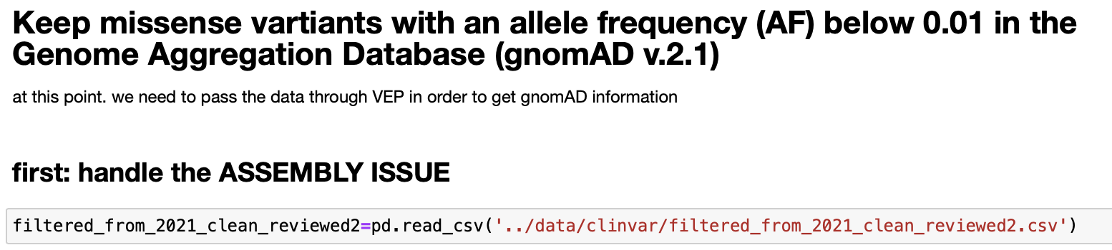
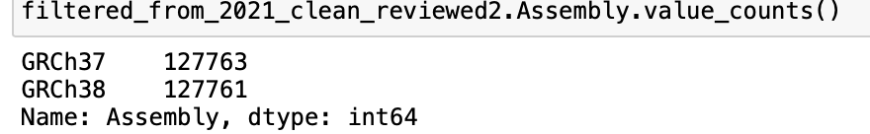
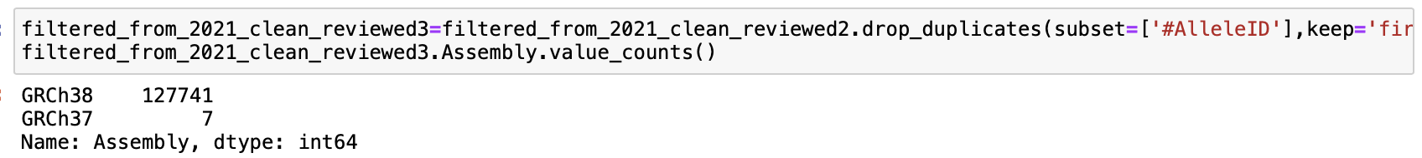
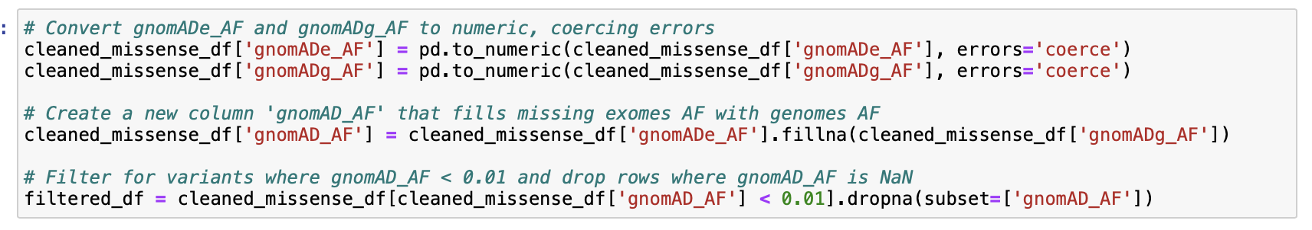
Filter: Several variants have the same value in “AlleleID” column. The only difference is the Assembly. Drop duplicates
Separate them before using with VEP (for retrieving gnomAD info). Coordinates info should not be mixed
1. Prepare input file
2. run VEP to retrieve gnomAD info
3. merge the output with the original file
file_grch38.vcf, file_grch37.vcf
Filter: gnomAD frequency

Slide 8
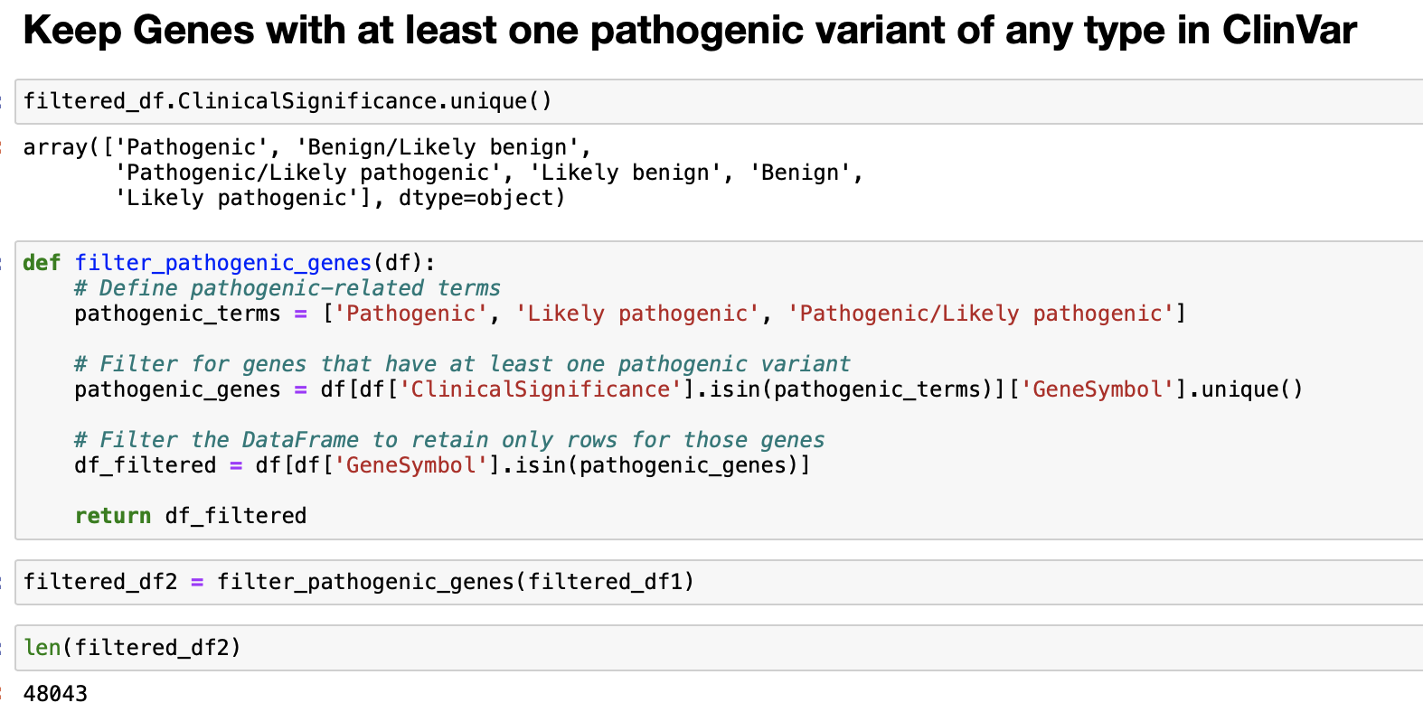
# To do: we need to filter for canonicals only. But, we will do it after getting the in silico tool predictions

Slide 9
Predictor: VEST4 (we run it using the tool’s page because it is not inside the VEP’s tools list)
http://cravat.us/CRAVAT/
Note: the CRAVAT/VEST4 tool works well if you create an account
1. VCF file prepare
2. Run VEST4
3. Parse the output to merge with the original file
Potential problems that need to be filtered: The input file might result in different variants, in this case we eliminate them, bcs we prioritize whatever coordinates & variants we have in the clinvar
Predictors: VEP output parse
Potential problems: All input might not be parsed. In that case we either eliminate them or we run the tool again?
Perhaps the web-based version is more problematic than command-line version?

Slide 10
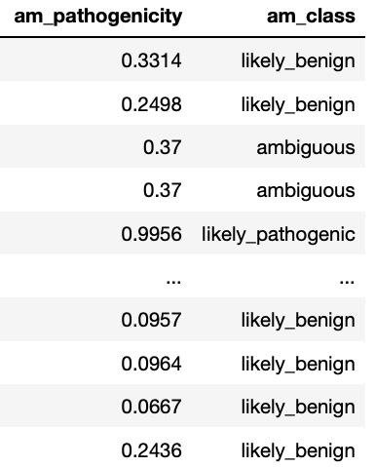
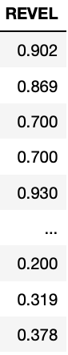
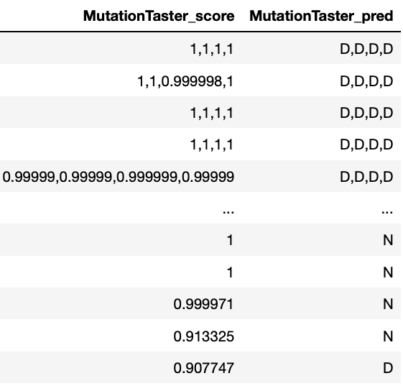
Parse the predictors & obtain binary predictions
Potential problems: predictors have different formats, each case handled separately or by grouping them in similar functions
Check VEP.py to see the functions if you want to explore
Thresholds source: check the Thresholds_log.xlxs file and the related links like https://www.varianteffect.org/veps

Slide 11
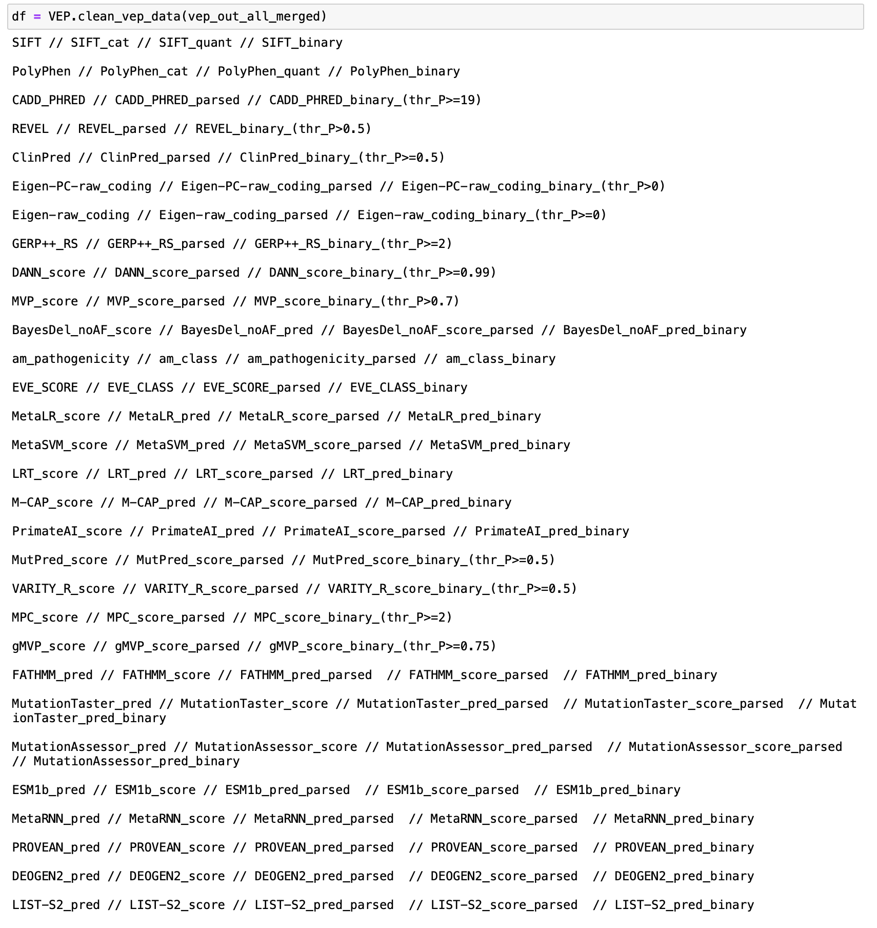
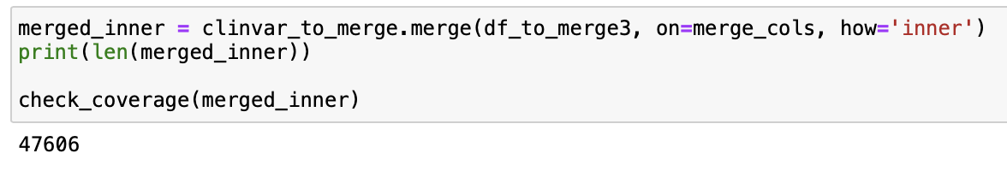
Parse the predictors & obtain binary predictions
Merge with the original clinvar file based on some common columns
With prints of column names used & created
Again, some variants will be lost bcs the same chr, ref allele, alt allele do not correspond to same amino acid variant in the output file of VEP, so I did an inner merge this time

Slide 12
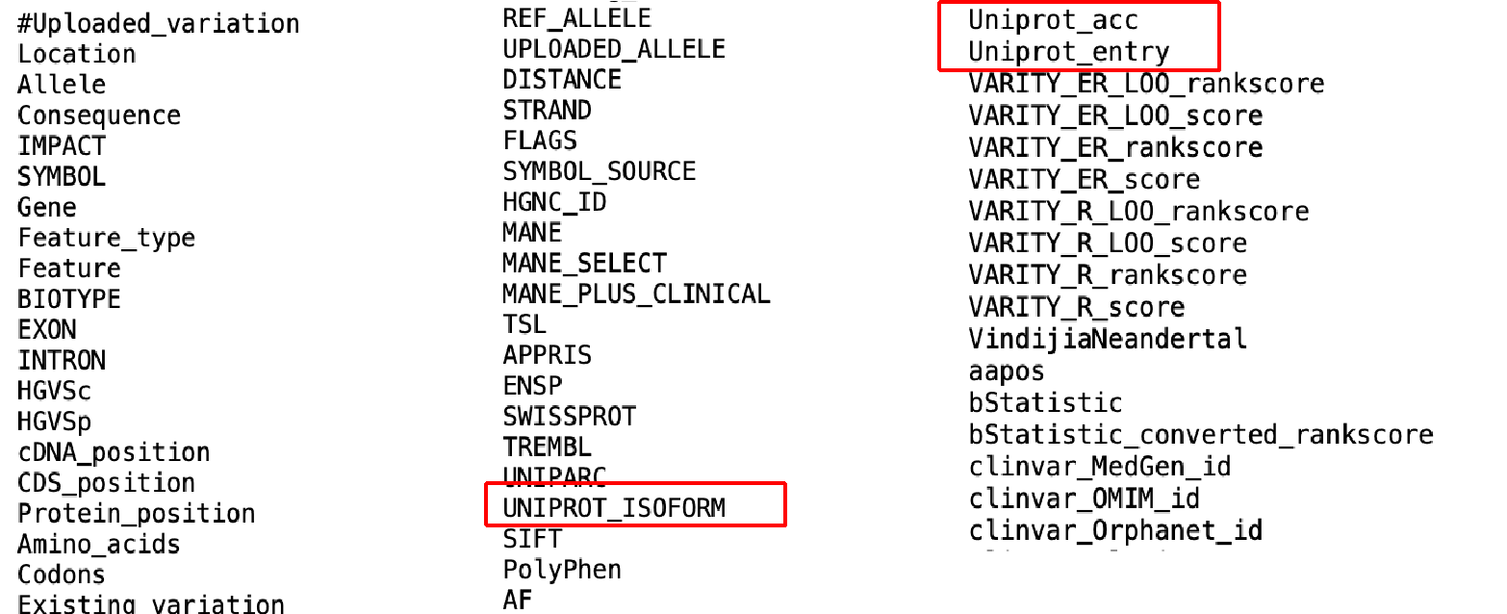
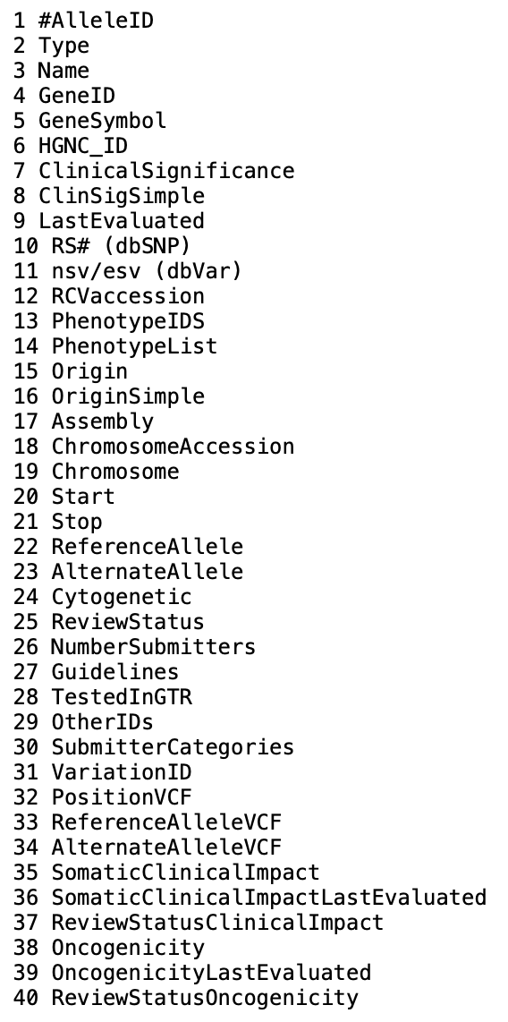
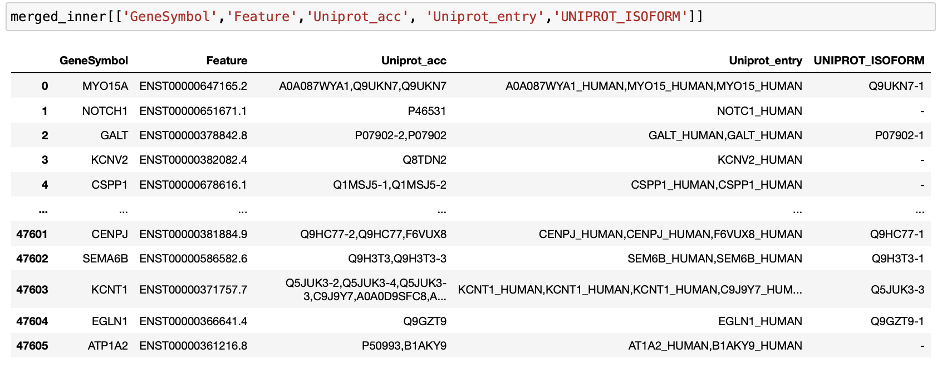
Filter for taking canonical only (bcs all our features are calculated for the canonical sequence & structure)
Originally, Clinvar does not include a straightforward info related to uniprot / canonical information
But we have these three columns coming from VEP tool after merging

Slide 13
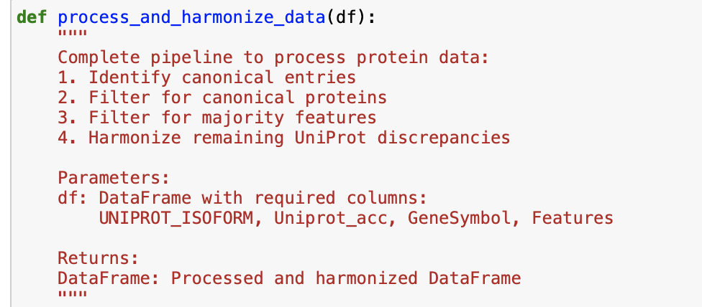
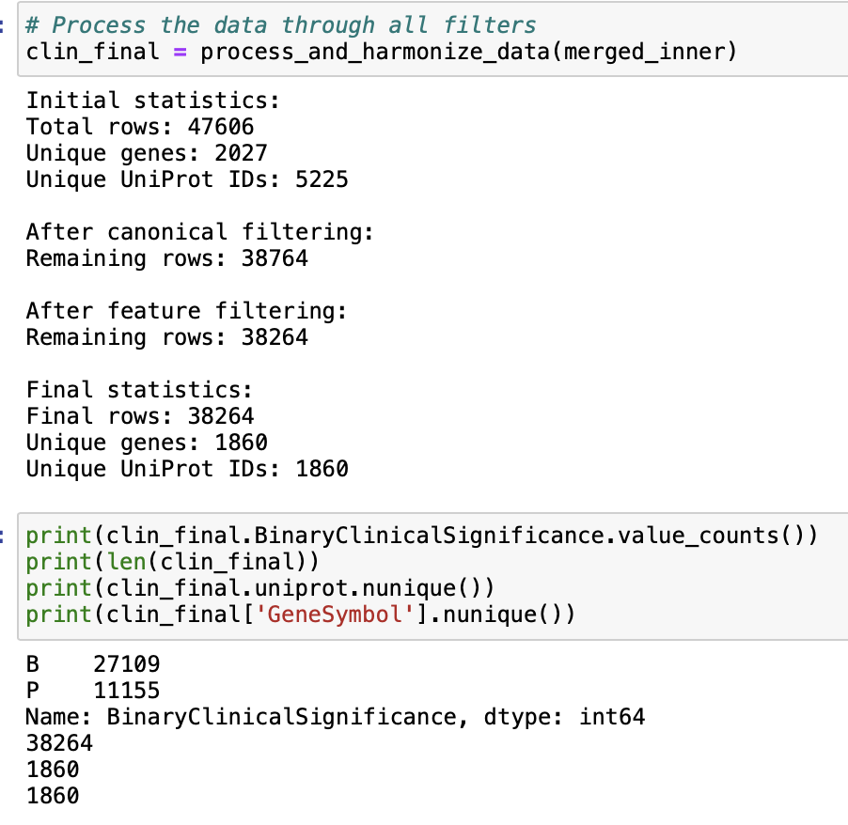
This pipeline:
Identifies and filters for canonical proteins
Standardizes UniProt IDs
Filters for majority of “Feature” column
Harmonizes any remaining UniProt discrepancies
Provides detailed statistics at each step
Performs final validation to ensure unique genes match unique UniProt IDs
The final result should give you a clean dataset where:
Only canonical proteins are included
Each gene has consistent features
Each gene maps to exactly one UniProt ID

Slide 14
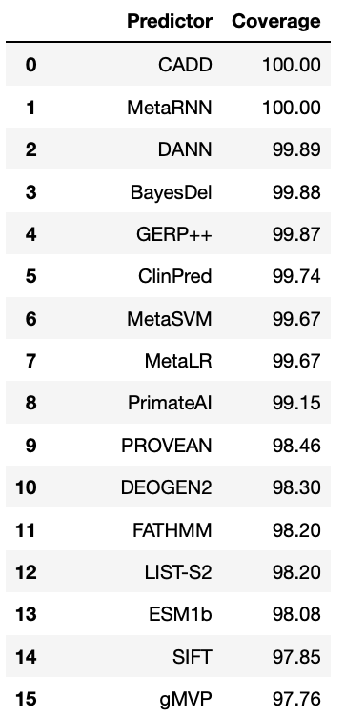
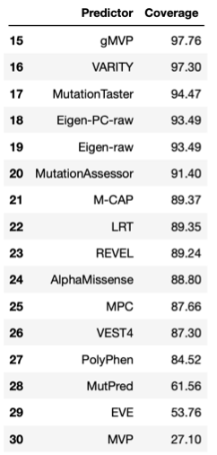
ClinVar
FINAL DATASET
1860 unique genes
38,264 variants
27,109 Benign
11,155 Pathogenic
Code cleaning & documenting DONE
Obtaining all predictions & cleaning DONE
Filtering out isoforms DONE

