Slide 1
2. Humsavar

Slide 2
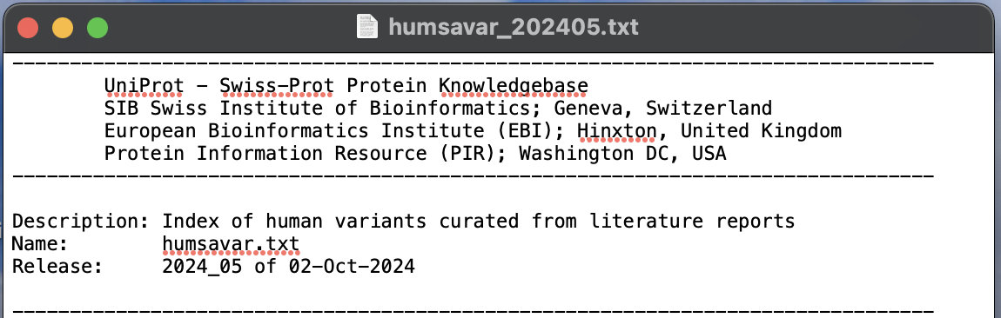
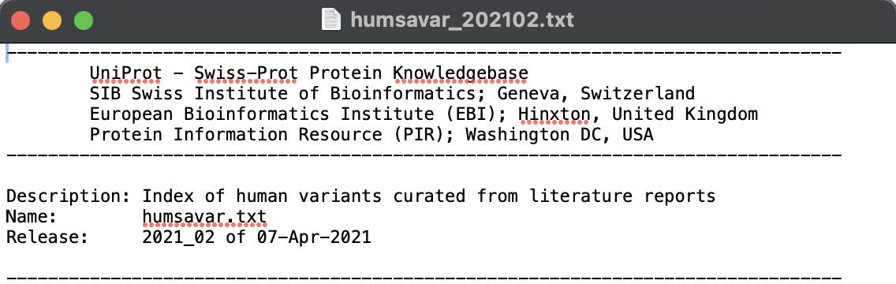
HumSavar
2024 data
Data source:
https://ftp.uniprot.org/pub/databases/uniprot/current_release/knowledgebase/variants/
2021 data
Data source:
https://ftp.uniprot.org/pub/databases/uniprot/previous_releases/release-2021_02/knowledgebase/

Slide 3
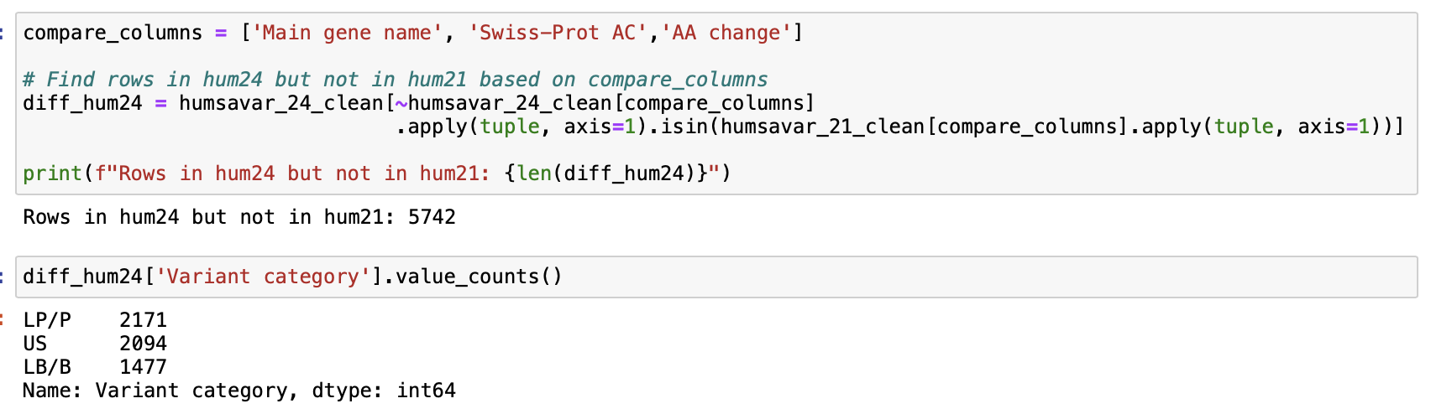
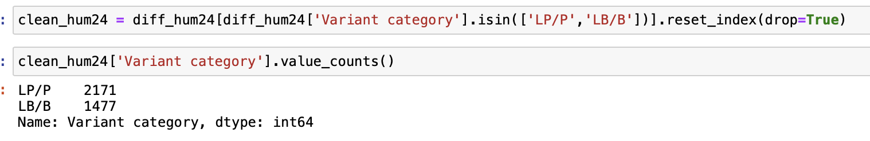
In this case, the files do not include any Date information. So many of the variants in 2021 are already included in 2024.
The goal here is keep the dataset with the latest information
Filter: Remove VUS

Slide 4
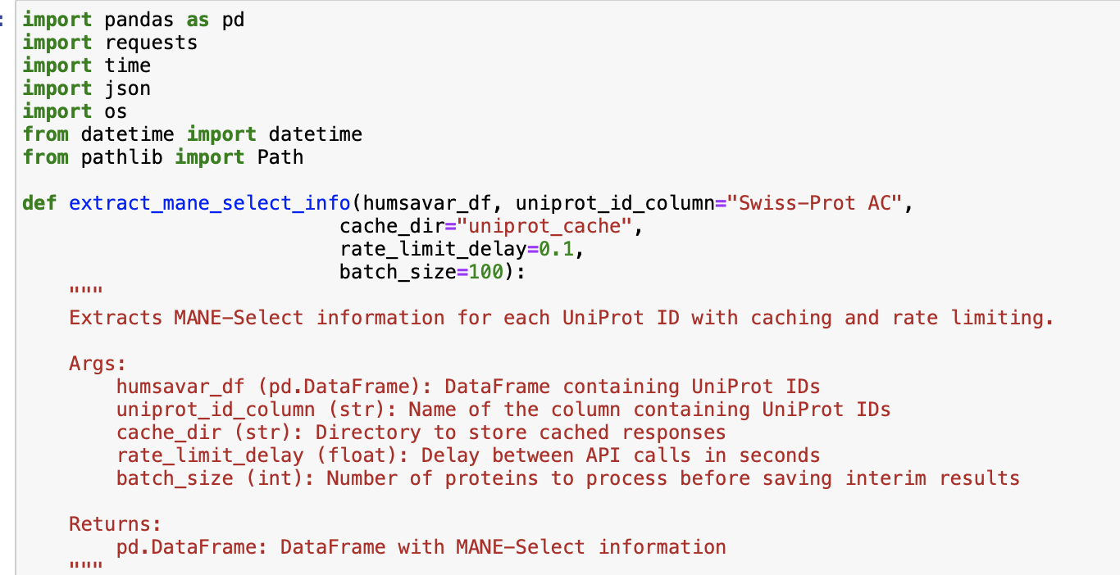
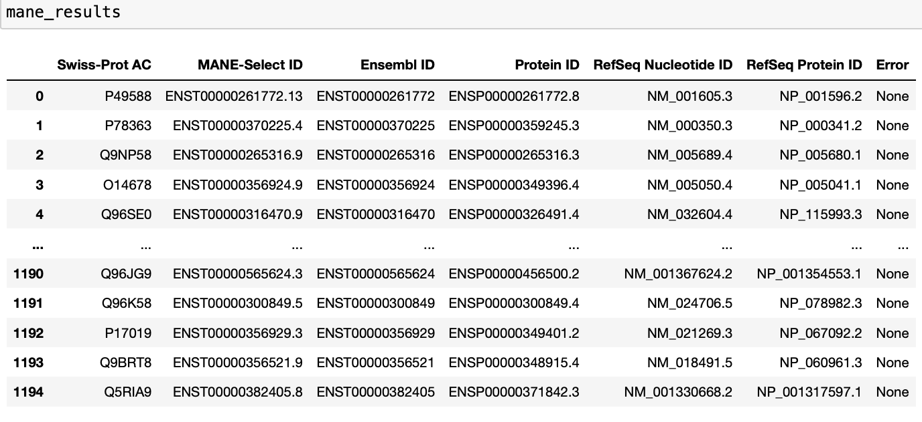
Add more information to this dataset by retrieving .json files from Uniprot

Slide 5
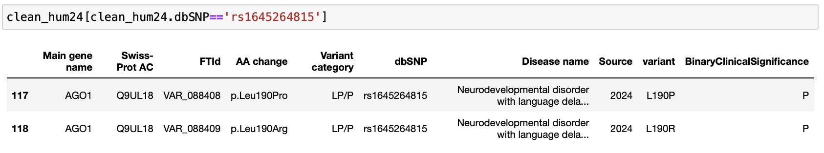
Predictor: VEST4 (we run it using the tool’s page because it is not inside the VEP’s tools list)
http://cravat.us/CRAVAT/
1. Prepare input file
2. Run VEST4
3. Parse the output to merge with the original file
Transcript-coordinate input format:
Variant ID, transcript identifier, amino-acid substitution, and (optional) sample ID, separated by a space or tab.
VAR4 NP_001135977 R641W 1 (substitution)
Predictors: VEP tool
Option 1: Retrieve only those with dbSNP ID number
Option 2: Retrieve nucleotide change information from REVEL downloads (Fail. Revel coverage not wide enough)
Option 3: Try generating VCF file for all those proteins from the transcript/exon information (Time consuming)
Option 4: Select 10 predictors and get predictions separately from each tool (Maybe/ Some tools still require genomic coordinate format.)
Potential problems: dbSNP column is also not clean & unique to variants.

Slide 6
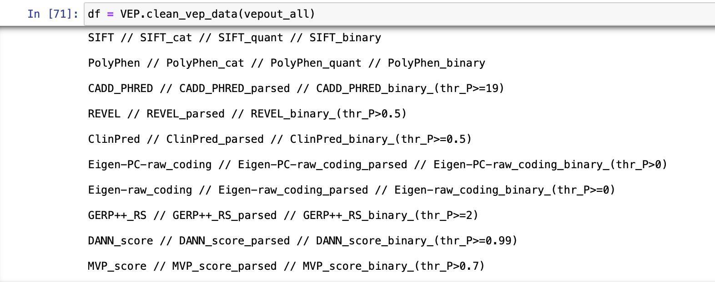
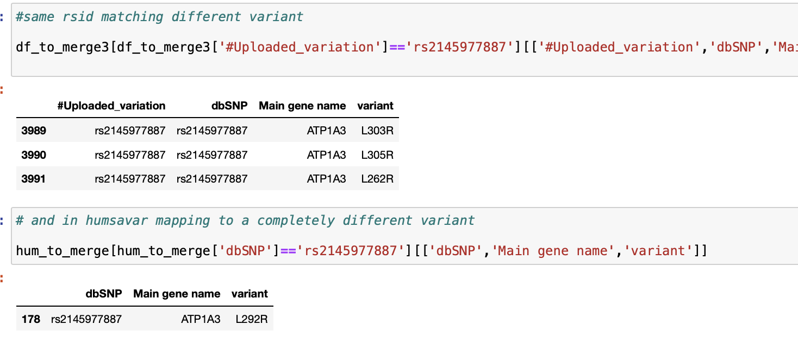
Predictors: VEP tool (parsing the results obtained from Option 1 (Retrieve only those with dbSNP ID number)
Clean and obtain binary predictions first
Merge with original humsavar file
Potential problems:
We might lose some variants after the merge…

Slide 7
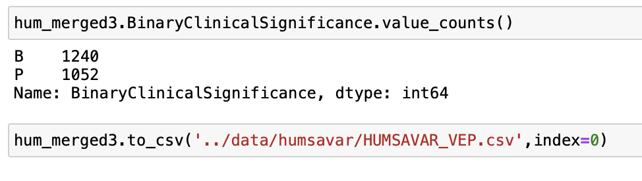
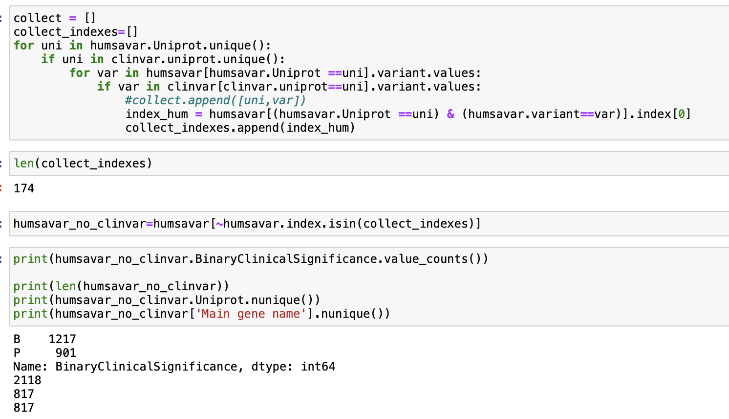
Two versions of the final HumSavar file:
One: cleaned dataset
Two: cleaned and filtered out for common variants in Clinvar

Slide 8
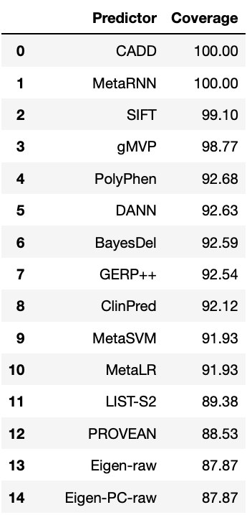
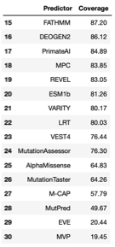
HumSavar
FINAL DATASET
840 unique genes
2292 variants
1240 Benign
1052 Pathogenic
Code cleaning & documenting DONE
Obtaining all predictions & cleaning DONE
FINAL DATASET (MINUS CLINVAR COMMONS)
817 unique genes
2118 variants
1217 Benign
901 Pathogenic
Cleaned from Clinvar variants version DONE

