Slide 1
Approximation Algorithm for Minimum Vertex Cover

Slide 2
Pseudocode
def find_min_cover(adj_matrix):
result = set()
while True:
removed_vertex, adj_matrix = remove_highest_degree(adj_matrix)
result.add(removed_vertex)
if check_edges(adj_matrix):
break
return result

Slide 3
Pseudocode
def remove_highest_degree(adj_matrix):
degrees = {v: len(neighbors) for v, neighbors in adj_matrix.items()}
max_degree = max(degrees.values())
candidates = [v for v, d in degrees.items() if d == max_degree]
selected_vertex = random.choice(candidates)
updated_adj_matrix = {
v: [neighbor for neighbor in neighbors if neighbor != selected_vertex]
for v, neighbors in adj_matrix.items() if v != selected_vertex
}
return selected_vertex, updated_adj_matrix

Slide 4
Analysis
remove_highest_degree
Worst case: O(V + E)
Must compute the degree of each vertex involves iterating through all vertices and their neighbors
find_min_cover
Worst case: O(V * (V + E)) = O(V² + V * E)
The function repeatedly calls remove_highest_degree and check_edges until all edges are removed. In the worst case, it performs this process once for every vertex.

Slide 5
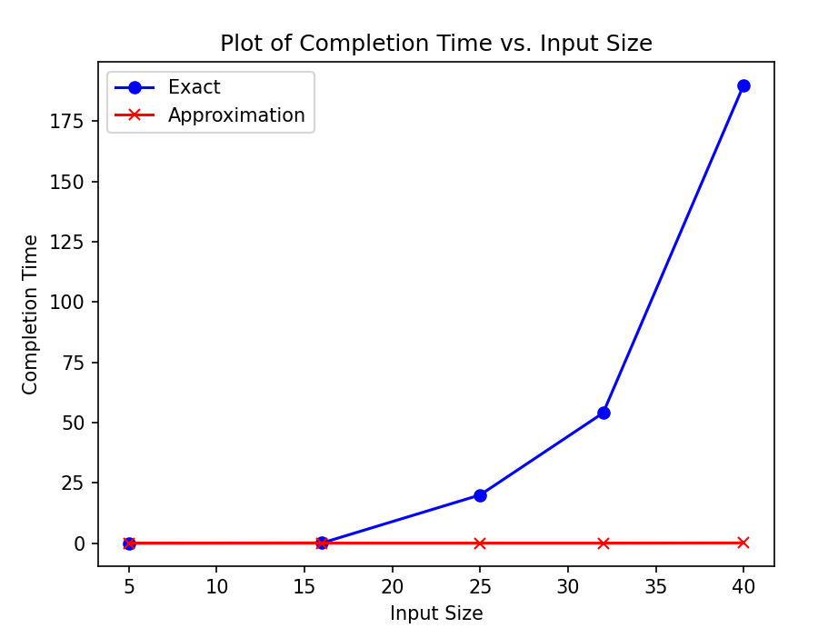
Runtime Performance

Slide 6
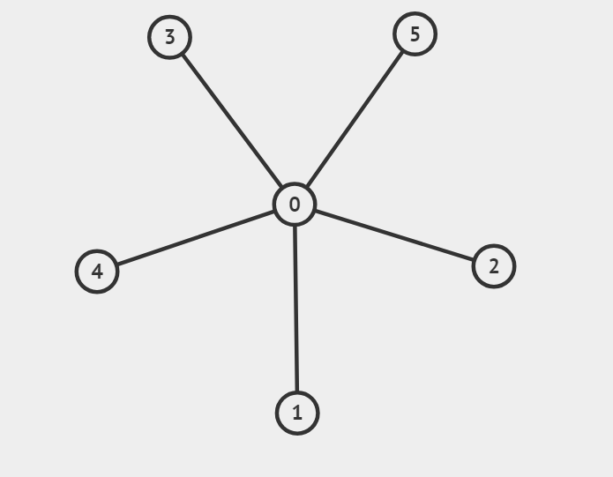
Comparing Test Results
Test 1
Approximation:
{0}
Exact:
{0}

Slide 7
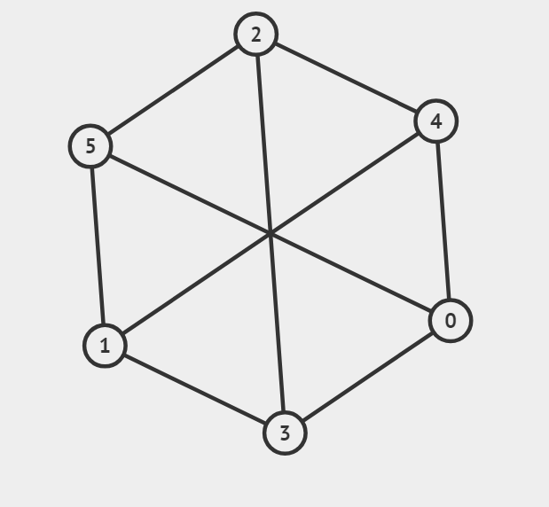
Comparing Test Results
Test 2
Approximation:
{0, 1, 2}
{3, 4, 5}
Exact:
{0, 1, 2}

Slide 8
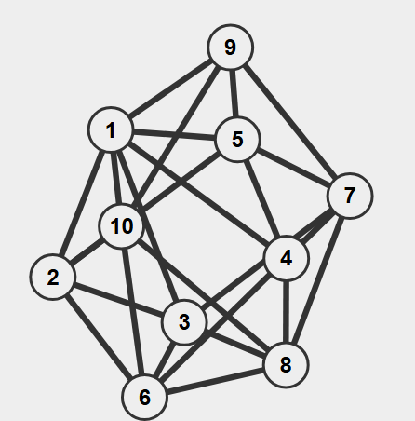
Comparing Test Results
Test 3
Approximation:
{1, 2, 5, 6, 7, 8, 9}
{1, 3, 5, 6, 7, 8, 10}
Exact:
{1, 2, 4, 6, 7, 8, 9}

Slide 9
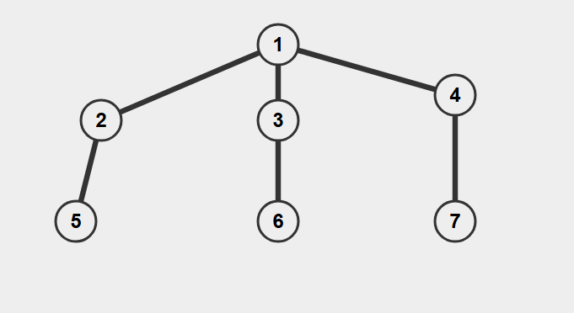
Comparing Test Results
Non-Optimal
Approximation:
{1, 5, 6, 7}
Exact:
{2, 3, 4}

