Slide 1

MASTERMIND
Ben Aitcheson
Jack Young

Slide 2
Project Vid ☺

Slide 3
Why Mastermind?
Mastermind takes aspects of Wordle but with Colours
Since these Games are popular now this was a good idea to try
Decided 2 Arduinos make this more reliable so made it a group project.

Slide 4
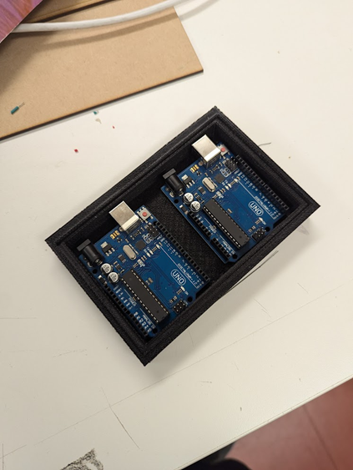
Problems and Scope
Figured out early that my scope would be too big so 2 Arduinos would make life much easier
3d Printing is a big problem after all the iterations, and maintenance the printers had

Slide 5
Hardware
1x4 led strip. 4x6 led strips. This is to display the colours for the mastermind and the player playing.
Power supply to power the game away from the computer

Slide 6
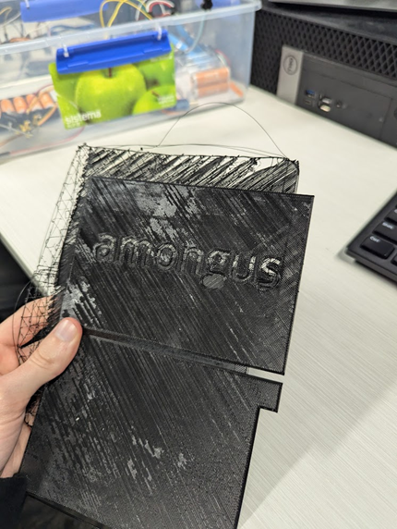
Discoveries we made
Start 3D printing early :\
3D printing tons of things can go wrong (it did for us) so learn and keep an eye on it
Plan as much as you can because you will discover things you didn’t know you would need.

Slide 7
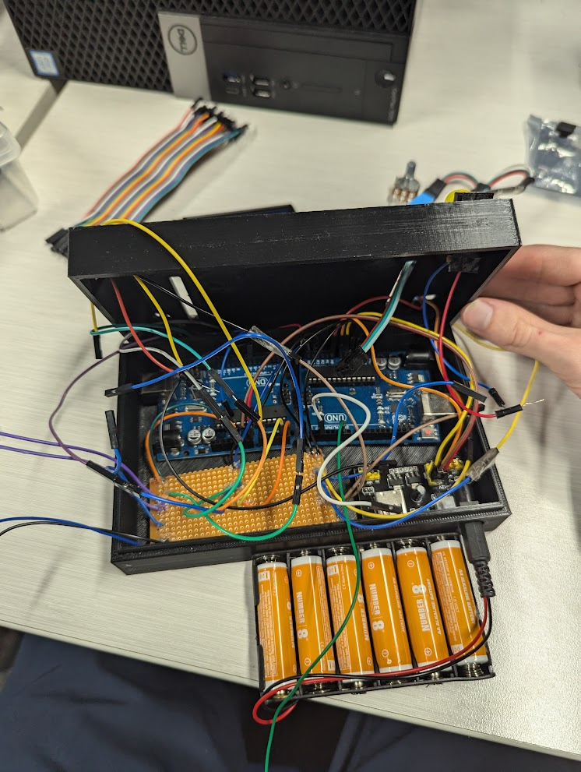
Things to know
At no point ask us to open it
We are 20% sure it won’t explode

