Slide 1

Hash Tables
Lecture 31
Data Structures and Abstractions

Slide 2
Important Advice for LAB/Assignment
You must complete Lab 10.
  Submission needed for the last assessed lab
  Submission needed for the assignment
Your BST needs to be usable beyond the purposes of the lab/assignment.
Follow the assignment specifications carefully. Read the QandA file (when available) regularly to see any clarification or advice.
  If the answer to your question is not there, ask early.
Be mindful of summing small floating point numbers. Errors accumulate.
  See the following for some advice:
    https://en.wikipedia.org/wiki/Kahan_summation_algorithm
    For a more detailed answer see: “What Every Computer Scientist Should Know About Floating-Point Arithmetic” at http://docs.oracle.com/cd/E19957-01/806-3568/ncg_goldberg.html

Slide 3
Maps
Previously we have looked at the STL map class, where any type can be used as a key into a container of paired values, giving direct access to the second part of the data.
So we can have:
map<string,string> DictionaryType;
Dictionary dictionary; // not really a good way to name
dictionary[“aardvark”] = “A nocturnal mammal of southern Africa”
cout << “arardvark:” << dictionary[“aardvark”];
//Work out how may string object constructions occurred in the lines //above

Slide 4
Hash Tables
One way to achieve this kind of direct access for the map class is to use what is known as a hash table.
  If keys are unique a balanced binary search tree can be used.
  If keys are not unique and key are unordered as in std::unordered_multimap or std::unordered_multiset , then hashing is used.
When storing the data, the key—in this case “aardvark” —is passed through a hash function, to give an index into an ordinary array. [1] [2]
The quality of the hash function determines how many different keys hash to the same index value. (technically known as “collisions”)
No hash function is perfect under all conditions, therefore there will always be clashes (“collisions”).
Therefore, there must also be a collision resolution defined.
Hash tables will always have empty space. To work most efficiently they are generally required to be no more than half full.
Notes:
[1] Why would you want to do something like this?
[2] Users of the STL map should not base their code on any underlying implementation of the map.

Slide 5
Dealing with Strings
The key used in the above example is a string.
Obviously, you cannot pass a string through a mathematical function.
Therefore, strings must be mapped to integers before hashing.
There are many ways to do this, however it is important to make sure that the method chosen does not promote collisions.

Slide 6
Insertion into a Hash Table
Insert (pair)
index = HashFunction (pair.key)
  index = index mod arraySize // in hash table i.e %
  IF array[index] is empty
  array[index] = pair
  ELSE
  HandleCollision (index, pair)
  ENDIF
End Insert
Notes:
[1] index is wrapped around the array using the mod % operator:

Slide 7
Searching a Hash Table
Search (key, found)
index = HashFunction (key)
    index = index mod arraySize
IF array[index] is empty
found = false
ELSE
IF array[index].key = key
found = true
ELSE // another key was hashed to the same index
found = CollisionSearch (index, pair)
ENDIF
ENDIF
End Search

Slide 8
Hash Functions
The ideal function would: [1]
  be easy to calculate;
  never produce the same index from two different keys;
  spread the records evenly throughout the array;
  deal with ‘bad’ keys better than others.
Of course, no function has all of these attributes under all conditions.
  It may be possible under restricted conditions where all keys are known in advance.
Common Hash Functions
  Truncation
  Extraction
  Folding
  Modular arithmetic
  Prime number division
  Mid-square hashing
  Radix conversion
Notes:
[1] Ideal function is possible if all keys are known in advance.
In the non-ideal case, the load factor needs to be kept below some bound. The load factor is the ratio
of number of keys to the number of places (buckets) available to store the keys.
A load factor close to 0 is wasting space without an increase in performance.

Slide 9
Radix Conversion
The best known of these is Radix Conversion.
Choose a low prime [1] number such as 7, 11 or 13 to use as the base of a polynomial. Then use the digits of the key as the factors of the polynomial.
Finally modulate by the array size, which should be a prime number.
For example, if
key = 32934648
array size = 997
Base = 7
Then
index = (3 * 7⁷ + 2 * 7⁶ + 9 * 7⁵ + 3 * 7⁴ + 4 * 7³ + 6 * 7² + 4 * 7 + 8) MOD 997 = 2866095 MOD 997
= 717
Notes:
[1] Why prime?

Slide 10
Collision Resolution
Collision resolution needs to:
  avoid clustering of records;
  be as simple to code as possible;
  only fail when the array is actually full;
  be ‘reversible’ to allow for deletion/search.
As before, no method fulfils all these requirements under every possible condition.
Common collision resolutions are:
  Linear probing
  Quadratic probing
  Random probing
  Linked collisions
  Overflow containers

Slide 11
Probing
Linear probing simply looks for the next empty space in the array. So if index is full, index+1 is checked, then index+2, index+3 etc. This has the disadvantage of increasing clustering and therefore collisions.
Quadratic probing looks for the next empty space using ‘square’ jumps. So if index is full, index+1 is checked, then index+4, index+9, index+16 etc. This avoids the clustering of linear probing, but can fail when the array is not full.
Random probing uses a random number generator—from a set starting point—for the increments in index. This avoids clustering, but is harder to reverse when a record is to be deleted (search?). Use pseudo -random number generator.

Slide 12
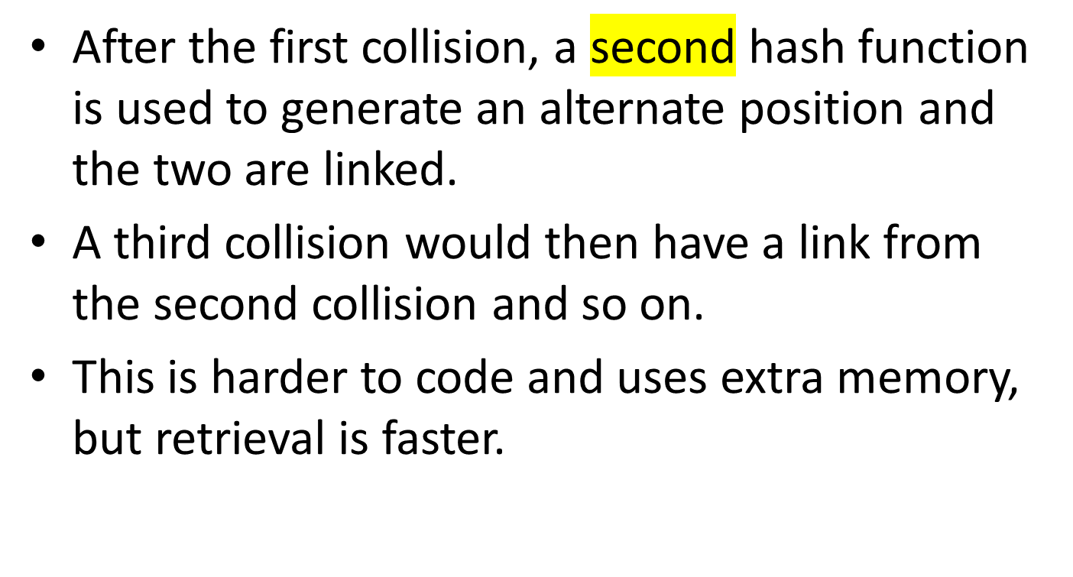
Linking Collisions
key1
key2

Slide 13
An Overflow Container
Instead of using a one dimensional array to store data, a two dimensional structure is used.
The records are placed in a linked list from the hashed index.
key2
key1

Slide 14
Readings
Reference book, Introduction to Algorithms. Chapter on Hash Tables.

Slide 15
Further Exploration
Khan Academy Video one particular example of the use Hash functions “Bitcoin: Cryptographic hash functions”
Tutorial on Hash functions http://research.cs.vt.edu/AVresearch/hashing/

