Slide 1

Graph Theory
Lecture 32
Data Structures and Abstractions

Slide 2
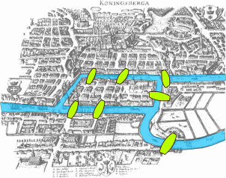
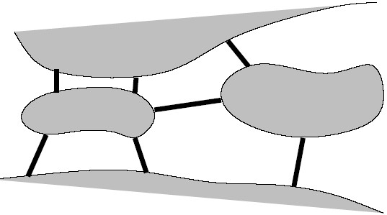
The Origins of Graph Theory
Graph Theory (unlike a lot of what we do) dates back to before 1736.
In Konisberg there were two islands in the middle of a river, connected by 7 bridges. [1]
  Textbook has the abstract version.
The question was: “is it possible
to cross each bridge exactly once?”
  Abstract representation is used to investigate solutions.
  Any solution obtained can then be used for similar problems.
In 1736, Euler answered this problem by establishing “Graph Theory” as a discipline. (The answer is “no”)
Notes:
[1] Image taken from https://en.wikipedia.org/wiki/Seven_Bridges_of_K%C3%B6nigsberg

Slide 3
Another Common Problem
As a child you may have met something similar:
Draw the shape below without taking your pen off the page and without going over any line or node more than once.
It is a graph problem, just as the Konisberg problem is a graph problem.

Slide 4
But...
But the theory itself remained a kind of mathematician-only esoteric field until
  Computers became available that could handle graph processing algorithms in reasonable time.
  Many of the complex problems of society were recognised to be graph problems.
  It was realised that Network traffic and the WWW were graphs.
  Some AI applications (simulations, neural networks etc) were discovered to use graph theory.
  Computer game playing required graph theory.

Slide 5
So What is a Graph?
A graph is a set of vertices connected by edges.
Two vertices are adjacent if they are connected by a single edge.
A graph is weighted if there is a number associated with each edge. (can be cost, distance, ..etc)
A graph is directed if any of the edges are one-way.
8
5
non-adjacent vertices
6
7
11
vertex
12
edge
adjacent vertices

Slide 6
Graph Definitions
1
4
5
2
3
6
A path is a sequence of adjacent vertices
A simple path is one that has distinct edges: no vertex is visited twice.
A cyclic path is one where the start and finish are the same vertex.
Two paths are disjoint if they have no vertices in common, other than, possibly, their endpoints. [see the red and blue paths]

Slide 7
In an unweighted graph, the length of a path is the number of traversed edges.
In a weighted graph, the length of a path is the sum of the weights of the traversed edges.
95
Length = 95+65+40+55+70 = 325
Length = 5
65
40
55
70

Slide 8
A connected graph is one where every vertex is reachable from every other vertex
A tour is a cyclic path that touches every vertex.
Connected
Not connected
<number> of 22

Slide 9
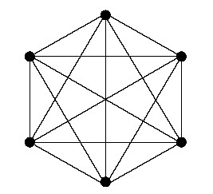
A complete graph is one where every vertex is adjacent to every other vertex.
A graph with no cycles (an acyclic graph) is a tree.

Slide 10
Data Structures to Represent Graphs
Representing a graph as vertices and edges is fine in the abstract (physical) sense but makes processing too difficult.
Two alternatives are therefore used within programming:
  Adjacency matrices
    Constant access time
    Slow search time
  Adjacency list
    Fast search time
    Slow access time
For both of these, the vertices are arbitrarily numbered.

Slide 11
Adjacency Matrix Representation
The graph is represented as a two dimensional array of boolean.
A vertex is not considered to connect to itself.
0
1
2
3
4
5
0 | 1 | 2 | 3 | 4 | 5
0
1
2
3
4
5
false | false | true | true | false | false
false | false | true | true | false | true
true | true | false | false | false | true
true | true | false | false | false | true
false | false | false | false | false | true
false | true | true | true | true | false

Slide 12
Drawing an Adjacency Matrix
Make sure you can draw an adjacency matrix for a graph. Use the Graph program to check your answers.

Slide 13
Adjacency List Representation
0
1
2
3
4
5
The graph is represented as a one dimensional sorted list of connected vertices:
0
1
2
3
4
5
2
3
2
3
5
0
1
5
0
1
5
5
1
2
3
4

Slide 14
Drawing an Adjacency List
Make sure you can draw an adjacency list for a graph. Use the Graph program to check your answers.

Slide 15
Matrix and List Comparison
Advantages of Lists
  More flexible as the size is not fixed
  Less space used: O(V+E) rather than O(V²) for a matrix.
  Faster processing (searching) at each vertex
Advantages of Matrices
  Easier to program
  Access time to find out if a pair of vertices are connected is constant time as opposed to O(V) for lists.

Slide 16
Directed Graph Definitions
Directed graphs are also known as di-graphs.
A vertex is reachable from another vertex if there is a path between them.
It is assumed that each vertex can reach itself.
The in-degree of a vertex is the number of edges leading into a vertex.
The out-degree of a vertex is the number of edges leading out of a vertex.

Slide 17
A sink is a vertex with out-degree of zero.
A source is a vertex of in-degree 1: it is reachable only from itself.
Sink
Source

Slide 18
A map is a di-graph where every vertex has out-degree 1.
A di-graph is strongly connected if every vertex is reachable from every other vertex.
A di-graph with no cycles is an Acyclic Directed Graph, or DAG.

Slide 19
Adjacency Matrix Representation of a Di-graph
The di-graph is represented as a two dimensional array of boolean.
Note that in a di-graph vertices are considered to be connected to themselves.
0
1
2
3
4
5
0 | 1 | 2 | 3 | 4 | 5
0
1
2
3
4
5
true | false | true | true | false | false
false | true | true | false | false | true
false | true | true | false | false | true
true | true | false | true | false | true
false | false | false | false | true | true
false | true | false | true | true | true

Slide 20
Adjacency List Representation
0
1
2
3
4
5
The di-graph is represented as a one dimensional sorted list of connected vertices:
0
1
2
3
4
5
0
2
3
1
2
5
2
1
5
3
0
1
5
4
5
5
1
3
4

Slide 21
Graph Domains
Social media – friendship networks
Interconnections in ecosystems
Genetics and ancestry
Chemical structures
Traversal problems
Travel itineraries
Neural networks
The WWW (the biggest graph of them all)
Electric circuits
Scheduling
Financial transactions
Compilers use graphs to represent call structures
Within games software
UML diagrams, data flow diagrams, E-R diagrams etc
Automatic diagram generation
etc.

Slide 22
Some Graph, Di-Graph and DAG Processing Problems
Searching: how do we get from a particular vertex to another.
Connectivity: is a given graph connected.
Find the minimum length set of edges that connects all vertices (the Minimum Spanning Tree or MST).
Find the shortest path between two vertices.
Find the shortest path from a specific vertex to all other vertices (the Shortest Path Tree or SPT).
Planarity: can a specific graph be drawn without any intersecting lines?
Matching: what is the largest subset of edges with the property that no two are connected to the same vertex?
Find the tour with the shortest path (mail carrier problem).
Topological Sort: sort the vertices of a DAG in order of the number of dependencies.

Slide 23
Complex problems
Graphs are a powerful tool for modelling complex problems.
“The great unexplored frontier is complexity
  I am convinced that nations and people that master the new science of complexity will become the economic, cultural, and political superpowers of the next century.” Heinz Pagels

Slide 24
In Fact
These problems are NP-Hard.
There is no solution for any of them that is guaranteed to be solvable in a reasonable amount of time.
  Restricted case solutions are possible but not in the general case.
There are only solutions that work quite well in some circumstances.
This, combined with the large number of domains, makes this field one that is rich in research possibilities.

Slide 25
Readings
Textbook Chapter on Graphs.
The lecture notes and textbook is sufficient for this unit.
Further exploration:
  Graphs and Networks has interesting applications of graphs, including a wall chart.
  How graph problems gave the biggest finite number known that no one can write but ends in 7.
  Interactive explanations of various algorithms [1]
  Complex systems: Network thinking, Melanie Mitchell, Artificial Intelligence, vol. 170(18), Science Direct, Elsevier.
  Reference book, Introduction to Algorithms. Part on Graph Algorithms contains a number of chapters on graph algorithms. (for further study)
  Consider doing the unit MAS225 where Graphs are covered in detail. https://handbook.murdoch.edu.au/units/12/MAS225
Notes:
[1] Shared with me by one of our graduates in industry, Sava

