Slide 1

Trees and Tree Searching
Lecture 28
Data Structures and Abstractions

Slide 2
Trees
Trees are ADS where every Node has directional links to one or more nodes underneath it. [1]
An m-tree is a node with 0:m links and 1:m-1 pieces of data in each node. For example, a 4-tree (quadtree or 4-way tree) might look something like this:
Notes:
[1]
Compare this idea of nodes with the one used in linked lists. The lecture notes examples show unidirectional links from parent to child.
There can be a link back from the child to the parent – see section on “Representing rooted trees” and the chapter on “Binary Search Trees” in our reference book, Introduction to Algorithms (ebook in My unit readings). The lecture notes and text do not show the link back to parent as a simplification.
There should be no closed loops in the way edges and nodes are connected. A different data structure called Graphs might have loops. Trees are a special case of Graphs.
If there are n nodes, there are n-1 edges.

Slide 3
Tree Definitions
The top node is called the root. [1]
Any node that is not the root node is a child of some parent.
Any node that has one or more children is a parent.
Nodes connected to same parent are called siblings. [2]
Any node that has no children is called a leaf.
Any part of the tree smaller than the whole is called a subtree.
Notes:
[1] In this unit we are interested in rooted trees. Rooted trees are trees where one node is special and can serve as the starting point of the tree. Unrooted trees are also called free trees.
[2] The siblings are the same distance away from the parent. Connection can be two-way: parent to child, and child back to parent.

Slide 4
Tree Use [1]
The back-ends of databases.
Data stores that are not databases.
Problem solving.
Game playing. [2]
Graphics and virtual reality: for tracking line of sight as well as storing screen objects.
Graph theory (e.g., path finding).
The algorithm used to insert data into the tree will vary from application to application.
Notes:
[1] There are other applications in other areas like electrical circuits, organic chemistry, .. etc.
[2] Game playing is not just for entertainment and entertainment is only a trivial example.
It can be used to simulate various real-world scenarios; decision making; to answer what-if questions, .. etc.
For further insights see Game Theory https://www.britannica.com/science/game-theory#:~:text=game%20theory%2C%20branch%20of%20applied,or%20strategies%2C%20in%20formulating%20strategy.
Quoted from above:
“Game theory has been applied to a wide variety of situations in which the choices of players interact to affect the outcome. In stressing the strategic aspects of decision making, or aspects controlled by the players rather than by pure chance, the theory both supplements and goes beyond the classical theory of probability. It has been used, for example, to determine what political coalitions or business conglomerates are likely to form, the optimal price at which to sell products or services in the face of competition, the power of a voter or a bloc of voters, whom to select for a jury, the best site for a manufacturing plant, and the behaviour of certain animals and plants in their struggle for survival. It has even been used to challenge the legality of certain voting systems.”

Slide 5
Traversal
Traversing a tree involves going to every node. [1]
This needs to be done for processes such as printing, gathering statistics, end-of-month calculations, searching etc.
It can be done either in-order, pre-order or post-order. [2]
The method chosen depends on the application.
In the traversal examples, we look at a 2-way or binary tree, as this is the simplest to understand.
Notes:
[1] As each node is visited, the time complexity is O(n)
Recursive approaches would involve function calls, and thus the runtime stack.
So, space complexity (think memory resources) is O(h), where h is the height of the tree
[2]
These traversals go down into the tree – “go deep”, so are “Depth first” approaches.

Slide 6
In-Order Traversal
Examples don’t have the terminating condition for recursion – see note [1]
  ProcessNode (node) [1]
    ProcessNode (leftLink)
    Process this node
    ProcessNode (rightLink)
  End ProcessNode
Notes:
[1]
A routine calling itself is called recursion. It is a kind of looping construct which makes use of the run-time stack (not the same as the ADS stack but the concept is the same – it is a LIFO). An out-of-control recursion will fill up your run-time stack. See textbook chapter on recursion.
A properly controlled recursion would have runtime stack requirements, space complexity being O(h), where h is the height of the tree. In your practical work, you *will* encounter this space complexity problem for a tree that is not balanced.
Very important:
In the example algorithm above, there is **no** terminating condition. This will normally lead to out-of-control recursion but in this case when the leaf node’s link is accessed, the program will be killed. So, if the value of the node is null, routine terminates – **this must be added to the algorithm**. See textbook chapter on Binary Trees in the textbook.

Slide 7
In-Order Traversal Animation
  ProcessNode (node)
    ProcessNode (leftLink)
    Process this node
    ProcessNode (rightLink)
  End ProcessNode
END

Slide 8
Pre-Order Traversal
  ProcessNode (node)
    Process this node
    ProcessNode (leftLink)
    ProcessNode (rightLink)
  End ProcessNode

Slide 9
Pre-Order Traversal Animation
  ProcessNode (node)
    Process this node
    ProcessNode (leftLink)
    ProcessNode (rightLink)
  End ProcessNode
END

Slide 10
Post-Order Traversal
  ProcessNode (node)
    ProcessNode (leftLink)
    ProcessNode (rightLink)
    Process this node
  End ProcessNode

Slide 11
Post-Order Traversal Animation
  ProcessNode (node)
    ProcessNode (leftLink)
    ProcessNode (rightLink)
    Process this node
  End ProcessNode
END

Slide 12
Tree Searching
Trees will also need to be searched, and there are many different search algorithms available.
When not using heuristics, there are two main ways in which to do a logical search:
  Depth first
    which is simply a search done in pre-order stopping when the target data is found; [1]
    the aim is to find any match to the target;
    this is commonly used when trying to find the one unique match.
  Breadth first
    where the nodes are searched in layers, down from the top;
    this search aims to find the match that is closest to the start;
    a common use for this is in game playing: you want to win as soon as possible.
Notes:
[1]
The 3 traversals looked at earlier (in-order, pre-order, post-order) are also Depth first searches.

Slide 13
Depth First Search Animation
  Search (node) : boolean
  boolean found
  found = target at this node
    IF not found
    found = Search (leftLink)
    IF not found
    found = Search (rightLink)
    ENDIF
    ENDIF
    return found
  End Search
X
X
END

Slide 14
Breadth First Animation [1]
Add root to a queue of pointers
WHILE queue is not empty AND not found
Dequeue (current)
If current.data == target
found = true
ELSE
Enqueue (current.left)
Enqueue (current.right)
ENDIF
ENDWHILE
X
X
Notes:
[1] An additional data structure is used – queue.

Slide 15
Breadth First Animation
Add root to a queue of pointers
WHILE queue is not empty AND not found
Dequeue (current)
If current.data == target
found = true
ELSE
Enqueue (current.left)
Enqueue (current.right)
ENDIF
ENDWHILE
current
X
X

Slide 16
Breadth First Animation
Add root to a queue of pointers
WHILE queue is not empty AND not found
Dequeue (current)
If current.data == target
found = true
ELSE
Enqueue (current.left)
Enqueue (current.right)
ENDIF
ENDWHILE
current
X
X

Slide 17
Breadth First Animation
Add root to a queue of pointers
WHILE queue is not empty AND not found
Dequeue (current)
If current.data == target
found = true
ELSE
Enqueue (current.left)
Enqueue (current.right)
ENDIF
ENDWHILE
current
X
X

Slide 18
Breadth First Animation
Add root to a queue of pointers
WHILE queue is not empty AND not found
Dequeue (current)
If current.data == target
found = true
ELSE
Enqueue (current.left)
Enqueue (current.right)
ENDIF
ENDWHILE
current
X
X

Slide 19
Breadth First Animation
Add root to a queue of pointers
WHILE queue is not empty AND not found
Dequeue (current)
If current.data == target
found = true
ELSE
Enqueue (current.left)
Enqueue (current.right)
ENDIF
ENDWHILE
current
X
X
END

Slide 20
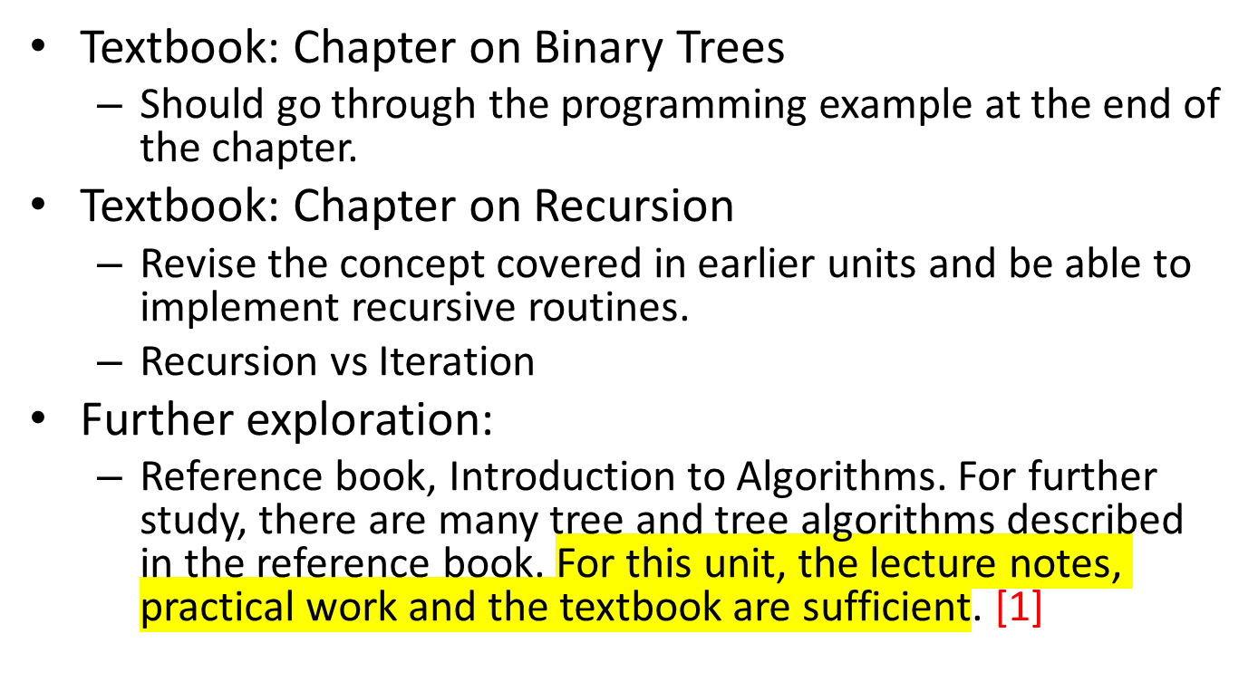
Readings
Notes:
[1]
There is a whole lot more to Tree data structure than what is covered in this unit.

