Slide 1
Book1
File created on: 07-07-2022 15:23:19

Slide 2
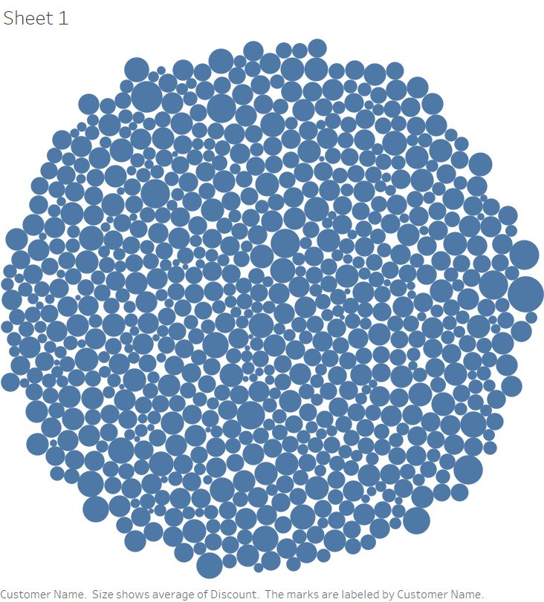

Slide 4
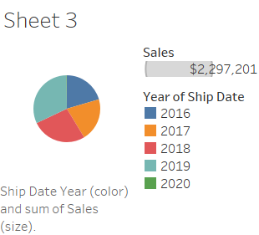

Slide 5
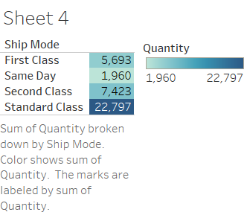

Slide 6
