Slide 1
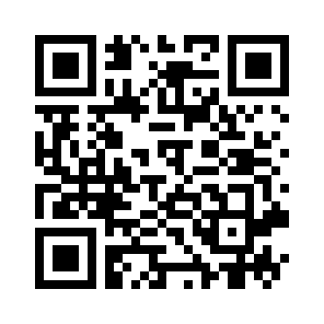

Slide 2
Saca el guisky cheli
Desmadre 75
1998

Slide 3
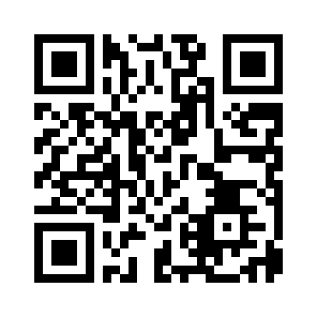

Slide 4
Sweet Child O' Mine
Guns N' Roses
1987

Slide 5
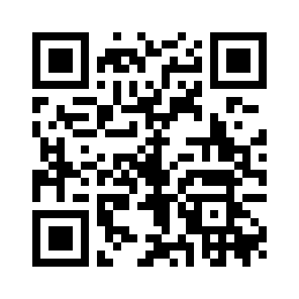

Slide 6
Under Pressure - Remastered 2011
Queen, David Bowie
1982

Slide 7
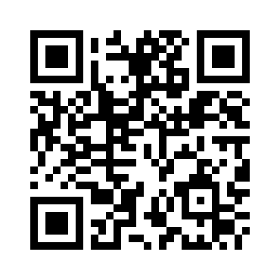

Slide 8
Quisiera ser
Duo Dinamico
1987

Slide 9
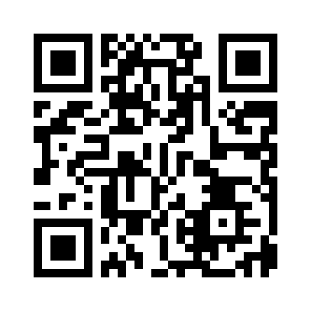

Slide 10
Cómo Te Atreves
Morat
2016

Slide 11
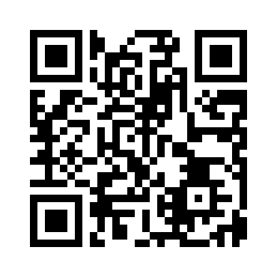

Slide 12
I'm an Albatraoz
AronChupa, Little Sis Nora
2014

Slide 13
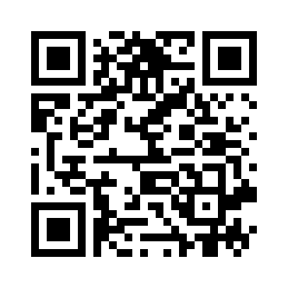

Slide 14
Dilemma (feat. Kelly Rowland)
Nelly, Kelly Rowland
2002

Slide 15
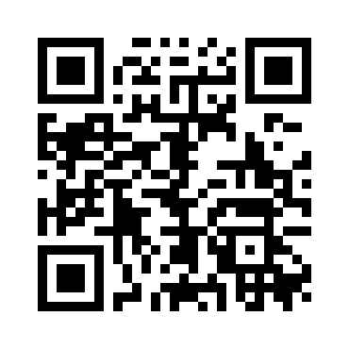

Slide 16
Nothing Compares 2 U
Sinéad O'Connor
1990

Slide 17
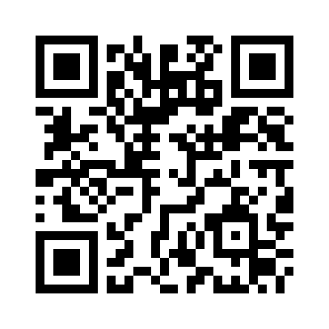

Slide 18
Ice Ice Baby
Vanilla Ice
1990

Slide 19
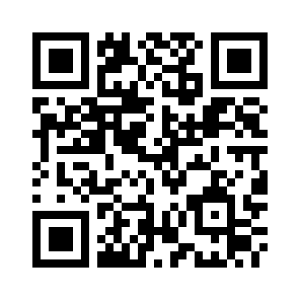

Slide 20
Amor, Amor
Lolita
2013

Slide 21
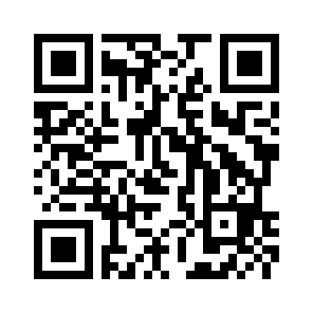

Slide 22
With A Little Help From My Friends
Joe Cocker
1969

Slide 23
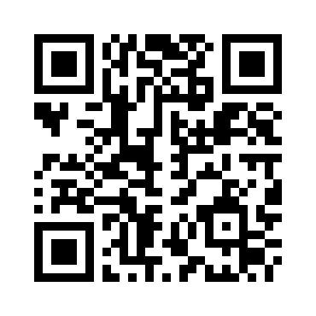

Slide 24
Lambada - Version 1989
Kaoma
1989

Slide 25
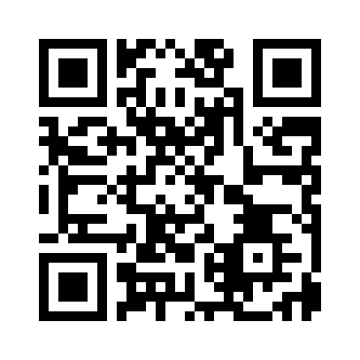

Slide 26
Self Control
Laura Branigan
1984

Slide 27
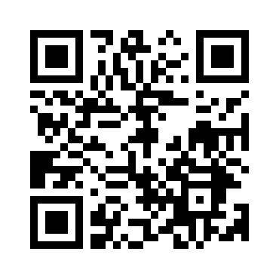

Slide 28
Dancing In the Dark
Bruce Springsteen
1984

Slide 29
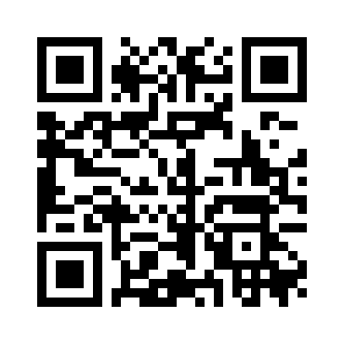

Slide 30
Bailar Pegados
Sergio Dalma
1991

Slide 31
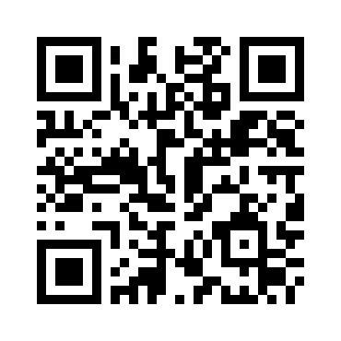

Slide 32
Caminando por la vida
Melendi
2005

Slide 33
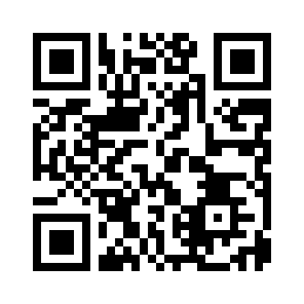

Slide 34
Africa
TOTO
1982

Slide 35
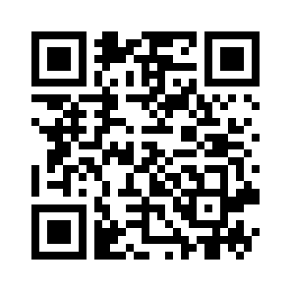

Slide 36
She Drives Me Crazy
Fine Young Cannibals
1988

Slide 37
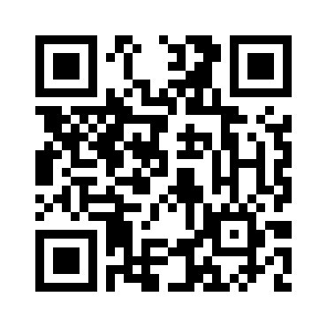

Slide 38
La Isla del Amor (feat. Maki)
Demarco Flamenco, Maki
2017

Slide 39
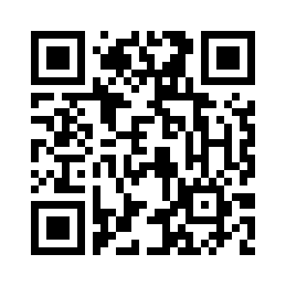

Slide 40
(What A) Wonderful World - Mono
Sam Cooke
1960

Slide 41
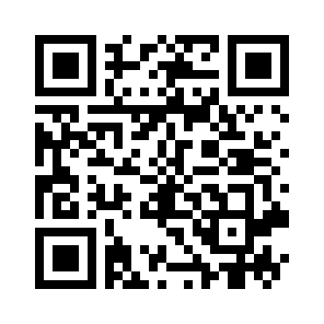

Slide 42
La Bicicleta
Carlos Vives, Shakira
2017

Slide 43
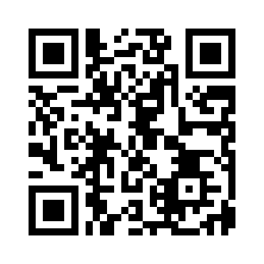

Slide 44
Scars To Your Beautiful
Alessia Cara
2016

Slide 45
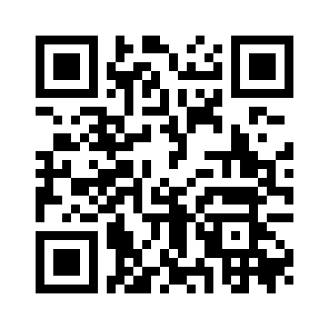

Slide 46
Dile - Remastered
Luis Aguile
2008

Slide 47
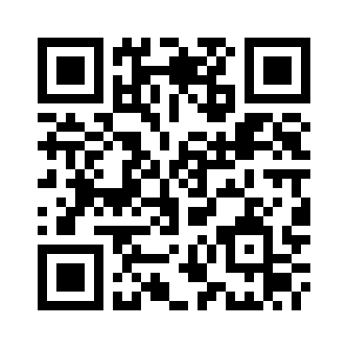

Slide 48
Call Me Maybe
Carly Rae Jepsen
2012

Slide 49
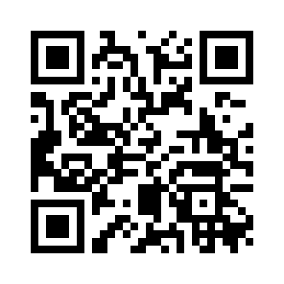

Slide 50
Se fué
Laura Pausini
1994

Slide 51
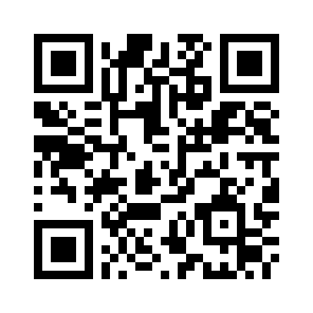

Slide 52
Wonderwall
Oasis
1995

Slide 53
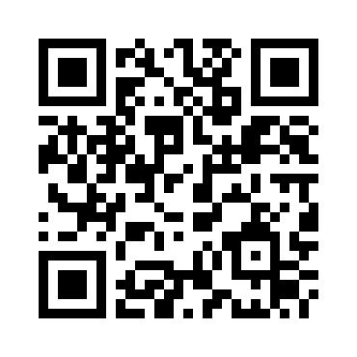

Slide 54
Cheap Thrills
Sia
2016

Slide 55
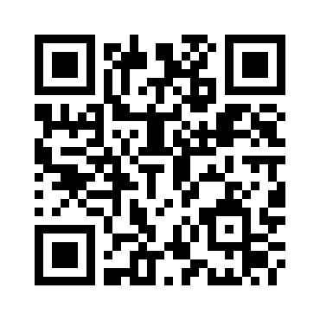

Slide 56
Super Freak
Rick James
1981

Slide 57
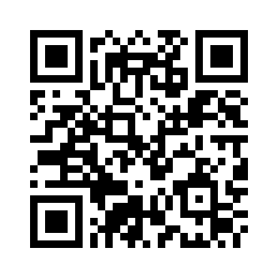

Slide 58
Hey Ya!
Outkast
2003

Slide 59
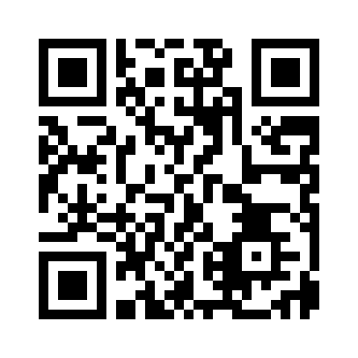

Slide 60
I Can Help
Billy Swan
1998

Slide 61
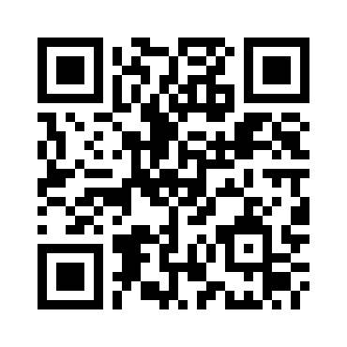

Slide 62
Colgando en tus manos (con Marta Sánchez)
Carlos Baute, Marta Sánchez
2009

Slide 63
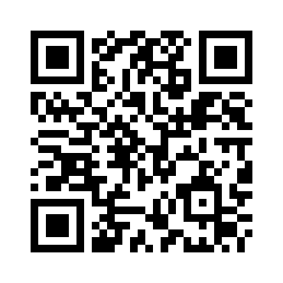

Slide 64
Black is Black
Los Bravos
1966

Slide 65
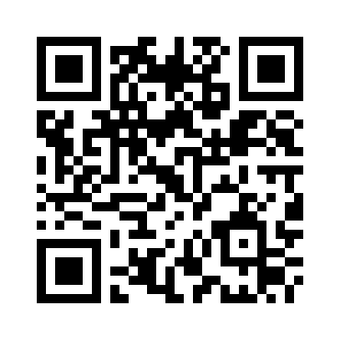

Slide 66
We Are Family - 1995 Remaster
Sister Sledge
1979

Slide 67
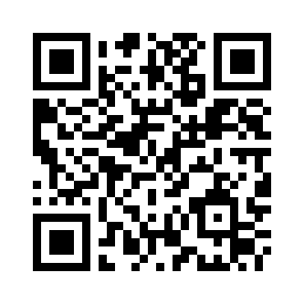

Slide 68
Un Ramito de Violetas
Cecilia
2013

Slide 69
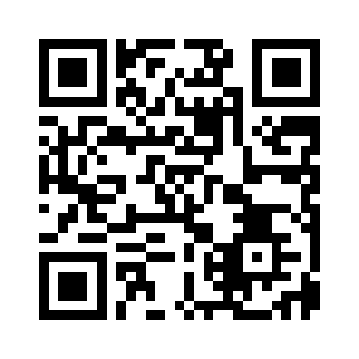

Slide 70
Soy rebelde
Jeanette
2011

Slide 71
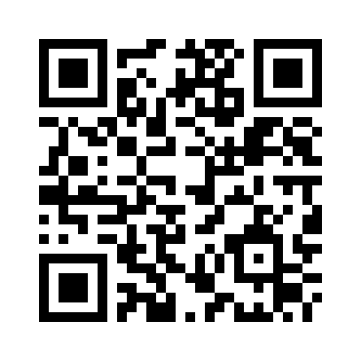

Slide 72
Gloria
Umberto Tozzi
1979

Slide 73
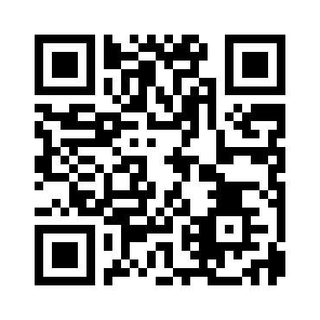

Slide 74
(I've Had) The Time of My Life - From "Dirty Dancing" Soundtrack
Bill Medley, Jennifer Warnes
2004

Slide 75
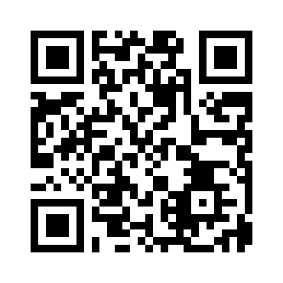

Slide 76
Celebration
Kool & The Gang
1980

Slide 77
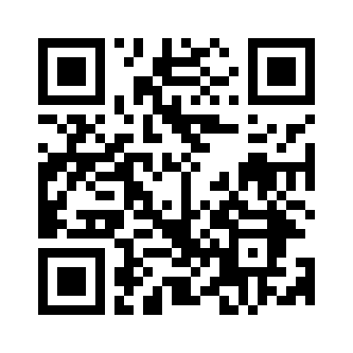

Slide 78
Shout
Tears For Fears
1985

Slide 79
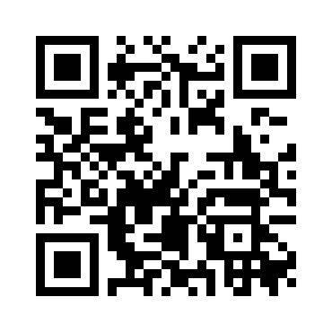

Slide 80
bad guy
Billie Eilish
2019

Slide 81
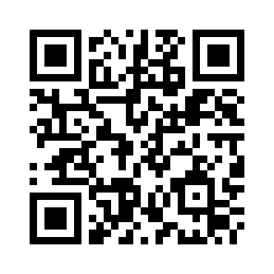

Slide 82
Everybody Hurts
R.E.M.
1992

Slide 83
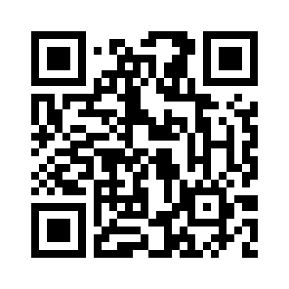

Slide 84
Resistiré
Duo Dinamico
1988

Slide 85
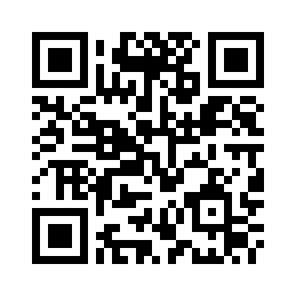

Slide 86
Dime Que Me Quieres
Tequila
1980

Slide 87
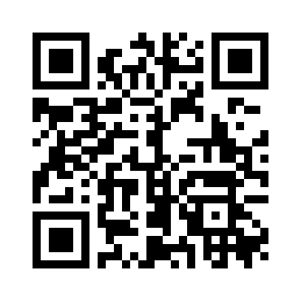

Slide 88
Pajaros de Barro
Manolo Garcia
1998

Slide 89
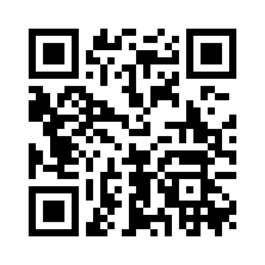

Slide 90
When a Man Loves a Woman - Mono
Percy Sledge
1966

Slide 91
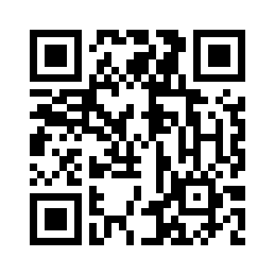

Slide 92
Marta, Sebas, Guille y los demás
Amaral
2005

Slide 93
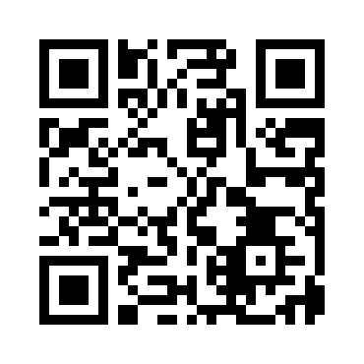

Slide 94
Libre
Nino Bravo
1976

Slide 95
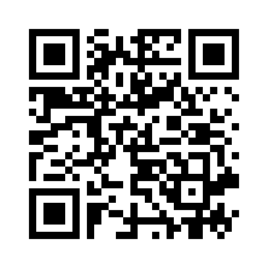

Slide 96
Bitter Sweet Symphony - Remastered 2016
The Verve
1997

Slide 97
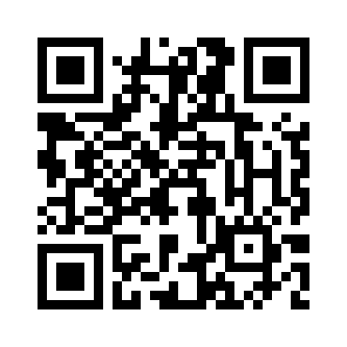

Slide 98
I Wanna Dance with Somebody (Who Loves Me)
Whitney Houston
1987

Slide 99
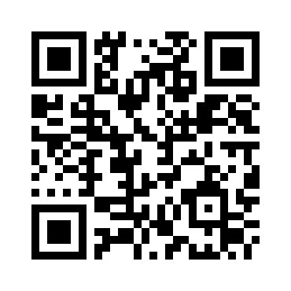

Slide 100
Zapatillas
El Canto Del Loco
2005

Slide 101


Slide 102
Guajira Guantanamera
Joseito Fernández
2012

Slide 103


Slide 104
Mi Gente
J Balvin, Willy William
2018

Slide 105


Slide 106
Waka Waka (This Time for Africa) [The Official 2010 FIFA World Cup (TM) Song] (feat. Freshlyground)
Shakira, Freshlyground
2010

Slide 107


Slide 108
It's a Heartache
Bonnie Tyler
2006

Slide 109


Slide 110
La Felicidad
Palito Ortega
2001

Slide 111


Slide 112
Malo
Bebe
2004

Slide 113


Slide 114
Cotton Eye Joe
Rednex
1994

Slide 115


Slide 116
Wrecking Ball
Miley Cyrus
2013

Slide 117


Slide 118
Barbie Girl
Aqua
1997

Slide 119


Slide 120
All About That Bass
Meghan Trainor
2015

Slide 121


Slide 122
Un Rayo de Sol
Los Diablos
2013

Slide 123


Slide 124
I Got You Babe
Sonny & Cher
1965

Slide 125


Slide 126
Vivir Así Es Morir de Amor
Camilo Sesto
1978

Slide 127


Slide 128
Yes Sir, I Can Boogie
Baccara
1998

Slide 129


Slide 130
Bailando - Spanish Version
Enrique Iglesias, Descemer Bueno, Gente De Zona
2015

Slide 131


Slide 132
Fireflies
Owl City
2009

Slide 133


Slide 134
Genie In a Bottle
Christina Aguilera
1999

Slide 135


Slide 136
The Best
Tina Turner
1989

Slide 137


Slide 138
My Heart Will Go On - Love Theme from "Titanic"
Céline Dion
1997

Slide 139


Slide 140
Volando Voy
Kiko Veneno
1992

Slide 141


Slide 142
Danza Kuduro
Don Omar, Lucenzo
2011

Slide 143


Slide 144
Firework
Katy Perry
2010

Slide 145


Slide 146
Knock On Wood
Amii Stewart
2012

Slide 147


Slide 148
Chacachá del tren (remastered)
Hermanas Fleta
2005

Slide 149


Slide 150
Don't Go
Yazoo
1982

Slide 151


Slide 152
Rigoletto: "La Donna E' Mobile"
Enrico Caruso
2011

Slide 153


Slide 154
Despacito
Luis Fonsi, Daddy Yankee
2019

Slide 155


Slide 156
Smells Like Teen Spirit
Nirvana
1991

Slide 157


Slide 158
Me Gustas Mucho
Rocío Dúrcal
1992

Slide 159


Slide 160
Hay que venir al sur
Raffaela Carrá
2013

Slide 161


Slide 162
Lola
The Kinks
1970

Slide 163


Slide 164
Lo Que Pasó, Pasó
Daddy Yankee
2004

Slide 165


Slide 166
In the Mood - 2006 Remastered Version
Glenn Miller
1939

Slide 167


Slide 168
Amante Bandido
Miguel Bosé
1984

Slide 169


Slide 170
Closer
The Chainsmokers, Halsey
2016

Slide 171


Slide 172
World Hold on (Children of the Sky) [Radio Edit]
Bob Sinclar, Steve Edwards
2006

Slide 173


Slide 174
I Like To Move It (feat. The Mad Stuntman) - Erick "More" Album Mix
Reel 2 Real, The Mad Stuntman, Erick Morillo
1994

Slide 175


Slide 176
Tu Enemigo
Pablo López, Juanes
2015

Slide 177


Slide 178
Friday I'm In Love
The Cure
1992

Slide 179


Slide 180
Tengo una Debilidad
Antonio Machín
2012

Slide 181


Slide 182
Salta!!!
Tequila
1981

Slide 183


Slide 184
No me importa nada
Luz Casal
1989

Slide 185


Slide 186
Never Ending Story
Limahl
2009

Slide 187


Slide 188
Mi Carro
Manolo Escobar
1991

Slide 189


Slide 190
Aquí No Hay Playa
The Refrescos
1989

Slide 191


Slide 192
Fly Away
Lenny Kravitz
1998

Slide 193


Slide 194
All That She Wants
Ace of Base
1993

Slide 195


Slide 196
Lean On (feat. MØ & DJ Snake)
Major Lazer, MØ, DJ Snake
2015

Slide 197


Slide 198
Lovefool
The Cardigans
1996

Slide 199


Slide 200
Mi gran noche
Raphael
1967

