Slide 1
Modelitos

Slide 2
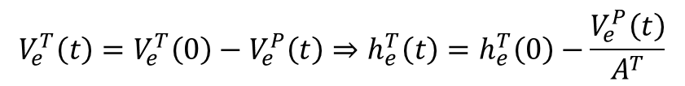




Tanques (I)
Ejemplo sin considerar celdas, ni electrodos ni nada
$$V_{e}^{T}\left(0\right)=h_{e}^{T}\left(0\right)∙A^{T}$$
$$V_{e}^{P}\left(0\right)=0$$
$$V_{e}^{P}\left(t\right)=al volumen sumado de las tuberias$$
$$h_{e}^{T}\left(0\right)$$
$$Tank$$
$$V_{e}^{T}\left(t\right)=V_{e}^{T}\left(0\right)−V_{e}^{P}\left(t\right)⇒h_{e}^{T}\left(t\right)=h_{e}^{T}\left(0\right)−\frac{V_{e}^{P}\left(t\right)}{A^{T}}$$
$$Pipes$$

Slide 3
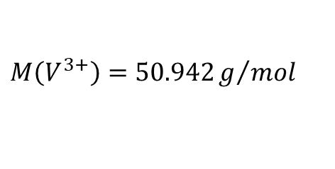
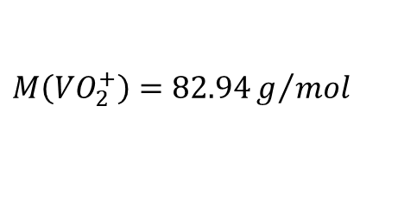
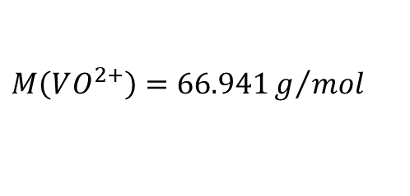
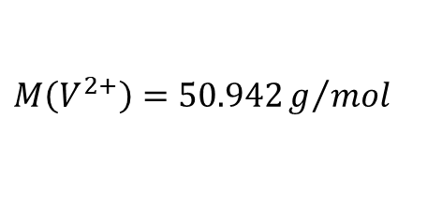
Especies de vanadio
Especies de vanadio que están disueltas:
En el electrolito negativo $V^{3+}$ y $V^{2+}$ y en el electrolito positivo $VO^{2+}$ y $VO_{2}^{+}$
$$M\left(V^{3+}\right)=50.942g/{mol}$$
$$M\left(VO^{2+}\right)=66.941g/{mol}$$
$$M\left(V^{2+}\right)=50.942g/{mol}$$
$$M\left(VO_{2}^{+}\right)=82.94g/{mol}$$

Slide 4
Artículos random usables
“Stability of highly supersaturated vanadium electrolyte solution and characterization of precipitated phases for vanadium redox flow battery”
“The leaching of vanadium pentoxide using sulfuric acid and sulfite as a reducing agent”
“Solubility of vanadyl sulfate in concentrated sulfuric acid solutions”
https://patentimages.storage.googleapis.com/7a/2b/86/b85d1a1b637adb/CN102198957A.pdf

Slide 5
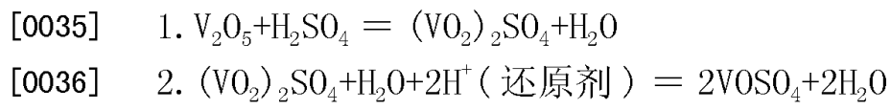
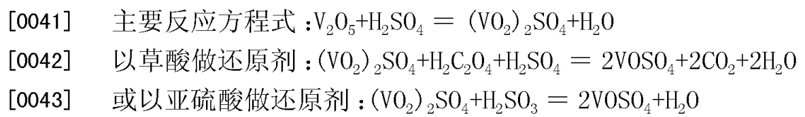
https://patentimages.storage.googleapis.com/7a/2b/86/b85d1a1b637adb/CN102198957A.pdf

