Slide 1
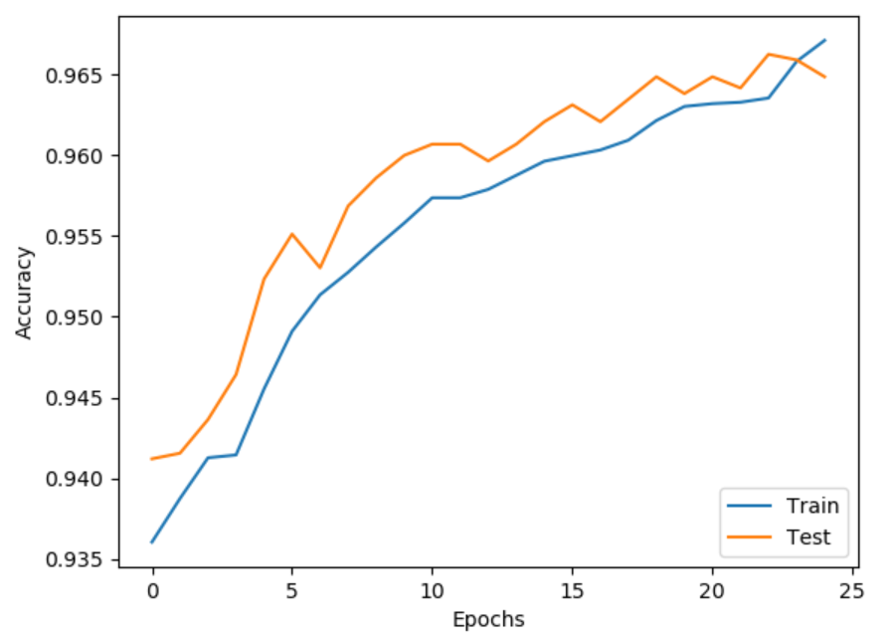
Data Augmentation. Learning rate = 0.0001. Optimizer = Adam. 128 neurons in fully connected layer
Accuracy = 0.9671
Test Accuracy = 0.9649

Slide 2
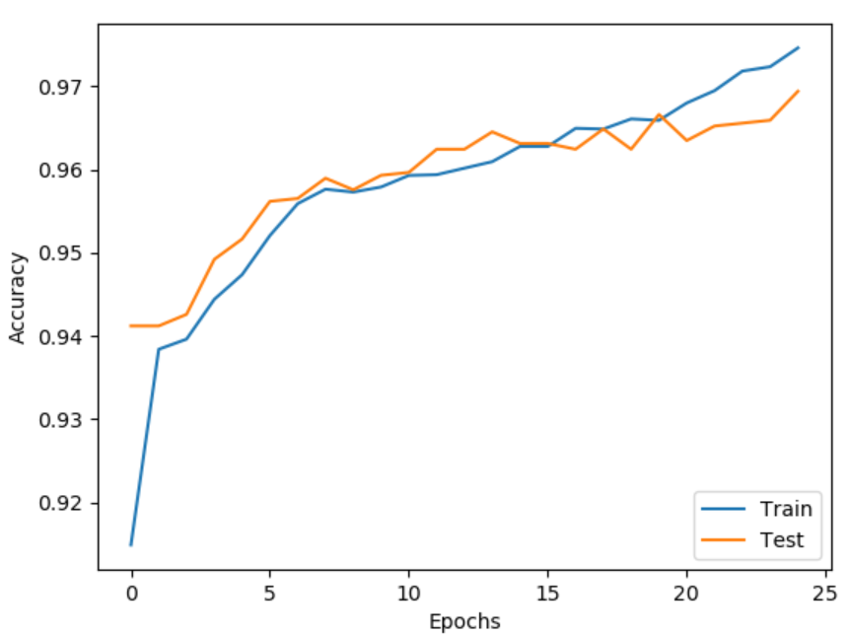
No Data Augmentation. Learning rate = 0.0001. Optimizer = Adam. 128 neurons in fully connected layer
Accuracy = 0.9746
Test Accuracy = 0.9694

Slide 3
Our data has 877 fails vs 13489 non-failed wafers. If the model always predicts ‘none’, it would get an accuracy of 0.93895. The current model performs better, but…

Slide 4
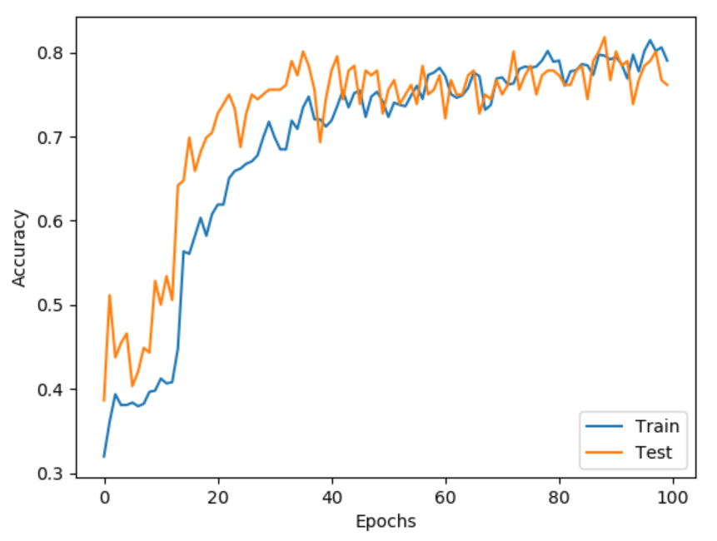
CNN to tell what failure it is – nones removed
Accuracy = 0.7903
Test Accuracy = 0.7614

Slide 5
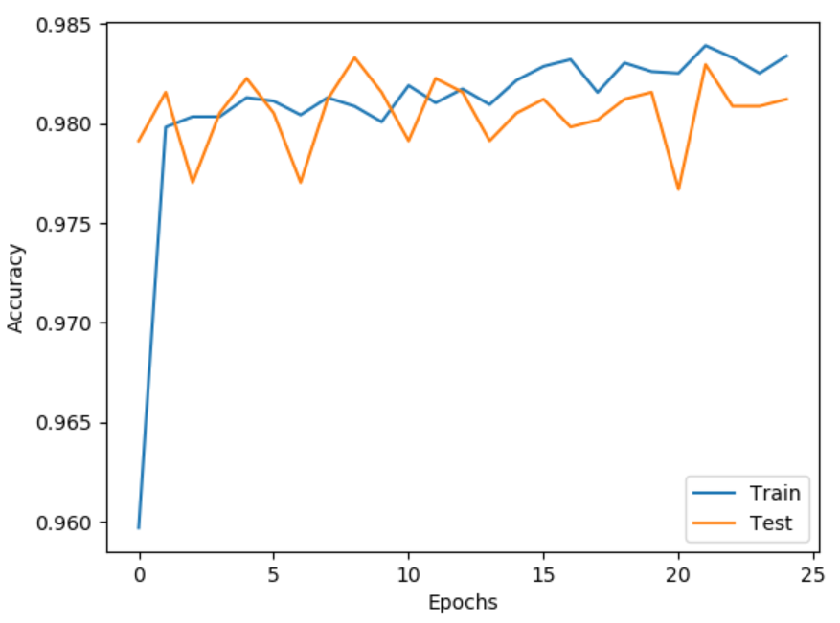
NN to tell if a wafer has failed or not
Accuracy = 0.9834
Test Accuracy = 0.9812

Slide 6
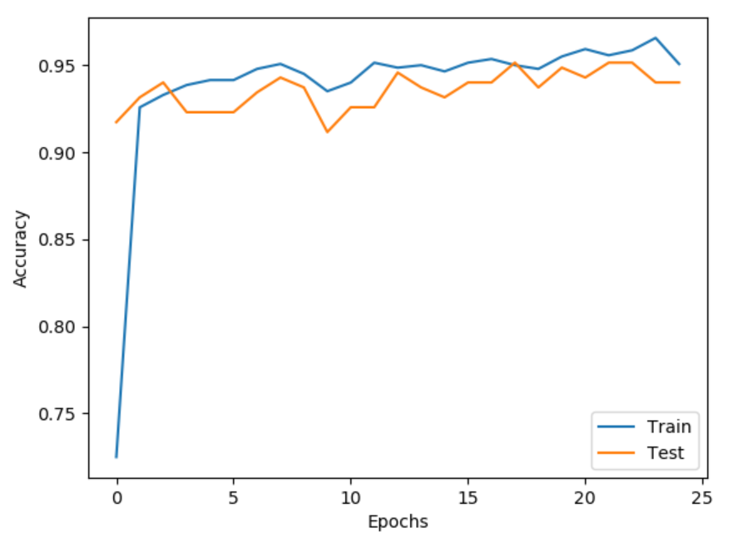
NN to tell if a wafer has failed or not for same number of failed and non-failed input data
Accuracy = 0.9508
Test Accuracy = 0.9402

