Slide 1
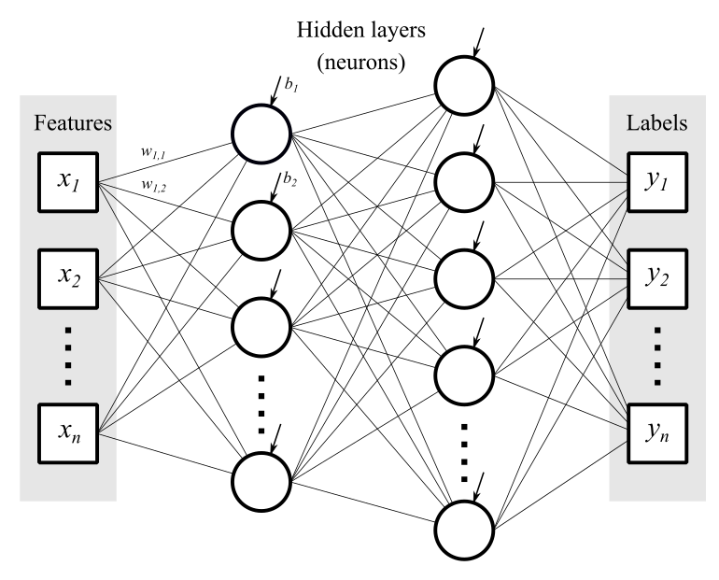
PROPOSED SOLUTION
Inputs
Outputs
Low computational burden.
Ability to imitate different controllers.
Notes:
The proposed solution is to use a neural-network-based imitator.
A neural network is computationally cheap universal approximator.
Neural network basics: each neuron computes previous values times weight vector and adds a bias value, then going through a nonlinear activation function.

Slide 2
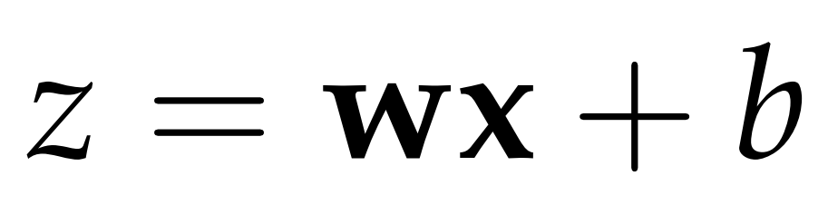
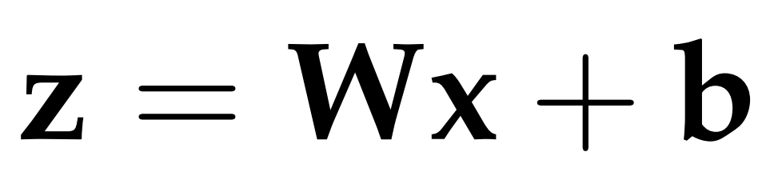
ARTIFICIAL NEURAL NETWORKS
Linear behaviour of a single unit:
Linear behaviour of a whole layer:
Notes:
The proposed solution is to use a neural-network-based imitator.
A neural network is computationally cheap universal approximator.
Neural network basics: each neuron computes previous values times weight vector and adds a bias value, then going through a nonlinear activation function.

Slide 3
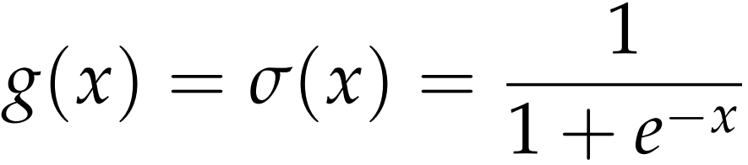
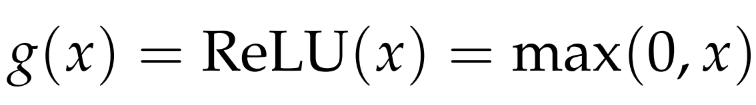
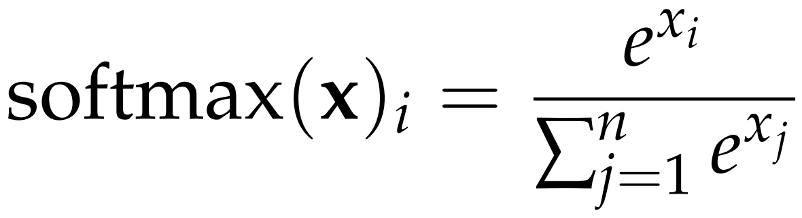
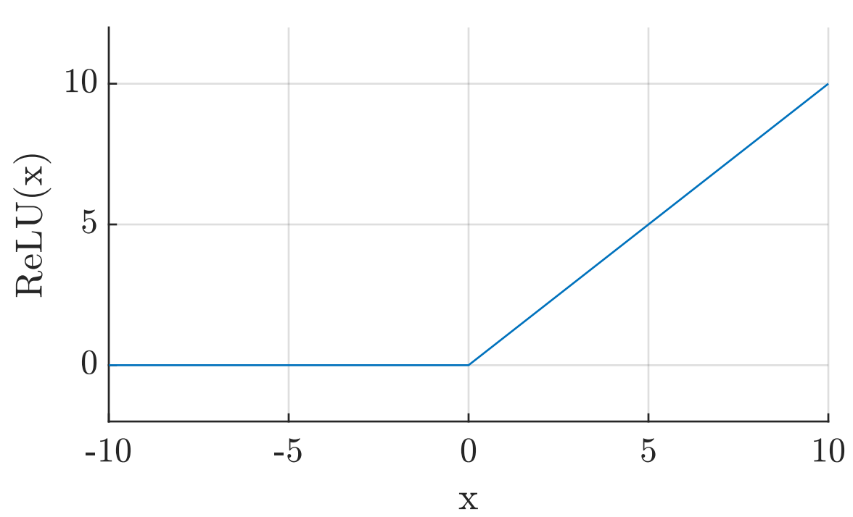
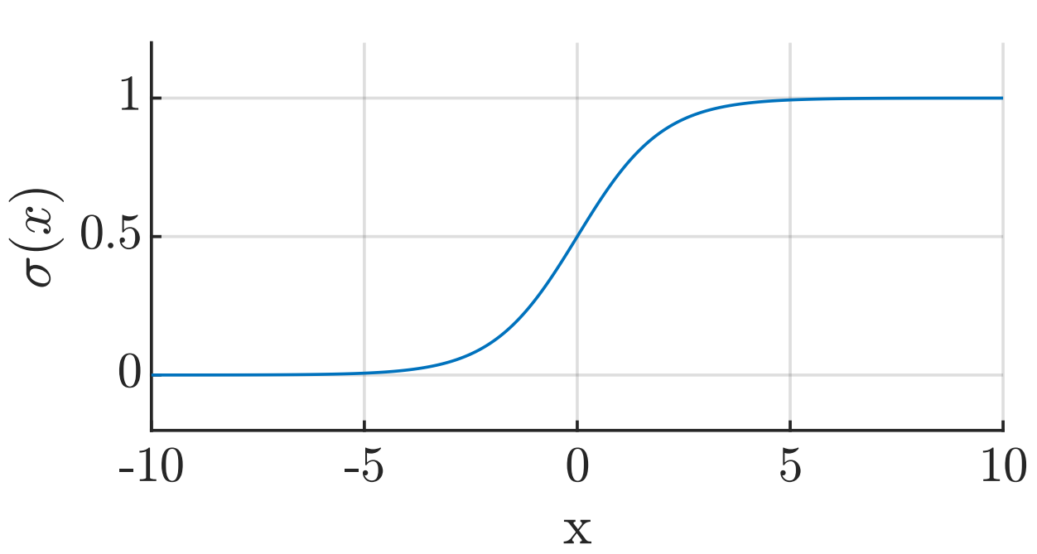
ARTIFICIAL NEURAL NETWORKS
Activation functions:
Notes:
The proposed solution is to use a neural-network-based imitator.
A neural network is computationally cheap universal approximator.
Neural network basics: each neuron computes previous values times weight vector and adds a bias value, then going through a nonlinear activation function.

Slide 4
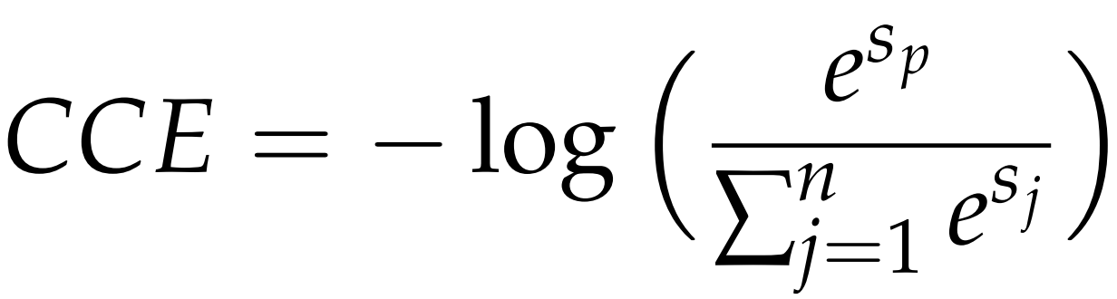
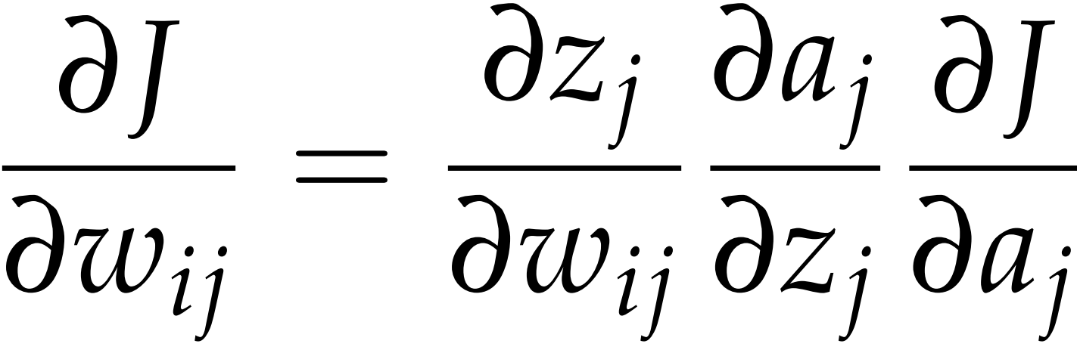
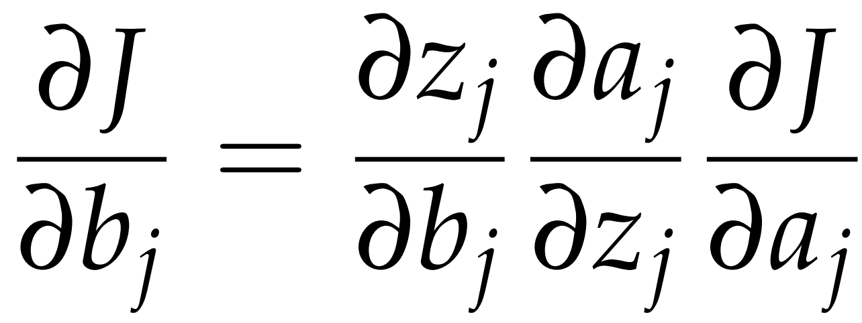
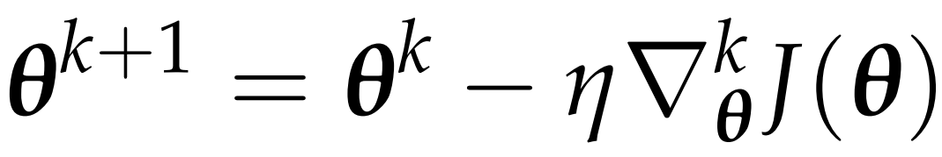
ARTIFICIAL NEURAL NETWORKS
Cost function:
Gradient computation through the back-propagation algorithm:
Network parameter update using steepest descent:
Notes:
The proposed solution is to use a neural-network-based imitator.
A neural network is computationally cheap universal approximator.
Neural network basics: each neuron computes previous values times weight vector and adds a bias value, then going through a nonlinear activation function.

Slide 5
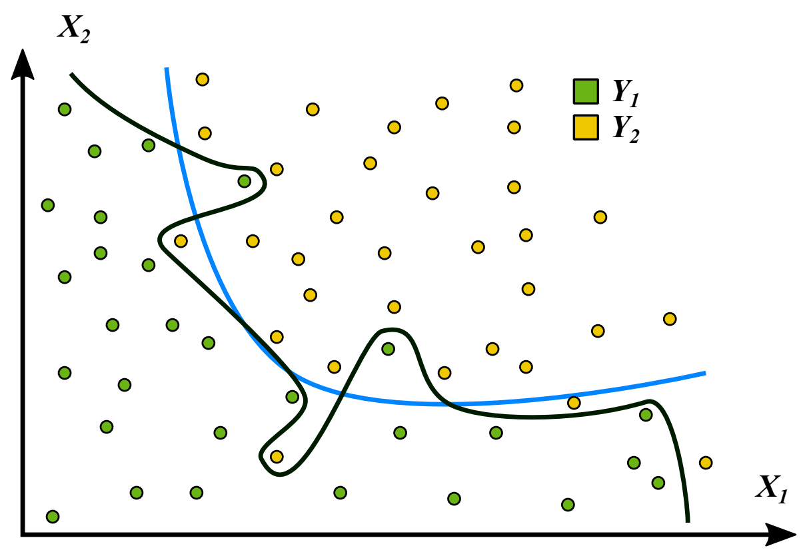
ARTIFICIAL NEURAL NETWORKS
Training a neural network.
Notes:
The proposed solution is to use a neural-network-based imitator.
A neural network is computationally cheap universal approximator.
Neural network basics: each neuron computes previous values times weight vector and adds a bias value, then going through a nonlinear activation function.

Slide 6
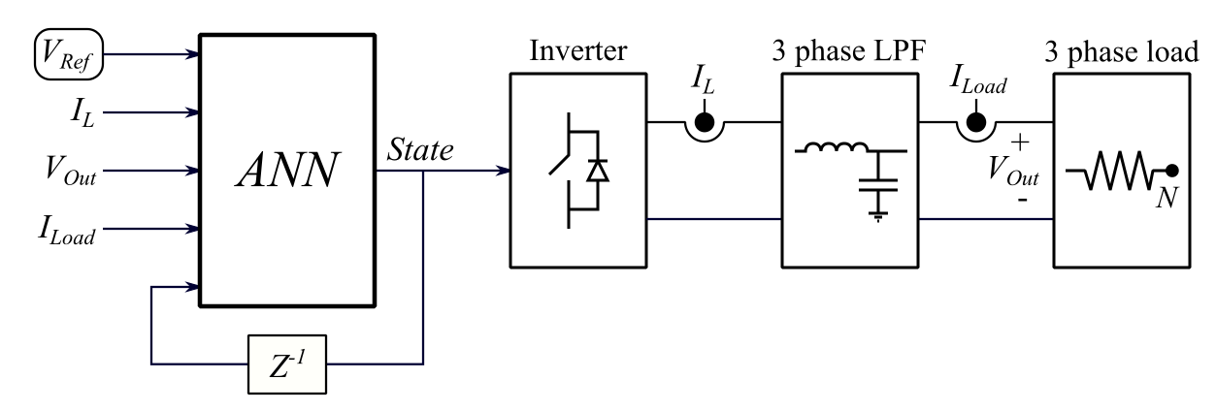
DATA ACQUISITION
2 million training data points
1 million random validation and test data points
Notes:
Explain the control scheme. Inputs: reference voltage, output voltage, inductor current, load current, previous system state.
Network trained using TensorFlow in Python using 2 million grid-generated data points within the operating range of the lab setup.
Validation and testing of the neural network performed on 1 million random data points inside the same bounds.

