Slide 1
CSS chapter 2
CONTENTS
STYLING LISTS
HYPER LINK
IMAGES
TABLEBORDER
BOX MODEL

Slide 2
STYLING LIST
In HTML, there are two main types of lists:
unordered lists (<ul>) - the list items are marked with bullets
ordered lists (<ol>) - the list items are marked with numbers or letters
LIST STYLE PROPERTY
The list-style property is a shorthand for the following properties:
list-style-type
list-style-position
list-style-image

Slide 3
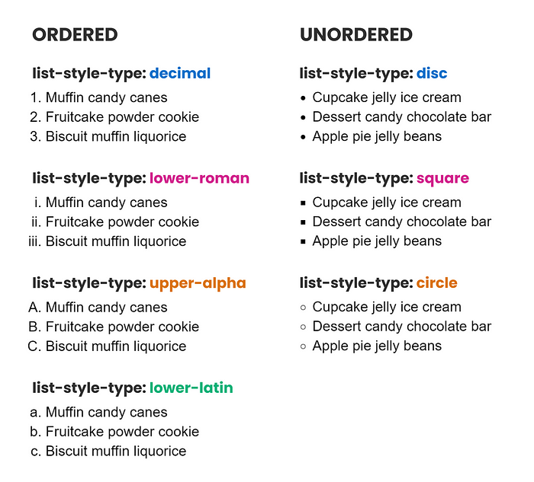

Slide 4
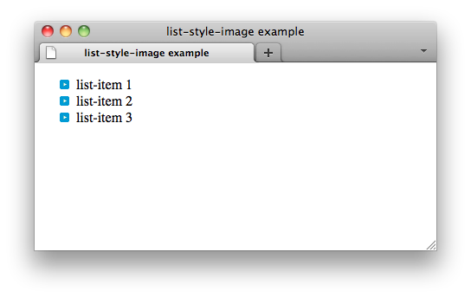
EXAMPLE
<!DOCTYPE html>
<html>
<head>
<style>
ul {
list-style: square inside url(“blueyoutube.gif");
}
</style>
</head>
<body>
<h1>The list-style Property</h1>
<p>The list-style is a shorthand property for all the list properties.</p>
<ul>
<li>list-item 1</li>
<li> list-item 2</li>
<li> list-item 3</li>
</ul>
</body>
</html>

Slide 5
LIST STYLE POSITION
The list-style-position property specifies the position of the list-item markers (bullet points).
list-style-position: outside; means that the bullet points
will be outside the list item.
The start of each line of a list item will be aligned vertically:
list-style-position: inside; means that the bullet points will be inside the list item. As it is part of the list item, it will be part of the text and push the text at the start:

Slide 6
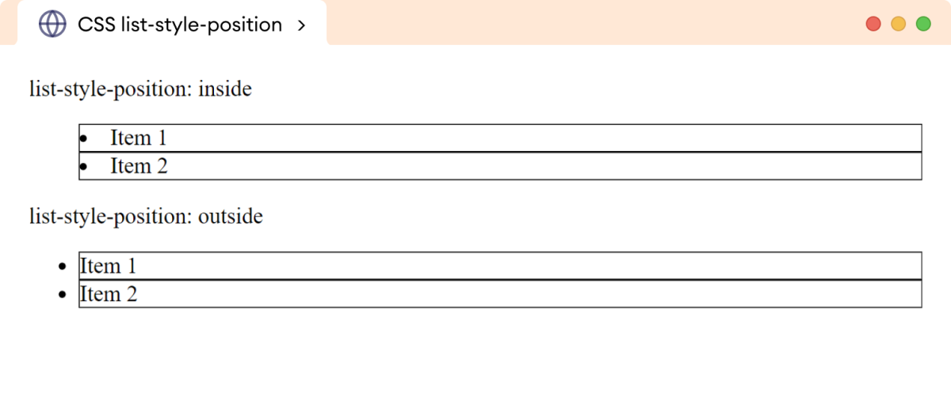

Slide 7
HYPER LINKS
Links can be styled differently depending on what
state they are in.The four links states are:
a:link - a normal, unvisited link
a:visited - a link the user has visited
a:hover - a link when the user mouses over it
a:active - a link the moment it is clicked

Slide 9
IMAGES
CSS allows you to apply various styles to images, making them more responsive, visually appealing, and interactive. You can modify the appearance and behavior of images on your webpage by using CSS properties like border-radius, box-shadow, filter, and others.
BORDER RADIOUS
BORDER
RESPONSIVE IMAGES

Slide 10
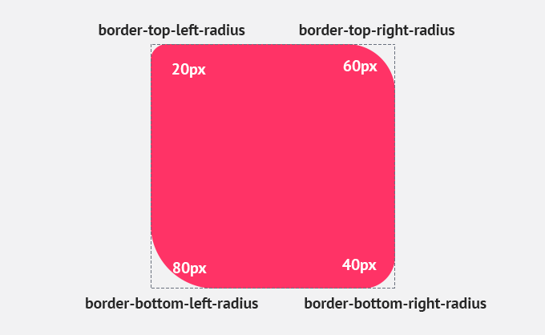
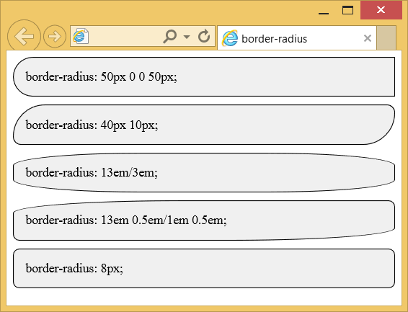
EXAMPLE

Slide 11
TABLE
CSS tables are used to style HTML tables, making them look neat and organized for clear data presentation.
Add borders, spacing, and colors to enhance table design.
Create responsive tables that adjust for all screen sizes.
TABLE PROPERTIES
Table border
Table size
Table alignment
Table style
Table responsive
<

Slide 12
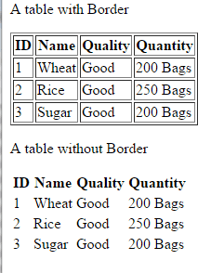
Example
table, th, td { border: 1px solid; }

Slide 13
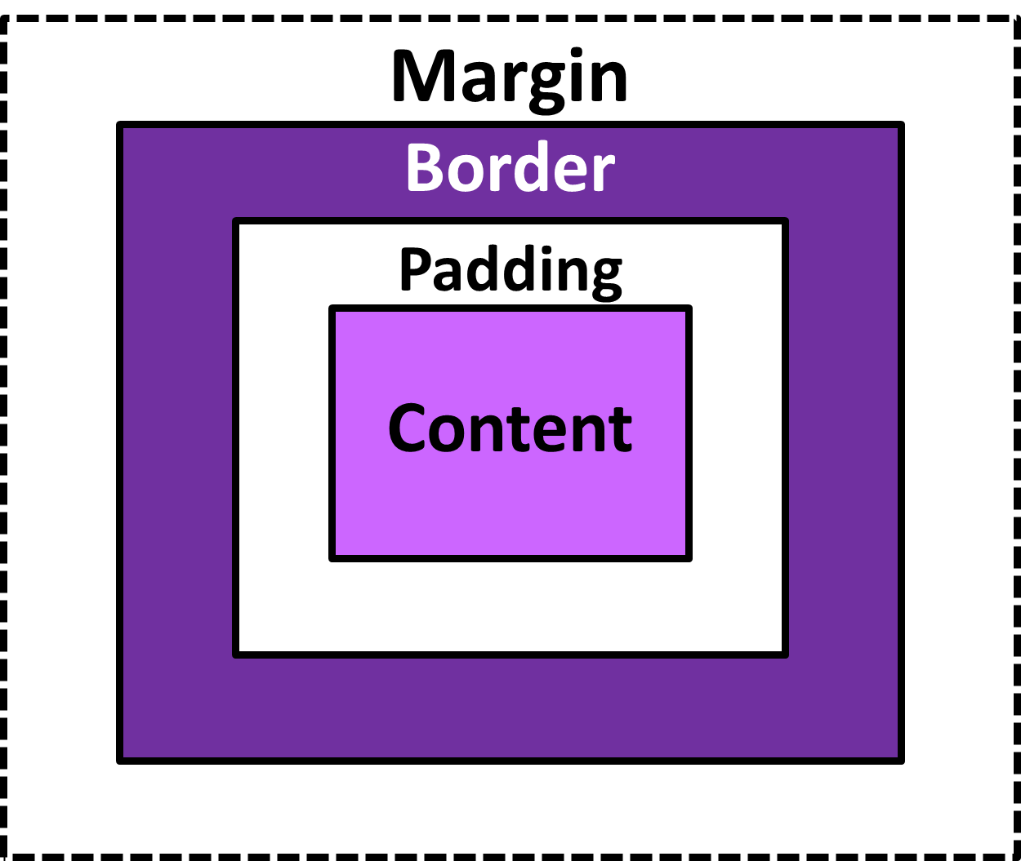
BOX MODEL

