Slide 1
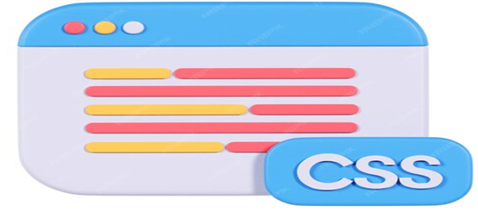

Cascading Style Sheet

Slide 2
OVERVIEW
What is CSS
Why CSS
CSS Syntax
CSS How To
CSS Id And Class Selectors
CSS Styling
CSS advantage & disadvantage
CSS id and class
3 types of css
css box model
Conclusion

Slide 3

What is CSS?
stands for Cascading Style Sheets
was first developed in 1997
is a language used to define the layout and appearance of web pages.
allow developers to separate content from design
External Style Sheets are stored in CSS files

Slide 4
Advantages
CSS saves time
Pages load faster: Less code means faster download times.
Easy maintenance: To change the style of an element, you only have to make an edit in one place.
Superior styles to HTML: CSS has a much wider array of attributes than HTML.

Slide 5
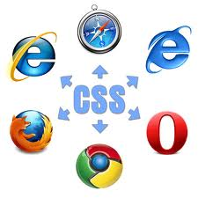
Disadvantages
Browser compatibility must be the most common difficulty.

Slide 6
CSS Syntax
A CSS rule has two main parts: a selector, and one or more declarations
The selector is normally the HTML element you want to style.
Declaration consists of property and Value.
The property is the style attribute you want to change.
Each property has a value.

Slide 7
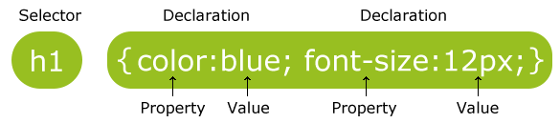
Example
To make CSS more readable we can put one declaration on each line:
h1 { color: blue; font-size:12px; }

Slide 8
Comments in CSS
Comments are used to explain your code and may help you when you edit the source code at a later date. Comments are ignored by browsers.
A CSS comment begins with "/*", and ends with "*/", like this:

Slide 9
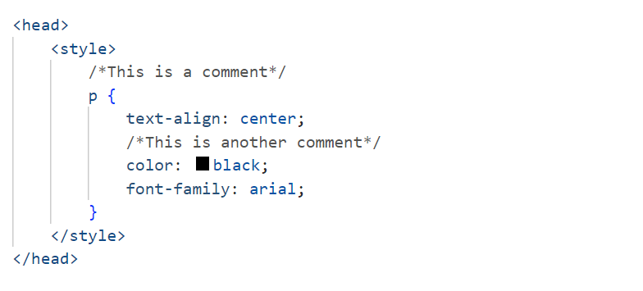
CSS

Slide 10
CSS id and class selectors
In addition to setting a style for an HTML element, CSS allows you to specify your selectors called "id" and "class".

Slide 11
Id Selector
The id selector is used to specify a style for a single, unique element.
Each element can have only one ID
Each page can have only one element with that ID
The id selector uses the id attribute of the HTML element, and is defined with a "#".
The style rule below will be applied to the element with <p id=“para1”>Sample Paragraph</p>
#para1 {text-align:center;color:red;}

Slide 12
Class Selector
The class selector is used to specify a style for a group of elements.
You can use the same class on multiple elements.
You can use multiple classes on the same element.
Unlike the id selector, the class selector is most often used on several elements.
This allows you to set a particular style for any HTML elements with the same class.
The class selector uses the HTML class attribute, and is defined with a ".“

Slide 13
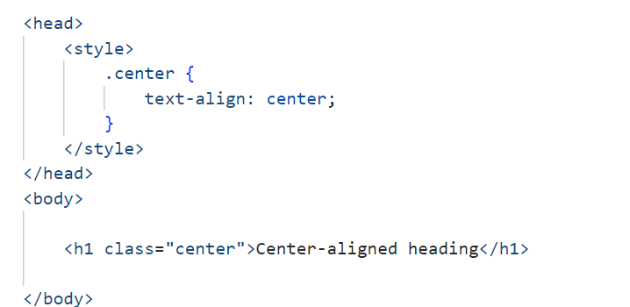
Class selector example

Slide 14
CSS How to…
Three Ways to Insert CSS
There are three ways of inserting a style sheet:
External style sheet
Internal style sheet
Inline style

Slide 15
External Style sheet
An external style sheet is ideal when the style is applied to many pages.
With an external style sheet, we can change the look of an entire Web site by changing one file. Each page must link to the style sheet using the <link> tag. The <link> tag goes inside the head section:
<head> <link rel="stylesheet" type="text/css" href="mystyle.css" /> </head>

Slide 16
Internal style sheet
An internal style sheet should be used when a single document has a unique style.
You define internal styles in the head section of an HTML page, by using the <style> tag

Slide 17
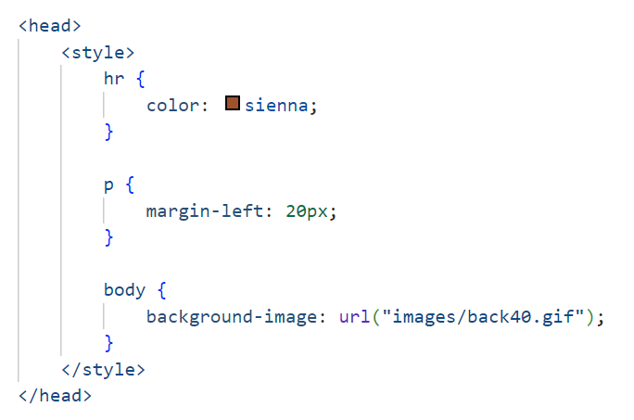
Example

Slide 18
Inline Styles
An inline style loses many of the advantages of style sheets by mixing content with presentation.
To use inline styles, use the style attribute in the relevant tag.
The style attribute can contain any CSS property.
Example:
<p style="color:sienna;margin-left:20px“>This is a paragraph.</p>

Slide 19
CSS Styling
Styling Backgrounds
Styling Text
Styling Fonts
Styling Links
Styling Lists
Styling Tables

Slide 20
CSS Background
CSS background properties are used to define the background effects of an element.
CSS properties used for background effects:
background-color
background-image
background-repeat
background-attachment
background-position

Slide 21
CSS Links
Links can be styled with any CSS property (e.g. color, font-family, background, etc.).
The four links states are:
a: link - a normal, unvisited link
a: visited - a link the user has visited
a: hover - a link when the user mouses over it
a: active - a link the moment it is clicked

Slide 22
Example
a:link, a:visited {
display:block;
font-weight:bold;
color:#FFFFFF;
background-color:#98bf21;
width:120px;
text-align:center;
padding:4px;
text-decoration:none;
}

Slide 23
CSS Lists
The CSS list properties allow you to:
Set different list item markers for ordered lists
Set different list item markers for unordered lists
Set an image as the list item marker

Slide 24
CSS Tables
To specify table borders in CSS, use the border property.
The border-collapse property sets whether the table borders are collapsed into a single border or separated.
The vertical-align property sets the vertical alignment, like top, bottom, or middle.
To control the space between the border and content in a table, use the padding property on td and th elements

Slide 25
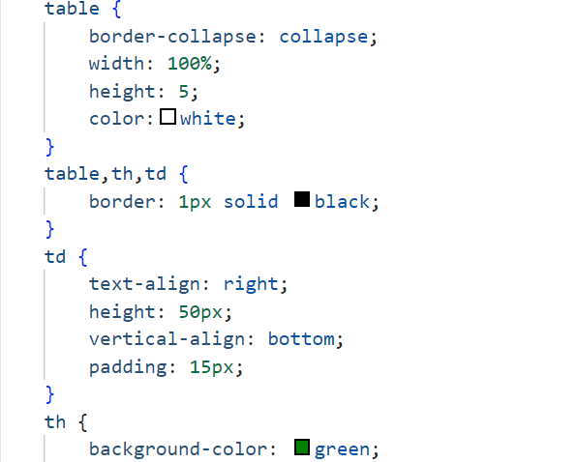
CSS Tables-Examples

Slide 26
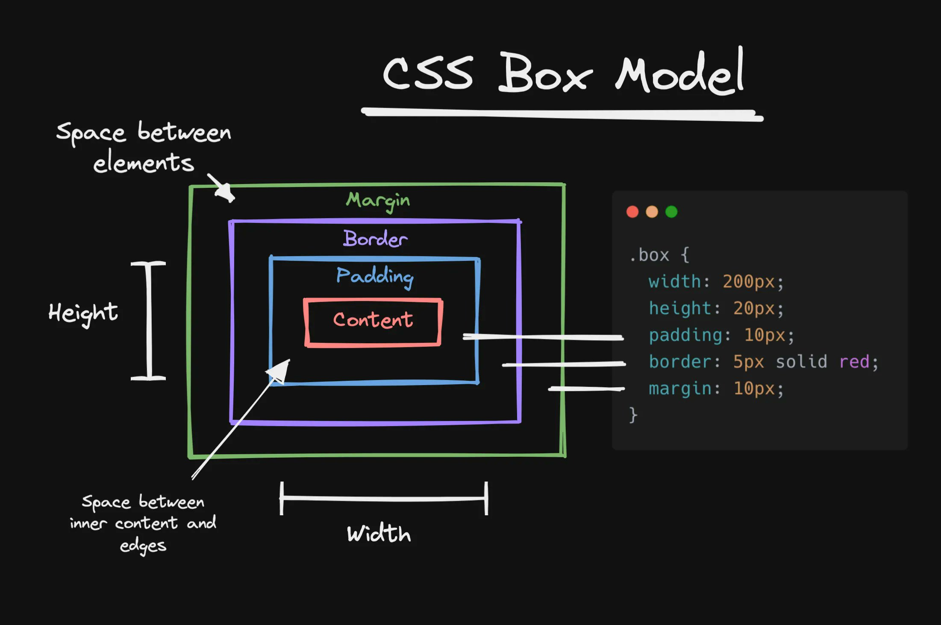

Slide 27
CSS Border
Border-style values:
none: Defines no border
dotted: Defines a dotted border
dashed: Defines a dashed border
solid: Defines a solid border
double: Defines two borders. The width of the two borders is the same as the border-width value

Slide 28
Different versions of CSS
CSS has gone through three revisions: CSS1, CSS2, and CSS3
Two commonly used versions of CSS which are CSS2 & CSS3.
The only difference between the three(CSS1,CSS2 & CSS3) is that CSS3 includes more functions and formulas.
About every other browser supports CSS2 moderately well.

Slide 29
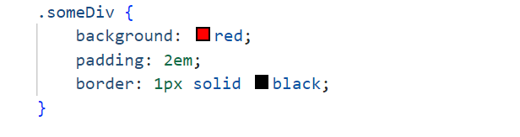
Best Practices
Here are some of the best CSS practices that will keep you writing solid CSS and avoiding some costly mistakes:
1. Make it Readable
Best Practise:

Slide 30
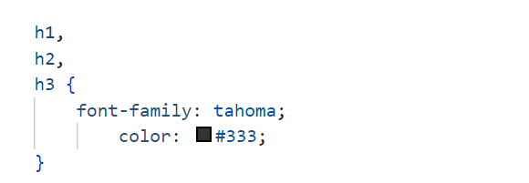
Best Practices
2. comment on each section!
styles go here...
3. Combine Elements: Elements in a style sheet share the same properties, combine them.

Slide 31
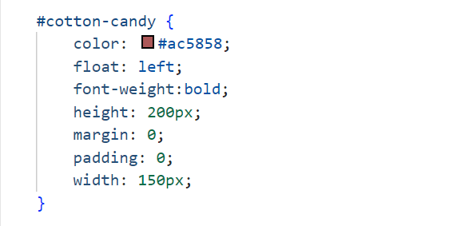
Best Practices
4. Alphabetize your Properties

Slide 32
Conclusion
With so many different properties that you can modify with CSS, the possibilities are endless.
Altering values for different elements would give your website an entirely different feel each time.
we explored the basics of CSS, and learned how to do some basic styling.

Slide 33


Slide 34


