Slide 1




CSS

Slide 2


Contents
Styling List
Hyper Link
Table
Images
Box Model
Border

Slide 3



Styling List
HTML has mainly 2 types of lists, they are ordered list and unordered list
Ordered list lists the items with numbers or letters.
Ordered list syntax : <ol> </ol>
Unordered list lists the items with bullet points.
Unordered list syntax: <ul> </ul>

Slide 4


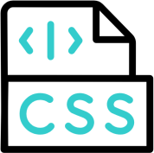

List-style-shorthand
Sets all the list properties in one declaration.
List-style-type, list-style-position, list-style-image are the properties that it sets.
Syntax: list-style: <list-style-type> <list-style-position> <list-style-image>
inherit
Example: ul {list-style: none;} sets all unordered lists to not display a
list-item maker. The default value is disc or outside or none

Slide 5
List Style Type
The list-style-type property specifies the type of list item marker
<style>
ul.a {
list-style-type: circle;
}
ul.b {
list-style-type: square;
}
</style>
</head>
<body>
<h2>The list-style-type Property</h2>
<p>Example of unordered lists:</p>
<ul class="a">
<li>Tour</li>
<li>Destination</li>
<li>Participants</li>
</ul>
<ul class="b">
<li>Tour</li>
<li>Destination</li>
<li>Participants</li>
</ul>
</body>

Slide 6
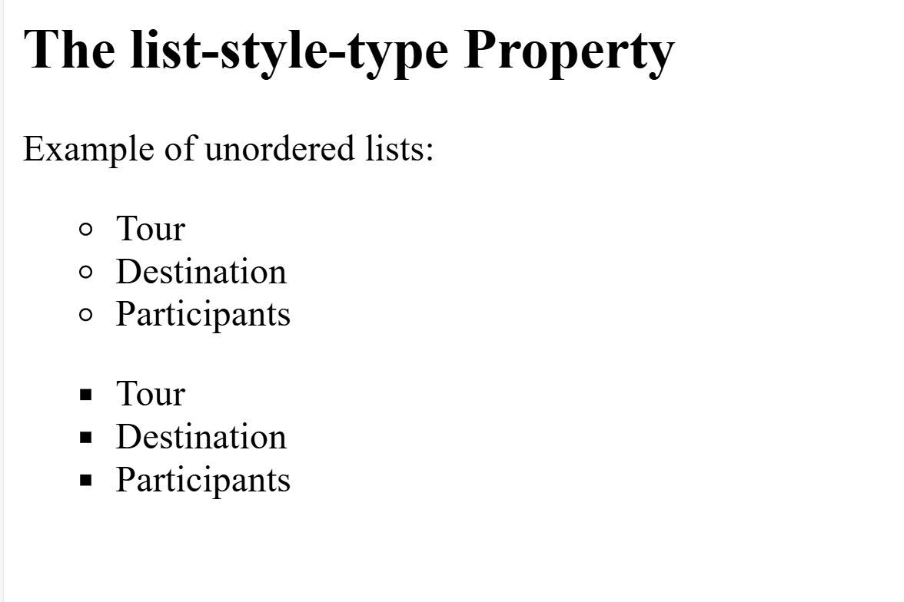
Example

Slide 7
List Style Position
List-style-position property specifies the position of the list item markers
<style> ul.a {
list-style-position: outside;
}
</style>
<ul class="a">
<li>Tour Details</li>
<li>Package </li>
<li>Tour Booking</li>
</ul>

Slide 8
List Style Images
Specifies image as the list item indication.
Initial value is none, syntax: list-style-image: none;
Applicable to all the list items.
Example: <ul>
<li> Destination 1 </li>
<li> Destination 2 </li>
</ul>
ul { list-style-image: url(“http://www.google.co.in/images/jobimage”)}

Slide 9
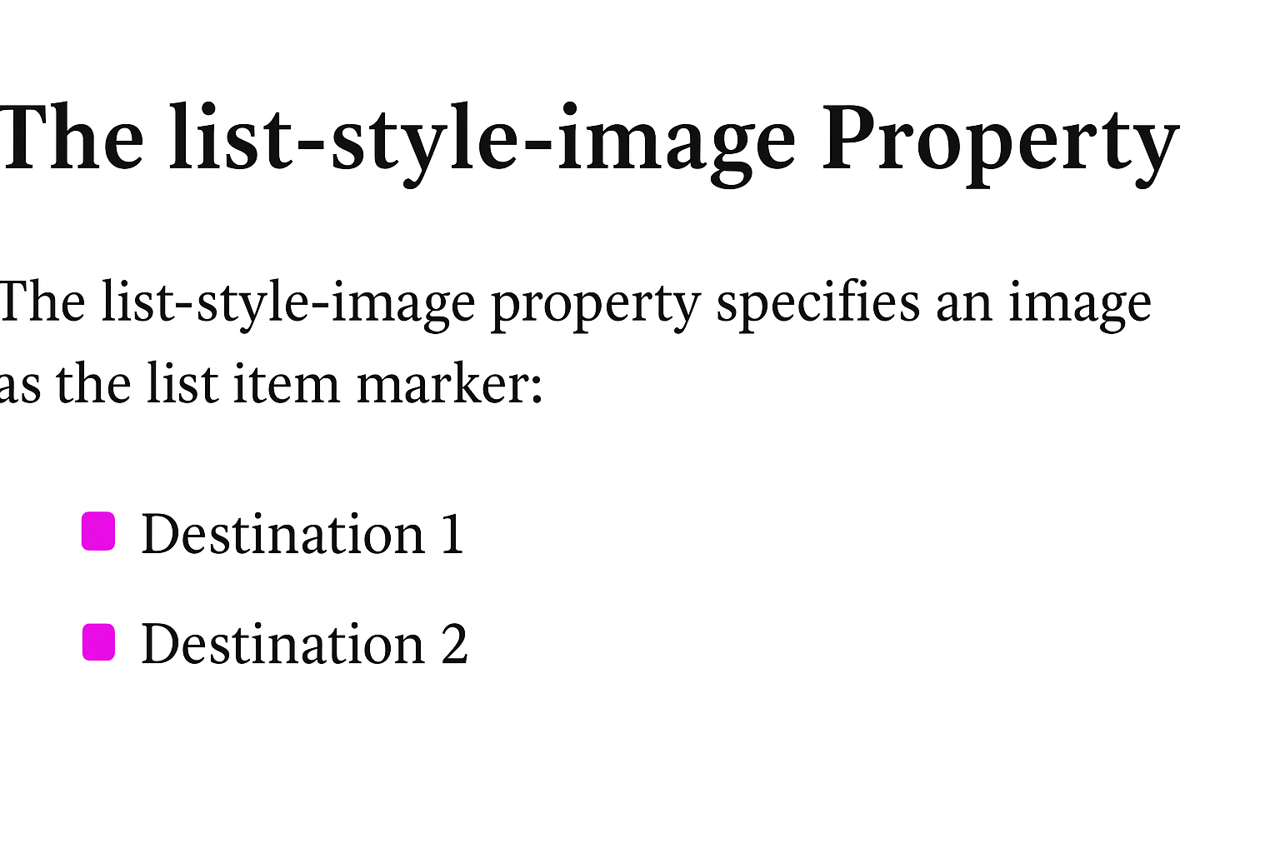
Example

Slide 10

Hyperlinks
Links can be styled with any css property (e.g. color, background, font-family etc.)
The four link states are
a normal, unvisited link
a link, the user has visited
a link when the user mouse over it.
a link when the moment is clicked.
Properties
a: link
a: visited
a: hover a: active
Color : The color property controls the link's text color in all its states:
Text-decoration : Mostly used to remove underlines from links. Background-color : It can be used to specify a background color for links. Using these properties and link states to make link buttons in css.

Slide 11
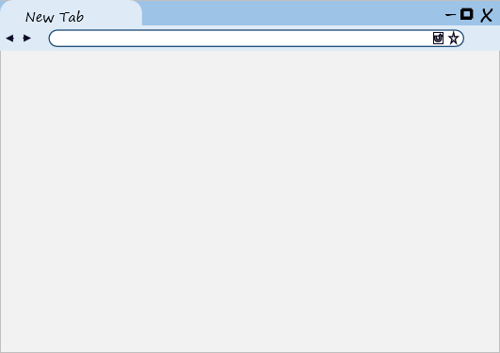

Example
_{align} <style>
/* unvisited link */ a:link {
color: red;
}
/* visited link */
a:visited { color: green;
}
/* mouse over link */ a:hover {
color: hotpink;
}
</style>
</head>
<body>
<p><a href="default.asp" target="_blank“>Text Link</a></p>
</body>

Slide 12
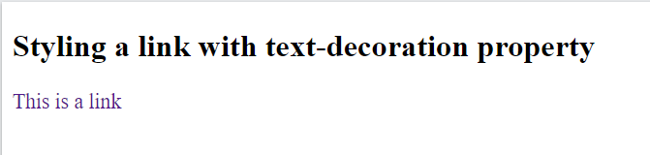
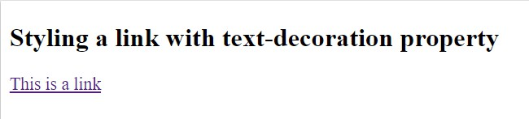
Example
align
<style> a:link {
text-decoration: none;
}
a:visited {
text-decoration: none;
}
a:hover {
text-decoration: underline;
}
a:active {
text-decoration: underline;
}
</style>
</head>
<body>
<h2>Styling a link with text-decoration property</h2>
<a href="default.asp" target="_blank">This is a link</a>

Slide 13
Example
align
<style> a:link {
background-color: yellow;
}
a:visited {
background-color: cyan;
}
a:hover {
background-color: lightgreen;
}
a:active {
background-color: hotpink;
}
</style>
</head>
<body>
This is a link
<a href="default.asp" target="_blank">This is a link</a>

Slide 14

Images
The image tag is written as <img> in HTML. It takes two important
attributes, src and alt. Src specifies the path to the image,
while alt specifies an alternative text for the image.
Attributes like width and height can be written inline with <img>
tag or specified later in the CSS.

Slide 15

Image Properties
border-radius
border
Responsive images

Slide 16

Table
A table in CSS is used to apply the various styling
properties to the HTML table elements to arrange the data in rows and columns. Table Borders, Table size, Table Alignment, Table Style, Table Responsive are the main properties of CSS table.

Slide 17
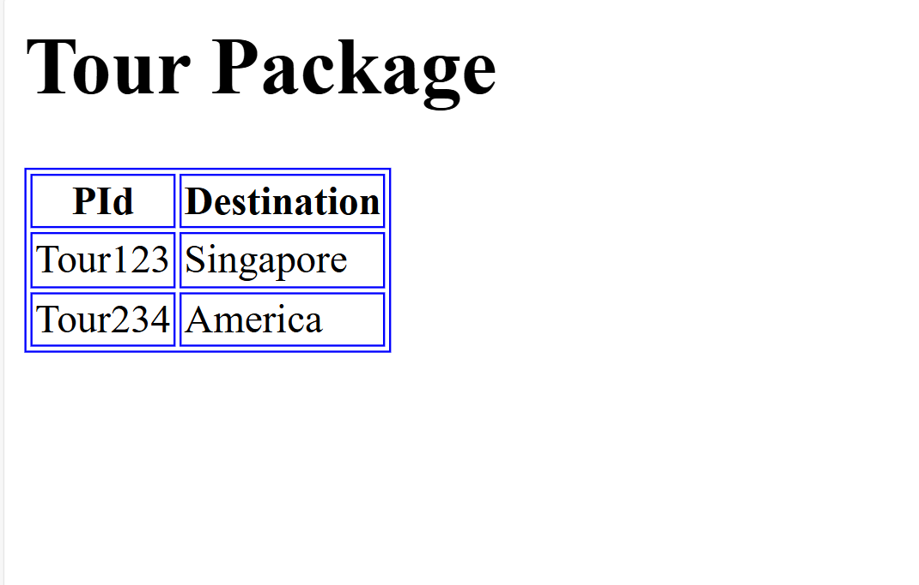
Example
align
<style> table, th,
td {
/* Styling the border. */ border: 1.5px solid blue;
}
</style>
<body>
<h1>Tour Package</h1>
<table>
<tr>
<th>PId</th>
<th>Destination</th>
</tr>
<tr>
<td>Tour123</td>
<td>Singapore</td>
</tr>
<tr>
<td>Tour234</td>
<td>America</td>
</tr>
</table>

Slide 18
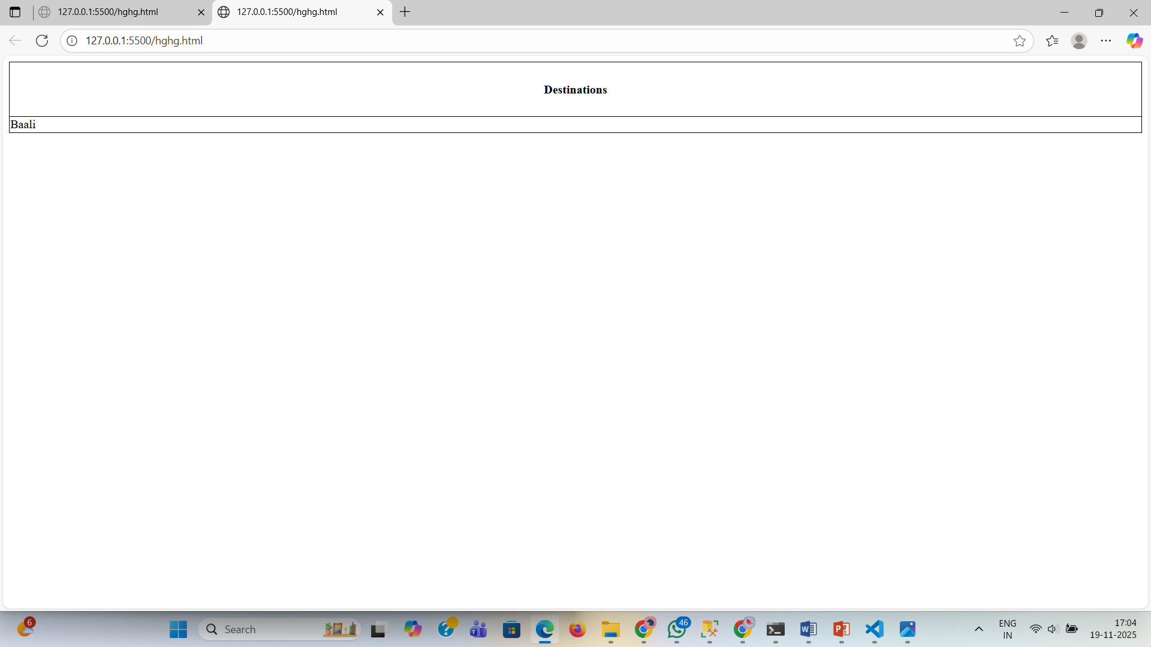
Example
align
<style>
table, td, th {
border: 1px solid black;
}
table {
border-collapse: collapse; width: 100%;
}
th {
height: 70px;
}
</style>
<table>
<tr>
<th>Destinations</th>
</tr>
<tr>
<td>Baali</td>
</tr>
</table

Slide 19

Border
The border property is a shorthand syntax in CSS that accepts multiple values for
drawing a line around the element it is applied to.
Border-style
Border-width
Border-color
Values

Slide 20

Box Model
A CSS box model is a compartment that includes numerous assets, such as edge, border, padding and material. It is used to develop the design and structure of a web page. It can be used as a set of tools to personalize the layout of different components. According to the CSS box model, the web browser supplies each element as a square prism.

Slide 21


Properties
Content : Material such as text, photographs, or other digital media is
included in this area.
Padding : this area is the space around the subject area and inside the border-box.
Border : It is a region between the padding-box and the margin.
Margin : This segment consists of the area between the boundary and the edge of the border.

Slide 22

Questions

